Slide 1
CIS 273 Web Design and Development
Developing a Website
Notes:
Welcome to Web Design and Development. In this lesson will discuss how to develop a website.
Next slide.

Slide 2
Topics
Exploring Web site structures
Creating a navigation list
Working with hypertext links
Specifying a folder path
Linking to locations within a document
Notes:
The following topics will be covered in this lesson:
Exploring Web site structures;
Creating a navigation list;
Working with hypertext links;
Specifying a folder path; and
Linking to locations within a document.
Next slide.

Slide 3

Exploring Web Site Structures: Linear
Visitors move between pages like pages in a book
Notes:
Web sites can be structured in various ways. All web sites should begin with a home page sometimes called a “splash page” that provides your visitor with a focal point and starting point for exploring your entire site. Your home page should have enough information to welcome visitors and help them to navigate to other pages with more specific information. How that navigation is accomplished depends on the structure you choose.
A linear structured web site is similar to reading a book. You begin on the first page and each successive link takes you the next page in order either forward or backward. This kind of structure works well for small web sites or ones that require sequencing of the pages in order to help present information in a logical and progressive way. You might wish to include links that take visitors to beginning of each section, like moving between chapters in a book. This structure is referred to as an augmented linear structure.
Next slide.

Slide 4
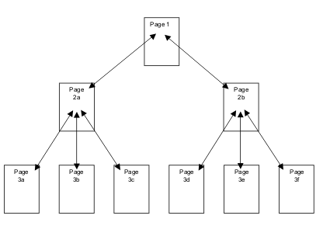
Exploring Web Site Structures: Hierarchical
Visitors can view pages out of sequence
Notes:
The hierarchical structure is one of the most common web structures. The web site is divided into specific sections with more detailed pages under each defined section. Visitors are able to move to a specific portion of the site without having to view pages that precede or follow any other page. The structure does not depend on a linear sequence and gives them the most control over their viewing experience.
As the illustration shows, each section links to pages that are related to the landing page for that section. You can see this on most web sites that sell products. The home page of the site introduces the store then each “department” might have their own landing page followed by products or sub-departments within the larger department.
Next slide.

Slide 5
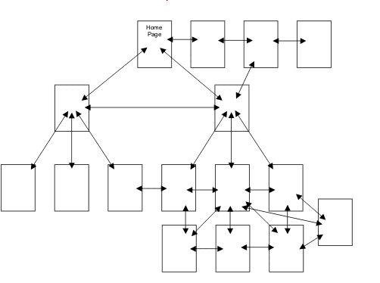
Exploring Web Site Structures: Mixed Structures
Used for larger complex sites
Notes:
A mixed structure web site combines both hierarchical and linear structures with the same site. The hierarchical structure is often the larger structure of the site while the linear structure is used for portions of a site. In an example of a store, departments might all be hierarchical but the payment section might use a linear structure as it walks your visitors through the process of completing an order and then entering payment information.
The nature of a complex site can leave visitors lost or confused navigating from page to page. In order to prevent this situation a mixed structure site will usually have a link to the home page on every page as well as a link to the top of its own section of the web site.
Many web developers add a site index that outlines all of the pages within the site as well as the contents to help visitors feel more at ease. This practice has gone in and out of common practice over the past ten years but is highly recommended for sites with many layers and complicated information.
A site that is not carefully planned in advance with pages added haphazardly is the least desirable structure of all. Without a road map or navigational plan your site will grow unwieldy and disorganized making it both difficult to navigate as well as difficult to maintain.
Next slide.

Slide 6

Exploring Web Site Structures: Protected Structures
Sections are unavailable to the public
Passwords protect pages for:
Subscribers
Administrators
Registered users
Students
Notes:
As a casual visitor to a site you may have access to only a portion of the site. Other portions of a web site might be password protected to prevent others from either viewing or altering the contents of a site. The New York Times and many celebrity sites allow the general public to view portions of their sites, but you’ll need to register and often pay a fee to view the rest of the material that is uploaded. Facebook requires you to login in order to view your pages and while there are some postings that are open to the public, you cannot view those without your own account.
Many businesses have sections of their sites available only to administrators who can add, modify, or delete information throughout the site on a set of administrative pages. Protected sites can be designed for employees to have access to proprietary information behind their password protected pages.
If you need to develop a web site that will employ protected pages you’ll want to be very careful when you storyboard or sketch out the structure to be certain you are placing the correct pages into their right sections.
Next slide

Slide 7
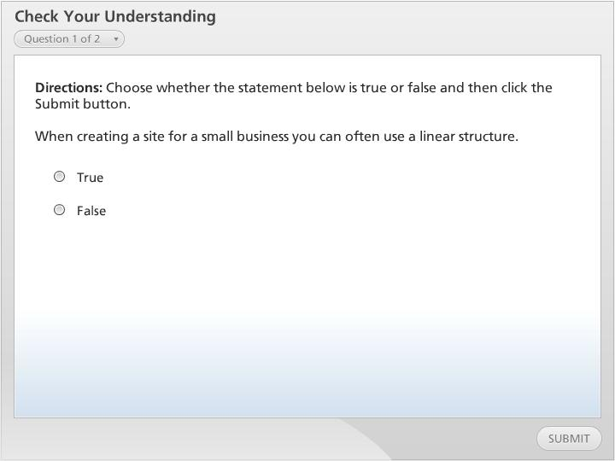



Check Your Understanding

Slide 8
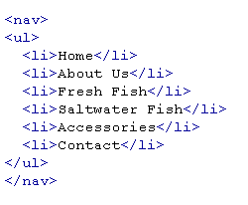
Creating a Navigation List
Navigation List for Fred’s Fish:
Notes:
A navigation list contains the text and hyperlinks to the various pages on a web site. HTML5 uses the <nav> element to define this section of your page. Inside of the <nav> you might have the elements for an unordered list using the <ul>element to place the text in an orderly fashion. Using CSS you will be able to change the direction of the list from vertical to horizontal if that is your preference for the design of your page.
Another benefit of the <nav> element in HTML 5 is that it helps to distinguish this list from other lists on your pages making it easier for people with disabilities to know which list is being used for which purposes.
Next slide.

Slide 9
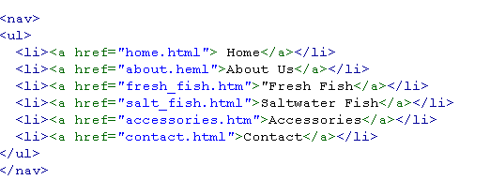
Hypertext Links
Hyperlinks added to the Navigation List
Notes:
Hypertext links are what allow visitors to navigate between your pages. They are what makes the Internet easy and fun to “surf” and helped to revolutionize the way we do so many tasks. The element that controls those links is the <a> element. Visitors know that text is a link based on the color the text appears in. The native colors for links are:
Blue for an unvisited link;
Purple for a visited link; and
Clicking a link turns the text red.
The native format also underlines the text to further help visitors to identify the links. If your pages are already blue or purple your links would be lost to view. Fortunately, through the use of CSS, it’s easy for a web developer to change link colors and even control whether or not there are underlines appearing along with the text.
When the code is added to the <a> element, it’s important to be sure the file path pointing to the page is correct. For now, we will assume all the pages are in the same folder allowing us to concentrate on the coding. After opening of <a> we will add href followed by an equal sign and set of quotation marks. The href mean “hypertext reference” and the content inside the quotes points to the page you are linking to as shown in the example in this slide.
Best practice in creating your links is to use all lowercase because some servers such as UNIX are case sensitive. It is also important to not have any spaces between words in your page names since those spaces will turn to %20 in the address bar of the browser.
Next slide.

Slide 10
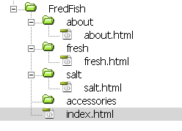
Specifying a File Folder
Organizes pages
Helps in maintaining your site
Absolute Paths
folder1/folder2/page
Relative Paths
../folder/page
Base Path
<base href=“path”>
Notes:
Organizing pages for a web site is like organizing the documents on your computer. It helps to keep things organized and manageable. The illustration in this slide shows the different sections of the site with a page in each section. Although these pages are named with the topic of the page, common practice is to name the first page in each folder index.html. The reason for this is that you can shorten the URL for a visitor by giving them the domain and the folder name as way to quickly to a specific section of your site. For example, if we had named the first page about fresh fish index.html you tell people to go to www.fredsfish.com/fresh and that page would open.
When you work with an absolute path you list the order of the folders that the page is located in each one followed by a forward slash. You would name each and every folder along the way. A relative path streamlines the process by referencing the folder the page is located in and the page itself. To make the path relative where there are many child folders involved you begin the path with two ellipses forward slash followed by the folder, a forward slash and the page as shown in the slide.
Setting a base path can further help to streamline your navigational links, especially when you have had to change folder locations. This element placed in the <head> portion of your code points to the folder your links are located in.
Next slide.

Slide 11
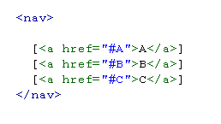

Linking to Locations in a Document
Navigates to a specific place on your page
Two part process:
Place square brackets around the text
U
sing the id attribute you set the link
Navigation List | Creating the Link
Notes:
Sometimes you’ll want to allow your visitors to navigate to a specific location on your page. This is a two-step process that will require a unique name for each link necessary. You’ll first identify the places where the hyperlink is located in your navigational list. The text is placed inside of square brackets and then the <a> element is added around the text. Note the use of the pound symbol as well inside quotes. This symbol lets your browser know that you are going to a specific location. In our example here we see inside of the <nav> element for the first link [<a href=“#A”> precedes the A and we close the element with </a>].
The destination will use the id attribute to tie it to the hyperlink. The id may be added to heading elements, the strong element, and others depending on how you’ve designed your page.
If you have many locations on a single page, you might want to give your visitors an easy way to return to the top of the page. To accomplish this add id=“top” to the <header> element. Then you can create the link to the top as necessary.
Next slide.

Slide 12

Linking to a Location in a Different Document
Takes your visitor to a specific place on a different page
Notes:
In web development there is an unspoken rule of “three clicks” which simply means a visitor should be able to reach their destination within three hyperlink clicks. One way to help reach this goal is to create an id for the part of the page you want visitors to find easily. This could be for a specific product or an FAQ, or special offer to name a few commonly used locations. The only difference in creating the hypertext link is the addition of the pound and the id name as shown in the slide.
Next slide.

Slide 13
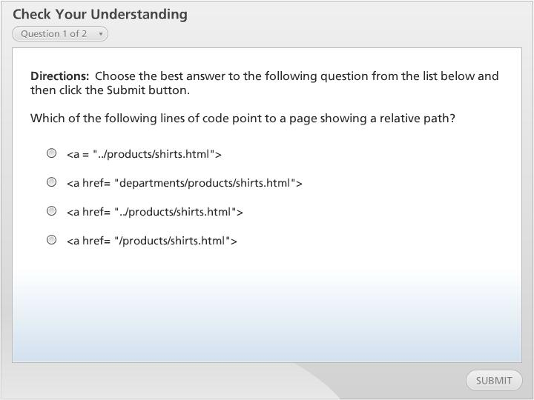
Check Your Understanding

Slide 14
Summary
Exploring Web site structures
Creating a navigation list
Working with hypertext links
Specifying a folder path
Linking to locations within a document
Notes:
We have reached the end of this lesson. Let’s take a look at what we’ve covered.
We started our discussion by exploring web site structures. We learned that there are different structural modes to accommodate different types of web sites.
Then we examined how to create a navigation list to add our hypertext links so visitors can move between pages easily.
Next we looked at how to add a hypertext links to make it possible to click to move to other pages.
We also looked at how to specify file paths based on the location of the files. We learned about the difference between absolute and relative paths for our links.
Then we looked at how to navigate to a specific location on a web page by adding the id attribute to our targets.
This completes this lesson.

