Slide 1
CIS 273 Web Design and Development
Introducing CSS
Notes:
Welcome to Web Design and Development. In this lesson will discuss working with style sheets and design layouts.
Next slide.

Slide 2
Topics
Exploring Display Styles
Creating a Reset Style Sheet
Designing the Background
Exploring Browser Extensions
Exploring Layout Designs
Floating Elements
Notes:
The following topics will be covered in this lesson:
Exploring Display Styles;
Creating a Reset Style Sheet;
Designing the Background;
Exploring Browser Extensions;
Exploring Layout Designs; and
Floating Elements.
Next slide.

Slide 3
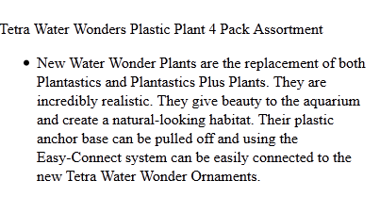
Set Display Properties
The Code:
blockquote {display: list-item;}
How it Appears:
Notes:
Browsers read the code in sequence starting at the top of your code and continuing down to the end. This means your code is read as blocks mostly in the form of paragraphs or as inline elements which is how your images display unless you add alignment commands. This will cause the page to display in the order you have written your code, not always the way you would like it to display. To avoid this lack of division for your content and to make your pages more appealing visually, you can use several methods to group elements together using the display and type of display as shown in our code examples in this slide.
Once again, you must keep in mind that not all browsers will respond to the code the same way, so remember to check your pages in at least two different browsers for consistency.
Next Slide

Slide 4
The Box Model
The Tetra Whisper Aquarium Air Pump offers minimum noise and maximum air flow. The Whisper® Air Pump offers a dome shape that actually flattens sound wave frequencies. In addition, each pump model features sound dampening chambers that are designed specifically for that model.
padding
border
margin
Notes:
All content on your pages are really displayed inside of a box. The illustration in the slide gives us a good visual image of all the different parts of the box model. Each part of the box controls a different aspect of the box:
The margin controls the external space around your content in relationship to the page.
The border can have different line styles to draw your visitor’s eye to different parts of your page.
The padding is the space between the content and the border; it’s often a good idea to add some padding so your content does not appear crowded.
The element content is in the center of the box and contains the text or images.
Next Slide

Slide 5
Creating a Reset Style Sheet
An Example of the Code:
Body * {
font-family: Bubble Boy, Verdana;
font-size: 100%;
font-weight: inherit;
line-height: 1.3em;
list-style: none;
vertical-alignment: baseline;
}
Notes:
Browsers have their own internal style sheets that are often not quite how the designer may have in mind. To help ensure that your pages are consistent with your designs you will need to create a reset style sheet that defines your own styles. One of the most common elements and display commands that are not widely supported is the block for your text. You will need to define your styles so that they are compliant for HTML5 as well. Begin with your body elements that remain consistent throughout your pages.
Notice in the code the use of the asterisk after the body element is named. This means that these styles will be applied to all the elements on your page unless you change something later in your style sheet.
Next slide.

Slide 6
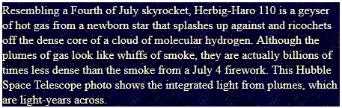
Defining a Background Image
The Code:
body * { background-image: url(stars.gif);
background-repeat: repeat;
color: #FFC; }
How it Appears:
Notes:
Adding a background color to a page makes it more interesting than plain white but there are times when you might want some texture on your pages. For example, if you were going to place images of jewelry you might want them to appear as though they were on black velvet or if your pages were about a beach vacation, you might want to have a sand background.
In our example we are using a star background for a page about astronomy. Notice that we also had to set the font color to something other than the default black for it to show.
Next slide.

Slide 7
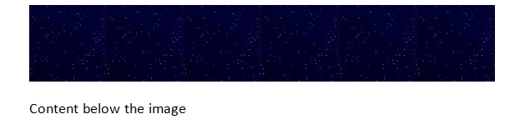
Setting Background Image Properties
The Code:
body * { background-image: url(stars.gif);
background-repeat: repeat-x;
color: #FFC; }
How it Appears:
Notes:
The default way that your browser displays a background image is to tile it, or repeat it over and over from left to right, top to bottom. That’s why sometimes when you view a page there seems to be a missing piece of something at the far right. We can choose to select how the image appears on the page by setting a repeat property.
The illustration in this slide is showing a repeat-x which displays the image across the top of the page. A repeat-y would display along the left margin, while no-repeat displays the image only once in the upper left corner of the page. Round will round off the number of times the image can fit in the window and space rounds off the times and adds a space between the image. Round and space are not widely supported by most browsers.
Next slide

Slide 8
Positioning Background Images
Code Examples:
background-position: 25% 25%;
background-position: right bottom;
background-position: 50px;
background-attachment: fixed;
Notes:
Sometimes you might want to use a watermark on your pages. This is often done to indicate that the content is a draft or confidential. Or you might want to have an image stick to a specific location on the page to mimic your printed material. To do this, you’ll use the background-position stating both the horizontal and vertical properties. These placements are based on the upper left corner of the page. The code displayed first would place the image at twenty five percent of the way in from the left and twenty five percent from the top.
The position for the right bottom will place the image on the lower right of the page. Finally, the fifty pixels will place your image fifty pixels to the right of left margin and centered vertically.
The attachment type will support fixed, leaving the image stationary like a watermark, or scroll so it will move with your document. Local will allow the image to scroll within a given element on your page.
Next Slide

Slide 9
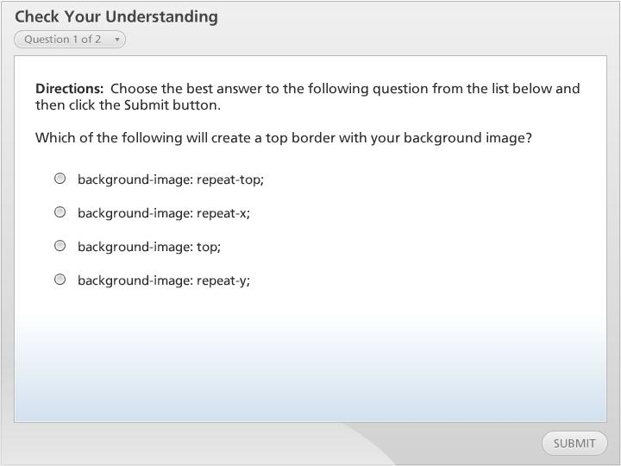



Check Your Understanding

Slide 10
Browser Extension Styles
selector {
css2_property: value;
-khtml-property: value;
-o-property: value;
-moz-property: value;
-webkit-property: value;
-ms-property: value;
css3_property: value;
}
selector {
-o-background-origin: padding-box;
-moz-background-origin: padding;
-webkit-background-origin: padding-box;
background-origin: padding-box;
}
Notes:
We have been seeing over and over again examples of how not all browsers will read your code equally. You might have been wondering how can you work around this dilemma and still provide cutting edge pages? One of the ways that helps to solve the problem is to use browser extension styles. The older browsers might not support CSS3 specifications so you’ll need to add some coding to help the browsers your visitors might be using to understand how to interpret your code.
To do this you’ll need to state the known CSS2 property followed by the extension beginning with the oldest, working your way towards the newest. The example in the slide gives a pattern on the left and a code example on the right. Note the CSS3 is the last one listed while the CSS2 begins the list.
Next Slide.

Slide 11
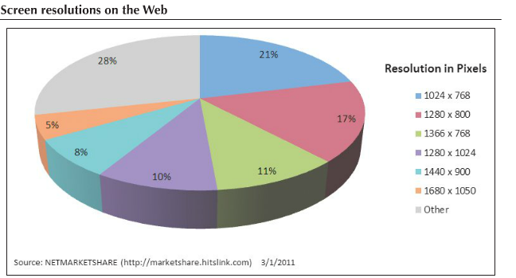
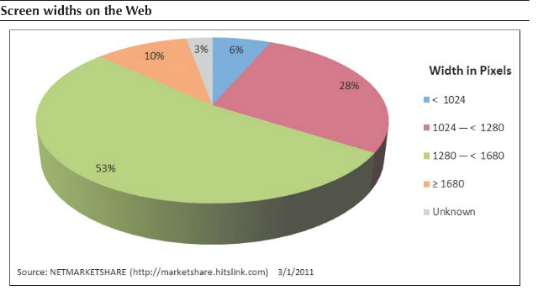
Exploring Layout Styles
Notes:
Until we are able to develop a crystal ball that lets web designers know exactly how their visitors access the web we will always find ourselves working to find ways to make our pages appear consistent in a world of multiple variables. We have to concern ourselves with more than just screen resolutions and think about the myriad of devices that can access the Web. While it is common for desktop and laptop width resolutions to be around one thousand two hundred eighty pixels, there are still a significant number of people who use one thousand twenty four as their preferred setting. Keep in mind that the entire screen is not being devoted to your page either. There needs to be room on the screen for toolbars and taskbars, and sometimes side panes as well.
Then we need to consider that some visitors are using a tablet or SmartPhone which has a much smaller screen and they still will want to view the content without need of a magnifying glass or constant scrolling back and forth. In the next few slides, we’ll examine some of the different kinds of layouts that can be used to help create pages that are flexible for different devices and resolutions.
Next slide.

Slide 12
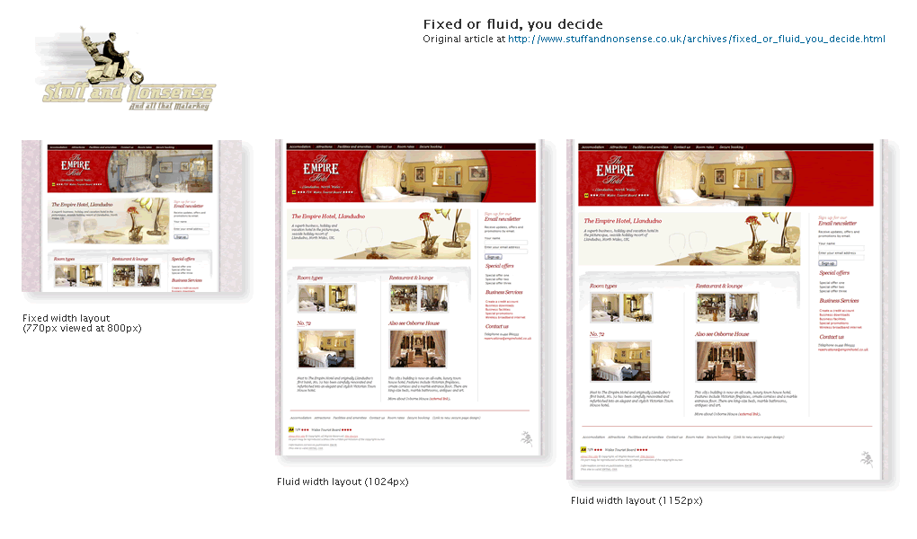
Fixed & Fluid Layouts
Notes:
The first two layouts we’ll look at are fixed layouts and fluid or liquid layouts. Each comes with its own set of advantages and disadvantages. In a fixed layout you assign the dimensions for a section of your page with a specific pixel value. If you assign a value that is higher than the resolution your visitor is using you could cause them to need to scroll horizontally, which is never considered a best practice and becomes tedious and annoying for the visitor. If the pixels assigned are too low for the visitors’ resolution they could be left with a huge white space on the right of the page making the page appear unfinished. The advantage to a fixed layout is that it is relatively simple to create.
A fluid layout uses percentages of the page, allowing the different sections of your page to take up a proportionate amount of the window regardless of the resolution set by your visitors. This layout is more adaptable in a market where there are too many variables in the ways visitors set their devices. The disadvantage here is that you’ll need to test your pages in different resolutions to ensure that the content is laid out properly and is balanced.
Next slide.

Slide 13
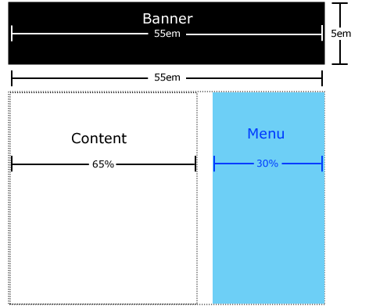
Elastic Layouts
Notes:
Another method to address the different scenarios is to use a combination of both fixed and fluid layouts. If the designer has the JavaScript skills they could write a script to check for browser resolution and direct the browser to the correct style sheet. The last option is to use an elastic layout that is based on relative font sizes using the em measurement.
One of the advantages here is that everything remains proportionate to other elements on the page. The major drawback here is that if the font is increased too much by the user, the page will extend far beyond the browser window and once again cause the user to scroll to view all the content.
In all cases of layouts, you’ll need to add the width and height along with the value stated in whichever unit of measurement you’ve chosen for your pages.
Next slide.

Slide 14
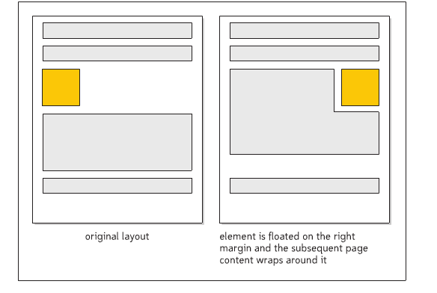
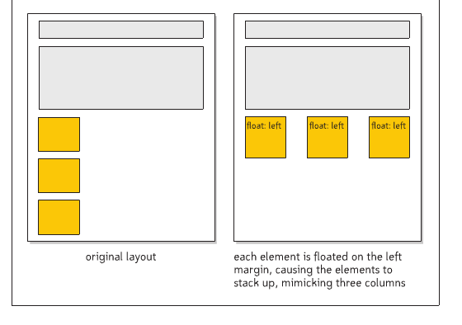
Float Elements
Notice how in both instances, the float
makes the pages easier to read and
the layout is more appealing.
Notes:
To have your content removed from the flow of the document you’ll add a float with its corresponding position. This is a way to have your content move around an image or a different section of your page. Without float your content would all just display one after another both wasting space and making readability more difficult for your visitors.
The illustrations in the slide help to demonstrate how float will assist you in creating layouts that are visually appealing as well as conserving space.
Next slide.

Slide 15
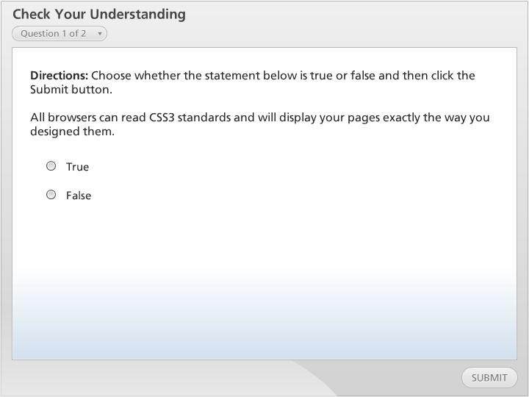
Check Your Understanding

Slide 16
Summary
Exploring Display Styles
Creating a Reset Style Sheet
Designing the Background
Exploring Browser Extensions
Exploring Layout Designs
Floating Elements
Notes:
We have reached the end of this lesson. Let’s take a look at what we’ve covered.
We started our discussion by examining how to set your display properties for your pages. This allows you more flexibility in your design. We also examined the Box Model and all of its components.
Then we looked at how to reset your style sheet to help your pages work in different browsers that might have different default settings.
Then we examined different ways to apply background images on your page including how to position them.
Next week looked at how browser extension styles to help your CSS properties display in various browsers and devices.
Finally, we looked at different layout styles that are available to the designer and how they each have their own pros and cons.
This completes this lesson.

