Slide 1
CIS 273 Web Design and Development
Creating Page Layouts with CSS
Notes:
Welcome to Web Design and Development. In this lesson will discuss creating page layouts with CSS.
Next slide.

Slide 2
Topics
Setting Margins and Padding
Working with Borders
Creating Rounded Corners
Managing Your Layout
Notes:
The following topics will be covered in this lesson:
Setting Margins and Padding;
Working with Borders;
Creating Rounded Corners; and
Managing Your Layout.
Next slide.

Slide 3
Setting Margins
The Code Syntax: margin-top: length;
margin-right: length;
margin-bottom: length;
margin-left: length;
Syntax for a Single Line:
margin: top right bottom left;
Application of the Syntax:
h2 {25px 30px 25px 30px; }
Notes:
When we looked at the Box Model we learned that there are margins that surround elements on our pages. In this slide we will explore how to set those margins for visual appeal and to help the flow of information on our pages. Since this is a box, we have the ability to address all four sides independently of each other. As the code syntax examples demonstrates, we can select each side and add a different length as our needs dictate. The length is usually expressed in pixels.
As our slide shows, you can write the code with differences for each side; you can do this one side at a time, include all four sides in one expression and they apply as the syntax at the top shows. If you only enter one value then that is applied to all four sides.
It is important to know that you can apply margins to elements such as a heading level as shown here or to your body and that will effect the entire page’s margins. This is a very good way to add white space and readability to your pages.
Next Slide.

Slide 4
Setting Padding
The Code Syntax: padding-top: length;
padding-right: length;
padding-bottom: length;
padding-left: length;
Syntax for a Single Line:
padding: top right bottom left;
Application of the Syntax:
td {5px 8px 5px 8px; }
Notes:
To set your padding, which is the space between your content and your margins, you will use the same syntax as you did for your margins. You can address each side or all the sides at once.
Something to keep in mind is that there can be too much of a good thing. If you’re adding lots of space for your margins, be sure that the padding does not display your content with so much space that you lose continuity and a cohesive look on your pages. You still want your visitors to see what content belongs together. There are no rules that say you must add this spacing to each possible element, experimenting with how each changes the feeling on your pages will be your best guide.
Another aspect to consider is to add a negative value to your spacing. All heading levels have the look of a double space in a Word document. By adding a negative pixel value you can make elements appear closer than their default settings. Once again, experimentation and your eyes will become your best guides.
Next slide.

Slide 5
Setting Border Widths, Colors & Styles
The Code Syntax Width: border-top-width: length;
border-right-width: length;
border-bottom-width: length;
border-left-width: length;
The Code Syntax Color:
border-top-color: length;
border-right-color: length;
border-bottom-color: length;
border-left-color: length;
The Code Syntax Color:
border-top-style: style;
border-right-style: style;
border-bottom-style: style;
border-left-style: style;
Notes:
By now it’s becoming clear that the pattern of our syntax remains constant. We address the border, the location, and the property. The value we use is compatible with the property. Lengths as we’ve already seen are usually expressed in pixels. Colors can be expressed using the named color, the hex values or rgb values. Most designers use the first two options.
The question remaining deals with what styles can we add to our borders? In the next slide we’ll see some illustrations of different styles in action. Remember that here as in so many other instances, not all browsers support all possible styles so you will always need to check your pages in different browsers to be sure your visitors are seeing what you intended.
Next slide.

Slide 6
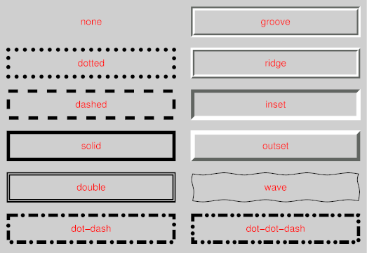
Border Styles
Notes:
In viewing these examples you can clearly see that by adding a style to your borders you are able to change the underlying message of the content. For example, adding a border style that is dashed could be a nice way of pointing out a coupon that your visitors might cut out after printing your page. The outset style can appear like a button; this is an interesting technique for your navigational elements. Then you could change outset to inset for the hover pseudo class and create the illusion of movement on the page. Add some color to the mix and the possibilities are almost endless.
Next slide.

Slide 7
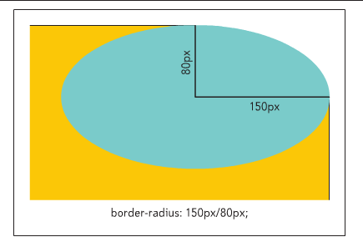
Creating Rounded Corners
The Code Syntax Width: border-top-left-radius: radius;
border-top-right-radius: radius;
border-bottom-left-radius: radius;
border-bottom-right-radius: radius;
An example of an elongated radius
Which gives your corner additional
interest.
Notes:
Square borders are the default setting but they can become boring. The ability to add a rounded corner can soften your pages and CSS3 supports this easily with the assistance of a little math. The math involved is the radius of the hypothetical circle around your element or three hundred sixty degrees. You’ll want to always be sure your totals add up to three hundred sixty not more and not less. A single radius entered will keep everything the same whereas two values entered will effect the opposite corners: the top left and bottom right and then the second value will be applied to the remaining two corners.
Elongating your corners requires the addition of horizontal and vertical values. The illustration in our slide shows how this variation adds a different layer of visual interest.
Next slide.

Slide 8
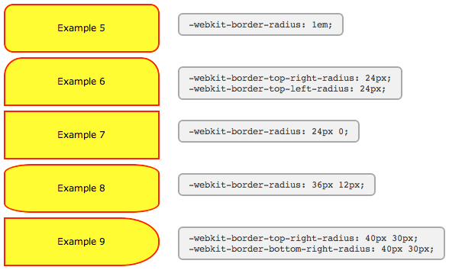
Browser Extensions to Rounded Corners
Notes:
Browser extensions are necessary for older versions of browsers. This illustration gives a good visual in understanding both how the extensions are applied and what the corners will look like. The good news for designers is that the newer versions of Firefox and Safari support the CSS3 syntax so you’ll only need to be concerned with the extensions for older browsers.
If you do not use the extensions the browsers will display differently although most will simply show a square border for your elements.
Next slide.

Slide 9
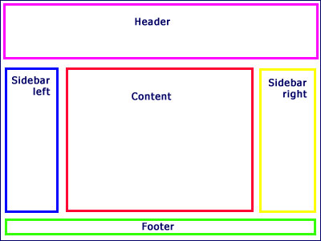
Managing Your Layout
A Simple Formula:
total width = content width + padding + border width
Notes:
When you are working on your layout don’t forget to add together the width of all of your elements on the page. This is most noticeable for pages that are using different sections with positioning to create a look and feel of a newsletter or printed material.
One technique to help you reduce the overall size of divisions on your page is to set your padding on the left and right sides to zero and use your margins to help control your spacing. Remember when you’re adding up all the different parts that you have to account for all four sides and it can become very confusing.
Another way to help you think through the process is draw out your storyboard for the page on graph paper adding the padding and margins as necessary. Then you’ll need to decide on the maximum width of your page beforehand but the graph paper makes it easy to see how the pieces all come together.
Next slide.

Slide 10
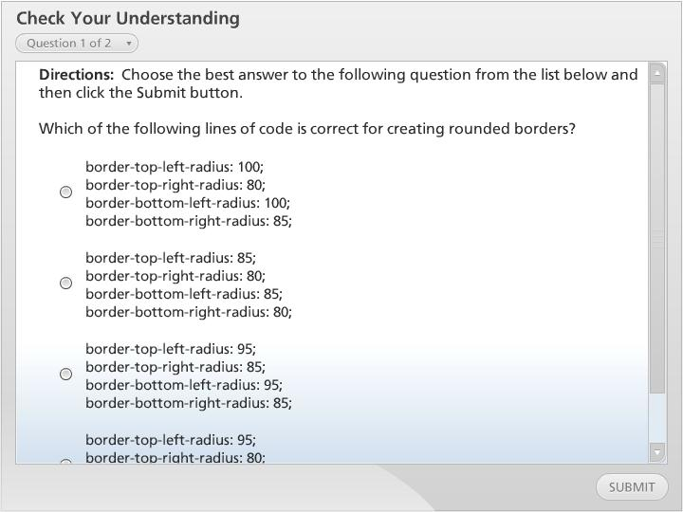



Check Your Understanding

Slide 11
Summary
Setting Margins and Padding
Working with Borders
Creating Rounded Corners
Managing Your Layout
Notes:
We have reached the end of this lesson. Let’s take a look at what we’ve covered.
We started our discussion by examining how to set your margins and padding for elements on your pages. We quickly discovered that this is an easy way to add white space to pages.
Then we examined how to apply different border styles which creates visual interest and another layer of how to separate your content.
Then we examined how to add rounded corners to our pages to avoid having everything look boxy.
Finally, we looked at ways to add up the widths of all our elements so that everything fits on the page the way we envisioned them.
This completes this lesson.

