Slide 1
CIS 273 Web Design and Development
Creating Page Layouts with CSS
Notes:
Welcome to Web Design and Development. In this lesson will discuss creating positioning objects with CSS.
Next slide.

Slide 2
Topics
Positioning Objects
Working With Overflow & Clipping
Stacking Elements
Notes:
The following topics will be covered in this lesson:
Positioning Objects;
Working With Overflow and Clipping; and
Stacking Elements.
Next slide.

Slide 3
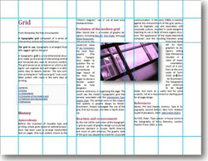
Positioning Objects
Coding Syntax:
position: type;
top: value;
right: value;
bottom: value;
left: value;
Notes:
One of the most exciting and innovative changes that CSS brought to web design was the ability to assign positioning on the page. Now through the use of our code we can have pixel perfect positioning through the use of the coordinates for each element. All of the coordinates relate to the upper left corner of the page. Generally speaking we only need to add the left and top coordinates because our width and height dimensions will imply the rest. Here is another place where using graph paper for your storyboard can come in handy. You can move items around on the graph paper easily before you start to apply your actual coding. This will not bypass the need to test in your browsers, but it can help cut down on some frustration as you work.
This slide shows some of the basic syntax patterns used for positioning elements. The type references one of five different ways to apply your positions and we’ll examine each one in future slides in more detail. For now they are: static which is the default, absolute, fixed, relative, and inherit.
Next Slide

Slide 4
Absolute Positioning
The Code:
#heading1 {
position: absolute;
left: 75px;
top: 117px;
width: 650px;
height: 125px;
}
Notes:
As the name implies, absolute positioning places the element exactly where you want it to be positioned on the page. One of the advantages here is that you are taking complete control of that placement. The danger is that the element is removed from the document flow and any other elements might not line up with the element you have placed. In very general terms, once you introduce a kind of positioning you’ll need to continue throughout your page so that everything goes where you want it.
The illustration here gives an idea of how you might combine your positioning with the width and height of an element on your page. This is not to scale, but you can see how you might be able to place something with precision. The star is an example of where you might have placed a logo on the page as an image with no repeating so you need the positioning to ensure that your heading does not overlap with the logo.
Next slide.

Slide 5
Relative Positioning
The Code:
#special {
position: relative;
left: 25px;
top: 225px;
width: 200px;
height: 210px;
}
Notes:
Relative positioning is used to place elements relative to where the browser would have placed them if no positioning had been applied. The element is still a part of the document flow with a change in the placement that is relative to the default placement.
The illustration has moved the white box for the special slightly down and left of the document flow’s default layout.
Another way you can use relative positioning is to center or place an element inside of another element. For example, you might wish to have a division that holds a small image as well as text. Relative positioning will allow you to place the image inside the division with precision. This involves using the width and height of your elements to place them, especially if you want to center an object either vertically or horizontally.
Next slide.

Slide 6
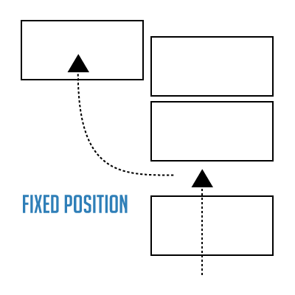
Fixed & Inherited Positioning
Notes:
When you fix an element through positioning you are fixing to a specified spot even while the pages are scrolling. This is not supported in the older browsers so be careful how you use this one. It can completely throw your alignment and page layout to the four winds!
The inherit positioning allows the element to inherit the position of a parent element. This follows the same pattern we explored with styles being inherited on your pages. Once again, you’ll want to take some extra precautions in while previewing your pages in different browsers.
Next slide.

Slide 7
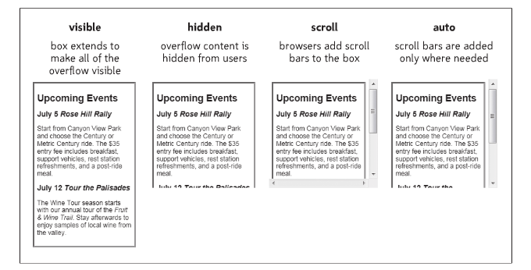
Working with Overflow
The Code Syntax:
overflow: type;
Notes:
What happens when you want to have the same layout for all your elements on your pages but sometimes your content doesn’t quite fit the section? You cannot edit the text because that’s not your job. You’ll need to use overflow to help keep your layout intact and still display all the content.
Overflow supports several different types such as visible which is the default, hidden, scroll and auto. Visible will allow the element to grow in order to accommodate all of the content. This defeats your goal of keeping everything the same size. Hidden will cut off the extra content which not helpful if you want all of the text to be on the page. Scroll will add a vertical and horizontal scroll bar so that your visitors can scroll to read the text that didn’t fit the section. Auto will add the scrollbars when necessary and not show them otherwise. Most designers tend to use auto so they have more freedom if their clients add content at the last minute.
Next slide.

Slide 8
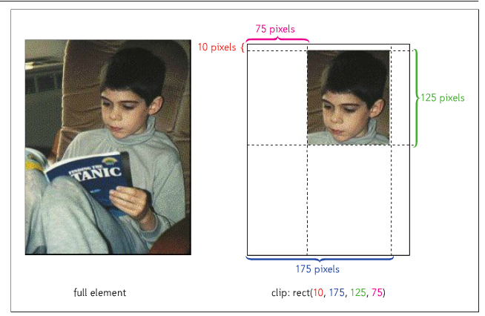
Clipping Elements
The Code Syntax:
clip: rect(top, right, bottom, left);
Notes:
When you clip an element you are defining what portions of the element are visible on the page leaving the rest hidden. This is similar to what you do when masking an image, in that you are not changing the actual size but defining what shows on your page.
You can use this creatively in conjunction with the semitransparent properties that are supported in CSS3 but once again, this newer technology might not be supported in all browsers. You are also not changing the size of an image – as shown in the slide – so you will not be changing the download time for your page either.
Next slide.

Slide 9
Stacking Elements
Code Syntax:
z-index: value;
z index: 2
z index: 1
z index: 3
Notes:
When you begin to use positioning on your pages you may have instances where one element appears on top of another element. This is known as stacking. While this can add some interesting visual interest to your pages, you might need to change the order that the elements are stacked in. That’s where the z-index comes into play. The higher the number the further up on the stacking it will appear.
The illustration in this slide demonstrates three elements on the page stacked. Transparency was added to the elements to allow us to easily see how they are layered or stacked on top of each other.
Next slide.

Slide 10
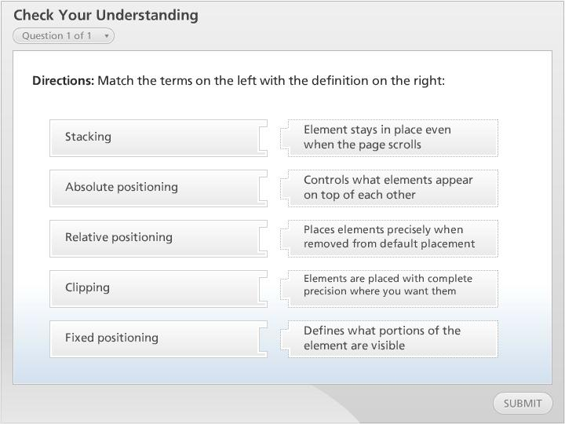



Check Your Understanding

Slide 11
Summary
Positioning Objects
Working With Overflow & Clipping
Stacking Elements
Notes:
We have reached the end of this lesson. Let’s take a look at what we’ve covered.
We started our discussion by examining different kinds of positioning available to control their exact placement on our pages.
Then we examined how to use overflow and clipping to help enhance layouts and control the amount of space being used.
Finally, we looked at how stacking allows elements to overlap each other on pages and how by using the z-index we can control that order.
This completes this lesson.

