Slide 1
CIS 273 Web Design and Development
Working with Tables and Columns
Notes:
Welcome to Web Design and Development. In this lesson will discuss working with tables and columns.
Next slide.

Slide 2
Topics
Formatting Tables with HTML Attributes
Formatting Tables with CSS
Applying Table Styles to Other Page Elements
Creating Columnar Layouts
Notes:
The following topics will be covered in this lesson:
Formatting Tables with HTML Attributes;
Formatting Tables with CSS;
Applying Table Styles to Other Page Elements; and
Creating Columnar Layouts.
Next slide.

Slide 3
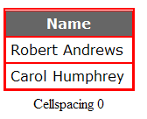
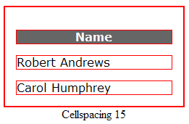

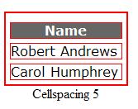
Cellspacing
The Syntax:
<table cellspacing = “value”>
Notes:
Cellspacing is the attribute that controls how much space exists between the cells on your table. As you can see in our slide, the more space you add, the wider apart the cells will appear. When you increase your border width to the table you can create the illusion of windowpanes in your tables as well.
This is very closely related to CSS margins but only supports pixels as a measurement. If you set the spacing to zero you might see a gridline that appears as a drop shadow in some browsers.
Use cellspacing as a way to add extra white space to your page to make your content more readable.
Next Slide

Slide 4
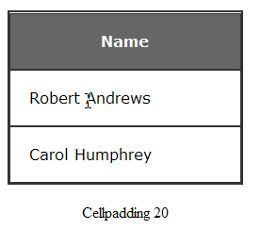
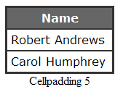

Cellpadding
The Syntax:
<table cellpadding = “value”>
Notes:
Cellpadding addresses the distance between your cell content and the cell borders. When you add some spacing you make the content easier to read. Too much spacing can make the content difficult to read because things become too far apart.
Cellpadding is closely related to the CSS padding that we examined earlier and like the cellspacing can only be expressed in pixels. It is probably not a good idea to add both spacing and padding unless you are keeping the values low so that your content is close enough together to be easy to read. Too much white space on a page can make the page look unorganized and the content disjointed.
Next Slide

Slide 5
Setting Table Width & Height
These can be set by pixel or percentage
Often determined by the content of the table
Never allow the width to cause horizontal scrolling
If you leave the height empty, the table will expand to accommodate the contents
<table width=“95%” height=“760”>
You can also set cell attributes this way
Notes:
Width and height for your table or for your cells can be set as either pixels or percentages. When you use a pixel you are setting an absolute value for the width or height. This can be a useful technique when you are adding an image to your table and you want the table to match the image exactly. Keep in mind that if you set your width to nine hundred fifty pixels it will not appear the same in a resolution of one thousand two hundred eighty pixels as it will in one thousand six hundred pixels or if someone has a very low resolution of seven hundred forty they will have to scroll to read your content.
Percentages are relative to the size of the browser window so seventy five percent will be three quarters of the browser at any given resolution. This may work better when you’re unsure of the resolutions your visitors are most likely to use and you want the table to adjust according to their settings. If you set a width in a cell of your table it will apply to all the cells in the same column so you only have to set that once.
For your height, you can set a fixed height or if you leave this attribute out the table will grow to fit the contents you have placed in the table.
Next slide.

Slide 6
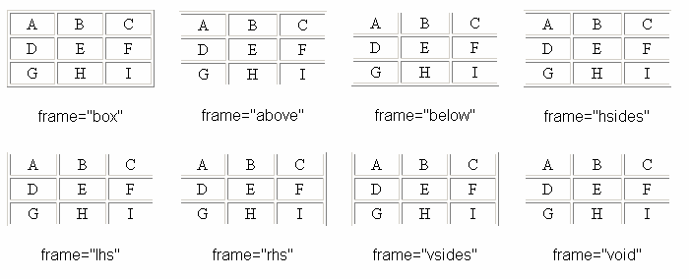
Table Frames
The Syntax:
<table frame= “type”>
Notes:
The table frames define which of the outside borders you will display on your table. As the illustration in the slide demonstrates each type of frame gives your table a very different look and feel. As you look at the different frames you might be asking yourself why would you leave off a border along a side of your table? The answer is that you can now have a table right up against your image and not give any additional spacing for the borders creating more visual interest and giving you, the designer more control.
Next slide.

Slide 7
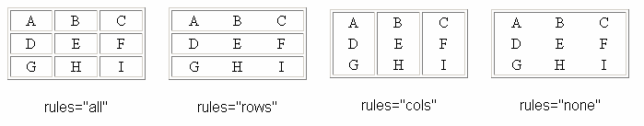
Table Rules
The Syntax:
<table rules= “type”>
Notes:
Table frames control the outside borders while table rules control the inside borders. Setting your rules allows you to emphasize the way your visitors view the content inside your table. Using cols for borders only along the columns is useful for long lists that are really separated by different cells as one example. Using none allows you to have your information formatted inside of the table neatly but the gridlines are removed so all your content appears to float freely on your page.
Table rules are very closely related to the CSS border-style property.
Next slide

Slide 8
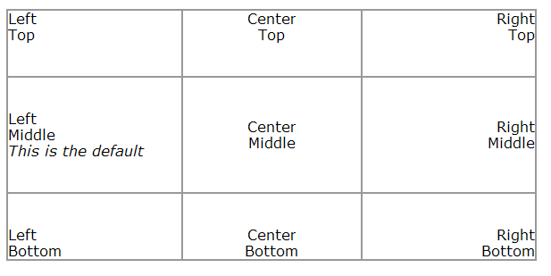
Cell Alignment
The Syntax:
<table align= “position” valign=“position”>
Notes:
Cell alignment can be addressed either horizontally using the align attribute or vertically using the valign attribute. Horizontal positions are set to left which is the default, center, and right. Vertical positions are middle which is the default, top, and bottom. By combining the two attributes you can place your content in nine discrete locations as shown in the slide.
Next Slide

Slide 9
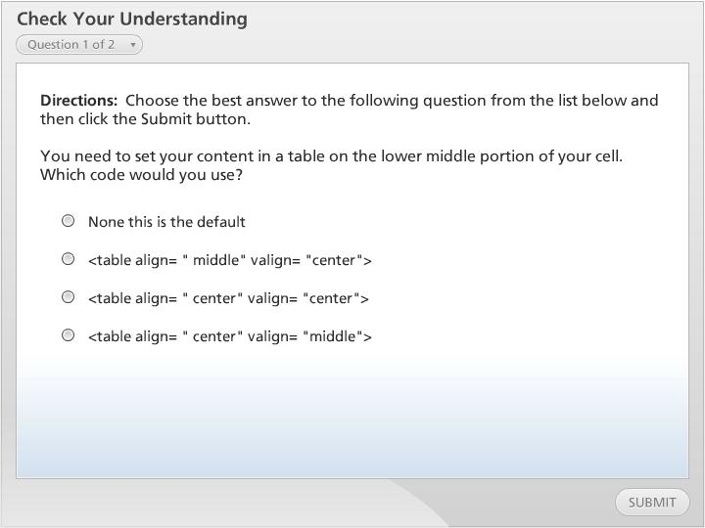



Check Your Understanding

Slide 10
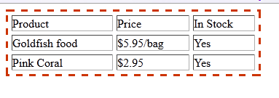
CSS & Table Properties
The Code:
table.price {
border: 3px dashed #C30;}
table.price th table.price td {
border: 1px thin #666;}
How it Appears:
Notes:
Before you begin to code you’ll want to make a decision about whether or not to use HTML attributes like the ones we’ve already examined or to use CSS to control your table’s appearance. Do not make the mistake of trying to use both. At some point your pages will not appear the way you planned in one browser or another.
To add borders to your tables you will probably first want to have named your table using a pseudo class and then you can apply the borders in the same way we have already looked at with border attributes. Then through contextual selectors you can work with the other attributes of your table’s borders. The example in our slide is referencing a pricing table.
Next Slide.

Slide 11
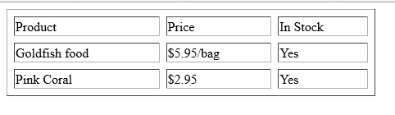

Separate & Collapsed Borders
The Syntax:
Border-collapse: type;
Border-spacing: value;
This is a separate border: table {border-collapse:separate;
border-spacing: 8px;}
This is a collapsed border: table {border-collapse: collapse;
border-spacing: 8px;}
Notes:
Using the border-collapse in CSS allows you to control the spacing between your cells in a way that is similar to cellspacing that we viewed earlier. When you collapse borders they are the thickness of each border added together but are collapsed into a single border. So if you had set your borders to one pixel and then collapsed them the result would still only be one pixel.
If you had been working with a hidden border then the collapsed border will remain hidden as well. You’ll need to view these in your browsers to determine which values will give you the cleanest and easiest to read table. Once again, we find there are no right or wrong approaches because each web site is unique and geared for a specific target audience.
Next slide.

Slide 12
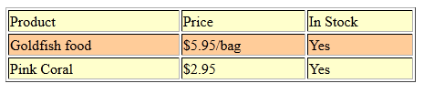
Creating Banded Tables
The Code:
table.price {
border: 3px thin #C30;}
table.price tr:nth-of-type(odd)
{background-color:#FFC;}
table.price tr:nth-of-type(even)
{background-color: #FC9; }
How it Appears:
Notes:
When you have a large table it’s often difficult to follow the text across the rows even with borders in place. Creating a table that displays each row in a different color is a nice way to add interest as well as readability to your table. The code in the slide takes our price table and adds some CSS to help separate out different rows.
If this were a longer table you can see how this technique will add ease of reading quite easily. A word of caution: for your visitors that might have colorblindness, remember to use colors that will not blend into each other or you will lose the whole point of doing this!
Next slide.

Slide 13
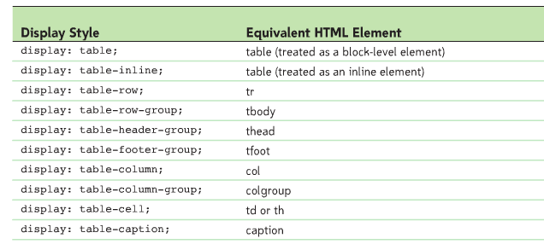
Using Table Styles for Other Elements
Notes:
One of the nicest things about CSS is that we are not always restricted to using the attributes for one element to only that element. The table in our slide demonstrates how we can use different attributes in creative ways.
For example, you could add the display style to a different element on your page to create a more consistent look throughout. This is a relatively newer form of coding and you may find that not all browsers will display as you had hoped.
Take your time to experiment with this code before you commit to using it.
Next slide.

Slide 14
Creating Columnar Layouts
The Code:
p {
-moz-column-count: 2;
column-count: 2;
column-width: 45%;
column-gap: 1.5em;
column-rule: 1px double blue;
}
Notes:
Creating columns will help to make it easier for your visitors to comprehend the content more easily. Usability tests have proven that eight to twelve words is the ideal line length for your columns. You’ll be combining several attributes as shown in our syntax examples to make the columns most effective.
The column-count will set the number of columns you are using. The column-width will set how wide. Remember if you are using pixels do not make the width so wide that you’ll force your visitors to scroll. If you’re using percentages it’s best to set the widths so they are less than one hundred percent to allow space for your borders and margins as well.
The column-gap is the space between the columns which will default to one em. Finally, the column rule defines the kind of border or line you wish to place between your columns. You can add more to these with the same patterns we examined for borders earlier by adding the style, color, width, and so on to the CSS rule.
Finally, you may need to add the browser extensions in order for this newest code to render on your pages. It may take a few extra moments to add the lines necessary – our example shows the code for Firefox – but it will make a huge difference for your visitors.
Next slide.

Slide 15
Summary
Formatting Tables with HTML Attributes
Formatting Tables with CSS
Applying Table Styles to Other Page Elements
Creating Columnar Layouts
Notes:
We have reached the end of this lesson. Let’s take a look at what we’ve covered.
We started our discussion by examining different attributes we can add to our tables using HTML. We looked at cellpadding, cellspacing, table frames and rules as well as cell alignment.
Then we examined how to format our tables using CSS which is a newer technology.
Next week looked at how to create a caption for your table and how that can make it easier to understand what your table is being used to display.
Then we looked at how to apply table styles to other elements and learned that not all browsers will render this code as expected.
Finally, we looked at how to create columnar layouts to increase readability to our pages.
This completes this lesson.

