Slide 1
Information Technology Capstone CIS498
Creating Your Twenty-First Century Workforce and Culture
Notes:
Welcome to Information Technology Capstone.
In this lesson we will discuss Chapter One of Unleashing the Power of IT.
Next slide.

Slide 2
Topics
Core Skills for Success
A Consistent Terminology
Who Will Benefit Most
Leveraging This Book
Notes:
The following topics will be covered in this lesson:
Core Skills for Success;
A Consistent Terminology;
People Who Will Benefit Most; and
Leveraging This Book.
Next slide.

Slide 3
Core Skills For Success
Transformational Leadership
Organizations and Cultures
Information Technology Workforce
Soft Skills
Communicating and Relationship-building
Collaborating and Managing Change
Marketing and Negotiating
Notes:
From a business leader’s perspective, market forces such as globalization, consumerization, and increasingly savvy consumers have turned technology into a key differentiator.
Technology has become a key differentiator because companies desire to expand into new markets and seek a competitive advantage. This has resulted in the need for people who are in charge of technology to become technologically advanced, business-minded, customer-focused and financially astute.
In order for these leaders to remain viable, they must adopt a transformational leadership mentality. They must proactively seek to transform their organization and culture. For this to be achieved, they need to develop an information technology workforce that has the new mindset, skill set and tool set that translates into the soft skills that lead to success which are communicating, relationship-building, collaborating, managing change, marketing, negotiating and the like.
Next slide.

Slide 4
A Consistent Terminology
Vocabulary:
IT
Clients or business partners
Customer
WIIFM (“wiff-em”)
Four Cs
Notes:
It is important to understand that a consistent vocabulary is key when an IT culture change effort is in progress. Sometimes words and phases might mean different things to different people. Therefore, the following words are defined:
IT is commonly referred to as the information technology organization responsible for managing and delivering technology and related services.
Clients or business partners are those who are the beneficiaries of IT’s products and services.
Customer refers to whom our corporations provide products and services.
WIIFM stands for What’s In It For Me. This is the concept that every IT professional must think about when considering a client’s point of view.
And lastly,
The Four Cs refers to increasing IT professional’s Competence, Confidence, Commitment, and Consistency.
Next slide

Slide 5
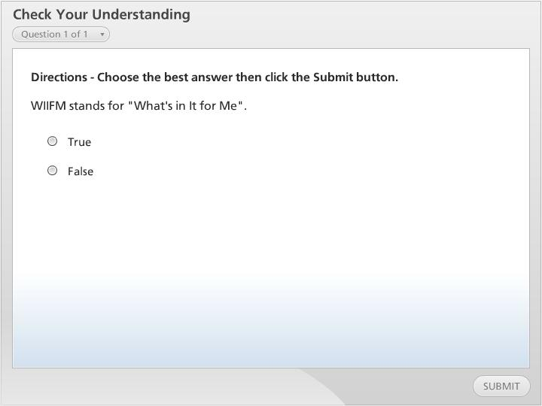



Check Your Understanding

Slide 6
Who Will Benefit Most
Chief Information Officer
Business Unit Officer
Regional Information Officer
Application Practitioners
Infrastructure Practitioners
IT Professionals
Notes:
The concepts that are covered in this text will be most beneficial to people who are involved with the IT professional and who must deliver quality products to customers.
Some of the titles and positions that this book would be most useful include:
Chief Information Officer or CIO;
Business Unit Officer;
Regional Information Officers;
Application and infrastructure practitioners
And IT professionals.
Next slide.

Slide 7
Leveraging This Book
Know Your Organizational Stage
A Good Approach
Engage Each Level of Management
Notes:
Each chapter of this text is important to the overall success of the IT leader. Every organization is not at the same stage in the transformation process, therefore it is not feasible to tackle all areas of this text all at once. You must know your organizational stage in order to leverage this book and achieve maximum benefit.
A good approach would be to select one or two chapters that address the areas that are most pressing within your organization. These should be your priorities.
It is advised that you engage each level of your management team in your IT initiative, because they play a critical role in building a new culture.
Next slide.

Slide 8
Summary
Core Skills for Success
A Consistent Terminology
Who Will Benefit Most
Leveraging This Book
Notes:
We have reached the end of this lesson. Let’s take a look at what we’ve covered.
The topics that were covered include:
Core Skills for Success, This topic addressed Transformational Leadership as it relates to organizations and culture, and the information technology workforce. In addition, soft skills were identified;
Next we discussed, A Consistent Terminology, which explained some key vocabulary that would be necessary to aid a culture change.
Then we covered, Who Will Benefit Most, which addressed who this book will help;
Finally, we reviewed, Leveraging This Book, which covered the best approach to reading and applying this book.
This completes the lesson.

