Slide 1
Information Technology Capstone CIS498
Transforming Your IT Team
Notes:
Welcome to Information Technology Capstone.
In this lesson we will discuss Transforming Your IT Team.
Next slide.

Slide 2
Topics
How to Make This Transition: Learn to Think Differently
Five Critical Success Factors that Enable Organizational Excellence
Conclusion: High-Performance Reality
Notes:
The following topics will be covered in this lesson:
First, How to Make This Transition: Learn to Think Differently;
Next, Five Critical Success Factors that Enable Organizational Excellence; and
Lastly, Conclusion: High-Performance Reality
Next slide.

Slide 3
How to Make This Transition: Learn to Think Differently
Mindset Change:
Force Yourself to Plan and Think of the Big Picture
Adopt a Proactive Approach
Resist the Temptation to Delve into Tactics
Be Candid with Yourself and Others
Prepare for and Embrace Change
Anticipate, Understand, Respect, and Work through Complexities
Notes:
The focus of this topic is on the six mindset changes:
Mindset Change One: Force Yourself to Plan and Think of the Big Picture. IT can not be all things to all people. A clear set of finite priorities should be developed. This will allow the IT leader to stay the course instead of constantly changes. In addition, this will allow clients to see how additional requests would impact the current priorities.
Mindset Change Two: Adopt a Proactive Approach. This is an important concept because a leader can not afford to assume a passive, victim’s mentality. An IT leader should take responsibility for IT initiatives and should never blame others or point fingers.
Mindset Change Three: Resist the Temptation to Delve into Tactics. Many IT leaders are techies at heart. Most often they feel the urge to jump in and fight fires as they arise. This should be avoided because IT leaders should focus on leadership activities. If an IT leader feels the need to jump in, that’s a warning that there is not enough focus on leadership.
Mindset Change Four: Be Candid with Yourself and Others. The best leaders have the courage to be candid, particularly when it comes to conflict. An IT leader should never practice conflict avoidance. Understanding oneself is key because an IT leader should be honest and candid about their own capabilities and weaknesses.
Mindset Change Five: Prepare for and Embrace Change. An IT profession is all about change. And if an IT leader resists change or never see it coming, it can have a truly negative impact on the company and on one’s career. When change is identified, the IT leader should use a SWOT tool. This will help the IT leader indentify the strengths, weaknesses, opportunities and threats of the change.
Mindset Change Six: Anticipate, Understand, Respect, and Work through Complexities. The success of IT leaders depends on their relationships with clients, peers, and staff. Effective leaders absolutely must get out of their offices and from behind their computers and work on developing relationships. Developing a relationship strategy is advisable.
Next slide.

Slide 4
Five Critical Success Factors that Enable Organizational Excellence
Leadership
Strategy
People
Best Practices
Execution
Notes:
Changing one’s mindset is one thing . Leading an IT organizational through a successful transformation is quite another. There are five challenges or success factors that leaders need to work through when they want to reposition themselves and their organizations for success.
The first success factor is Leadership. IT leaders should lead by positively influencing and inspiring others.
The second success factor is strategy. IT leaders should establish the right winning game plan for the organization.
The third success factor is People. Always hire and professionally develop the winning team.
The fourth success factor is Best Practices. Leverage IT best practices right-sized for your organization.
The fifth and last success factor is Execution. IT leaders should translate the IT strategy, goals, and initiatives into specific action plans that deliver measurable results.
Next slide

Slide 5
Conclusion: High-Performance Reality
Leadership is a journey
Never turn a blind eye to change
Top Ten Leadership Strategies
Notes:
Leadership is a journey, not a destination. IT leaders must continually raise the bar so that they continuously improve themselves and their staffs.
In order for this reality to occur, IT leaders should never turn a blind eye to changes that are clearly making them obsolete. IT leaders should adhere and implement leadership strategies.
We will present the top ten leadership strategies for transforming your IT team.
Number one: Build trusting relationships;
Number two: Be resilient and effective under pressure;
Number three: Keep promises;
Number four: Focus on results;
Number five: Align with the business;
Number six: Think strategically while balancing tactics;
Number seven: Keep abreast of technology and business trends;
Number eight: Effectively navigate politics and executive team dynamics;
Number nine: Build solid client relationships and strategies:
Number ten: Prioritize time investment to deliver optimal results.
Next slide.

Slide 6
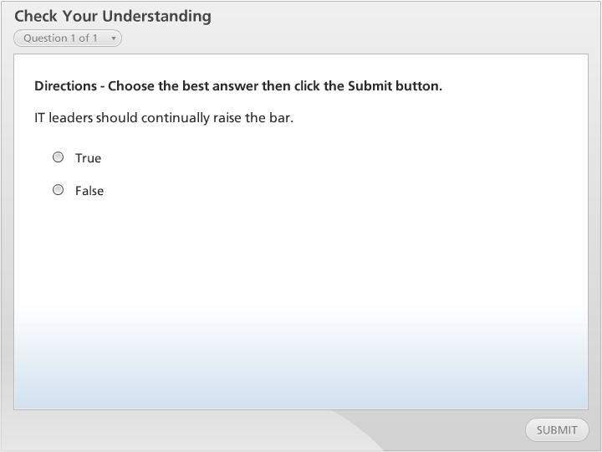



Check Your Understanding

Slide 7
Summary
How to Make This Transition: Learn to Think Differently
Five Critical Success Factors that Enable Organizational Excellence
Conclusion: High-Performance Reality
Notes:
We have reached the end of this lesson. Let’s take a look at what we’ve covered.
The topics that were covered include:
How to Make This Transition: Learn to Think Differently. Old habits are hard to break, therefore practicing the six mindset changes will aid in the transformation;
Then we covered, the Five Critical Success Factors that Enable Organizational Excellence. These factors are essential to work through when an IT leader desires to reposition the organization for success;
And lastly, we discussed, the Conclusion: High-Performance Reality. This topic addressed leadership strategies for transforming the IT team.
This completes the lesson.

