Slide 1
Information Technology Capstone CIS498
Building a Client-Focused IT Culture
Notes:
Welcome to Information Technology Capstone.
In this lesson we will discuss Building a Client-Focused IT Culture.
Next slide.

Slide 2
Topics
Good Service
Service Skills and Mindsets
Strategies for Developing a Service Mentality
Notes:
The following topics will be covered in this lesson:
Good Service;
Service Skills and Mindsets; and
Strategies for Developing a Service Mentality
Next slide.

Slide 3
Good Service
Definition
Characteristics
What Good Service is not
Notes:
Good Service at an abstract level is the sense that the people that are involved with the transaction are fully engaged with meeting the expectations you have regarding the experience they are providing.
Some characteristics of good service include:
Sincerity;
Righting wrongs instead of abdicating responsibility;
Addressing issues promptly and courteously;
Working to understand the client’s needs;
Going out of your way to resolve an issue;
Being easy to work with;
And approaching issues constructively.
Most of all, service starts with understanding and really caring about the client’s goals and concerns.
Good service is not:
Insincere gestures;
and it is not caving to all requests just to keep the client happy;
Next slide.

Slide 4
Service Skills and Mindsets
A We Mindset
Learning to Love Complaints
Making Every Interaction Count
Notes:
A We Mindset is about developing a service mentality that does not reflect an individual effort. All too often, people in the IT department take one another for granted, treating each other as thought they don’t count as much as other coworkers. IT should be a unified group committed to delivering service to the organization.
Learning to Love Complaints is probably one of the most difficult mindsets to establish; however, it is a key factor in the transformation process. Complaints should simply be seen as input or information that you otherwise wouldn’t be privy to.
The third mindset, Making Every Interaction Count, focuses on the daily interactions IT has with business clients and IT peers. It must be recognized that every impression counts when it comes to providing good service. These impressions have been labeled moments of truth. These interactions leave clients with an impression of IT’s performance whether positive or negative.
Next slide.

Slide 5
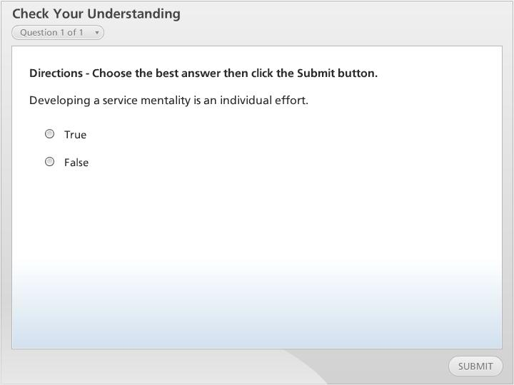



Check Your Understanding

Slide 6
Strategies for Developing a Service Mentality
Never Let it Go
Clearly Define Your Service Level Offerings
Engage Your Clients in the Culture Shift
Notes:
IT leaders who want to affect a service mentality culture talk about the issue all the time. They never let it go. At every meeting, the IT professional should convey that the client is at the center of the discussion. IT leaders also need to encourage individuals to understand what their clients are working on, what the business is doing, and what the stress points are.
Clearly Define Your Service Level Offerings. For example you might define three levels of service.
One. Basic: Focus on quick turnaround;
Two. Enhanced: Focus on quick turnaround and client convenience;
Three. Premium: Focus on all of the preceding plus anything else that’s required, as long as the client is willing and able to pay for it.
Engage Your Clients in the Culture Shift. A service strategy will only be successful if your staff sees things through the eyes of the client. Always invite the client into the process and ask for their impressions. Keeping the client engage will have them involved in the transformation.
Next slide.

Slide 7
Summary
Good Service
Service Skills and Mindsets
Strategies for Developing a Service Mentality
Notes:
We have reached the end of this lesson. Let’s take a look at what we’ve covered.
The topics that were covered include:
Good Service which is all about being sincere with clients and seeing things through their eyes;
Then we discussed, Service Skills and Mindsets. A We Mindset is about developing a service mentality that does not reflect an individual effort;
And lastly, Strategies for Developing a Service Mentality touched upon, never Letting go of client-centered discussions, clearly defining service level offerings and engaging the clients in the culture shift;
This completes the lesson.

