Slide 1
Information Technology Capstone CIS498
Evolving into the Role of Consultant
Notes:
Welcome to Information Technology Capstone.
In this lesson we will discuss Evolving into the Role of Consultant.
Next slide.

Slide 2
Topics
A Consultant’s Role
The Reasons to become More Consultative
Learning to Change Hats: The Four Roles of IT
How to Become a Consultant
The Difficulties of Becoming a Consultant
Notes:
The following topics will be covered in this lesson:
A Consultant’s Role;
The Reasons to become More Consultative;
Learning to Change Hats: The Four Roles of IT;
How to Become a Consultant; and
The Difficulties of Becoming a Consultant.
Next slide.

Slide 3
A Consultant’s Role
Embrace Consultant Role
Develop Trust
General Characteristics
Notes:
The word consultant is often associated with a negative stereotype of external consultants; however, everyone in the IT organization from the CIO down to the entry-level staff members should embrace the role of a consultant.
Trust must be developed between IT professional and client. In order for this to be accomplished, IT leaders must develop a whole new mindset, as well as a set of skills to help clients define what they really need.
Here, generally, are the characteristics that clients expect to see in a consultant:
One, confidence in her own capabilities without arrogance;
Two, enthusiasm and complete engagement during the project;
Three, accessibility and responsiveness;
Four, knowledge about the client’s line of business and a willingness to learn more;
And Five, dedication to the client’s best interests.
Next slide.

Slide 4
The Reasons to Become More Consultative
Bring Value to the table
Business Strategy
Competition
Notes:
There are several reasons why an IT professional needs to become more consultative.
First, as a good consultant, you need to bring value to the table. In other words, you must bring a technological perspective in respect to the business and you should have the human interaction skills so that people will actually be able to hear what you have to say.
Second, information technology has become so intertwined with business strategy that one shouldn’t be pursued without the other. IT professionals should be more concerned with the application of technology to business initiatives then the technology itself.
Lastly, competition has never been hotter for IT, particularly as lower-cost offshore options are becoming a more familiar and often-used choice for low-level coding and routine testing and increasingly even more strategic projects.
Next slide.

Slide 5
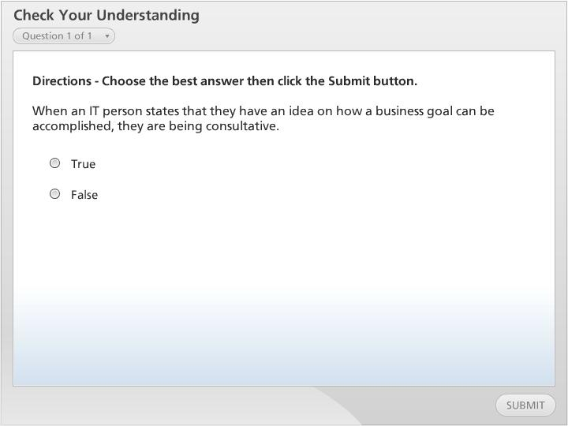



Check Your Understanding

Slide 6
Learning to Change Hats: The Four Roles of IT
Technical Wizard
Technical Assistant
Silent Influencers
Problem-Solving Partner
Notes:
In a workshop, there are four different consulting roles. All of them have intrinsic value when used at the right time.
First, there is the technical wizard who is considered the hero role. Wizards normally descend upon a problem and save the day.
Second is the technical assistant who can appear as the order taker. This role occurs when the business department knows exactly what it wants and IT is suppose to carry out the requirements.
Third, the silent influencers are not actually silent but informally influence their clients’ perspectives. For example, you can send clients articles on relevant topics or hold brown-bag lunch gatherings to explain technology concepts and how they relate to current business needs.
And lastly, the problem-solving partner offers the greatest opportunity for influence. In this role you and the client set out together to solve problems.
Next slide.

Slide 7
How to Become a Consultant
Business Acumen
Human Interaction Skills
Audience Profile
Listening
Empathy
Diplomacy
Avoiding Emotional Hooks
Educating Without Arrogance
Rapport Building
Notes:
Historically, technology expertise may have gotten your hired, but today, it’s business acumen that gets you invited to the table and its human interaction capabilities that will get you invited back.
Business acumen must be developed. The goal is to educate yourself and your staff on the client’s areas of expertise and the current business pressures they face. This will be accomplished by spending time with the client and observing daily activities. Understanding the business environment as well as the challenges, responsibilities, and pressures that clients face will assist IT in applying technology in the most effective ways possible.
Perhaps even more importantly, IT professionals need to strengthen their communication skills in order to interact with clients effectively. Some of the more important interaction skills IT leaders and their staffs need to develop include:
Audience Profile which is the process of learning and understanding the client;
The next skill is Listening which is the process of ensuring that you understand what you hear, absorbing it, and acting on it with any degree of accuracy;
Next is Empathy which is acknowledging and respecting a client’s point of view. Empathy does not mean that you agree with the situation or perspective;
Then there is Diplomacy. This is having the ability to be respectful even when you may not agree but you remain respectful;
Lastly, Avoiding Emotional Hooks insists that you resist the humanistic characteristics that render us all ineffective. These characteristics could be caused from lack of validation or people who constantly attack. The key is not to be consumed by the ill behavior of others.
Next slide.

Slide 8
The Difficulties of Becoming a Consultant
Develop a Good Rapport
Become a Strategic Business Partner
Notes:
The idea of developing consulting skills and learning to influence other people is simpler than the reality. It requires IT and business clients to learn about each other’s area of expertise, and it takes time for this to occur.
Having the desire to go the extra mile to understand the needs of a client may require an IT professional to be proactive. Listening to the needs and wants of the client is what really matters. Clients may even pay a premium price for a consultant that makes them feel comfortable. Building a good and positive rapport is imperative to the consultant’s success.
Clients do not normally hear consultants talk about the business, so when a consultant seems to focus on strategic business initiatives instead of technology, the client can sometimes be caught off guard. Over time, focusing on the client and becoming a strategic business partner will achieve greater success than not.
Next slide.

Slide 9
Summary
A Consultant’s Role
The Reasons to become More Consultative
Learning to Change Hats: The Four Roles of IT
How to Become a Consultant
The Difficulties of Becoming a Consultant
Notes:
We have reached the end of this lesson. Let’s take a look at what we’ve covered.
First, a consultant’s role where we reviewed characteristics that clients expect to see in a IT professional;
Next we covered, the reasons to become more consultative. One reason is that clients need you to bring value to the table. Another reason is that clients need consultants to focus more on business initiatives then the technology itself. Also, competition is brutal, therefore client focus must be increased.
Next, we discussed Learning to Change Hats: The Four Roles of IT. There are four different consulting roles. All of them have intrinsic value. The four roles are technical wizard, technical assistant, silent influencers, and problem-solving partner;
Then we reviewed, How to Become a Consultant which focused on the need for IT professionals to strengthen their communication skills in order to interact with clients effectively;
Lastly, we covered, The Difficulties of Becoming a Consultant. This topic focused on developing a good rapport and becoming a strategic business partner instead of just another consultant who is focused on technology.
This completes the lesson.

