Slide 1
Information Technology Capstone CIS498
Negotiating: Getting What You Want without Damaging the Relationship
Notes:
Welcome to Information Technology Capstone.
In this lesson we will discuss Negotiating: Getting What You Want without Damaging the Relationship.
Next slide.

Slide 2
Topics
Position versus Interest Negotiations
Three Key Factors/Three-Step Process
Applying the Key Factors to the Second Step: Information Exchange
The Final Step: Now Comes the Bargaining
Conclusion: Effective Negotiators are Made, Not Born
Notes:
The following topics will be covered in this lesson:
Position Versus Interest Negotiations;
Three Key Factors-Three-Step Process;
Applying the Key Factors to the Second Step: Information Exchange;
The Final Step: Now Comes the Bargaining; and
Conclusion: Effective Negotiators are Made, Not Born.
Next slide.

Slide 3
Position versus Interest Negotiations
Negotiations
Do not take a Position
Focus on Interests
Notes:
IT leaders are forced to negotiate with someone in the organization almost daily. Negotiations can be considered to be what happens when someone wants something from someone else. For IT leaders, the ability to negotiate with clients and other IT staff is important because securing the resources needed to perform tasks is connected to the leaders negotiation skills.
IT Leaders and staff must get past their aversion to negotiating and learn how to manage the conflict that is an inevitable part of daily life. The most important thing about learning to be a skilled negotiator is understanding that it is not something to avoid or downplay. Negotiating is a necessary component of two parties working out a difference of opinion.
In normal negotiation each person usually takes a position. Do not take a position as part of negotiating. This causes each person to be at extremes which usually causes maximum distance between positions. Negotiations focus on the position that was taken and movement can be slow or impossible.
An alternative method to negotiating is based upon interests. By focusing on interests the scope of potential negotiating possibilities increases. This technique will allow negotiators to discuss multiple options that have nothing to do with what their position is.
Next slide.

Slide 4
Three Key Factors/ Three-Step Process
Negotiating Process
Key Factors
Negotiating Elements
People and Relationships
Styles and Situations
Notes:
The three steps to the negotiating process are planning and preparation, the information exchange and bargaining. In each of these steps there are three key factors: negotiating elements; people and relationships; and styles and situations.
In order to be an effective negotiator you must assess your own positions, interests, and options, as well as those of the other party. These would be considered to be the negotiating elements. Everyone in every situation has multiple interests, and these need to be brought to the table so that you are not limited to the positions that both parties usually take. It is important to understand the needs and concerns of your clients so that you can anticipate reactions and understand what possible leverage the client may have.
In the people and relationships phase you need to assess the degree of trust you have with the people that you are negotiating with and work to repair any poor or non-existent relationships.
In the styles and situations phase you should assess your own negotiating style as well as the other party. Most people normally have multiple negotiating styles and it is best for you to determine which style you should be using and what style the other person is using.
Next slide.

Slide 5
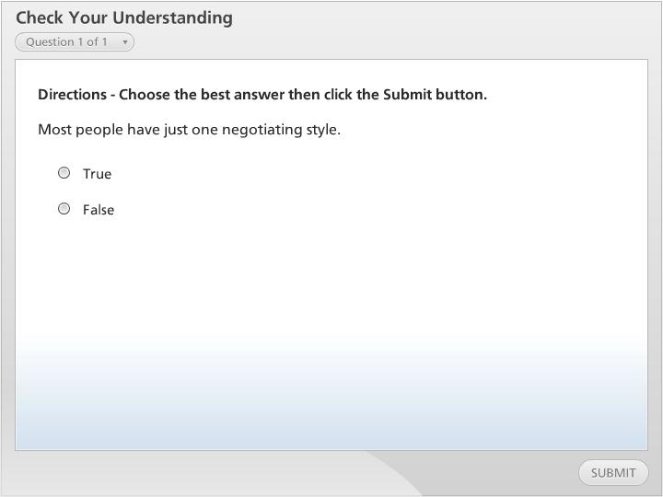



Check Your Understanding

Slide 6
Applying the Key Factors to the Second Step: Information Exchange
Meet Opposing Party
Test Your Assessments
Actively Listen
Notes:
In the information exchange phase, you actually meet face to face with the opposing party. This is not where bargaining starts but it is where your assessments get vetted.
This phase will allow you to determine if your assessments are correct or if they need adjustment. The second step is all about dialogue, relationship building, and establishing rapport. During this phase, it is immensely important that you actively listen.
Next slide.

Slide 7
The Final Step: Now Comes the Bargaining
Use Information From Previous Steps
Give and Take Phase
Listen to Your Conscience
Notes:
The last or final step is when the actual bargaining begins. In this step you use all the information you have gathered and vetted in the first and second steps. At this point, you should know your interests and options as well as the other party’s interests. This causes you to understand the bargaining situation that you are entering, the negotiating style you will use, and the style that you are going to encounter.
Bargaining is mainly made up of exchanges, concessions, and deal-making. This should be a give and take phase. It must be understood that different people with different negotiation styles have different views of what is fair and ethical. You can not separate the way you act in negotiations from the person you are in life. The best advice is to let you conscience be your guide.
Next slide.

Slide 8
Conclusion: Effective Negotiators are Made, Not Born
Learn Techniques
Negotiations is a Process
Find a Negotiation Style
Notes:
Negotiations are commonplace among IT people. In order to become more comfortable, you should learn about the techniques that experienced negotiators use and use them consistently.
Remember that negotiations do not start at the bargaining table. There is much that must be done prior to sitting down with the other party. All the preparations take a lot of time but well done properly, they are well worth the extra time.
You should decide what negotiating style works best for you then try to use it in several different situations.
Next slide.

Slide 9
Summary
Position versus Interest Negotiations
Three Key Factors; Three-Step Process
Applying the Key Factors to the Second Step: Information Exchange
The Final Step: Now Comes the Bargaining
Conclusion: Effective Negotiators are Made, Not Born
Notes:
We have reached the end of this lesson. Let’s take a look at what we’ve covered.
Position versus Interest Negotiations in which we discussed that IT leaders should not focus on a position but the interests that are associated with a position;
Next, we discussed the Three Key Factors; Three-Step Process with a focus on the three key factors: negotiating elements, people and relationships, and styles and situations;
Next, we covered, Applying the Key Factors to the Second Step: Information Exchange which covered the face-to-face meeting that takes place prior to the actual bargaining.
Then, we discussed, The Final Step: Now Comes the Bargaining. The focus here was on the use information from previous steps, acknowledging that this is the give and take phase, and lastly that the best guide is your conscience; and
The final Conclusion: Effective Negotiators are Made, Not Born. This topic put forth that IT professionals should learn a technique and use it often.
This completes the lesson.

