Slide 1
Information Technology Capstone CIS498
Training and Education
Notes:
Welcome to Information Technology Capstone.
In this lesson we will discuss Training and Education.
Next slide.

Slide 2
Topics
Training for Modern Project Management
Need for Business Education
International Institute For Learning
Identifying the Need for Training
Selecting Students
Fundamentals of Project Management Education
Designing Courses and Conducting Training
Measuring Return on Investment
Project Management is Now a Profession
Competency Models
Notes:
The following topics will be covered in this lesson:
Training for Modern Project Management;
Need for Business Education;
International Institute For Learning;
Identifying the Need for Training;
Selecting Students;
Fundamentals of Project Management Education;
Designing Courses and Conducting Training;
Measuring Return on Investment;
Project Management is Now a Profession;
And Competency Models.
Next slide.

Slide 3
Topics, continued
Harris Corporation
Alcatel-Lucent: Recognizing the Value of a PMP
Integrated Project Management at Satyam
Hewlett-Packard; and
Exel
Notes:
Additionally, these following topics will be covered in this lesson:
Harris Corporation;
Alcatel-Lucent: Recognizing the Value of a PMP;
Integrated Project Management at Satyam;
Hewlett-Packard; and
Exel.
Next slide.

Slide 4
Training for Modern Project Management
Basic Project Management
Advanced Project Management
Notes:
Project management training courses, from the 1950s and throughout the 10960s, concentrated on the advantages and disadvantages of various organizational forms. It was realized that project management skills based in trust, teamwork, cooperation, and communication can solve the worst structural problems.
Two basic programs exist:
Basic project management, which stresses behavioral topics such as multiple reporting relationships, time management, leadership, conflict resolution, negotiation, team building, motivation
and basic management areas; and
Advanced project management, which stresses scheduling techniques and software packages used for planning and controlling projects.
Next slide.

Slide 5
Need for Business Education
Accountability
Managing Business
Business Principles
Notes:
Most project managers today have an understanding of technology rather than a command of technology. This results in a shared accountability association between the project manager and
all affected line managers. Due to this accountability, managers are becoming certified project managers.
Project managers are treated as though they are managing a part of the business instead of just the project. Project managers are expected to make sound decisions concerning the business
and project. Project managers must understand business principles which underscores the need for business education.
Next slide.

Slide 6
International Institute For Learning
Evolutionary Years
Revolutionary years
Crystal Ball
Notes:
During the Evolutionary years which was during the 1980s, training courses were geared to advancing the project manager’s skills. The focus of the training was on basic concepts.
In recent years, many companies have realized the business importance of managing projects more effectively and analyzing the ways in which projects meet overall corporate goals. This period is know as the revolutionary years.
If one could look into a crystal ball, some of the possible trends that are forthcoming will included:
One. A company’s ability to manage many, many projects which will affect a company’s competitive position in the marketplace;
Two. There will be a blending of project management methodologies with other proven business strategies;
Three. Strategic planning will become a way of life for project managers;
And five. Project management will focus on knowledge and best practices.
This list is not exhaustive but is a good start.
Next slide.

Slide 7
Identifying the Need for Training
Build Project Management Knowledge
Benefit of the Bottom Line
Notes:
The critical factors surrounding identifying the need for training are:
First, that training is one of the fastest ways to build project management knowledge in a company; and
Second, that training should be conducted for the benefit of the corporate bottom line through enhanced efficiency and effectiveness.
Many companies are realizing that benefits of project management are greatly accelerated through proper training.
Next slide.

Slide 8
Selecting Students
Thorough Understanding
Team Effort
Lay the Foundation
Notes:
A thorough understanding of project management skills and techniques is needed throughout the organization if project management is to be successful.
Project management is a team effort, not an individual responsibility.
Laying a good foundation is important. Starting with top executives and working down is a good approach.
Next slide.

Slide 9
Fundamentals of Project Management Education
Training and Education
Delivery and Evaluation
Notes:
Today, project management is delivered in many ways. University courses, university seminars, distance learning and in-house seminars are just a few approaches that company take to train and education employees.
In addition, the delivery and evaluation of concepts may vary. Typical delivery systems include: lectures, discussions, exams and case studies.
Next slide.

Slide 10
Designing Courses and Conducting Training
On-the-Job Training is Less Effective
Internal or Public
Notes:
Many companies have realized that on-the-job training may be less effective than formal training. This has come to light because people normally make considerable mistakes while trying to perform project management activities. It makes more since to train people to perform activities properly.
When designing courses one should consider whether to have the course internally or use public training from an outside vendor. Sometimes having a vendor design a custom course is optimal but not in all circumstances.
If the training course is internal, one must be sure to choose the right trainers and speakers. Choosing people with solid backgrounds and credentials is crucial to the training experience.
Next slide.

Slide 11
Measuring Return on Investment
Continuous Return
Include All Costs
Outside Consultants
Notes:
It is important to remember that training should not be performed unless there is a continuous return on dollars for the company.
The cost of having employees away from normal responsibilities must be considered. Just including the cost of the lecturer is not a good practice. There are many factors that should be considered.
Some companies use outside consultants to determine the return on investment. Consultants base their evaluations on personal interviews, on-the-job assessments, and written surveys.
Next slide.

Slide 12
Project Management is Now a Profession
Once Considered Part-time Occupation
Creation of Job Descriptions
Notes:
In the past, project management was viewed as a part-time occupation. Most training was designed for one’s primary job because project management was considered an ancillary activity.
However, in recent years, project management and program management have become recognized professions.
Job descriptions have been developed for both, project managers and program managers.
This has allowed for the development of training materials that are associated with the job descriptions.
Next slide.

Slide 13
Competency Models
Training Programs Support Model
Three Major Areas
Notes:
In recent years, core competency models have been used to clearly depict the skill levels needed to be effective as a project manager.
Training programs have been instituted to support the core competency models.
One company, Lilly Research laboratories, has classified the project management competencies under three major areas:
One: Scientific Expertise, Two: Technical Expertise, and Three: Process Skills.
Each area focuses on individual abilities of the project manager.
Next slide.

Slide 14
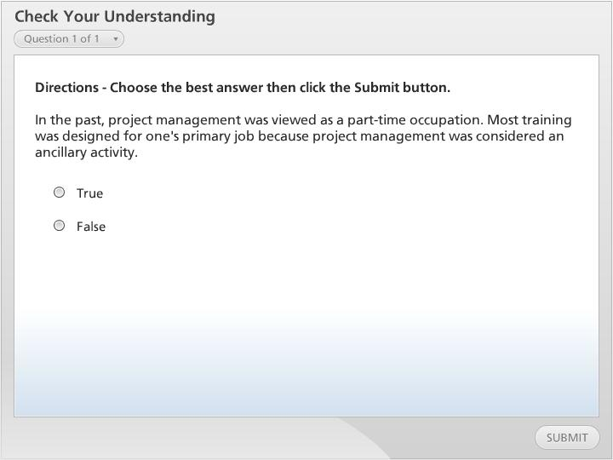



Check Your Understanding

Slide 15
Harris Corporation
Adhere to All Procedure and Standards
Continuous Improvement
Basic Philosophy
Notes:
The amount of information that is covered in a project management training course can be endless. Most often, students wonder if the information and procedures are necessary.
For aerospace and defense contractors, it is important to adhere to all procedures and standards.
Harris Corporation undergoes continuous improvement in project management which allows them to out perform many competitors. They have a history of success in project management.
Harris Corporation has adopted a basic philosophy for project management which is used throughout the organization. These principles and concepts allow the company to be a leader in project management.
Next slide.

Slide 16
Alcatel-Lucent: Recognizing the Value of a PMP
Capitalize on Collective Knowledge
Return on Investment
Notes:
Too often, companies fail to capitalize on the collective knowledge that certified project managers bring to an organization.
The Project Management Professional credential should not be treated as something to be placed on a business card, or included in a proposal as part of competitive bidding efforts.
Alcatel-Lucent has recognized the value that a PMP can make to the company. These project managers can provide a huge return on investment. The return on investment can be seen in the form of mentorship for project managers who aspire to become certified or wish to recertify their credentials.
Next slide.

Slide 17
Integrated Project Management at Satyam
Integration
Project Management Competency Development Framework
Notes:
Integration is a process of combining various elements and also includes management and control principles as well to assemble all of the components.
Satyam uses a Project Management Competency Development Framework that focuses on making each role holder at a certain level effective.
Then, the next skills for the next role are realized and achieved. This process was aligned with the Project Management Institute’s Project Manager Competency Development.
With this background, the Integrated Project Management practice was developed for senior project leads. This allows them to be able to take up the role of project manager.
Next slide.

Slide 18
Hewlett-Packard
Project Management Development
Project Management Professional Certification
Project Management Institute Support
Notes:
The quality of project management training and education that is given to company employees is one of the most important factors in achieving success and excellence in project management.
Hewlett-Packard has committed to the program and project management development. Three areas are key:
First, Project Management Development consists of well over one hundred courses. The courses cover project leadership, management, communication, risk management, contracting, managing business performance, scheduling and cost control, and quality.
Second, Project Management Professional Certification is very important at Hewlett-Packard. HP Services has over five thousand individuals who have earned Project Management Professional certification.
Third, HP actively supports the Project Management Institute. The Institute has more than two hundred sixty-five thousand members. They set the standards for project management.
Next slide.

Slide 19
Exel
Training and Education Accelerates Maturity
Theoretical Training Aids Process
All Employees are Aware of Training
Notes:
Training and education can speed up the project management maturity process.
This may occur if project management theoretical training is accompanied by training on the corporate project management methodology.
Exel does not currently require project management training for all employees; however, all sections are aware of the PM methodology and the training provided.
The company has trained over seven thousand associates in the PM methodology.
The PM training curriculum can also lead to certification training.
Next slide.

Slide 20
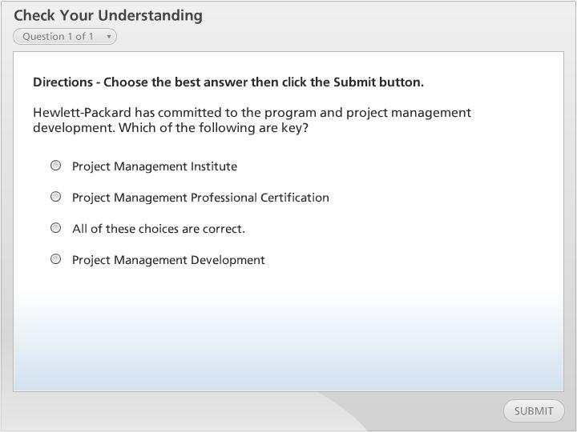
Check Your Understanding

Slide 21
Summary
Training for Modern Project Management
Need for Business Education
International Institute For Learning
Identifying the Need for Training
Selecting Students
Fundamentals of Project Management Education
Designing Courses and Conducting Training
Measuring Return on Investment
Project Management is Now a Profession
Competency Models
Notes:
We have now reached the end of this lesson. Let’s take a look at what we’ve covered:
First we covered, Training for Modern Project Management. This topic discussed how many companies have realized the business importance of managing projects more effectively and analyzing the ways in which projects meet overall corporate goals ;
Next, Need for Business Education was covered. This topic illustrated that project managers have an understanding of technology but not a command of technology. This issue is what drives the shared accountability between the project manager and affected line managers;
Next, International Institute For Learning was discussed. This topic focused on the evolutionary years, revolutionary years and a crystal ball view of training in the future;
Next, we examined Identifying the Need for Training. This topic highlighted the importance of building project management knowledge and how project management activities benefit the bottom line;
Next, we discussed Selecting Students for project management training. The main points were that a thorough understanding of project management within the organization is important and that project management is a team effort that should be adhered to by all employees;
Fundamentals of Project Management Education noted training and education, and delivery and evaluation of training;
Next, Designing Courses and Conducting Training was discussed. This topic covered how on-the-job training is less effective for project management. Also, when deciding upon training options, a company must determine whether to have training internally or use public training services;
Next, Measuring Return on Investment was covered. This topic covered the need to quantify the return that is received from project management training;
Next, the topic: Project Management is Now a Profession was covered. This topic underscored the premise that project management is a profession and that job descriptions have been created;
Next, Competency Models was discussed. This topic covered how core competency models have had training programs instituted for support;
Next slide.

Slide 22
Summary, continued
Harris Corporation
Alcatel-Lucent: Recognizing the Value of a PMP
Integrated Project Management at Satyam
Hewlett-Packard
Exel
Notes:
Additionally, the following topics were covered in this lesson:
It was noted that Harris Corporation, an aerospace and defense contractor, finds it important to adhere to all procedures and standards. These actions make them a high-functioning project management oriented organization;
Next, Alcatel-Lucent: Recognizing the Value of a PMP focused on how the organization has recognized the value that a PMP can make to the company. Contributions of project managers to the bottom line is important to the company;
Next, Integrated Project Management at Satyam was discussed. This topic noted the importance of integrated roles within project management training;
Next, Hewlett-Packard was discussed in regard to Project Management Development that exists at the organization, the high regard for PMP Certification, and the support of the Project Management Institute;
Finally, we covered, Exel. This organization is inclusive when it comes to project management training. At the very least, all employees are aware of the training opportunities.
This concludes the lesson.

