Slide 1
Information Technology Capstone CIS498
Informal Project Management
Notes:
Welcome to Information Technology Capstone.
In this lesson we will discuss Informal Project Management.
Next slide.

Slide 2
Topics
Informal versus Formal Project Management
Trust
Communication
Cooperation
Teamwork
Color-coded Status Reporting
Informal Project Management at Work
Notes:
The following topics will be covered in this lesson:
Informal versus Formal Project Management;
Trust;
Communication;
Cooperation;
Teamwork;
Color-coded Status Reporting; and
Informal Project Management at Work;
Next slide.

Slide 3
Informal versus Formal Project Management
Formal is Expensive
Informal is Based on Checklists
Concurrent Engineering
Four Elements of Organizational Culture
Notes:
Formal project management is an expensive method for controlling a project. It requires volumes of paperwork and normally keeps the project manager very busy, which takes away from the
Actual management of the project. Informal project management is built more around checklists. Policies and procedures represent formality. Checklists represent informality.
Real cost savings materialized in the early 1900s with the growth of concurrent engineering. This process shortened product development times by taking activities that had been done in series
And performing them in parallel. The move from formal to informal demands required a change in organizational culture. The four basic elements of an organizational culture are:
One. Trust;
Two. Communication;
Three. Cooperation; and
Fourth. Teamwork.
Next slide.

Slide 4
Trust
Critical to Project Execution
Reduces Need for Paperwork
Benefits Accrue
Notes:
Trust is a critical part of executing a project. Trust is the key to the successful implementation of informal project management. Without trust, projects would become formal and the
Mountains of paperwork that was designed to keep track of the project would once again be required. When the relationship between a customer and a contractor is based on trust, numerous
Benefits accrue to both parties. Some benefits of trust may include: Long-term contracts, repeat business, minimal documentation and sponsorship at middle-management levels.
Next slide.

Slide 5
Communication
Misconceptions
Project Managers Communicate
Informally
Verbally
Notes:
Within an organization there are many misconceptions regarding how effective communication is. For instance, employees may claim that communication is poor, while senior managers
Describe it as fine. The difference is usually related to the fact that management is usually involved in most activities that relate to the transfer of information. These activities could be
Meetings, emails, or even verbal or written updates from superiors or subordinates. Much of the information never makes it way down to lower level employees.
The point is that communication is not perceived the same throughout an organization.
Most project managers prefer to communicate verbally and informally. Good project management methodologies promote not only informal project management but also effective
Communication laterally as well as vertically. Most organizations believe that there is a positive link between good project management methodology and effective communication.
Next slide.

Slide 6
Cooperation
Benefit of All
Members Know What is Right
Comfort Level Affects Team
Notes:
Cooperation is the willingness of individuals to work with others for the benefit of all. For companies that are successful in project management, cooperation is the norm, not the exception.
Members of a team normally know what the right thing to do is, but cooperation forces them to do it. The level of cooperation may hinge upon how well a group knows each other so project
Teams that have a long history may outperform newly established teams. In short, the comfort level of team members will affect the execution of the project.
Next slide.

Slide 7
Teamwork
Spirit of Cooperation
Characteristics
Sharing of ideas
Trust
Commitment
Sharing of Information
Openness and Honesty
Notes:
Teamwork is the work performed by people acting together with a spirit of cooperation under the limits of coordination.
In excellent companies, teamwork has the following characteristics:
One. Employees and managers share ideas;
Two. Employees and managers trust each other;
Three. Employees and managers are committed to the work and promises made;
Four: Employees and managers share information freely;
And, five. Employees and managers are consistently open and honest with each other.
Next slide.

Slide 8
Color-coded Status Reporting
Encourages Informal Project Management
Indicates Status
Notes:
Color-coded status reporting has grown significantly over the years. Color coded reports encourage informal project management. Color coding can draw attention to problems and show that a project is on track.
Colors can be used to indicate:
One. Status has not been addressed;
Two. Status is addressed, but no problems exist;
Three. Project is on course; or
Four. A problem definitely exists and is critical.
This is not a finite list because color-coding may be used for an array of situations related to project progression.
Next slide.

Slide 9
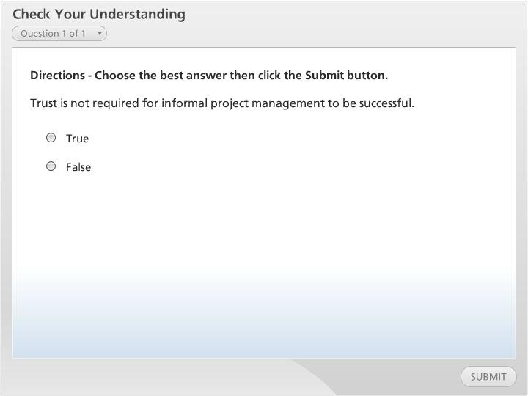



Check Your Understanding

Slide 10
Informal Project Management at Work
Polk Lighting
Boeing Aerospace
Notes:
Informal project management was used at Polk Lighting and at Boeing Aerospace.
Both companies have found that using informal project management has enabled them to thrive.
Polk Lighting had revenues of thirty-five million annually. The president of the company used informal project management, initially, to keep a tight rein on research and development. When a new executive was hired for research and development, the informal project management methodology remained, in spite of company sales doubling.
Boeing Aerospace worked with Thiokol Corporation to develop a propulsion system for a new short range attack missile. Even though Boeing was a very large company and Thiokol is much smaller, they solidified their relationship on trust and cooperation. Informal project management was the used throughout the project.
These two examples illustrate that trust is a major part of informal project management. In addition, the size of the project does not seem to matter as long as all parties are open and honest.
Next slide.

Slide 11
Summary
Informal versus Formal Project Management
Trust
Communication
Cooperation
Teamwork
Color-coded Status Reporting
Informal Project Management at Work
Notes:
We have now reached the end of this lesson. Let’s take a look at what we’ve covered:
First we covered, Informal versus Formal Project Management. The trend has moved toward informal project management which encourages trust, openness and honesty;
Next, the topic of Trust highlighted the fact that Trust is the key to the successful implementation of informal project management;
Next, Communication covered the issue of understanding that there are misconceptions regarding the quality and effectiveness of communication within an organization;
Next, the topic of Cooperation put forth that successful companies make cooperation the norm;
Next, the topic of Teamwork is covered by given characteristics of teamwork within excellent companies;
Next, Color-coded Status Reporting was covered. This showed that color-coding helps denote project progression; and
Finally, we covered, Informal Project Management at Work. It was illustrated that trust is a major part of informal project management;
This concludes this lesson.

