Slide 1
Chapter 10: Introduction to Inheritance

Slide 2
Objectives
Learn about the concept of inheritance
Extend classes
Override superclass methods
Call constructors during inheritance
Access superclass methods
Employ information hiding
Learn which methods you cannot override
Java Programming, Seventh Edition

Slide 3
Learning About the Concept of Inheritance
Inheritance
  A mechanism that enables one class to inherit both the behavior and the attributes of another class
  Apply your knowledge of a general category to more specific objects
Java Programming, Seventh Edition

Slide 4
Diagramming Inheritance Using the UML
Unified Modeling Language (UML)
  Consists of many types of diagrams
Class diagram
  A visual tool
  Provides an overview of a class
Java Programming, Seventh Edition

Slide 5
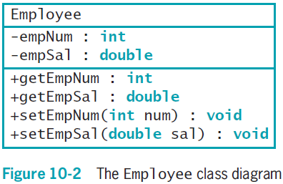
Diagramming Inheritance Using the UML (cont’d.)
Java Programming, Seventh Edition

Slide 6
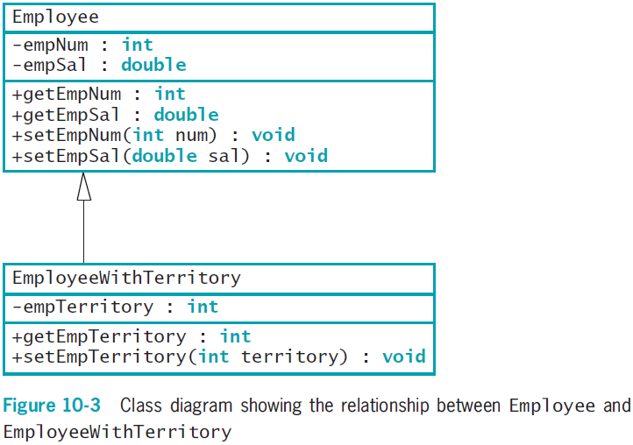
Diagramming Inheritance Using the UML (cont’d.)
Java Programming, Seventh Edition

Slide 7
Diagramming Inheritance Using the UML (cont’d.)
Use inheritance to create a derived class
  Save time
  Reduce errors
  Reduce the amount of new learning required to use a new class
Java Programming, Seventh Edition

Slide 8
Inheritance Terminology
Base class
  Used as a basis for inheritance
  Also called:
    Superclass
    Parent class
Java Programming, Seventh Edition

Slide 9
Inheritance Terminology (cont’d.)
Derived class
  Inherits from a base class
  Always “is a” case or an example of a more general base class
  Also called:
    Subclass
    Child class
Java Programming, Seventh Edition

Slide 10
Extending Classes
Keyword extends
  Used to achieve inheritance in Java
  Example:
    public class EmployeeWithTerritory extends Employee
Inheritance is a one-way proposition
  A child inherits from a parent, not the other way around
Subclasses are more specific
instanceof operator
Java Programming, Seventh Edition

Slide 11
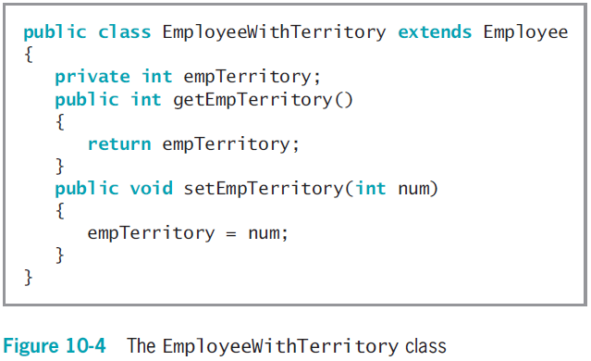
Extending Classes (cont’d.)
Java Programming, Seventh Edition

Slide 12
Overriding Superclass Methods
Create a subclass by extending an existing class
  A subclass contains data and methods defined in the original superclass
  Sometimes superclass data fields and methods are not entirely appropriate for subclass objects
Polymorphism
  Using the same method name to indicate different implementations
Java Programming, Seventh Edition

Slide 13
Overriding Superclass Methods (cont’d.)
Override the method in the parent class
  Create a method in a child class that has the same name and parameter list as a method in its parent class
Subtype polymorphism
  The ability of one method name to work appropriately for different subclass objects of the same parent class
Java Programming, Seventh Edition

Slide 14
Calling Constructors During Inheritance
When you instantiate an object that is a member of a subclass, you call at least two constructors:
  The constructor for the base class
  The constructor for the extended class
The superclass constructor must execute first
When the superclass contains a default constructor, the execution of the superclass constructor is transparent
Java Programming, Seventh Edition

Slide 15
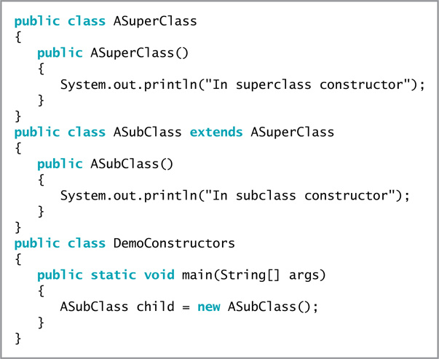
Calling Constructors During Inheritance (cont’d.)
Figure 10-8 Three classes that demonstrate constructor calling when a subclass object is instantiated
Java Programming, Seventh Edition

Slide 16
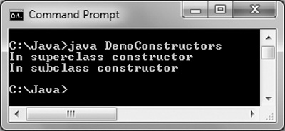
Calling Constructors During Inheritance (cont’d.)
Figure 10-9 Output of the DemoConstructors application
Java Programming, Seventh Edition

Slide 17
Using Superclass Constructors
That Require Arguments
When you write your own constructor, you replace the automatically supplied version
When extending a superclass with constructors that require arguments, the subclass must provide the superclass constructor with the arguments it needs
Java Programming, Seventh Edition

Slide 18
Using Superclass Constructors
That Require Arguments (cont’d.)
When a superclass has a default constructor, you can create a subclass with or without its own constructor
When a superclass contains only constructors that require arguments, you must include at least one constructor for each subclass you create
  The first statement within each constructor must call one of the superclass constructors
Java Programming, Seventh Edition

Slide 19
Using Superclass Constructors
That Require Arguments (cont’d.)
Call the superclass constructor
  super(list of arguments);
Keyword super
  Always refers to the superclass
Java Programming, Seventh Edition

Slide 20
Accessing Superclass Methods
Use the overridden superclass method within a subclass
  Use the keyword super to access the parent class method
Java Programming, Seventh Edition

Slide 21
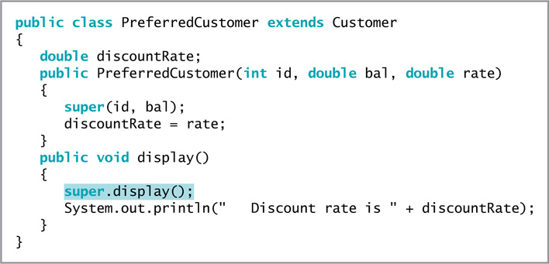
Accessing Superclass Methods (cont’d.)
Figure 10-13 The PreferredCustomer class
Java Programming, Seventh Edition

Slide 22
Comparing this and super
Think of the keyword this as the opposite of super within a subclass
When a parent class contains a method that is not overridden, the child can use the method name with super or this, or alone
Java Programming, Seventh Edition

Slide 23
Employing Information Hiding
Within the Student class:
  The keyword private precedes each data field
  The keyword public precedes each method
Information hiding
  The concept of keeping data private
  Data can be altered only by methods you choose and only in ways that you can control
Java Programming, Seventh Edition

Slide 24
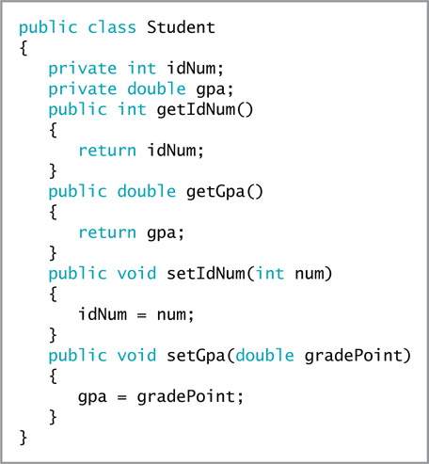
Employing Information Hiding (cont’d.)
Figure 10-16 The Student class
Java Programming, Seventh Edition

Slide 25
Employing Information Hiding (cont’d.)
When a class serves as a superclass, subclasses inherit all data and methods of the superclass
  Except private members of the parent class are not accessible within a child class’s methods
Java Programming, Seventh Edition

Slide 26
Employing Information Hiding (cont’d.)
Keyword protected
  Provides an intermediate level of security between public and private access
  Can be used within its own class or in any classes extended from that class
  Cannot be used by “outside” classes
Java Programming, Seventh Edition

Slide 27
Methods You Cannot Override
static methods
final methods
Methods within final classes
Java Programming, Seventh Edition

Slide 28
A Subclass Cannot Override static
Methods in Its Superclass
A subclass cannot override methods declared static in the superclass
A subclass can hide a static method in the superclass by declaring a static method with the same signature as the static method in the superclass
  Then call the new static method from within the subclass or in another class by using a subclass object
  Within the static method of a subclass, you cannot access the parent method using the super object
Java Programming, Seventh Edition

Slide 29
A Subclass Cannot Override static
Methods in Its Superclass (cont’d.)
Although a child class cannot inherit its parent’s static methods, it can access its parent’s static methods in the same way any other class can
Java Programming, Seventh Edition

Slide 30
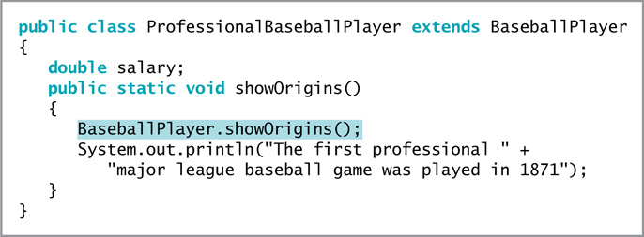
A Subclass Cannot Override static
Methods in Its Superclass (cont’d.)
Figure 10-22 The ProfessionalBaseballPlayer class
Java Programming, Seventh Edition

Slide 31
A Subclass Cannot Override final
Methods in Its Superclass
A subclass cannot override methods declared final in the superclass
final modifier
  Does not allow the method to be overridden
Virtual method calls
  Default in Java
  The method used is determined when the program runs
  The type of object used might not be known until the method executes
Java Programming, Seventh Edition

Slide 32
A Subclass Cannot Override final
Methods in Its Superclass (cont’d.)
Advantages to making the method final:
  The compiler knows there is only one version of the method
  The compiler knows which method version will be used
  It can optimize a program’s performance by removing calls to final methods
    Replaces them with expanded code of their definitions at each method call location
    Called inlining the code
Java Programming, Seventh Edition

Slide 33
A Subclass Cannot Override Methods in a final Superclass
When a class is declared final:
  All of its methods are final regardless of which access modifier precedes the method name
  It cannot be a parent class
Java Programming, Seventh Edition

Slide 34
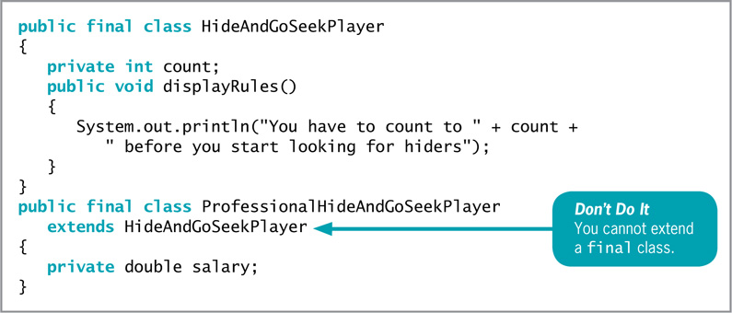
A Subclass Cannot Override Methods in a final Superclass (cont’d.)
Figure 10-28 The HideAndGoSeekPlayer and ProfessionalHideAndGoSeekPlayer classes
Java Programming, Seventh Edition

Slide 35
You Do It
Demonstrating Inheritance
Overriding a Superclass Method
Understanding the Role of Constructors in Inheritance
Java Programming, Seventh Edition

Slide 36
Don’t Do It
Don’t capitalize the o in the instanceof operator
Don’t try to directly access private superclass members from a subclass
Don’t forget to call a superclass constructor from within a subclass constructor if the superclass does not contain a default constructor
Don’t try to override a final method in an extended class
Don’t try to extend a final class
Java Programming, Seventh Edition

Slide 37
Summary
Inheritance
  A mechanism that enables one class to inherit both the behavior and the attributes of another class
Keyword extends
  Used to achieve inheritance in Java
Polymorphism
  The act of using the same method name to indicate different implementations
Java Programming, Seventh Edition

Slide 38
Summary (cont’d.)
Use a superclass method within a subclass
  Use the keyword super to access it
Information hiding
  The concept of keeping data private
Keyword protected
  Provides an intermediate level of security between public and private access
A subclass cannot override methods that are:
  Declared static in a superclass
  Declared final or declared within a final class
Java Programming, Seventh Edition

