Slide 1
Chapter 14: Introduction to Swing Components

Slide 2
Objectives
Understand Swing components
Use the JFrame class
Use the JLabel class
Use a layout manager
Extend the JFrame class
Java Programming, Seventh Edition

Slide 3
Objectives (cont’d.)
Add JTextFields, JButtons, and tool tips to a JFrame
Learn about event-driven programming
Understand Swing event listeners
Use the JCheckBox, ButtonGroup, and JComboBox classes
Java Programming, Seventh Edition

Slide 4
Understanding Swing Components
UI components
  Buttons, text fields, and other components with which the user can interact
Swing components
  Descendants of JComponent
  Inherit from the java.awt.Container class
To take advantage of the Swing UI components and their methods, insert import javax.swing.*; at the beginning of Java program files
Java Programming, Seventh Edition

Slide 5
Understanding Swing Components (cont’d.)
Container
  A type of component that holds other components
  Can treat a group as a single entity
  Defined in the Container class
  Often takes the form of a window that you can:
    Drag
    Resize
    Minimize
    Restore
    Close
Java Programming, Seventh Edition

Slide 6
Understanding Swing Components (cont’d.)
Window class
  A child of Container
  Does not have title bars or borders
  Is rarely used
  Instead, use the following subclasses:
    Frame
    JFrame
Java Programming, Seventh Edition

Slide 7
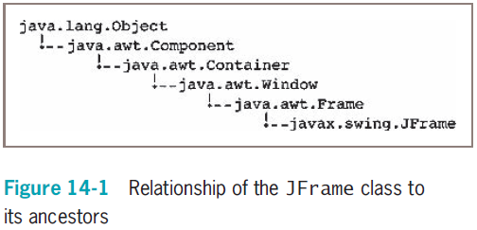
Using the JFrame Class
Java Programming, Seventh Edition

Slide 8
Using the JFrame Class (cont’d.)
Create a JFrame so you can place other objects within it for display
The JFrame class has four constructors:
  JFrame()
  JFrame(String title)
  JFrame(GraphicsConfiguration gc)
  JFrame(String title, GraphicsConfiguration gc)
Java Programming, Seventh Edition

Slide 9
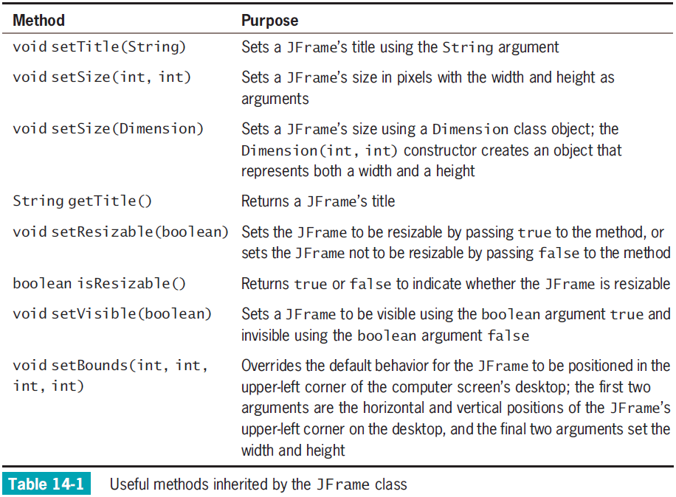
Java Programming, Seventh Edition

Slide 10
Using the JFrame Class (cont’d.)
Create JFrame
  JFrame firstFrame = new JFrame("Hello");
Set size and title
  firstFrame.setSize(200, 100);
  firstFrame.setTitle("My frame");
Java Programming, Seventh Edition

Slide 11
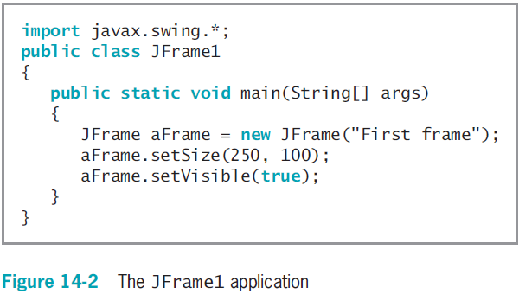
Using the JFrame Class (cont’d.)
Java Programming, Seventh Edition

Slide 12
Using the JFrame Class (cont’d.)
To close JFrame, click the Close button
  JFrame becomes hidden and the application keeps running
    Default behavior
  To change this behavior, use the setDefaultCloseOperation() method
Java Programming, Seventh Edition

Slide 13
Customizing a JFrame’s
Appearance
Window decorations
  Icon and buttons
Look and feel
  The default appearance and behavior of a user interface
  The setDefaultLookAndFeelDecorated() method sets JFrame’s look and feel
Java Programming, Seventh Edition

Slide 14
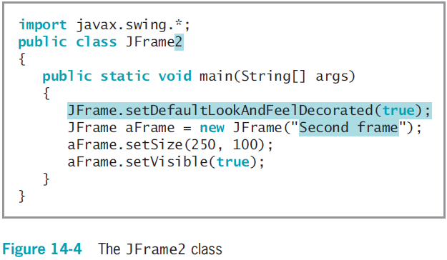
Customizing a JFrame’s
Appearance (cont’d.)
Java Programming, Seventh Edition

Slide 15
Using the JLabel Class
JLabel
  Holds text you can display
  Available constructors
  Methods:
    add() method
    remove() method
    setText() method
    getText() method
Java Programming, Seventh Edition

Slide 16
Changing a JLabel’s Font
Font class
  Creates an object that holds typeface and size information
  To construct a Font object, you need three arguments:
    Typeface
    Style
    Point size
setFont() method
  Requires a Font object argument
Java Programming, Seventh Edition

Slide 17
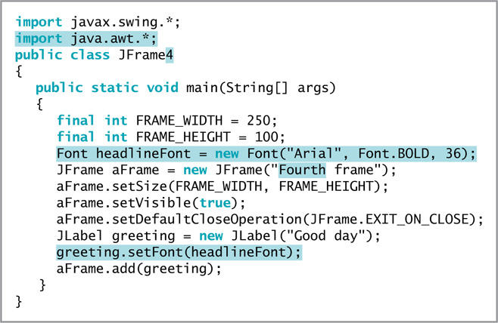
Changing a JLabel’s Font (cont’d.)
Figure 14-10 The JFrame4 program
Java Programming, Seventh Edition

Slide 18
Using a Layout Manager
Layout manager
  A class that controls component positioning
BorderLayout
  The normal (default) behavior of a JFrame
  Divides a container into regions
Flow layout manager
  Places components in a row
Java Programming, Seventh Edition

Slide 19
Extending the JFrame Class
When you create a class that descends from the JFrame class:
  You can set the JFrame’s properties within your object’s constructor
  Then, when the JFrame child object is created, it is automatically endowed with the features you specified
Create a child class using the keyword extends
Call the parent class’s constructor method using the keyword super
Java Programming, Seventh Edition

Slide 20
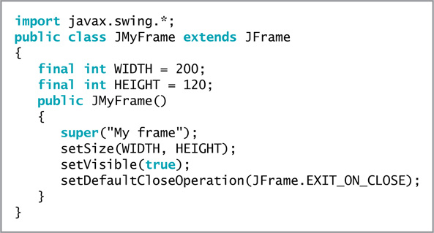
Extending the JFrame Class (cont’d.)
Figure 14-16 The JMyFrame Class
Java Programming, Seventh Edition

Slide 21
Adding JTextFields, JButtons, and Tool Tips to a JFrame
In addition to including JLabel objects, JFrames often contain other window features, such as JTextFields, JButtons, and tool tips
Java Programming, Seventh Edition

Slide 22
Adding JTextFields
JTextField
  A component into which a user can type a single line of text data
  Has several constructors
  Methods:
    setText() method
    getText() method
    setEditable() method
Java Programming, Seventh Edition

Slide 23
Adding JButtons
JButton
  Click with a mouse to make a selection
  Has five constructors
  Methods:
    setText()
    getText()
add() method
  Adds a JButton to a JFrame
Java Programming, Seventh Edition

Slide 24
Adding JButtons (cont’d.)
When clicked, no resulting actions occur
  The code has not yet been written to handle user-initiated events
Java Programming, Seventh Edition

Slide 25
Using Tool Tips
Tool tips
  Popup windows
  Help a user understand the purpose of components in an application
  Appear when a user hovers the mouse pointer over the component
setToolTipText() method
  Set a tool tip for a Component
Java Programming, Seventh Edition

Slide 26
Learning About Event-Driven Programming
Event
  Occurs when a user takes action on a component, such as clicking the mouse on a JButton object
Event-driven program
  A program in which the user might initiate any number of events in any order
Source
  The component on which an event is generated
Listener
  The object that is interested in an event
Java Programming, Seventh Edition

Slide 27
Learning About Event-Driven Programming (cont’d.)
To respond to user events within any class you create, you must:
  Prepare your class to accept event messages
  Tell your class to expect events to happen
  Tell your class how to respond to events
Java Programming, Seventh Edition

Slide 28
Preparing Your Class to Accept Event Messages
Import the java.awt.event package
Add the phrase implements ActionListener to the class header
Implementing ActionListener provides you with standard event method specifications that allow your listener to work with ActionEvents
Java Programming, Seventh Edition

Slide 29
Telling Your Class to Expect Events to Happen
addActionListener() method
aButton.addActionListener(this);
  Causes any ActionEvent messages (button clicks) that come from aButton to be sent to “this current object”
Java Programming, Seventh Edition

Slide 30
Telling Your Class How to Respond to Events
The ActionListener interface contains the actionPerformed(ActionEvent e) method specification
  The body of the method contains any statements that you want to execute when the action occurs
When more than one component is added and registered to a JFrame, it might be necessary to determine which component was used
  Find the source of the event using getSource();
Java Programming, Seventh Edition

Slide 31
Using the setEnabled() Method
setEnabled() method
  Makes a component unavailable, and then makes it available again in turn
  Use after a specific series of actions has taken place
Java Programming, Seventh Edition

Slide 32
Understanding Swing
Event Listeners
Classes that respond to user-initiated events must implement an interface that deals with events called event listeners
Many types of listeners exist in Java
  Each can handle a specific event type
A class can implement as many event listeners as it needs
An event occurs every time the user types a character or clicks the mouse button
Java Programming, Seventh Edition

Slide 33
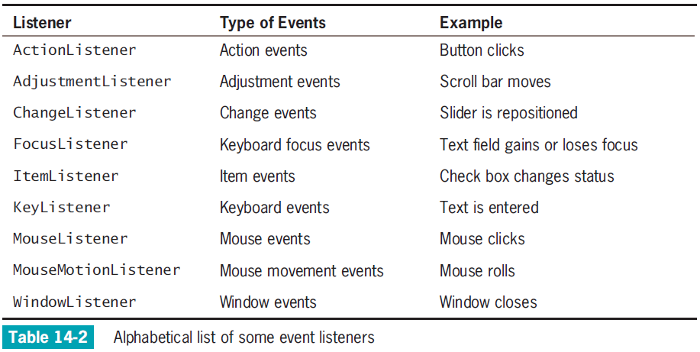
Understanding Swing
Event Listeners (cont’d.)
Java Programming, Seventh Edition

Slide 34
Understanding Swing
Event Listeners (cont’d.)
Create relationships between Swing components and classes that react to users’ manipulations of them
JCheckBox responds to the user’s clicks
  addItemListener() method
  Register JCheckBox as a type of object that can create an ItemEvent
  Format:
  theSourceOfTheEvent.addListenerMethod (theClassThatShouldRespond);
Java Programming, Seventh Edition

Slide 35
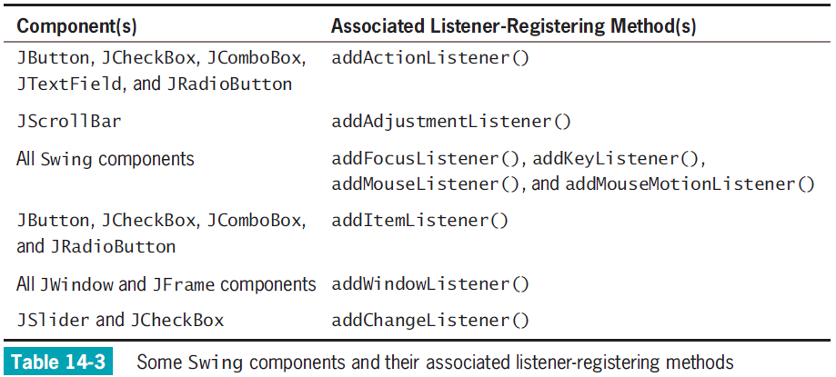
Understanding Swing
Event Listeners (cont’d.)
Java Programming, Seventh Edition

Slide 36
Understanding Swing
Event Listeners (cont’d.)
The class of the object that responds to an event contains a method that accepts the event object created by the user’s action
  Specific methods react to specific event types
If you declare a class that handles an event, create a class to do one of the following:
  Implement a listener interface
  Extend a class that implements a listener interface
Java Programming, Seventh Edition

Slide 37
Understanding Swing
Event Listeners (cont’d.)
If you declare a class that extends MyFrame, you need not include implements ItemListener in its header
You must register each instance of the event-handling class as a listener for one or more components
Java Programming, Seventh Edition

Slide 38
Using the JCheckBox, ButtonGroup, and JComboBox Classes
Besides JButtons and JTextFields, several other Java components allow a user to make selections in a UI environment
Java Programming, Seventh Edition

Slide 39
The JCheckBox Class
JCheckBox
  Consists of a label positioned beside a square
  Click the square to display or remove a check mark
  Use to allow the user to turn an option on or off
Constructors:
  JCheckBox()
  JCheckBox("Check here")
  JCheckBox("Check here", false)
Java Programming, Seventh Edition

Slide 40
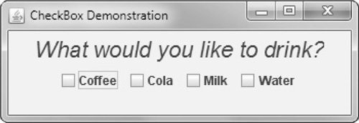
The JCheckBox Class (cont’d.)
Figure 14-35 Output of the CheckBoxDemonstration class
Java Programming, Seventh Edition

Slide 41
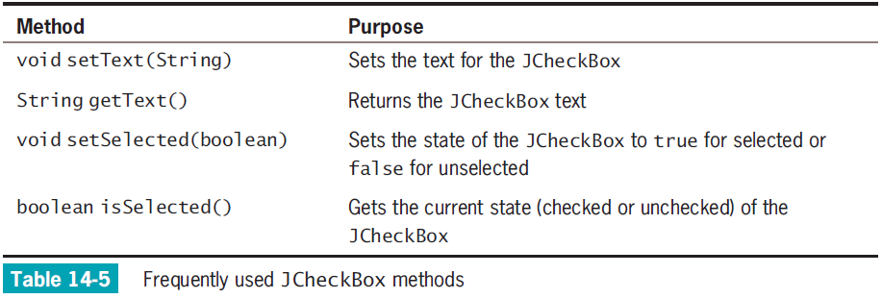
The JCheckBox Class (cont’d.)
Java Programming, Seventh Edition

Slide 42
The JCheckBox Class (cont’d.)
Methods:
  setText()
  setSelected()
  isSelected()
When the status of JCheckBox changes from unchecked to checked:
  An ItemEvent is generated
  The itemStateChanged() method executes
Java Programming, Seventh Edition

Slide 43
The ButtonGroup Class
ButtonGroup
  Groups several components so that the user can select only one at a time
When you group JCheckBox objects, all of the other JCheckBoxes are automatically turned off when the user selects any one check box
Java Programming, Seventh Edition

Slide 44
The ButtonGroup Class (cont’d.)
To create a ButtonGroup in a JFrame and then add JCheckBox:
  Create a ButtonGroup
    ButtonGroup aGroup = new ButtonGroup();
  Create a JCheckBox
    JCheckBox aBox = new JCheckBox();
  Add aBox to aGroup
    aGroup.add(aBox);
Java Programming, Seventh Edition

Slide 45
The JComboBox Class
JComboBox
  A component that combines two features:
    A display area showing a default option
    A list box containing additional , alternate options
  When the user clicks the JComboBox, a list of alternative items drops down
    If the user selects one, it replaces the box’s displayed item
Java Programming, Seventh Edition

Slide 46

The JComboBox Class (cont’d.)
Figure 14-39 A JComboBox before and after the user clicks it
Java Programming, Seventh Edition

Slide 47
The JComboBox Class (cont’d.)
To build a JComboBox:
  Use a constructor with no arguments and then add items with the addItem() method
  Alternatively, use an array of Objects as the constructor argument
    String[] majorArray = {"English", "Math", "Sociology"};
    JComboBox majorChoice = new JComboBox(majorArray);
Java Programming, Seventh Edition

Slide 48
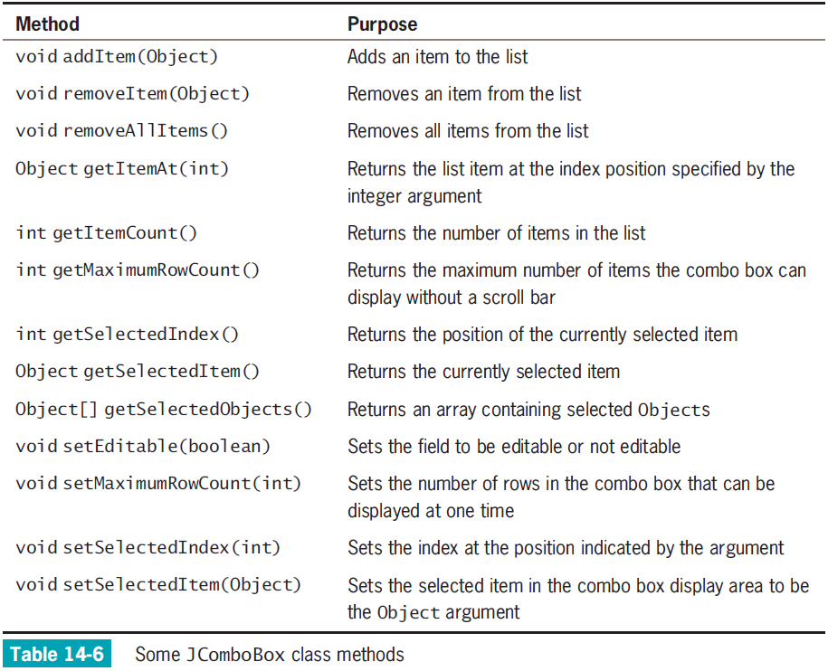
Java Programming, Seventh Edition

Slide 49
The JComboBox Class (cont’d.)
setSelectedItem() or setSelectedIndex() method
  Choose one item in the JComboBox to be the selected item
getSelectedItem() or getSelectedIndex() method
  Discover which item is currently selected
Treat the list of items in a JComboBox object as an array
  The first item is at position 0
  The second item is at position 1
  And so on
Java Programming, Seventh Edition

Slide 50
You Do It
Creating a JFrame
Ending an Application When a JFrame Closes
Adding Components to a JFrame
Adding Functionality to a JButton and a JTextField
Distinguishing Event Sources
Including JCheckBoxes in an Application
Java Programming, Seventh Edition

Slide 51
Don’t Do It
Don’t forget the x in javax when you import Swing components into an application
Don’t forget to use a JFrame’s setVisible()method if you want the JFrame to be visible
Don’t forget to use setLayout()when you add multiple components to a JFrame
Java Programming, Seventh Edition

Slide 52
Don’t Do It (cont’d.)
Don’t forget to call validate()and repaint()after you add or remove a component from a container that has been made visible
Don’t forget that the ButtonGroup class does not begin with a J
Java Programming, Seventh Edition

Slide 53
Summary
JFrame
  A Swing container that resembles a window
  Has a title bar and borders, and the ability to be resized, minimized, restored, and closed
Many types of listeners exist in Java
  Each can handle a specific event type
  Register a listener with the event source
  Handle an event in the event-handling method
Java Programming, Seventh Edition

Slide 54
Summary (cont’d.)
JCheckBox
  Consists of a label positioned beside a square
ButtonGroup
  Groups several components so the user can select only one at a time
JComboBox
  Displays an area showing an option combined with a list box containing additional options
Java Programming, Seventh Edition

