Slide 1
Chapter 11: Advanced Inheritance Concepts

Slide 2
Objectives
Create and use abstract classes
Use dynamic method binding
Create arrays of subclass objects
Use the Object class and its methods
Use inheritance to achieve good software design
Create and use interfaces
Create and use packages
Java Programming, Seventh Edition

Slide 3
Creating and Using
Abstract Classes
Abstract class
  Cannot create any concrete objects
  Can inherit
  Usually has one or more empty abstract methods
When declaring an abstract class:
  Use the keyword abstract
  Provide the superclass from which other objects can inherit
  Example:
    public abstract class Animal
Java Programming, Seventh Edition

Slide 4
Creating and Using
Abstract Classes (cont’d.)
An abstract method does not have:
  A body
  Curly braces
  Method statements
To create an abstract method:
  Use the keyword abstract
  The header must include the method type, name, and parameters
  Include a semicolon at the end of the declaration
  Example:
    public abstract void speak();
Java Programming, Seventh Edition

Slide 5
Creating and Using
Abstract Classes (cont’d.)
Subclass of abstract class
  Inherits the abstract method from its parent
    Must provide the implementation for the inherited method or be abstract itself
  Code a subclass method to override the empty superclass method
Java Programming, Seventh Edition

Slide 6
Using Dynamic Method Binding
Every subclass object “is a” superclass member
  Convert subclass objects to superclass objects
  Can create a reference to a superclass object
    Create a variable name to hold the memory address
    Store a concrete subclass object
    Example:
    Animal animalRef;
    animalRef = new Cow();
Java Programming, Seventh Edition

Slide 7
Using Dynamic Method Binding (cont’d.)
Dynamic method binding
  Also called late method binding
  An application’s ability to select the correct subclass method
  Makes programs flexible
When an application executes, the correct method is attached (or bound) to the application based on current and changing (dynamic) context
Java Programming, Seventh Edition

Slide 8
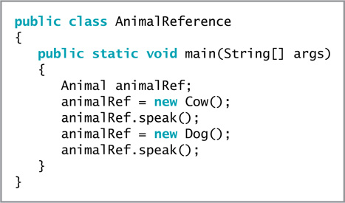
Using Dynamic Method Binding (cont’d.)
Figure 11-8 The AnimalReference application
Java Programming, Seventh Edition

Slide 9
Using a Superclass as a Method Parameter Type
Useful when you want to create a method that has one or more parameters that might be one of several types
Use dynamic method binding
  public static void talkingAnimal (Animal animal)
  Dog dog = new Dog();
  talkingAnimal(dog);
Java Programming, Seventh Edition

Slide 10
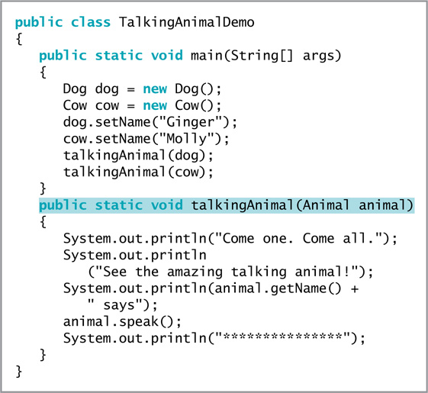
Using a Superclass as a Method Parameter Type (cont’d.)
Figure 11-10 The TalkingAnimalDemo class
Java Programming, Seventh Edition

Slide 11
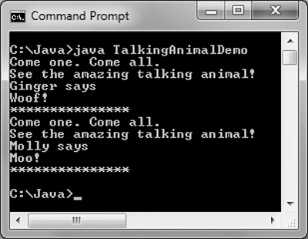
Using a Superclass as a Method Parameter Type (cont’d.)
Figure 11-11 Output of the TalkingAnimalDemo application
Java Programming, Seventh Edition

Slide 12
Creating Arrays of
Subclass Objects
Create a superclass reference
  Treat subclass objects as superclass objects
    Create an array of different objects that share the same ancestry
Create an array of three Animal references
  Animal[] animalRef = new Animal[3];
  Reserve memory for three Animal object references
Java Programming, Seventh Edition

Slide 13
Using the Object Class and Its Methods
Object class
  Every Java class is an extension of the Object class
  Defined in the java.lang package
  Imported automatically
  Includes methods to use or override
Java Programming, Seventh Edition

Slide 14
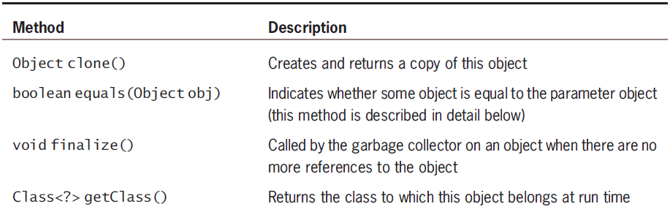
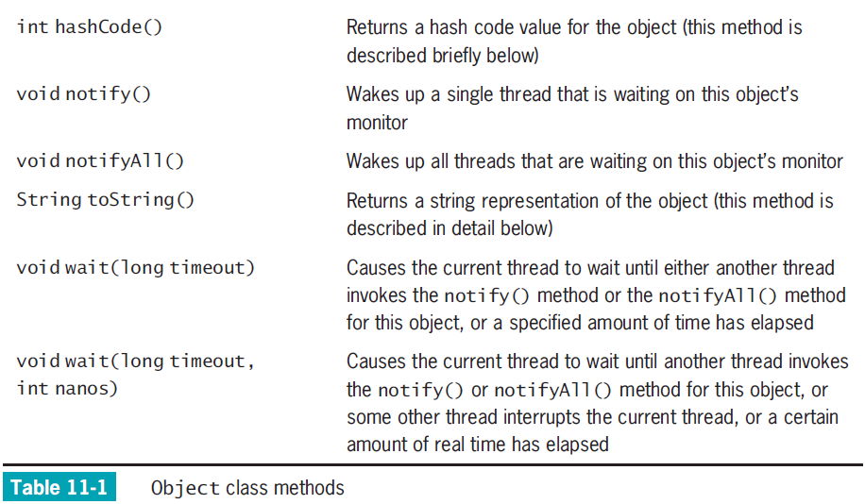
Java Programming, Seventh Edition

Slide 15
Using the toString() Method
toString() method
  Converts an Object into a String
  Contains information about the Object
  Output :
    Class name
    @ sign
    Hash code
Java Programming, Seventh Edition

Slide 16
Using the toString() Method (cont’d.)
Write an overloaded version of the toString() method
  Display some or all data field values for an object
  Can be very useful in debugging a program
    Display the toString() value
    Examine its contents
Java Programming, Seventh Edition

Slide 17
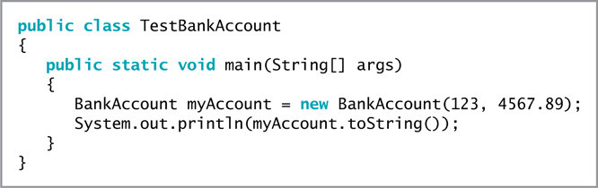
Using the toString() Method (cont’d.)
Figure 11-18 The TestBankAccount application
Java Programming, Seventh Edition

Slide 18
Using the equals() Method
equals() method
  Takes a single argument
    The same type as the invoking object
  Returns a boolean value
    Indicates whether objects are equal
  Considers two objects of the same class to be equal only if they have the same hash code
Java Programming, Seventh Edition

Slide 19
Using the equals() Method (cont’d.)
Example of the equals() method:
  if(someObject.equals (someOtherObjectOfTheSameType))
  System.out.println("The objects are equal");
To consider objects to be equal based on contents, you must write your own equals() method
Java Programming, Seventh Edition

Slide 20
Using the equals() Method (cont’d.)
Object method hashCode()
  Returns an integer representing the hash code
  Whenever you override the equals() method:
    You should override the hashCode() method as well
    Equal objects should have equal hash codes
Java Programming, Seventh Edition

Slide 21
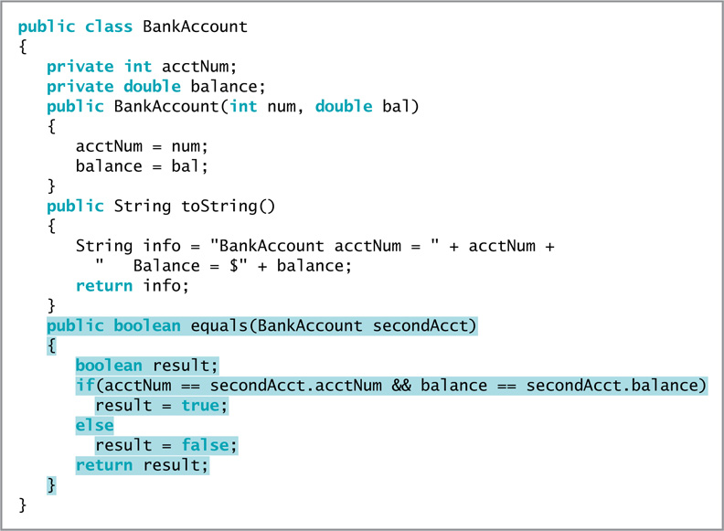
Figure 11-22 The BankAccount class containing its own equals() method
Java Programming, Seventh Edition

Slide 22
Using Inheritance to Achieve
Good Software Design
You can create powerful computer programs more easily if components are used either “as is” or with slight modifications
Make programming large systems more manageable
Java Programming, Seventh Edition

Slide 23
Using Inheritance to Achieve
Good Software Design (cont’d.)
Advantages of extendable superclasses
  Save development time
    Much code is already written
  Save testing time
    Superclass code is already tested
  Programmers understand how a superclass works
  A superclass maintains its integrity
    The bytecode is not changed
Java Programming, Seventh Edition

Slide 24
Creating and Using Interfaces
Multiple inheritance
  Inherit from more than one class
  Prohibited in Java
  Variables and methods in parent classes might have identical names
    Creates conflict
    Which class should super refer to when a child class has multiple parents?
Java Programming, Seventh Edition

Slide 25
Creating and Using Interfaces (cont’d.)
Interface
  An alternative to multiple inheritance
  Looks like a class except all of its methods are implicitly public and abstract, and all of its data items are implicitly public, abstract, and final
  A description of what a class does
  Declares method headers
Java Programming, Seventh Edition

Slide 26
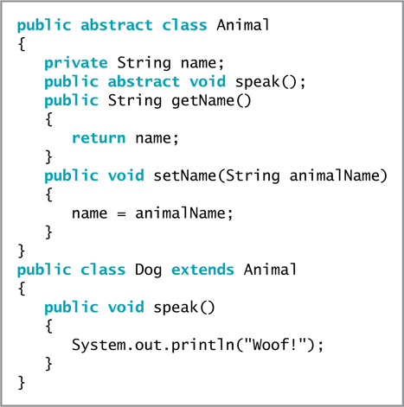
Creating and Using Interfaces (cont’d.)
Figure 11-24 The Animal and Dog classes
Java Programming, Seventh Edition

Slide 27
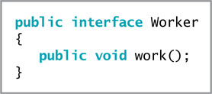
Creating and Using Interfaces (cont’d.)
Figure 11-25 The Worker interface
Java Programming, Seventh Edition

Slide 28
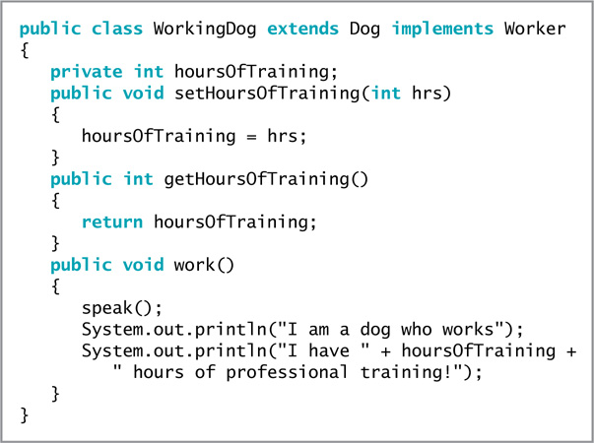
Creating and Using Interfaces (cont’d.)
Figure 11-26 The WorkingDog class
Java Programming, Seventh Edition

Slide 29
Creating and Using Interfaces (cont’d.)
Create an interface
  Example:
  public interface Worker
Implement an interface
  Use the keyword implements
    Requires the subclass to implement its own version of each method
  Use the interface name in the class header
    Requires class objects to include code
    public class WorkingDog extends Dog implements Worker
Java Programming, Seventh Edition

Slide 30
Creating and Using Interfaces (cont’d.)
Abstract classes versus interfaces
  You cannot instantiate concrete objects of either
  Abstract classes
    Can contain nonabstract methods
    Provide data or methods that subclasses can inherit
      Subclasses maintain the ability to override inherited methods
    Can include methods that contain the actual behavior the object performs
Java Programming, Seventh Edition

Slide 31
Creating and Using Interfaces (cont’d.)
Abstract classes versus interfaces (cont’d.)
  Interfaces
    Methods must be abstract
    Programmers know what actions to include
    Every implementing class defines the behavior that must occur when the method executes
    A class can implement behavior from more than one parent
Java Programming, Seventh Edition

Slide 32
Creating Interfaces to Store Related Constants
Interfaces can contain data fields
  Data fields must be public, static, and final
Interfaces contain constants
  Provide a set of data that many classes can use without having to redeclare values
Java Programming, Seventh Edition

Slide 33
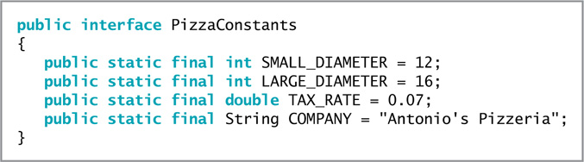
Creating Interfaces to Store Related Constants (cont’d.)
Figure 11-29 The PizzaConstants interface
Java Programming, Seventh Edition

Slide 34
Creating and Using Packages
Package
  A named collection of classes
  Easily imports related classes into new programs
  Encourages other programmers to reuse software
  Helps avoid naming conflicts or collisions
  Gives every package a unique name
Java Programming, Seventh Edition

Slide 35
Creating and Using Packages (cont’d.)
Create classes for others to use
  Protect your work
    Do not provide users with source code in files with .java extensions
    Provide users with compiled files with .class extensions
  Include the package statement at the beginning of the class file
    Place compiled code into the indicated folder
Java Programming, Seventh Edition

Slide 36
Creating and Using Packages (cont’d.)
Compile the file to place in a package
  Use a compiler option with the javac command
    The -d option places the generated .class file in a folder
Package-naming convention
  Use your Internet domain name in reverse order
Collisions
  Class naming conflicts
Java Programming, Seventh Edition

Slide 37
Creating and Using Packages (cont’d.)
Java ARchive (JAR) file
  A package or class library is delivered to users as a JAR file
  Compresses and stores data
    Reduces the size of archived class files
  Based on the Zip file format
Java Programming, Seventh Edition

Slide 38
You Do It
Creating an Abstract Class
Extending an Abstract Class
Extending an Abstract Class with a Second Subclass
Instantiating Objects from Subclasses
Using Object References
Using an Interface
Creating a Package
Java Programming, Seventh Edition

Slide 39
Don’t Do It
Don’t write a body for an abstract method
Don’t forget to end an abstract method header with a semicolon
Don’t forget to override any abstract methods in any subclasses you derive
Don’t mistakenly overload an abstract method instead of overriding it
Don’t try to instantiate an abstract class object
Don’t forget to override all the methods in an interface that you implement
Don’t use the wildcard format to import multiple classes when creating your own packages
Java Programming, Seventh Edition

Slide 40
Summary
Abstract class
  A class that you create only to extend from, but not to instantiate from
  Usually contains abstract methods
    Methods with no method statements
Can convert subclass objects to superclass objects
Dynamic method binding
  Create a method that has one or more parameters that might be one of several types
  Create an array of superclass object references but store subclass instances in it
Java Programming, Seventh Edition

Slide 41
Summary (cont’d.)
Interface
  Similar to a class
  All methods are implicitly public and abstract
  All of its data fields are implicitly public, static, and final
  To create a class that uses an interface, include the keyword implements and the interface name in the class header
Place classes in packages
  Convention uses Internet domain names in reverse order
Java Programming, Seventh Edition

