Slide 1
Chapter 13:
File Input and Output

Slide 2
Objectives
Learn about computer files
Use the Path and Files class
Learn about file organization, streams, and buffers
Use Java’s IO classes to write to and read from a file
Create and use sequential data files
Learn about random access files
Write records to a random access data file
Read records from a random access data file
Java Programming, Seventh Edition

Slide 3
Understanding Computer Files
Volatile storage
  Computer memory or random access memory (RAM)
  Temporary
Nonvolatile storage
  Not lost when computer loses power
  Permanent
Computer file
  Collection of information stored on nonvolatile device in computer system
Java Programming, Seventh Edition

Slide 4
Understanding Computer Files (cont'd.)
Permanent storage devices
  Hard disks
  Zip disks
  USB drives
  Reels or cassettes of magnetic tape
  Compact discs
Categories of files by the way they store data
  Text files
  Binary files
Java Programming, Seventh Edition

Slide 5
Understanding Computer Files (cont'd.)
Data files
  Contain facts and figures
Program files or application files
  Store software instructions
Root directory
Folders or directories
Path
  A complete list of disk drive plus the hierarchy of directories in which a file resides
Java Programming, Seventh Edition

Slide 6
Understanding Computer Files (cont'd.)
When you work with stored files in an application, you perform the following tasks:
  Determine whether and where a path or file exists
  Open a file
  Write information to a file
  Read data from a file
  Close a file
  Delete a file
Java Programming, Seventh Edition

Slide 7
Using the Path and Files Classes
Path class
  Use it to create objects that contain information about files or directories
Files class
  Use it to perform operations on files and directories
java.nio.file package
  Include it to use both the Path and Files classes
Java Programming, Seventh Edition

Slide 8
Creating a Path
First, determine the default file system on the host computer
  FileSystem fs = FileSystems.getDefault();
Define a Path using the getPath() method
  Path path = fs.getPath ("C:\\Java\\Chapter.13\\Data.txt");
Every Path is either an absolute path or a relative path
Java Programming, Seventh Edition

Slide 9
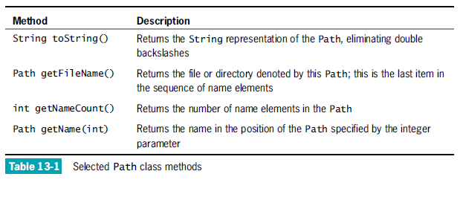
Retrieving Information About a Path
Java Programming, Seventh Edition

Slide 10
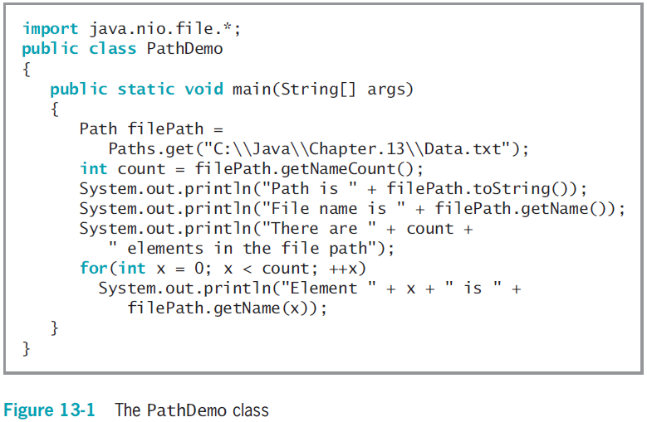
Retrieving Information About a Path (cont’d.)
Java Programming, Seventh Edition

Slide 11
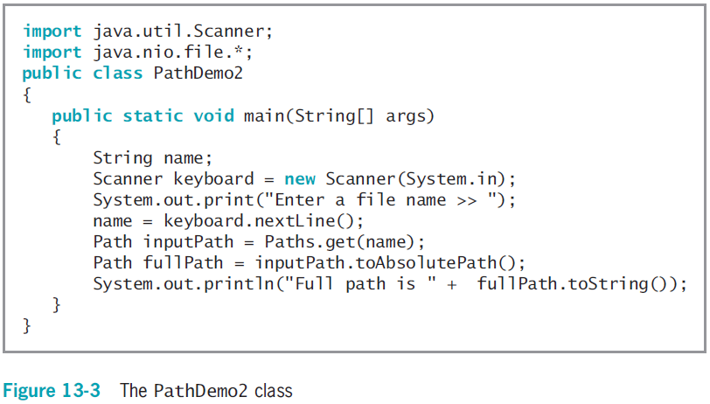
Converting a Relative Path to an Absolute One
Java Programming, Seventh Edition

Slide 12
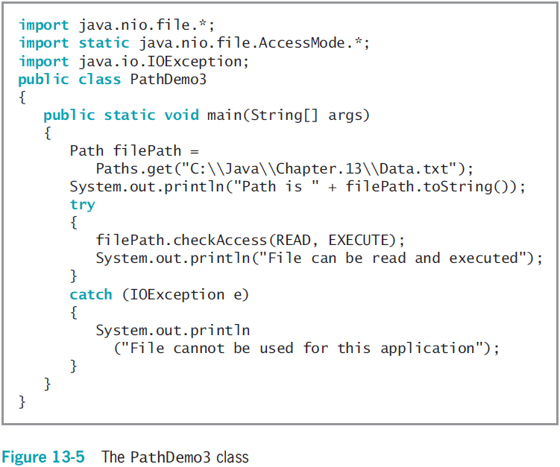
Checking File Accessibility
Java Programming, Seventh Edition

Slide 13
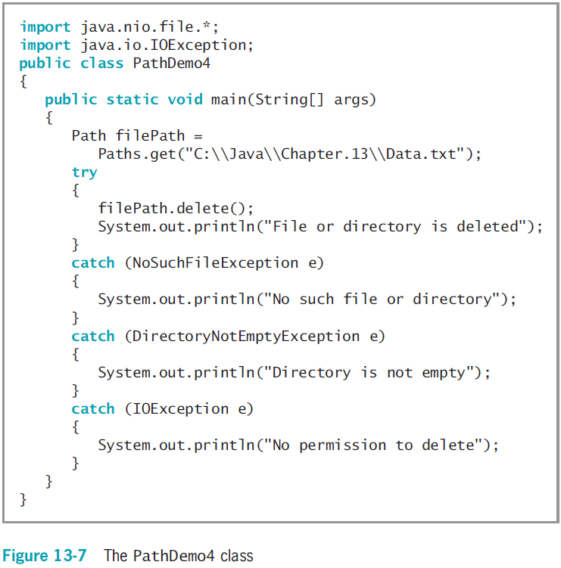
Deleting a Path
Java Programming, Seventh Edition

Slide 14
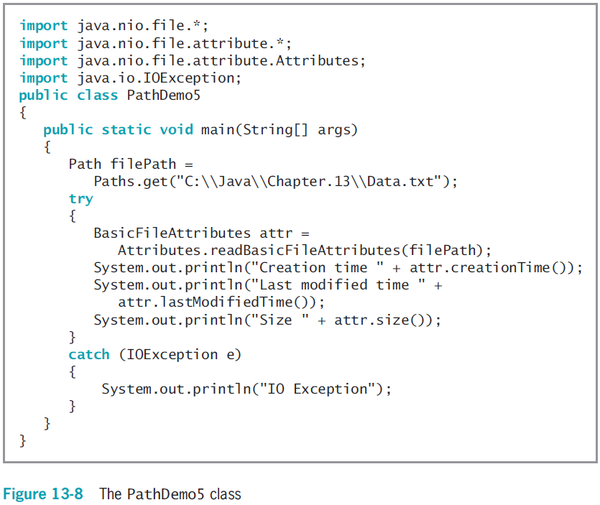
Determining File Attributes
Java Programming, Seventh Edition

Slide 15
File Organization, Streams, and Buffers
When you need to retain data for any significant amount of time, save it on a permanent, secondary storage device
Businesses store data in hierarchy
  Character
  Field
  Record
  Files
Sequential access file
  Each record stored in order based on value in some field
Java Programming, Seventh Edition

Slide 16
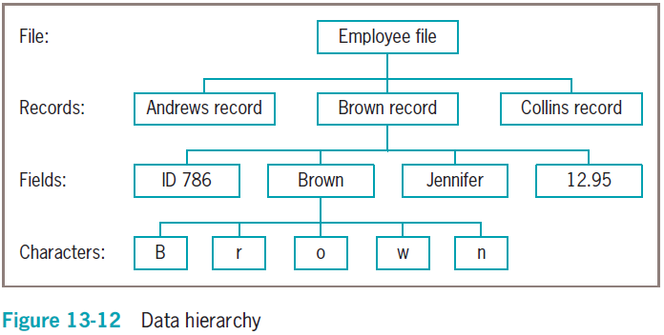
File Organization, Streams, and Buffers (cont'd.)
Java Programming, Seventh Edition

Slide 17
File Organization, Streams, and Buffers (cont'd.)
Open a file
  Create object
  Associate a stream of bytes with it
Close the file
  Make it no longer available to your application
  You should always close every file you open
Stream
  Bytes flow into your program from an input device
  Bytes flow out of your application to an output device
  Most streams flow in only one direction
Java Programming, Seventh Edition

Slide 18
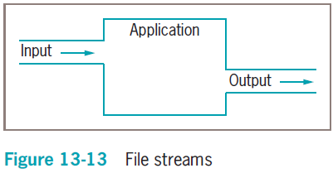
File Organization, Streams, and Buffers (cont'd.)
Java Programming, Seventh Edition

Slide 19
File Organization, Streams, and Buffers (cont'd.)
Buffer
  Memory location where bytes are held after they are logically output, but before they are sent to the output device
  Using a buffer improves program performance
Flushing
  Clears any bytes that have been sent to a buffer for output, but have not yet been output to a hardware device
Java Programming, Seventh Edition

Slide 20
Using Java’s IO Classes
InputStream, OutputStream, and Reader
  Abstract classes that contain methods for performing input and output
System.out
  PrintStream object
  Defined in System class
System.err
  Usually reserved for error messages
Java Programming, Seventh Edition

Slide 21
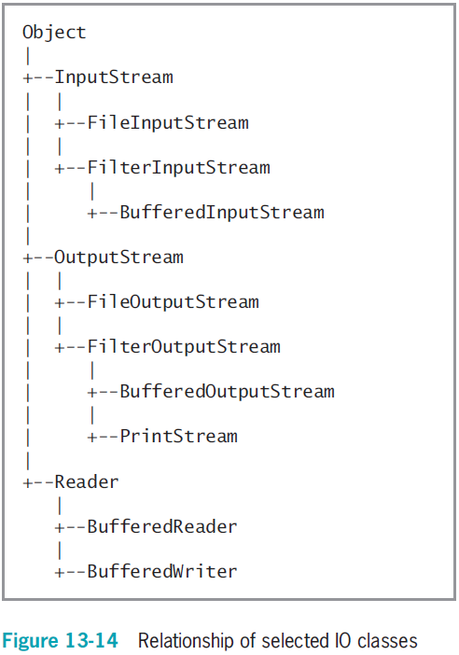
Java Programming, Seventh Edition

Slide 22
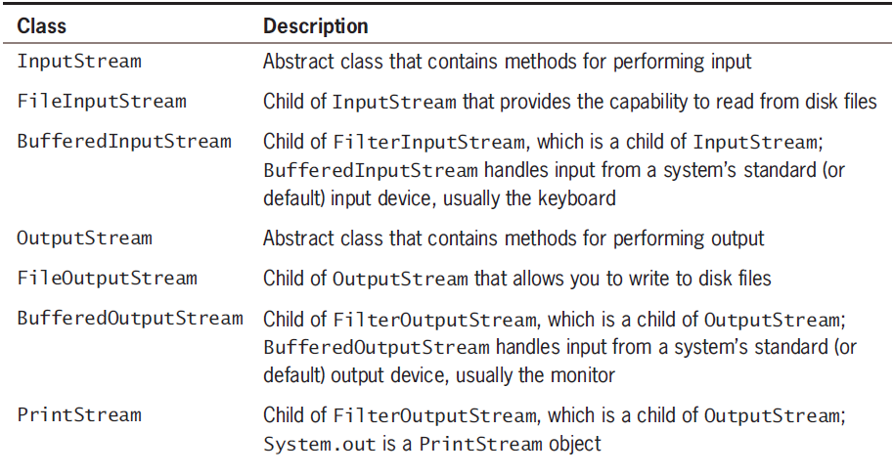
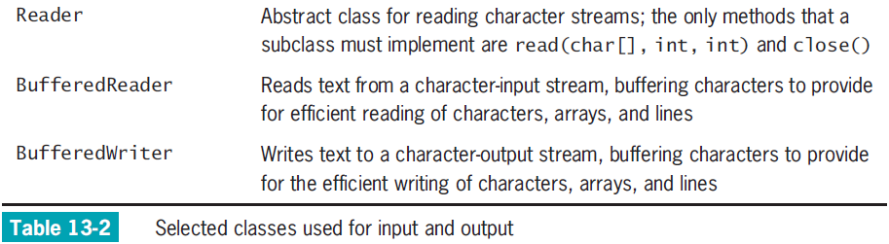
Using Java’s IO Classes (cont'd.)
Java Programming, Seventh Edition

Slide 23
Writing to a File
Assign file to the OutputStream
  Construct a BufferedOutputStream object
  Assign it to the OutputStream
Create a writeable file by using the Path class newOutputStream() method
  Creates a file if it does not already exist
  Opens the file for writing and returns an OutputStream that can be used to write bytes to the file
Java Programming, Seventh Edition

Slide 24
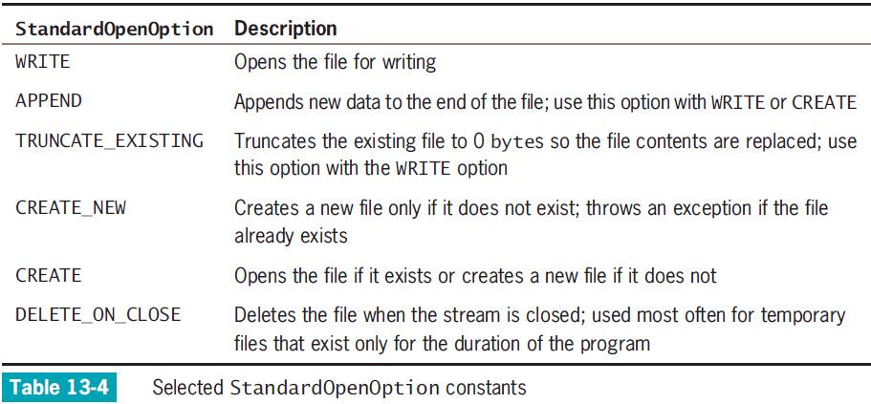
Writing to a File (cont’d.)
Java Programming, Seventh Edition

Slide 25
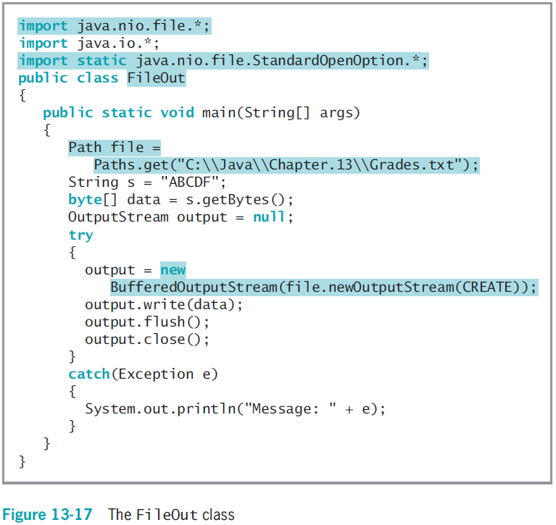
Java Programming, Seventh Edition

Slide 26
Reading from a File
Use an InputStream like you use an OutputStream
Open a file for reading with the newInputStream() method
  The method returns a stream that can read bytes from a file
Java Programming, Seventh Edition

Slide 27
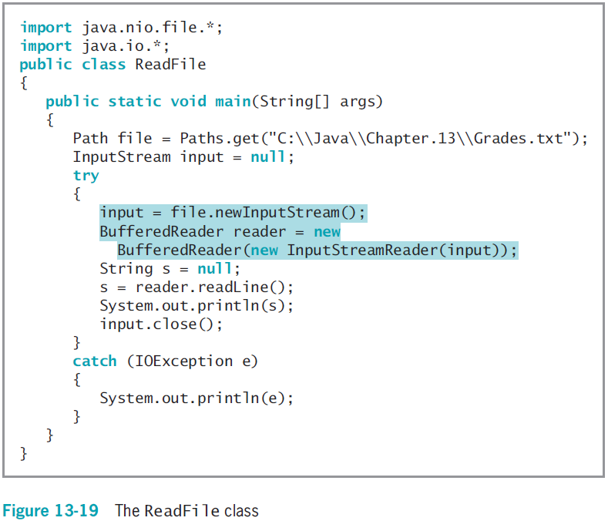
Java Programming, Seventh Edition

Slide 28
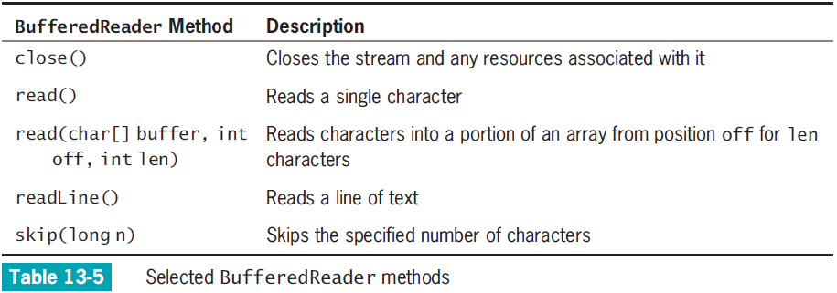
Reading from a File (cont’d.)
Java Programming, Seventh Edition

Slide 29
Creating and Using Sequential Data Files
BufferedWriter class
  Counterpart to BufferedReader
  Writes text to an output stream, buffering the characters
  The class has three overloaded write() methods that provide for efficient writing of characters, arrays, and strings, respectively
Java Programming, Seventh Edition

Slide 30
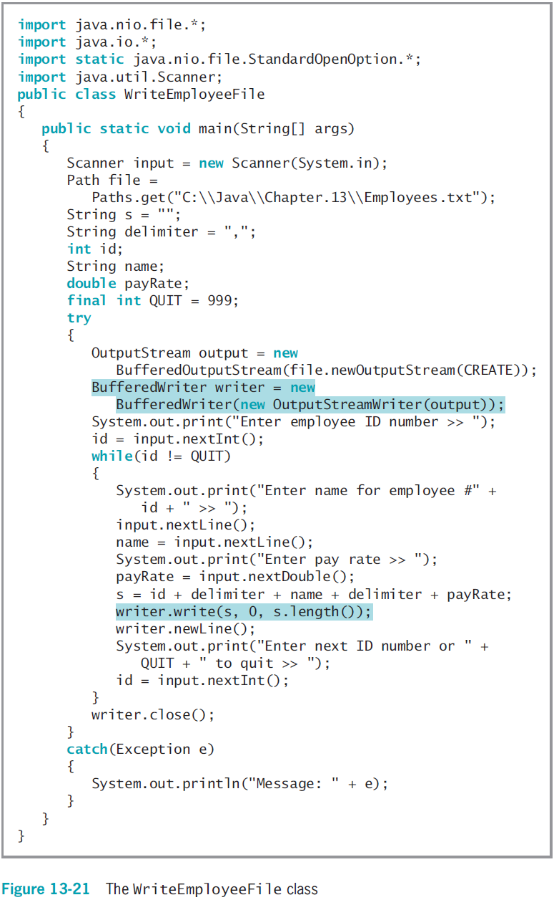
Java Programming, Seventh Edition

Slide 31
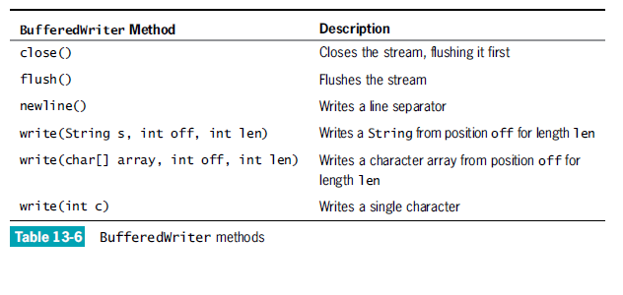
Creating and Using Sequential Data Files (cont’d.)
Java Programming, Seventh Edition

Slide 32
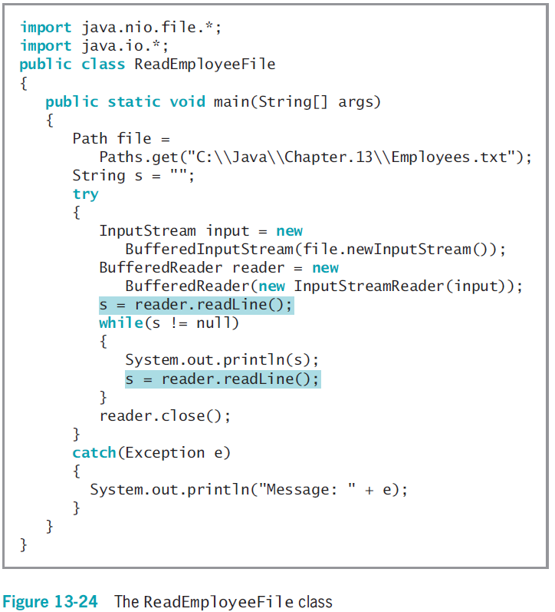
Java Programming, Seventh Edition

Slide 33
Learning About Random
Access Files
Sequential access files
  Access records sequentially from beginning to end
  Good for batch processing
    Same tasks with many records one after the other
  Inefficient for many applications
Real-time applications
  Require immediate record access while client waits
Java Programming, Seventh Edition

Slide 34
Learning About Random
Access Files (cont'd.)
Random access files
  Records can be located in any order
  Also called direct access files or instant access files
File channel object
  An avenue for reading and writing a file
  You can search for a specific file location, and operations can start at any specified position
ByteBuffer wrap() method
  Encompasses an array of bytes into a ByteBuffer
Java Programming, Seventh Edition

Slide 35
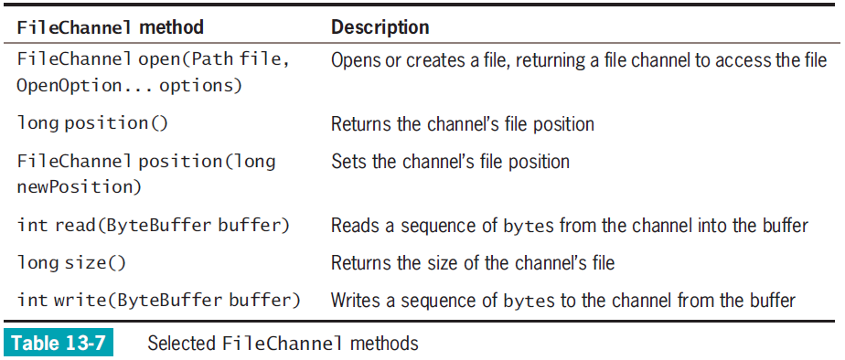
Learning About Random
Access Files (cont'd.)
Java Programming, Seventh Edition

Slide 36
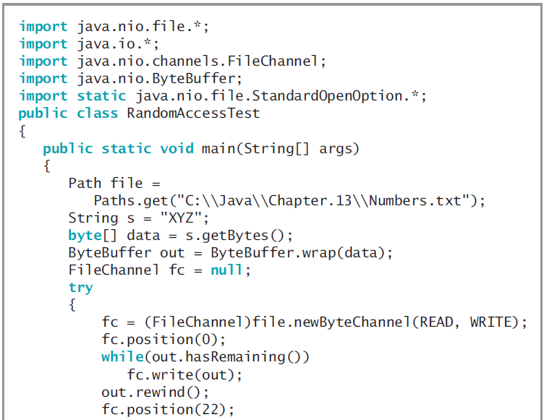
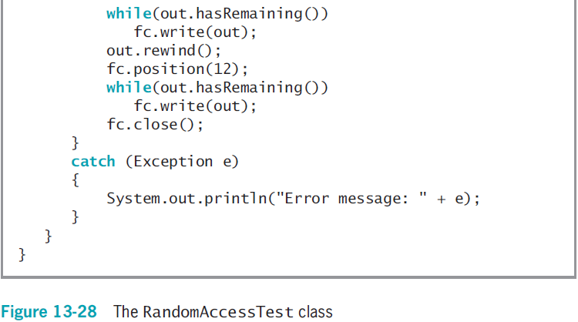
Java Programming, Seventh Edition

Slide 37
Writing Records to a Random
Access Data File
Access a particular record
  fc.position((n-1) * 50);
Place records into the file based on a key field
Key field
  A field that makes a record unique from all others
Java Programming, Seventh Edition

Slide 38
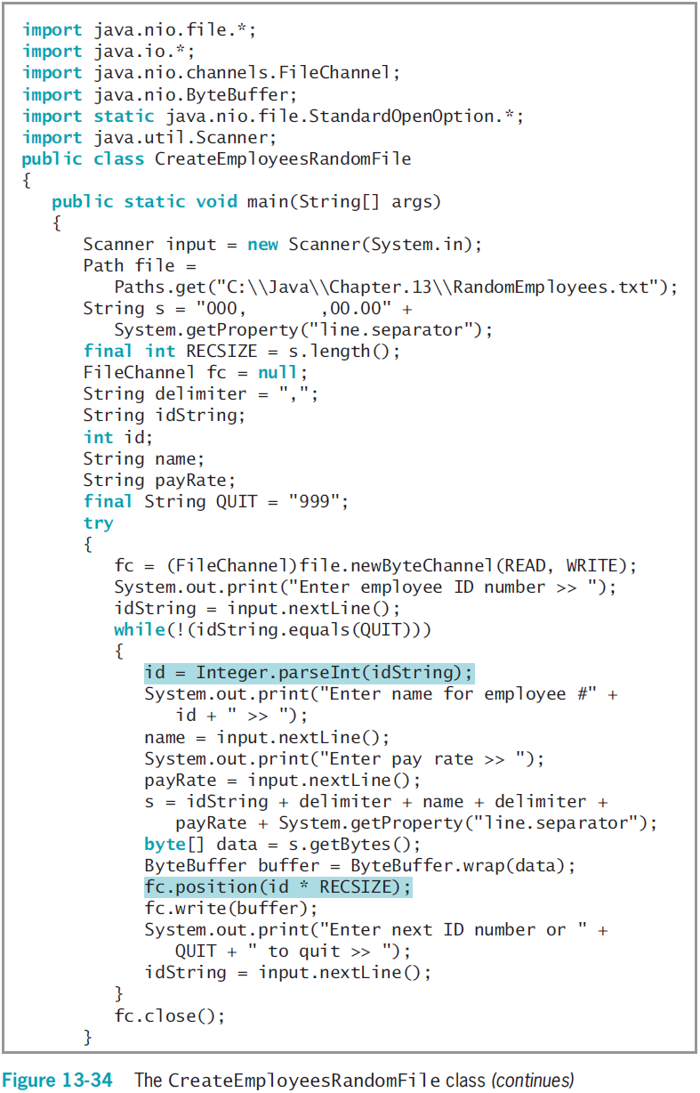
Java Programming, Seventh Edition

Slide 39
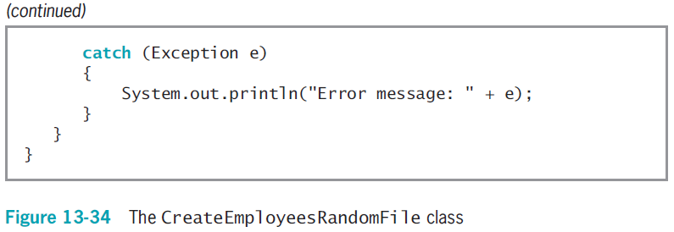
Writing Records to a Random
Access File (cont’d.)
Java Programming, Seventh Edition

Slide 40
Reading Records from a Random Access File
You can process a random access file either sequentially or randomly
Java Programming, Seventh Edition

Slide 41
Accessing a Random Access File Sequentially
ReadEmployeesSequentially application
  Reads through 1,000-record RandomEmployees.txt file sequentially in a for loop (shaded)
  When ID number value is 0:
    No user-entered records are stored at that point
    The application does not bother to print it
Java Programming, Seventh Edition

Slide 42
Accessing a Random Access File Randomly
To display records in order based on the key field, you do not need to create a random access file and waste unneeded storage
  Instead, sort the records
By using a random access file, you retrieve specific record from the file directly without reading through other records
Java Programming, Seventh Edition

Slide 43
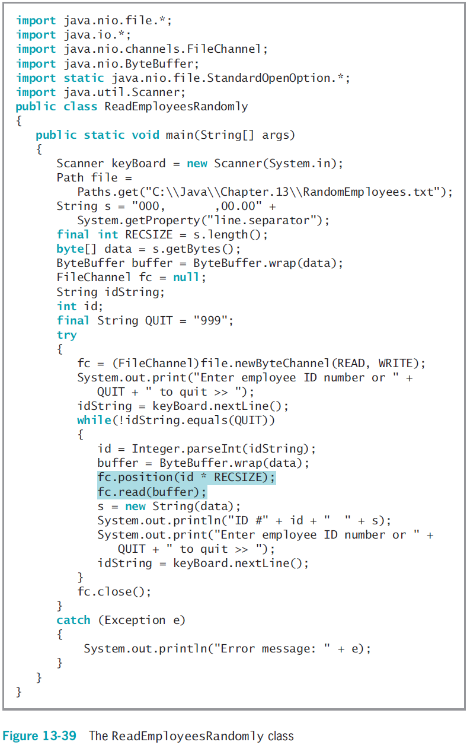
Java Programming, Seventh Edition

Slide 44
You Do It
Creating Multiple Random Access Files
Writing a Method to Create an Empty File
Adding Data Entry Capability to the Program
Setting Up a Program to Read the Created Files
Displaying File Statistics
Reading a File Sequentially
Reading a File Randomly
Java Programming, Seventh Edition

Slide 45
Don’t Do It
Don’t forget that a Path name might be relative and that you might need to make the Path absolute before accessing it
Don’t forget that the backslash character starts the escape sequence in Java
  You must use two backslashes in a string that describes a Path in the DOS operating system
Java Programming, Seventh Edition

Slide 46
Summary
Files
  Objects stored on nonvolatile, permanent storage
File and Files class
  Gather file information
Java views file as a series of bytes
  Views a stream as an object through which input and output data flows
DataOutputStream class
  Accomplishes formatted output
Java Programming, Seventh Edition

Slide 47
Summary (cont'd.)
DataInputStream objects
  Read binary data from InputStream
Random access files
  Records can be located in any order
  RandomAccessFile class
Write objects to files if they implement Serializable interface
Java Programming, Seventh Edition

