Slide 1
Chapter 16: Graphics

Slide 2
Objectives
Learn about the paint() and repaint() methods
Use the drawString() method to draw Strings using various fonts and colors
Draw lines and shapes
Learn more about fonts
Draw with Java 2D graphics
Java Programming, Seventh Edition

Slide 3
Learning About the paint() and repaint() Methods
Rerender
  To redisplay a display surface
Painting
  System-triggered painting
  Application-triggered painting
paint() method
  Write your own method to override the default
  Method header
    public void paint(Graphics g)
Java Programming, Seventh Edition

Slide 4
Learning About the paint() and repaint() Methods (cont’d.)
Graphics object
  Preconfigured with the appropriate values for drawing on the component
repaint() method
  Use when a window needs to be updated
  Calls the paint() method
  Creates a Graphics object
Java Programming, Seventh Edition

Slide 5
Using the setLocation() Method
Place a component at a specific location within a JFrame’s content pane
Change the position of a component by using the setLocation() method
  pressMe.setLocation(100, 50);
Java Programming, Seventh Edition

Slide 6
Creating Graphics Objects
Call the paint() method
  Use the automatically created Graphics object
  Instantiate any Graphics object
    Graphics draw = getGraphics();
  getGraphics() method
Java Programming, Seventh Edition

Slide 7
Using the drawString() Method
drawString() method
  Allows you to draw a String in a JFrame window
  Requires three arguments:
    String
    x-axis coordinate
    y-axis coordinate
  Is a member of the Graphics class
Java Programming, Seventh Edition

Slide 8
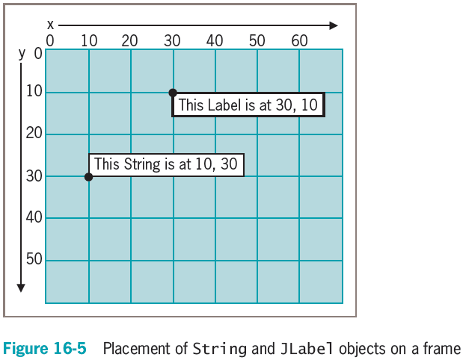
Using the drawString() Method (cont’d.)
Java Programming, Seventh Edition

Slide 9
Using the setFont() and setColor() Methods
setFont() method
  Requires a Font object
You can instruct a Graphics object to use a font
  somegraphicsobject.setFont(someFont);
Java Programming, Seventh Edition

Slide 10
Using Color
setColor() method
  Designates a Graphics color
  Use 13 Color class constants as arguments
    brush.setColor(Color.GREEN);
Java Programming, Seventh Edition

Slide 11
Drawing Lines and Shapes
Java provides several methods for drawing a variety of lines and geometric shapes
Java Programming, Seventh Edition

Slide 12
Drawing Lines
drawLine() method
  Draws a straight line between any two points
  Takes four arguments:
    x- and y-coordinates of the line’s starting point
    x- and y-coordinates of the line’s ending point
Java Programming, Seventh Edition

Slide 13
Drawing Rectangles
drawRect() method
  Draws the outline of a rectangle
fillRect() method
  Draws a solid or filled rectangle
Both require four arguments:
  x- and y-coordinates of the upper-left corner of the rectangle
  The width and height of the rectangle
Java Programming, Seventh Edition

Slide 14
Drawing Rectangles (cont’d.)
clearRect() method
  Draws a rectangle
  Requires four arguments:
    x- and y-coordinates of the upper-left corner of the rectangle
    The width and height of the rectangle
  Appears empty or “clear”
drawRoundRect() method
  Creates rectangles with rounded corners
  Requires six arguments
Java Programming, Seventh Edition

Slide 15
Creating Shadowed Rectangles
draw3DRect() method
  A minor variation on the drawRect() method
  Draws a rectangle that appears to have “shadowing” on two edges
  Contains a Boolean value argument:
    true if the rectangle is darker on the right and bottom
    false if the rectangle is darker on the left and top
fill3DRect() method
  Creates filled three-dimensional rectangles
Java Programming, Seventh Edition

Slide 16
Drawing Ovals
drawOval() and fillOval() methods
  Draw ovals using the same four arguments that rectangles use
Java Programming, Seventh Edition

Slide 17
Drawing Arcs
drawArc() method arguments:
  x- and y-coordinates of the upper-left corner of an imaginary rectangle that represents the bounds of the imaginary circle that contains the arc
  The width and height of the imaginary rectangle that represents the bounds of the imaginary circle that contains the arc
  The beginning arc position
  The arc angle
Java Programming, Seventh Edition

Slide 18
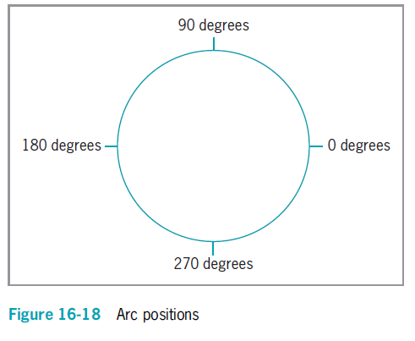
Drawing Arcs (cont’d.)
Java Programming, Seventh Edition

Slide 19
Drawing Arcs (cont’d.)
fillArc() method
  Creates a solid arc
    Two straight lines are drawn from the arc endpoints to the center of the imaginary circle whose perimeter the arc occupies
Java Programming, Seventh Edition

Slide 20
Creating Polygons
drawPolygon() method
  Draws complex shapes
  Requires three arguments:
    The integer array, which holds a series of x-coordinate positions
    The second array, which holds a series of corresponding
    y-coordinate positions
    The number of pairs of points to connect
Java Programming, Seventh Edition

Slide 21
Creating Polygons (cont’d.)
fillPolygon() method
  Draws a solid shape
  If the beginning and ending points are not identical, two endpoints are connected by a straight line before the polygon is filled with color
addPoint() method
  Adds points to a polygon indefinitely
Java Programming, Seventh Edition

Slide 22
Copying an Area
copyArea() method
  Requires six parameters:
    The x- and y-coordinates of the upper-left corner of the area to be copied
    The width and height of the area to be copied
    The horizontal and vertical displacement of the destination of the copy
Java Programming, Seventh Edition

Slide 23
Using the paintComponent() Method with JPanels
Use the paintComponent() method when creating drawings on a JPanel
JFrame is not a child of JComponent
  Does not have its own paintComponent() method
Java Programming, Seventh Edition

Slide 24
Learning More About Fonts
getAvailableFontFamilyNames() method
  Is part of the GraphicsEnvironment class defined in the java.awt package
  Returns an array of String objects that are names of available fonts
You cannot instantiate the GraphicsEnvironment object directly
  Get the reference object to the current computer environment
    Call the static getLocalGraphicsEnvironment() method
Java Programming, Seventh Edition

Slide 25
Discovering Screen Statistics Using the Toolkit Class
getDefaultToolkit() method
  Provides information about the system in use
getScreenResolution() method
  Returns the number of pixels as an integer
You can create a Toolkit object and get the screen resolution using the following code:
  Toolkit tk = Toolkit.getDefaultToolkit();
  int resolution = tk.getScreenResolution();
Java Programming, Seventh Edition

Slide 26
Discovering Screen Statistics Using the Toolkit Class (cont’d.)
Dimension class
  Use for representing the width and height of a user interface component
  Constructors:
    Dimension() creates an instance of Dimension with a width and height of 0
    Dimension(Dimension d) creates an instance of Dimension whose width and height are the same as for the specified dimension
    Dimension(int width, int height) constructs a Dimension and initializes it to the specified width and height
Java Programming, Seventh Edition

Slide 27
Discovering Screen Statistics Using the Toolkit Class (cont’d.)
getScreenSize() method
  Is a member of the Toolkit object
  Returns an object of type Dimension, which specifies the width and height of the screen in pixels
Java Programming, Seventh Edition

Slide 28
Discovering Font Statistics
Leading
  The amount of space between baselines
Ascent
  The height of an uppercase character from the baseline to the top of the character
Descent
  Measures the parts of characters that “hang below” the baseline
Height of a font
  The sum of leading, ascent, and descent
Java Programming, Seventh Edition

Slide 29
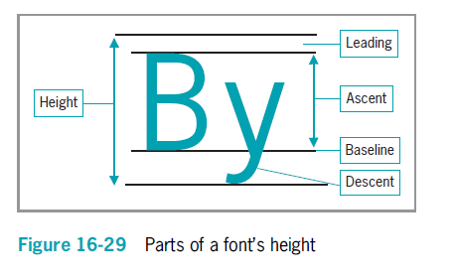
Discovering Font Statistics (cont’d.)
Java Programming, Seventh Edition

Slide 30
Discovering Font Statistics (cont’d.)
getFontMetrics() method
  Discovers a font’s height
  Returns the FontMetrics object
Use one of the FontMetrics class methods with the object to return one of a Font’s statistics:
  public int getLeading()
  public int getAscent()
  public int getDescent()
  public int getHeight()
Java Programming, Seventh Edition

Slide 31
Discovering Font Statistics (cont’d.)
stringWidth() method
  Returns the integer width of a String
  Requires the name of the String
  Is a member of the FontMetrics class
Java Programming, Seventh Edition

Slide 32
Drawing with Java 2D Graphics
Java 2D
  Higher quality, two-dimensional (2D) graphics, images, and text
Graphics2D class
  Features include:
    Fill patterns
    Strokes
    Anti-aliasing
Java Programming, Seventh Edition

Slide 33
Drawing with Java 2D Graphics (cont’d.)
Graphics2D class (cont’d.)
  Found in the java.awt package
  Produced by casting, or converting, and promoting a Graphics object
The process of drawing with Java 2D objects:
  Specify the rendering attributes
  Set a drawing stroke
  Create objects to draw
Java Programming, Seventh Edition

Slide 34
Specifying the Rendering Attributes
Use the setColor() method
  Specify 2D colors
  Use a Graphics2D object and set the color to black
    gr2D.setColor(Color.BLACK);
Fill patterns
  Control how a drawing object is filled in
  Can be a solid, gradient, texture, or pattern
  Created by using the setPaint() method of Graphics2D with a fill pattern object
Java Programming, Seventh Edition

Slide 35
Specifying the Rendering Attributes (cont’d.)
Gradient fill
  A gradual shift from one color at one coordinate point to a different color at a second coordinate point
  Acyclic gradient
  Cyclic gradient
Java Programming, Seventh Edition

Slide 36
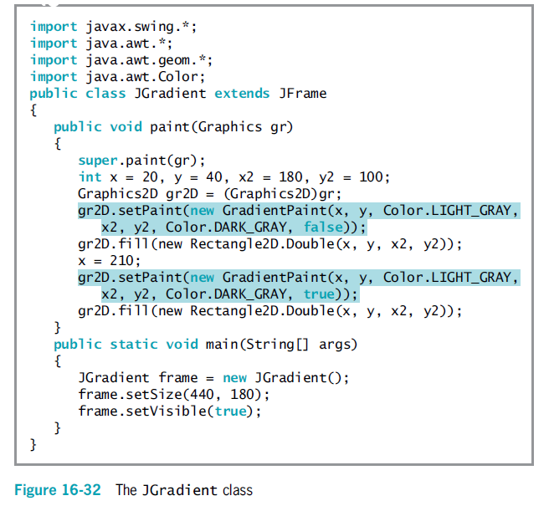
Java Programming, Seventh Edition

Slide 37
Setting a Drawing Stroke
Stroke
  Represents a single movement
  setStroke() method
Stroke interface
BasicStroke class
Endcap styles
  Apply to the ends of lines that do not join with other lines
Juncture styles
  For lines that join
Java Programming, Seventh Edition

Slide 38
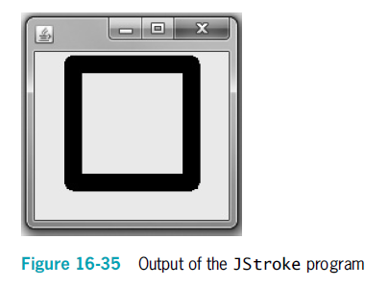
Setting a Drawing Stroke (cont’d.)
Java Programming, Seventh Edition

Slide 39
Creating Objects to Draw
Objects drawn in Java 2D are created by defining them as geometric shapes
  Use the java.awt.geom package classes
  Define the shape
  Use the shape as an argument to the draw() or fill() methods
Lines
Line2D.Float
Line2D.Double
Point2D.Float
Point2D.Double
Java Programming, Seventh Edition

Slide 40
Creating Objects to Draw (cont’d.)
Rectangles
Rectangle2D.Float
Rectangle2D.Double
Rectangle2D.Float rect = new Rectangle2D.Float(10F, 10F, 50F, 40F);
Ovals
Ellipse2D.Float
Ellipse2D.Double
Ellipse2D.Float ell = new Ellipse2D.Float(10F, 73F, 40F, 20F);
Java Programming, Seventh Edition

Slide 41
Creating Objects to Draw (cont’d.)
Arcs
Arc2D.Float
Arc2D.Double
Arc2D.PIE
Arc2D.CHORD
Arc2D.OPEN
Arc2D.Float ac = new Arc2D.Float (10,133,30,33,30,120,Arc2D.PIE);
Java Programming, Seventh Edition

Slide 42
Creating Objects to Draw (cont’d.)
Polygons
Define movements from one point to another
GeneralPath object
GeneralPath pol = new GeneralPath();
moveTo()
lineTo()
closePath()
Java Programming, Seventh Edition

Slide 43
You Do It
Using the drawString() Method
Using Fonts and Colors
Creating Your Own Graphics Object
Examining Screen Coordinates
Creating a Drawing
Copying an Area
Java Programming, Seventh Edition

Slide 44
You Do It (cont’d.)
Using FontMetrics Methods to Compare Fonts
Using FontMetrics Methods to Place a Border Around a String
Using Drawing Strokes
Working with Shapes
Java Programming, Seventh Edition

Slide 45
Don’t Do It
Don’t forget to call super.paint() as the first statement in the paint() method
Don’t forget that the setLocation() method works correctly only when it is used after the layout manager has finished positioning all of the application’s components
Don’t forget that the lower-left corner of a String is placed at the coordinates used when you call drawString()
Don’t forget to use paintComponent() rather than paint() when creating graphics on a JPanel
Java Programming, Seventh Edition

Slide 46
Summary
paint() method
drawString() method
  Draws a String in a JApplet window
Methods for drawing a variety of lines and geometric shapes
getAvailableFontFamilyNames() method
  Discovers fonts available on a system
Java 2D
  Higher quality
Java Programming, Seventh Edition

