Slide 1
Chapter 17: Applets, Images, and Sound

Slide 2
Objectives
Learn about applets
Write an HTML document to host an applet
Use the init() method
Work with JApplet components
Understand the JApplet life cycle
Understand multimedia and use images
Add sound to JApplets
Java Programming, Seventh Edition

Slide 3
Introducing Applets
Applets
  Java programs called from within another application
  Frequently are run from a Web page
  Can contain any number of components
  Can respond to user-initiated events
  Behaviors come from a Java class named JApplet
Java Programming, Seventh Edition

Slide 4
Introducing Applets (cont’d.)
Similar to a Java application
  Use a .java file extension
  Compile into bytecode using the javac command
  Saved with the .class extension
  Can contain:
    Methods you define
    Variables and constants
    Decisions, loops, and arrays
    GUI elements
Java Programming, Seventh Edition

Slide 5
Introducing Applets (cont’d.)
Different from a Java application
  Descend from the JApplet class
  Run from another application
    Do not use the java command to execute an applet
  Do not contain a main() method
  Do not set a default close operation
  Cannot delete, read, or create files on the user’s system
  Cannot run any other program on the user’s system
Java Programming, Seventh Edition

Slide 6
Understanding the JApplet Class
Import JApplet
  import javax.swing.JApplet;
JApplet
  A Swing class from which you can inherit
Java Programming, Seventh Edition

Slide 7
Running an Applet
You run an applet from a document, usually in HTML
HTML, or Hypertext Markup Language
  A simple language used to create Web pages for the Internet
  Contains many commands
Two ways to run an applet:
  In a Web browser
  Using the Applet Viewer
    appletviewer command
Java Programming, Seventh Edition

Slide 8
Writing an HTML Document to Host an Applet
When you create an applet:
  Write the applet in Java
    Save with a .java file extension
  Compile the applet into bytecode using the javac command
  Write an HTML document that includes a statement to call your compiled Java class
  Load the HTML document into a Web browser or run the Applet Viewer program
Java Programming, Seventh Edition

Slide 9
Writing an HTML Document to Host an Applet (cont’d.)
Web browser
  A program that allows the display of HTML documents
  Often contains Java applets
Untrusted code carries the possibility of doing harm
  Applet code is not trusted
Sandbox
  A safe area in which applet code can run
Java Programming, Seventh Edition

Slide 10
Writing an HTML Document to Host an Applet (cont’d.)
Run an applet from within an HTML document:
  <HTML>
  <object code = "AClass.class" width = 300 height = 200> </object>
  </HTML>
Three object tag attributes:
  code
    The name of the compiled applet
  width
  height
Java Programming, Seventh Edition

Slide 11
Writing an HTML Document to Host an Applet (cont’d.)
Pixels
  Set with width and height
<applet> and </applet> tag set
  Can be used instead of the <object> tag
  It’s better to use the <object> tag
Java Programming, Seventh Edition

Slide 12
Using the init() Method
JApplet class methods
  Invoked by the Web browser when the browser runs an applet
    public void init()
    public void start()
    public void paint()
    public void stop()
    public void destroy()
Java Programming, Seventh Edition

Slide 13
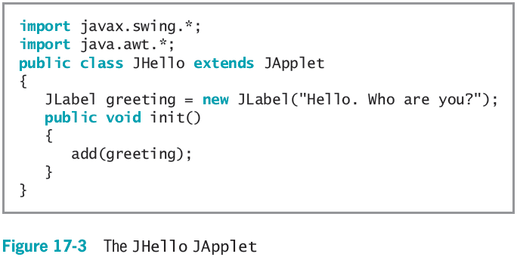
Using the init() Method (cont’d.)
Java Programming, Seventh Edition

Slide 14
Working with JApplet Components
All the techniques that are used with JFrames can also be used with JApplets:
  Change the font and color of labels
  Use layout managers
  Add multiple GUI components
  Change the background color
  Add listeners for user events
  Add images and sounds
Java Programming, Seventh Edition

Slide 15
Understanding the JApplet
Life Cycle
Applets are popular
  Easy to use in Web pages
JApplet class
  Contains methods automatically called by the browser:
    init()
    start()
    stop()
    destroy()
Java Programming, Seventh Edition

Slide 16
The init()
Method
init() method
  Executes when a Web page containing a JApplet is loaded or when the appletviewer command is run
Java Programming, Seventh Edition

Slide 17
The start()
Method
start() method
  Executes after the init() method
  Executes again every time the applet becomes active after it has been inactive
Java Programming, Seventh Edition

Slide 18
The stop()
Method
stop() method
  Invoked when a user leaves a Web page
Java Programming, Seventh Edition

Slide 19
The destroy()
Method
destroy() method
  Called when the user closes the browser or the Applet Viewer
  Releases any resources JApplet might have allocated
Every JApplet has the same life cycle outline
Java Programming, Seventh Edition

Slide 20
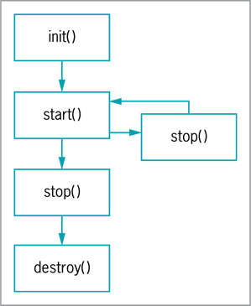
The destroy()
Method (cont’d.)
Figure 17-10 The JApplet life cycle
Java Programming, Seventh Edition

Slide 21
Understanding Multimedia and Using Images
Multimedia
  The use of sound, images, graphics, and video in computer programs
Java provides extensive multimedia tools:
  Java 2D or Java 3D Application Programming Interface (API)
  Java Media Framework (JMF) API
  Java Sound
  Java Advanced Imaging API
  Java Speech API
Java Programming, Seventh Edition

Slide 22
Adding Images to JApplets
Image
  A likeness of a person or thing
Image formats supported by Java:
  Graphics Interchange Format (GIF)
  Joint Photographic Experts Group (JPEG)
  Portable Network Graphics (PNG)
Image class
  Provides many of Java’s image capabilities
Java Programming, Seventh Edition

Slide 23
Adding Images to JApplets (cont’d.)
Declare an Image
  companyLogo = getImage(getCodeBase(), "logo.gif");
Use the applet paint() method to display an Image
drawImage() method
  Is a Graphics method
ImageObserver
  Can be any object that implements the ImageObserver interface
  All Components inherit this implementation
Java Programming, Seventh Edition

Slide 24
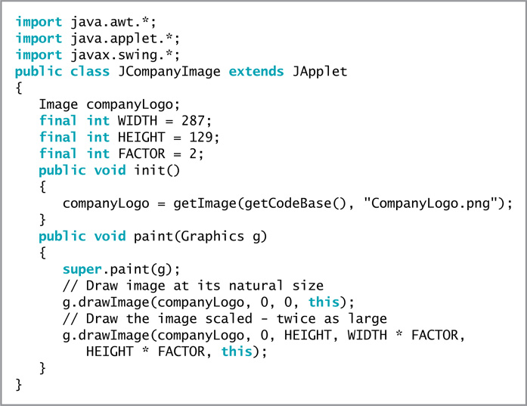
Figure 17-15 The JCompanyImage JApplet
Java Programming, Seventh Edition

Slide 25
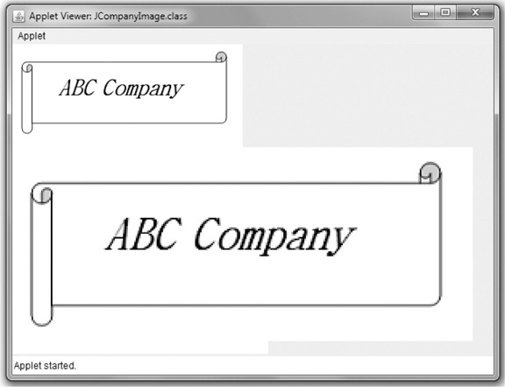
Adding Images to JApplets (cont’d.)
Figure 17-17 Output of the JCompanyImage JApplet
Java Programming, Seventh Edition

Slide 26
Using ImageIcons
ImageIcon class
  Creates images in applications and applets
  Is simpler than working with Image
You can place an ImageIcon on a Component
  ImageIcon arrowPicture = new ImageIcon("arrow.gif");
  JButton arrowButton = new JButton(arrowPicture);
paintIcon() method
  Displays ImageIcon images
Java Programming, Seventh Edition

Slide 27
Adding Sound to JApplets
Java supports sound using methods from the Applet class
play() method of the Applet class
  The simplest way to retrieve and play a sound
  Two forms
  Codebase attribute
    Indicates the filename of the applet’s main class file
  getCodeBase() method:
  AudioClip aClip =
new AudioClip(getCodeBase(), "tune.au");
Java Programming, Seventh Edition

Slide 28
You Do It
Creating an HTML Document to Host an Applet
Creating and Running a JApplet
Running a JApplet in Your Web Browser
Creating a More Complicated JApplet
Making the JApplet’s Button Respond to Events
Understanding the Applet Life Cycle
Creating an HTML Document to Host the JApplet
Displaying Images
Playing Sounds
Java Programming, Seventh Edition

Slide 29
Don’t Do It
Don’t forget a matching closing tag for every opening tag in an HTML document
Don’t forget to use the .class extension with the name of a JApplet
Don’t add a main() method to a JApplet
Don’t try to execute an applet using the java command
Java Programming, Seventh Edition

Slide 30
Summary
Applets
  Programs called from within another application
  Run within a Web page or within another program called Applet Viewer
Applet life cycle
  init()
  start()
  stop()
  destroy()
Java Programming, Seventh Edition

Slide 31
Summary (cont’d.)
Images
  Image
  ImageIcon
Sounds
  Applet
Java Programming, Seventh Edition

