Slide 1
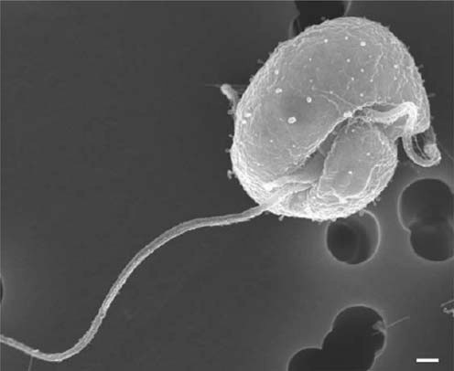
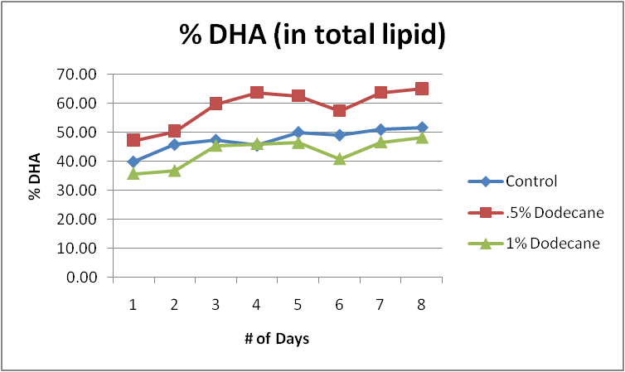
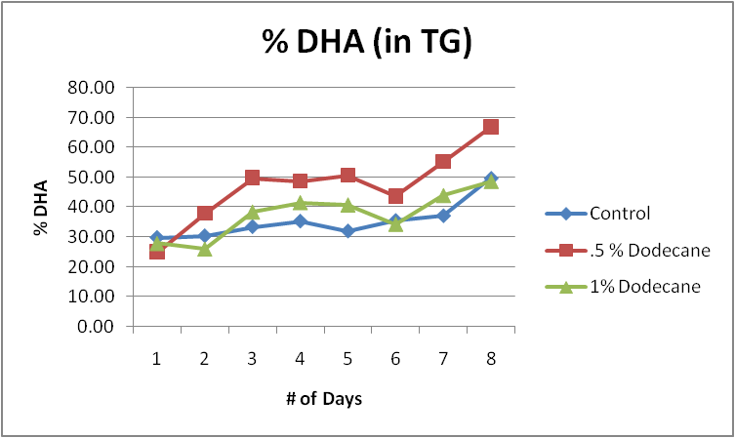
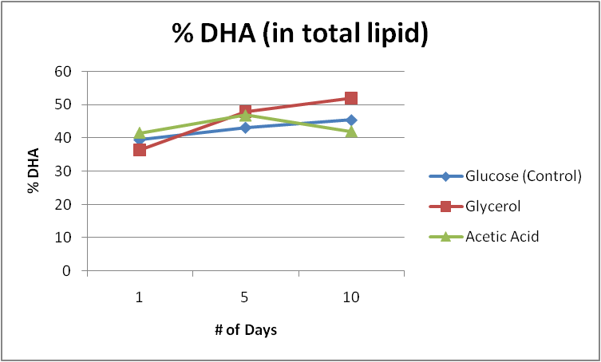
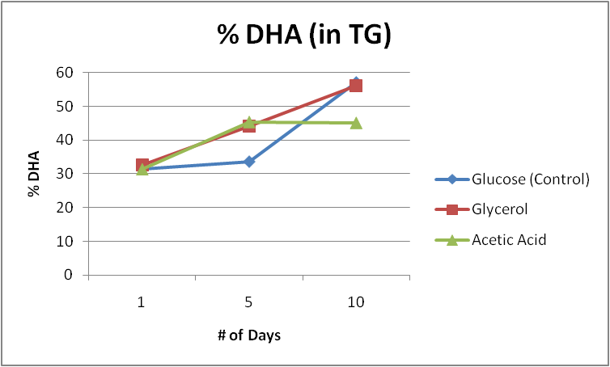
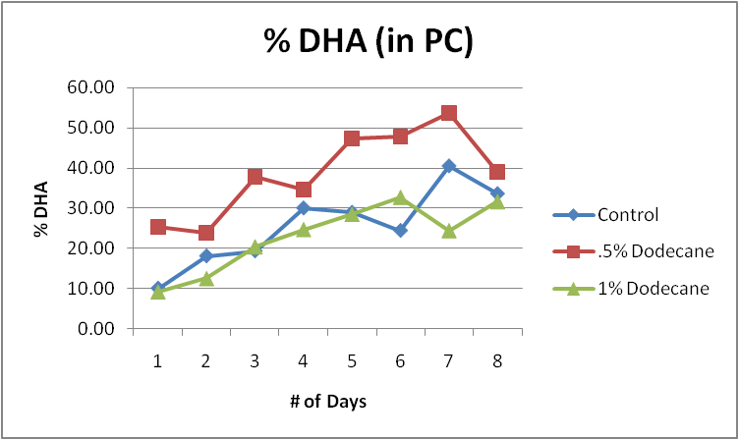
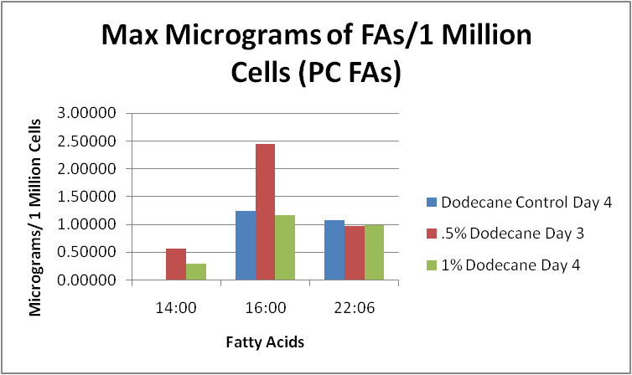
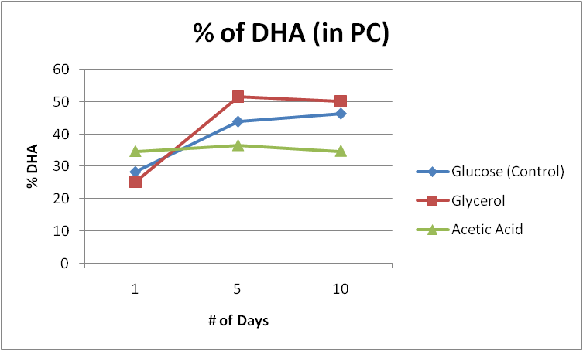
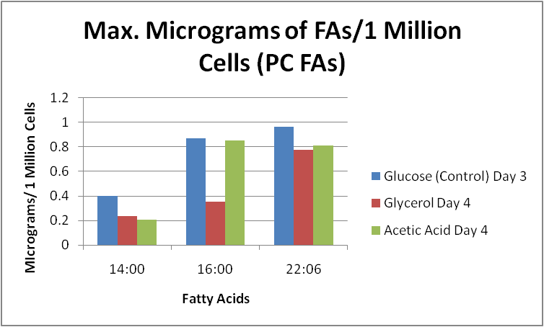
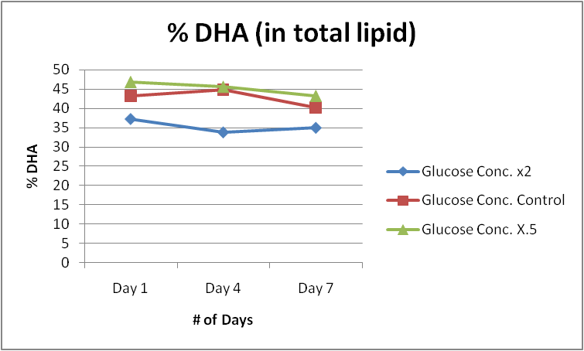
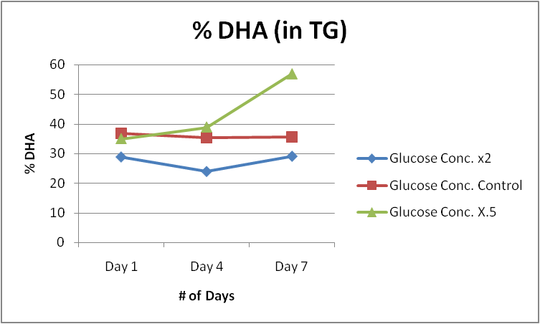
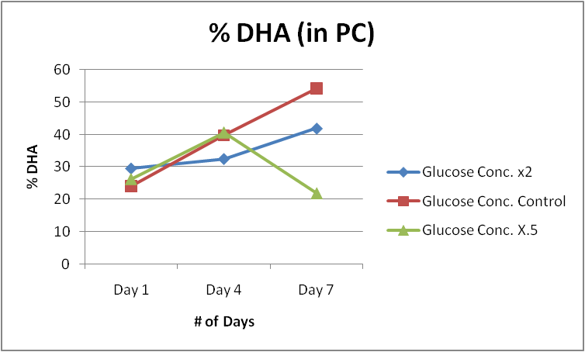
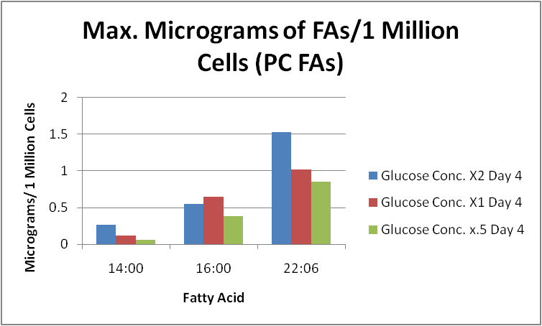
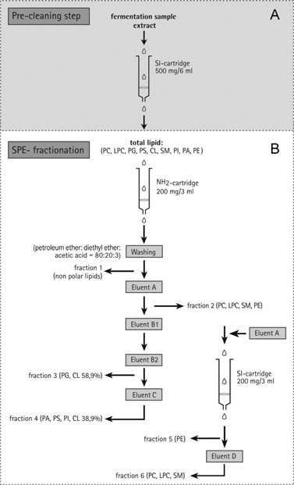
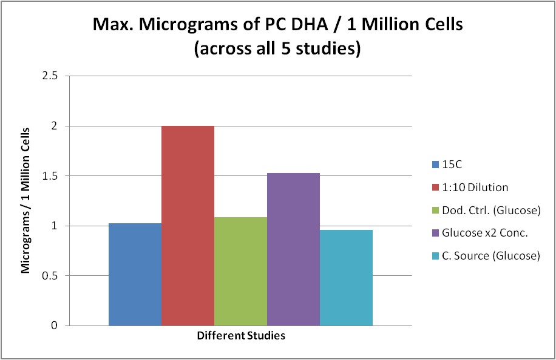
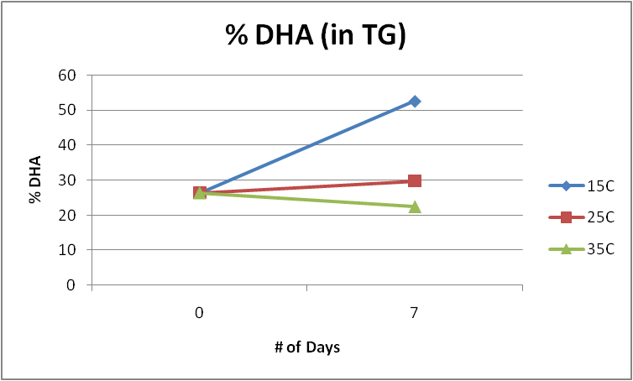
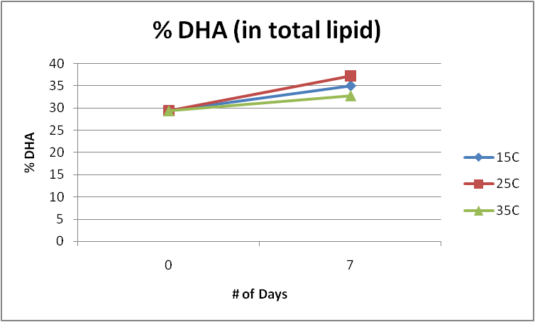
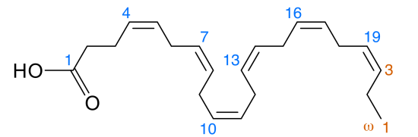
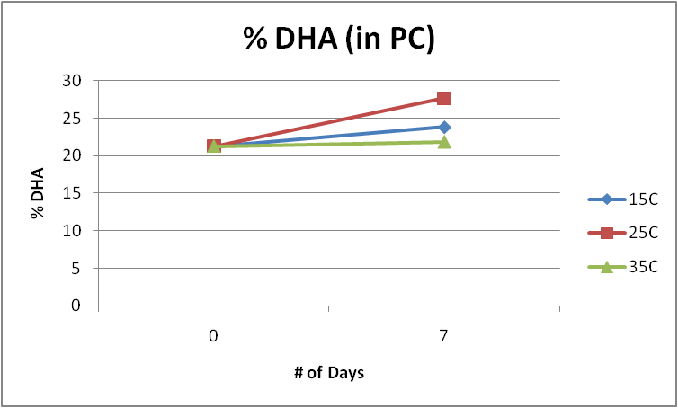
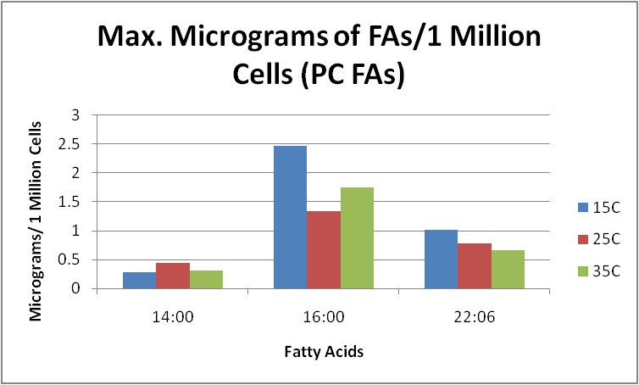
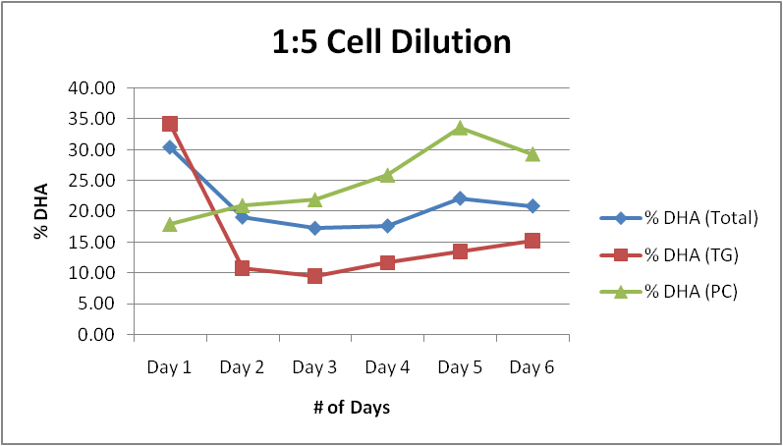
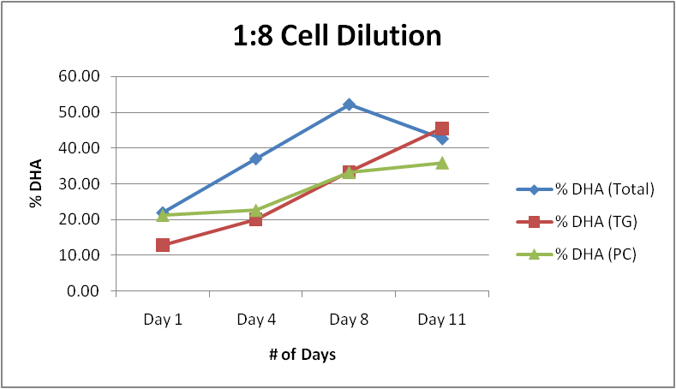
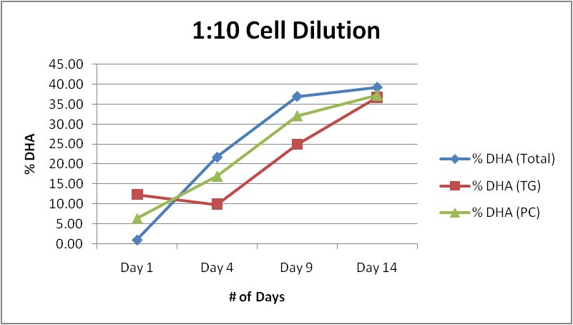
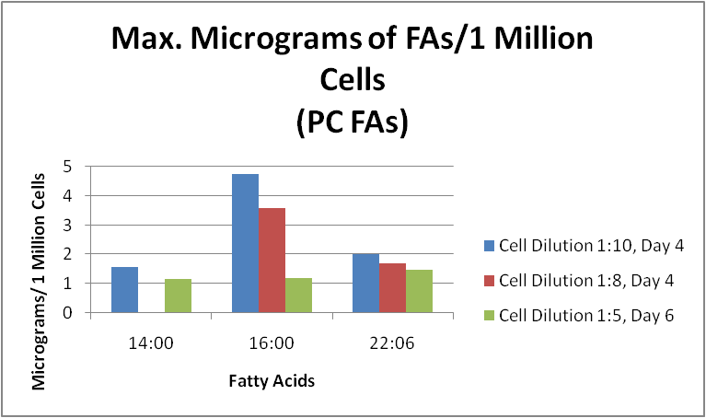

The effect of environmental factors on the distribution of DHA among neutral and phospholipids in microalgae.
Konrad Kadzielawa, Papasani V. Subbaiah, PhD
University of Illinois at Chicago
Abstract
Methods
Results
Results
Conclusion
Crypthecodinium cohnii is a species of dinoflagellate microalga that is frequently used in the industrial production of Docosahexaenoic acid (DHA), an essential fatty acid which is highly concentrated in the brain and whose consumption is associated with a number of health benefits. Most industrial production results in the triglyceride (TG) form of the DHA which is not effective in enriching brain DHA. Since recent studies show that there is a transporter at blood-brain barrier that transports exclusively the lysophosphatidylcholine (LPC) form of DHA (Mfsd2a), it is of great practical importance to develop an effective method to maximize the production of this desirable form of DHA.
Hence, the focus of this study is to maximize the amount of DHA in the phospholipid form produced by the C.cohnii through varying their environmental growth factors, e.g. temperature, carbon source, cell concentration, pH etc. The preliminary analysis done by GC/MS and LC/MS of the total fatty acid composition as well as TG/phospholipid DHA composition, suggests that the environmental factors are a significant factor influencing the total amount as well as the chemical form of the DHA produced by the algae. Specifically, reducing the growth temperature was found to enrich the neutral lipid, while harvesting the algae in subconfluent conditions was found to enrich the phospholipid.
The results of this study might be used for the optimal preparation of the PC DHA which could then be easily converted to LPC DHA suitable for human consumption.
C. cohnii cells were ordered from ATCC (30772) and stored in liquid nitrogen for 1 month prior to cultivation. Cells were recovered and subsequently grown for 5 days in ATCC Culture Medium 460 in flat tubes (10 ml). Cells were then centrifuged, ATC 460 discarded, cells were inoculated in 25 ml conical flask in media A (glucose, salt, yeast extract) until reaching confluence. Cells were then further inoculated in 125 ml conical flask and rested until reaching confluence. Cells were then split into 5 flasks – first three (3) were split based on different initial cell concentration - 25 ml of confluent cells was put in 125 ml, 200 ml, and 250 ml as final volume conical flasks. Other flasks were kept for further experiments. Aliquots of 10 ml were taken out daily, cell count was recorded /1ml, aliquots were frozen in phosphate buffered saline solution.
Cells were extracted using Bligh-Dyer method (.9:1:1, water, methanol, chloroform), evaporated under N₂, each sample fractionated by NH₂ silica cartridge into TG and PC fractions (look below), again dried under N₂, methylated (.5 mL BHT, 22:3 100 μg/ml standard) and further extracted with 2:1 hexane:water.
The samples were analyzed by their total fatty acid composition using GC/MS, results exported to Microsoft Excel and further analyzed.
Study 1: Dodecane Concentrations
Study 2: Glucose Concentration
Study 3: Temperature Change
Study 4: Cell Dilution
Study 5: Carbon Source
The overall conclusion can be drawn from Figure 2 which quite succinctly summarizes the overall findings of the experiment. Using 5 different environmental factors as our variables and the amount of PC DHA / 1 million cells as our outcome, it can be stated that neither lowering the temperature, adding dodecane nor varying the carbon source yielded any significant differences in dry weight of PC DHA. The only two factors that affected our outcome were the dilution factor of our cells (by how much we diluted the cells in terms of initial : final volume of the cell suspension) and how much glucose was placed into the growth medium. This lies in stark opposition to a variety of studies hitherto cited which have shown quite significant increases in DHA when C. cohnii were exposed to dodecane, different carbon sources and temperature. Nevertheless, most of these studies focused on the total or neutral lipid form of the DHA and not the phospholipid, which according to very recent studies is the more bioavailable form of DHA and which, in near future, might be the recommended form of DHA to be produced.
The results of this study can be used to maximize the production of phospholipid DHA in the industrial setting.
Discussion
The effect of environmental factors on the DHA production by the C.cohnii microalgae strain has been well studies and documented. However, no previous study have looked at the relation between total, TG and PC DHA forms and how we can maximize the production of each.
The cell count during cultivation strongly suggests two main growth phases in C. cohnii: the rapid division and stable stationary phase. All of the hereby studies have focused primarily on what happens during the rapid division phase (first 7 days after dilution).
Cell dilution study strongly suggests that rapid growth phase causes an increase in total DHA, decrease in TG DHA and a slight increase in PC DHA – possibly due to PC DHA use being a membrane phospholipid necessary part of their cell wall synthesis.
The glucose concentration study strongly suggest that as resources are being exhausted (carbon source x.5) and algae stop multiplying sooner, there is a decisive shift from the PC DHA to TG DHA, with a significant difference in PC DHA between standard and double glucose concentration.
The dodecane experiment suggest that as a fatty acid percentage, PC DHA does not vary greatly with the carbon source – as opposed to saturated fatty acids.
The temperature study agrees with the general literature that lower temperature enhances the production of PUFAs by the C. cohnii – possibly in order to maintain proper membrane lipid fluidity and functions, but also an increased production of saturated FAs.
What is worth noticing is that the absolute amounts of DHA, in any form, at the end of each of the studies, hover around 1-1.5 μg/1 million cells implying that if our sole interest is to maximize the final amount of the PC DHA, we are better off using the cheapest ingredients available.
Our method of fractionation – based on
“An improved SPE method for fractionation
and identification of phospholipids” Fauland, Trozmuller (2013)
Introduction
Figure 2
Docosahexaenoic acid (DHA) is essential for the growth and functional development of the brain in infants as well as maintenance of normal brain function in adults. It has been reported that DHA in the diet improves learning ability, whereas deficiencies of DHA are associated with deficits in learning. A multitude of diseases have been linked to lower levels of DHA in the brain, among them: fetal alcohol syndrome, attention deficit hyperactivity disorder, cystic fibrosis, phenylketonuria, unipolar depression, aggressive hostility, adrenoleukodystrophy as well as Alzheimer’s disease.¹
The issue at hand is that most of the natural products which have DHA in them, contain the triglyceride (TG) form of the DHA and that most of the industrial methods of DHA production aim at total DHA enrichment which as mentioned previously, do not enrich the brain with DHA.
References
Environmental Factors
Health benefits of docosahexaenoic acid (DHA), Horrocks LA1, Yeo YK.
“An improved SPE method for fractionation and identification of phospholipids” Fauland, Trozmuller (2013)
“Crypthecodinium cohnii with emphasis on DHA production: a review” – Mendes, Silva (Picture taken)
“Mfsd2a is a transporter for the essential omega-3 fatty acid docosahexaenoic acid” – Nguyen, Silver
C. cohnii were grown in a variety of environmental factors:
Different initial cell concentration (dilution factors of 1:5, 1:8 and 1:10)
Dodecane exposure (Control, .5%, 1%)
Glucose Concentration (x.5, Control, x2)
Carbon Source (Acetic Acid, Glucose, Glycerol)
Temperature (15°°C, 25°C, 35°C)
Our new friend, Crypthecodinium cohnii

