Slide 1

Large Leaderboard
General address for material delivery* adopsbe@adux.com
*Material sent to a personal mail address will not be taken into account

Slide 2
Delivery guidelines
Delay : 3 business days
3rd party
HTML5
JPG / GIF
Feedback on material validity within 48H
If material fails to meet our requirements: restart procedure
Campaign material should include
All necessary creatives that meet our specifications
Destination links that are live
For HTML5: zip-file with all files included
For 3rd party material: active redirects

Slide 3
Specifications
Specification | Explanation
SSL Compliance | Compliant SSL ads are recommended. SSL ensures that your ads reach the widest possible audience across our network and the web. Non-compliant SSL ads will be excluded from SSL compliant publisher sites
Extension | .html, .css, .js contained in a zip-file (.zip)
Size | 840x250
Max weight file | 99ko
Destination link | Max 1024 characters
HTML5 specifications | Limited outside network connection Limited libraries, fonts (Max 1. each type) Code compression (optional) Use <meta name="ad.size" content="width=[WIDTH],height=[HEIGHT]">
3rd party | Accepted

Slide 4
Specifications
Site info | Explanation
Clicktag | Should be placed in .html file (without minification/obfuscation). Ads must use the clicktag variable as destination of the click event, whether handled by anchor tags. (<a>), window.location, window.open or any other method of navigating. Implementation: <a id=“clickarea” target=“_blank”><a/> Javascript – var clickarea = document.getElementById(“clickarea”); Clickarea.href= clickTag;

Slide 5
Specifications
Details | Explanation
ZIP-file specifications (IAB specifications) | At least 1 .html file (starting point of the ad) in the .zip. Structure files as needed (files in subfolders or presented solely within the folder). All code & assets should be referred to by the .html file. Minimize the # of individual files (for performance reasons). All code and assets needed to run the ad should be in the .zip file. The ad needs to be selfcontained so that rendering the ad is not dependent on a network connection. Exceptions include files such as Javascript libraries or web fonts, but the file size of these external files should still be considered part of the overall file size if they are loaded upon the initial file load.
Audio | Sound: off by default (always user initiated on click action). A sound on/off button
Animation | 3 loops within 15sec (unlimited during user interaction)

Slide 6
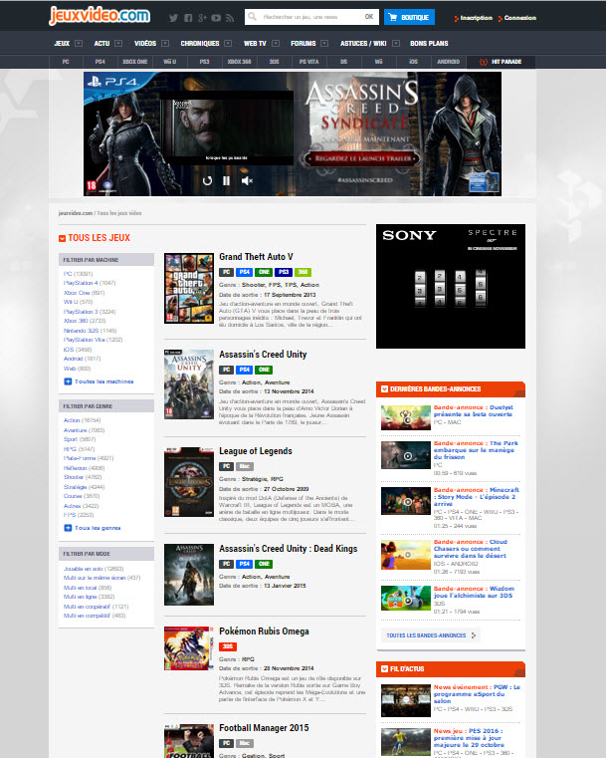
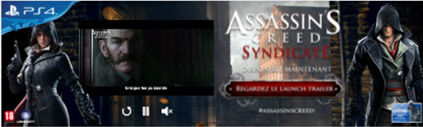
Example

