Slide 1
Microsoft Movies
Phase 1 Project

Slide 2
Table of contents
01
02
03
04
Overview
Analysis
What is the business problem
What data did I use and how did I analyze the data
Fidings
Recommendations
My findings from analyzing the data
Recommendations for the business

Slide 3
01
Overview
What is the business Problem?

Slide 4
To begin
Business Problem
You are planning to join in on the fun of creating original films like the like of Netflix and Amazon Prime Video. My task was to explore different type of films and which of this films are doing well in box office, then offer my recommendations on which film to create based of the correlations of the different genres to the profits, popularity, rating, directors, and writers.

Slide 5
02
Analysis

Slide 6
Analysis
The analyzed data is from top movie websites, such as Box Office Mojo, IMDB, and rotten Tomatoes. Some tables contained names of movies, some the name of the directors and writers of the movies and others the title of the movies. The problem is that, not only is the data contained in this tables unclean but they are unlink able.

Slide 7
Analysis
In order to make the data useful, I had to link the tables and ensure the data did not have any missing value. To do this I had to establish a relationship among the tables. The key which allowed for the table to be linked was the movie titles and Movie names

Slide 8
03
Findings

Slide 9
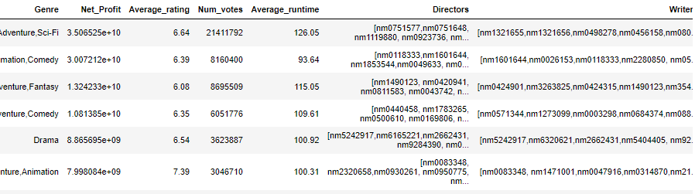
Genres with most profits

Slide 10
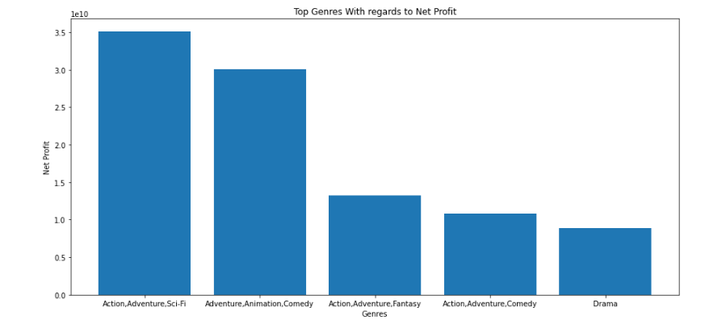
Bar Graph

Slide 11
The table shows the top five most profitable genres to be:
Action,Adventure,Sci-Fi
Adventure,Animation,Comedy
Action,Adventure,Fantasy
Action,Adventure,Comedy
Drama

Slide 12
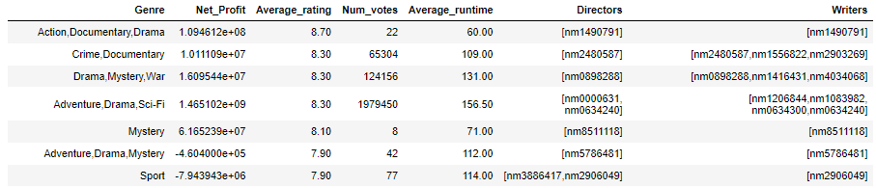
Genres with highest ratings

Slide 13
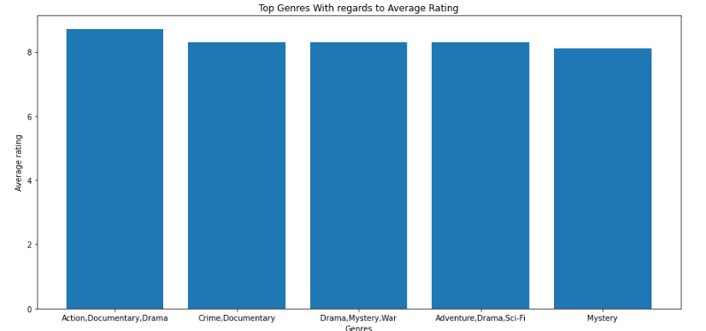
Bar Graph

Slide 14
The table shows the top five highest rated genres which are:
Action,Documentary,Drama
Crime,Documentary
Drama,Mystery,War
Adventure,Drama,Sci-Fi
Mystery

Slide 15
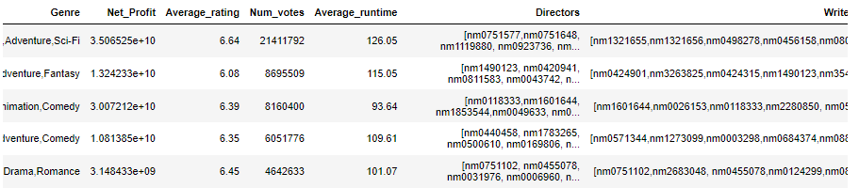
Most popular genre

Slide 16
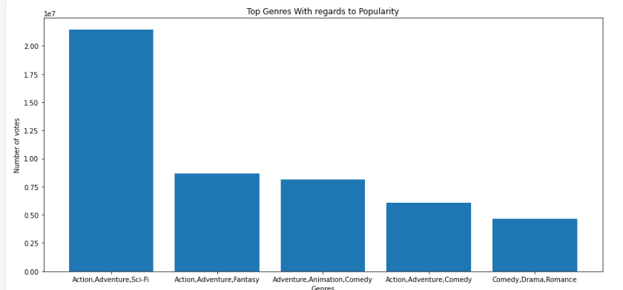
Bar Graph

Slide 17
The table shows the top five most popular genres are:
Action,Adventure,Sci-Fi
Action,Adventure,Fantasy
Adventure,Animation,Comedy
Action,Adventure,Comedy
Comedy,Drama,Romance

Slide 18
04
Recommendations

Slide 19
Recommendations
In an attempt to optimize the three different categories, I tried locating the genres that were in all three tables, but there were none. But on combing two tables, there are 17 genres that are in both the top twenty genres with regards to net profit and top twenty genres with regards to popularity.

Slide 20
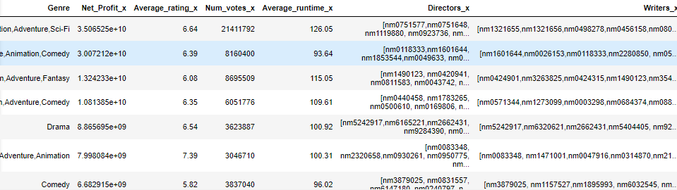
Sample of table

Slide 21
The table shows the top five genres as:
Action,Adventure,Sci-Fi
Adventure,Animation,Comedy
Action,Adventure,Fantasy
Action,Adventure,Comedy
Drama

Slide 22
Recommendation
Based of the data above, I would recommend the following:
Focusing on the five genres I have just listed above because they merge to very important factors to the success of movies, i.e. Net profit and popularity

Slide 23
Recommendation
2. I would recommend to get a hold of the staff associated with the high performing genres such as the directors and writers for a start

Slide 24
Recommendation
3. Finally I would recommend the average runtime for each genre to maintained because, for you to have similar high results you must adhere to the current methods already in place.

Slide 25
Thanks
Kevin Kagia - 0717306331

