Slide 1
Distributed Database Systems
Kalkidan Fekadu, Tee Kah Hui

Slide 2
Content
01
02
03
04
ARCHITECTURE
DATA LOADING
DEMO
EXTRA FEATURES

Slide 3



TOOLS
MongoDB
Jupyter Notebook
Sharding, Replication, Monitoring
Query
Studio 3T
Monitoring, GUI

Slide 4
ARCHITECTURE
GridFS
Shard-1
(primary)
Shard-1
(secondary)
Front End
Config-1
(primary)
DBMS 1
Region: Hong Kong
Category: Science
Mongos
Config-1
(secondary)
Shard-2
(primary)
Shard-2
(secondary)
Config-1
(secondary)
DBMS 2
Region: Beijing
Category: Science & Technology
Shard-3
(primary)
Shard-3
(secondary)
Shard-3
(secondary)
DBMS 3

Slide 5

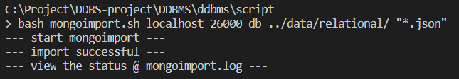
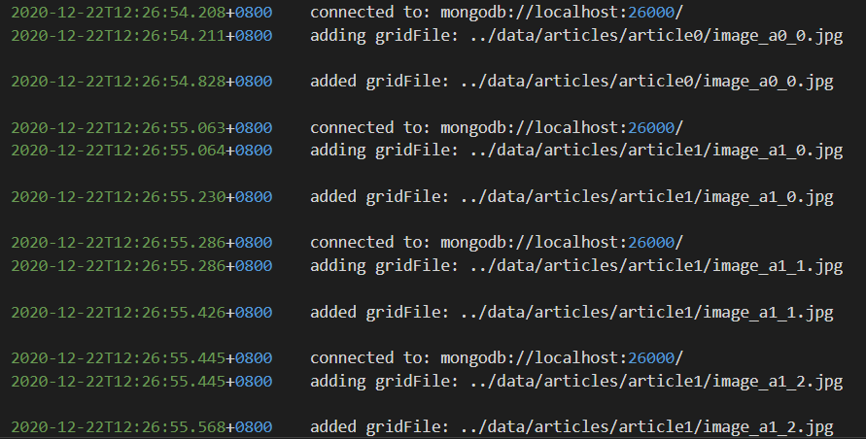
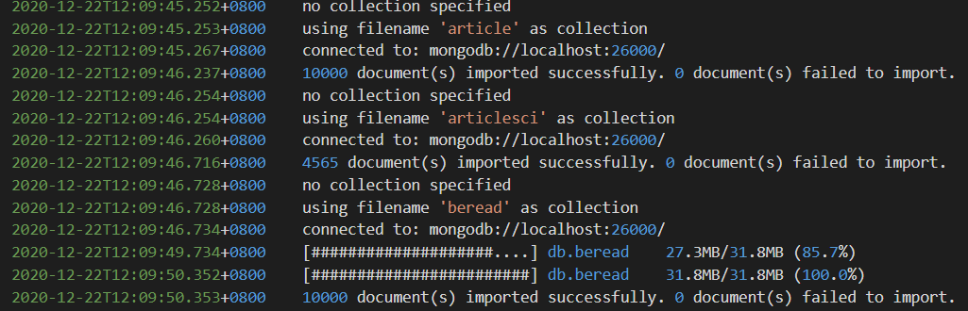
Data Loading
MONGOIMPORT
MONGOFILES
user, read, article, beread, popular-rank
unstructured data

Slide 6
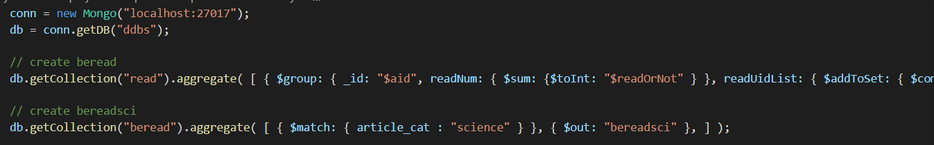
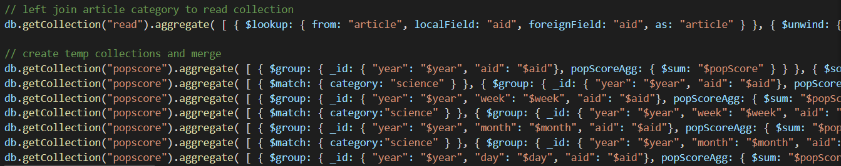
Aggregate

Slide 7
Calculate popular score
readOrNot
Popular Score
agreeOrNot
shareOrNot
0.01 * readTimeLength
commentOrNot

Slide 8
AGGREGRATION
category: science
DBMS 1
article
articlesci
category: science
bereadsci
beread
read
readregion
user
popscore
popyear
popyear
DBMS 2
popmonth
popweek
popday

Slide 9
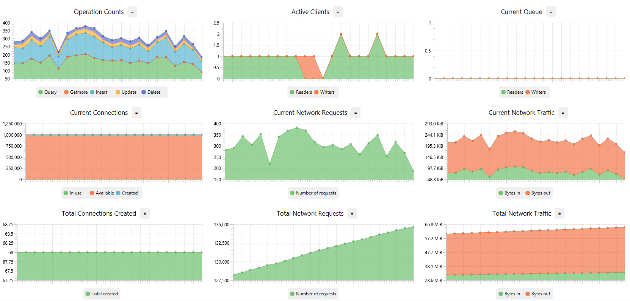
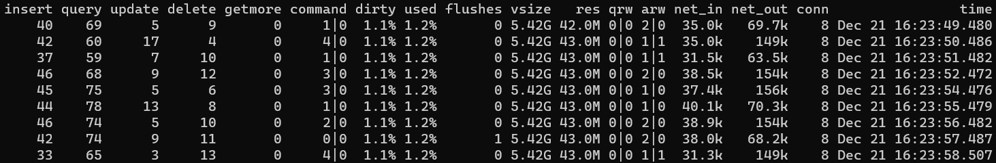
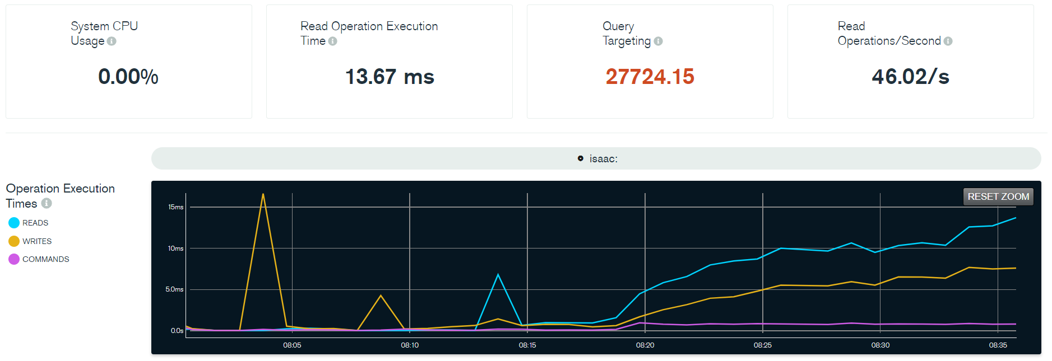
MONITORING
MONGODB
STUDIO 3T
sh.status()
mongostat
MongoDB 4.0 Free Monitoring
Server status chart

Slide 10
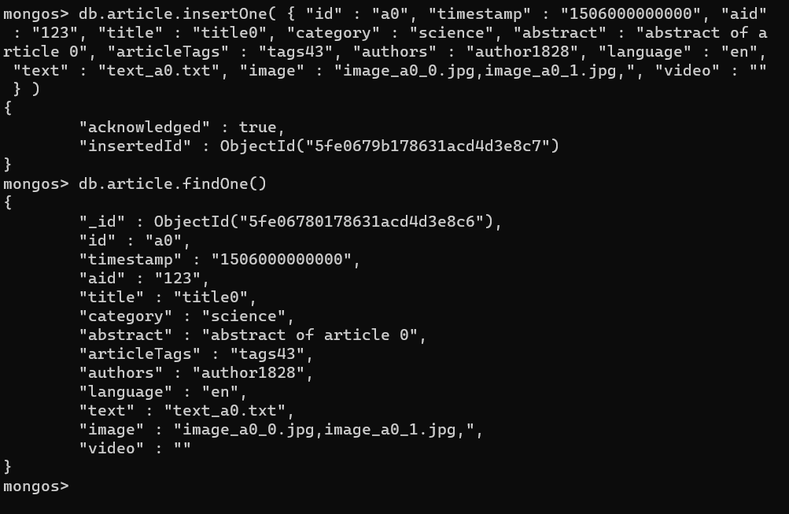
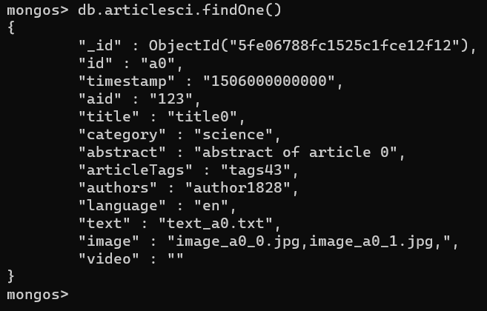
ARTICLE LISTENER

Slide 11
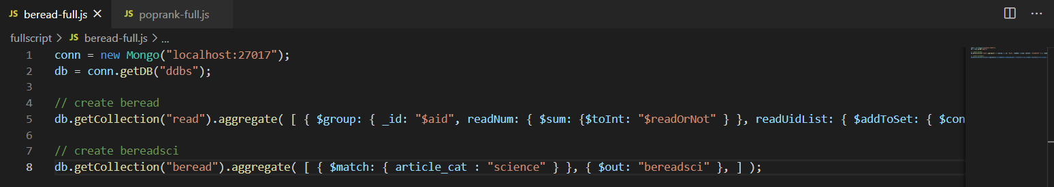
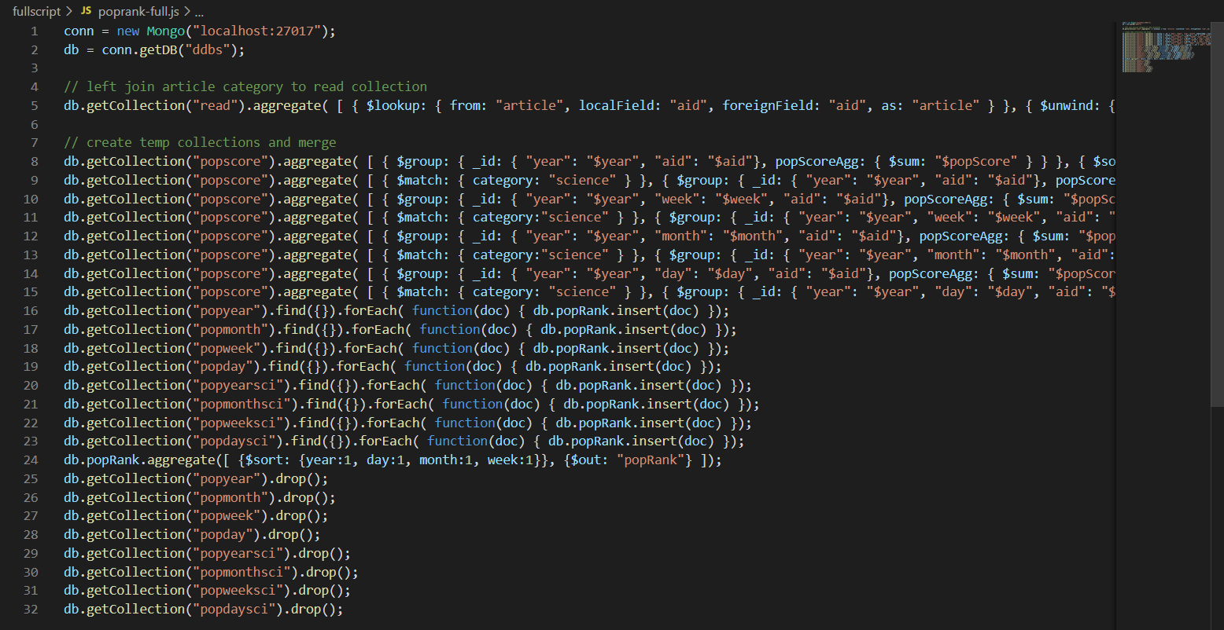
BEREAD & POPRANK AGGREGATOR
BEREAD
POPRANK

Slide 12
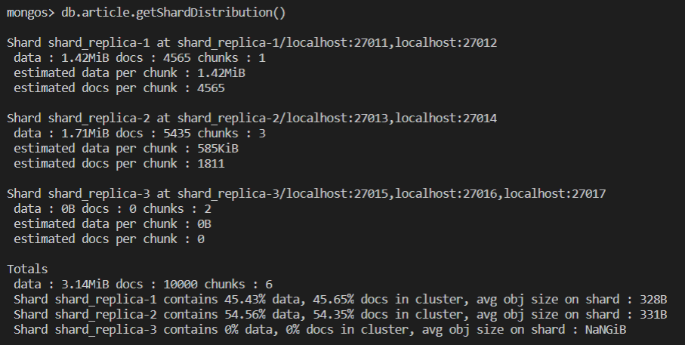
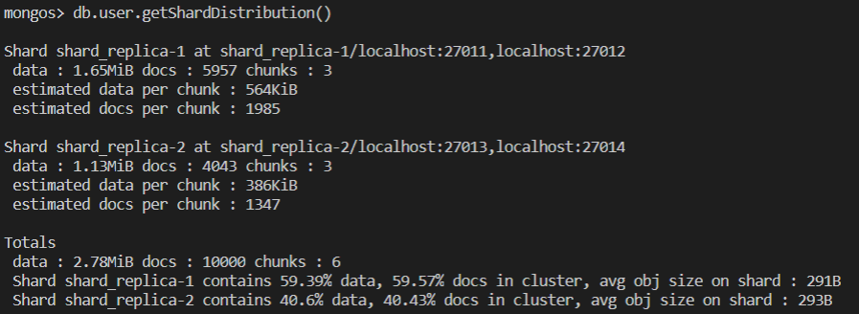
SHARDING
article
user

Slide 13
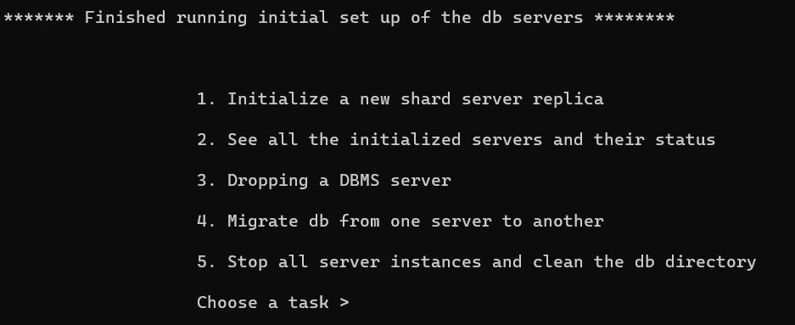
SETUP

Slide 14
DEMO

Slide 15
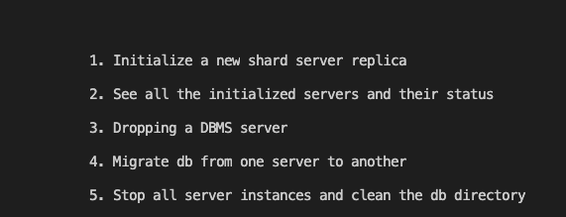

Slide 16
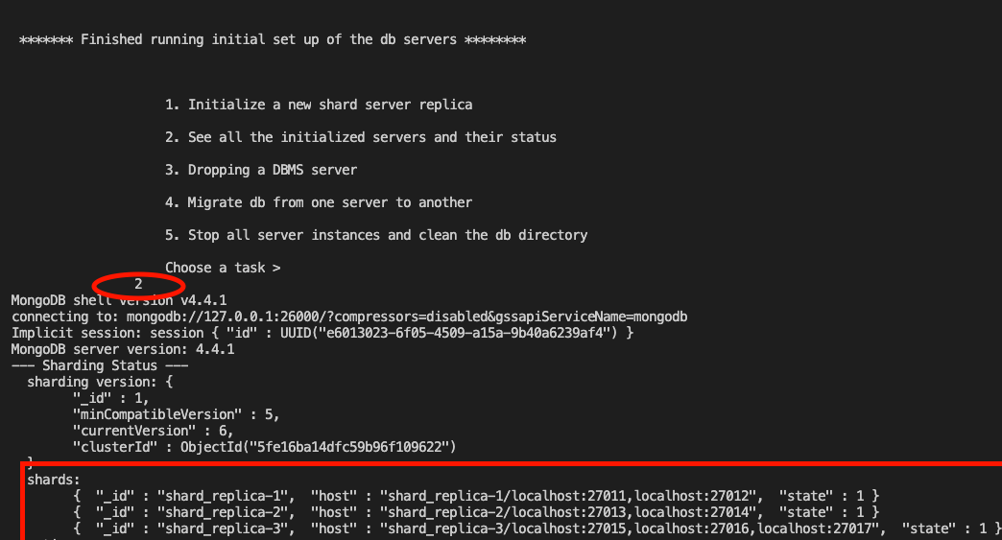
Monitoring | DBMS status
sh.status

Slide 17

Monitoring | DBMS status
host address of the primary servers for each shard
URL to the Free Monitoring tool

Slide 18

Monitoring | DBMS status

Slide 19
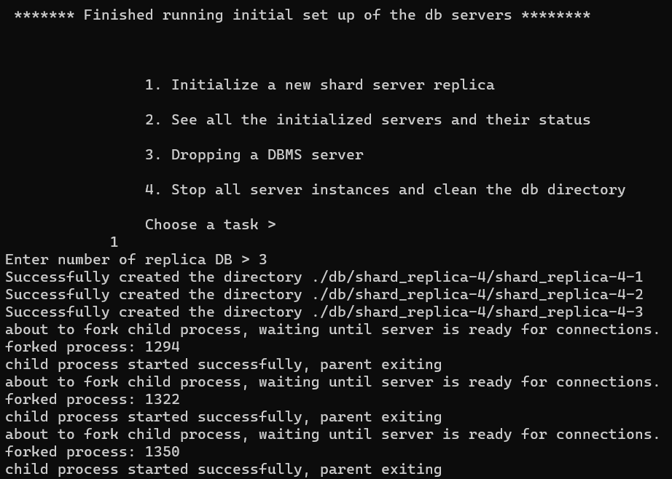
ADDING SHARD

Slide 20
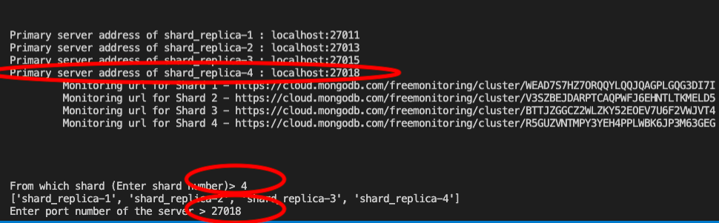
DROPPING SERVER | Before

Slide 21
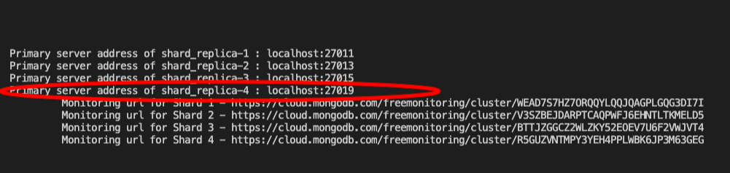
DROPPING SERVER | After

Slide 22
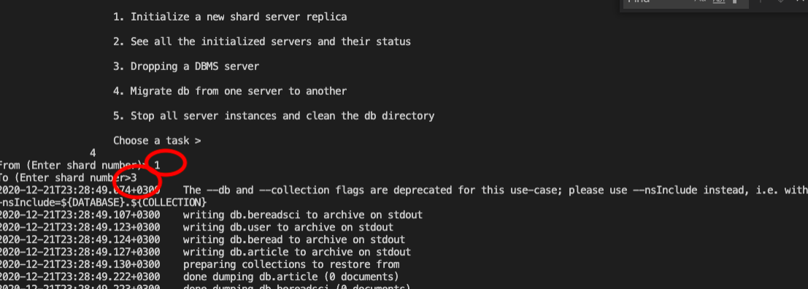

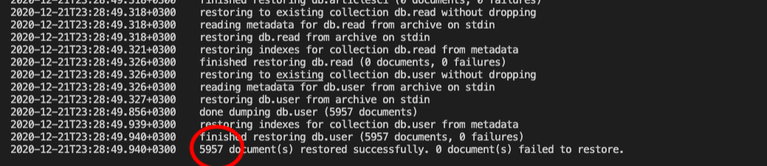
MIGRATION

Slide 23
THANK YOU

