Slide 1
Operations Qualification System Playback
Date : 04/20/2011

Slide 2
Outline
Business Process & Application Mapping
Application Functional Overview
Application Technical Overview
Application Operational Overview
Application Ticket Information
Application Inventory Status

Slide 3
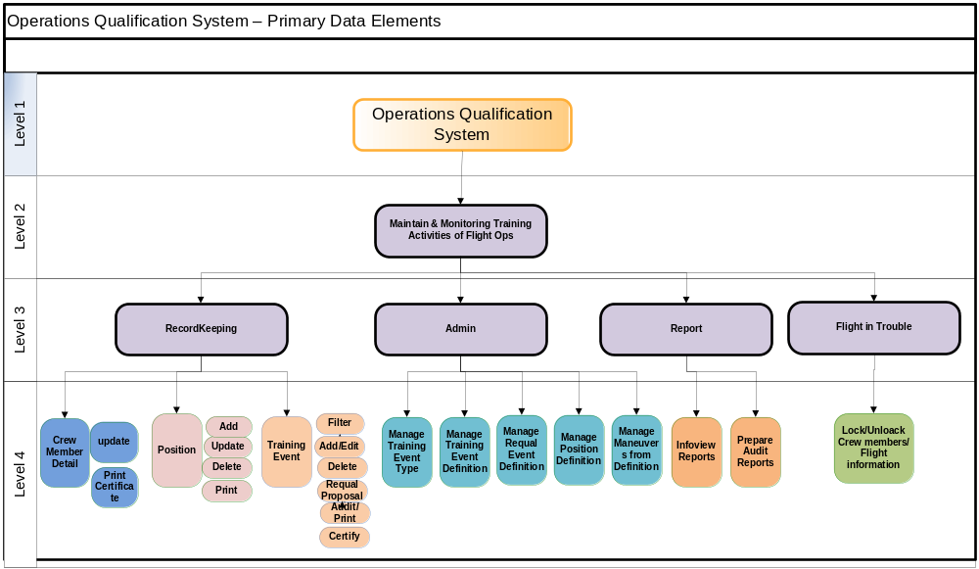
Business Processes

Slide 4
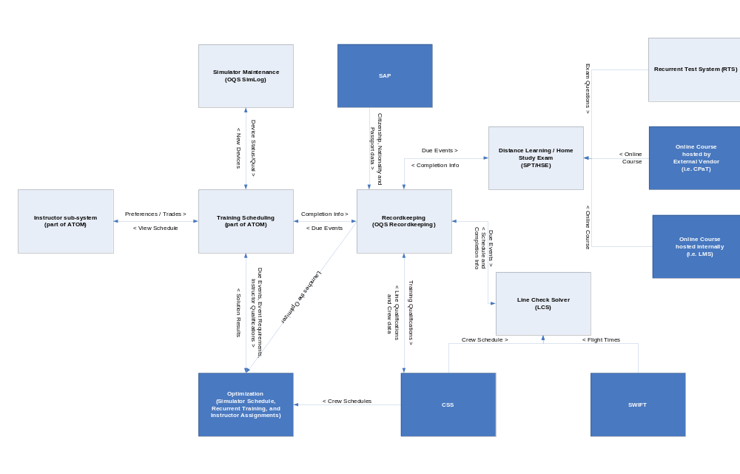
OQS – Application Process Overview

Slide 5
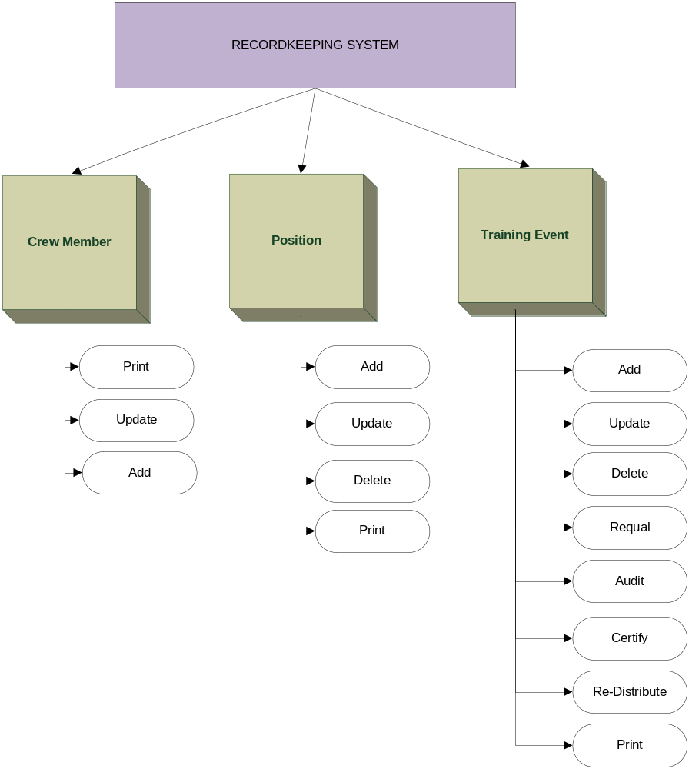
OQS – Process

Slide 6
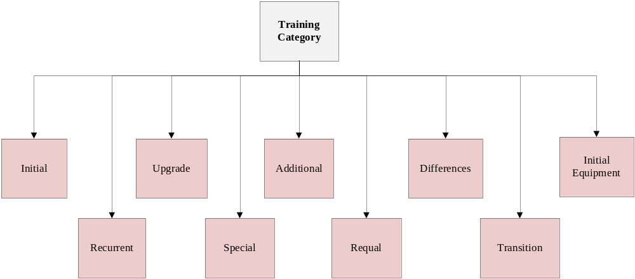
Training Events - Category

Slide 7
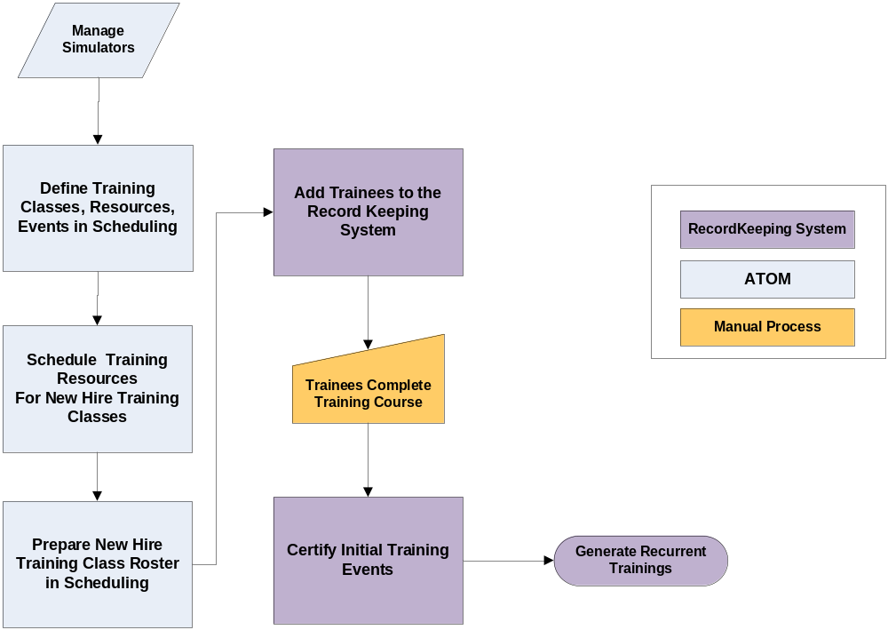
Training Category – Initial Training Events

Slide 8
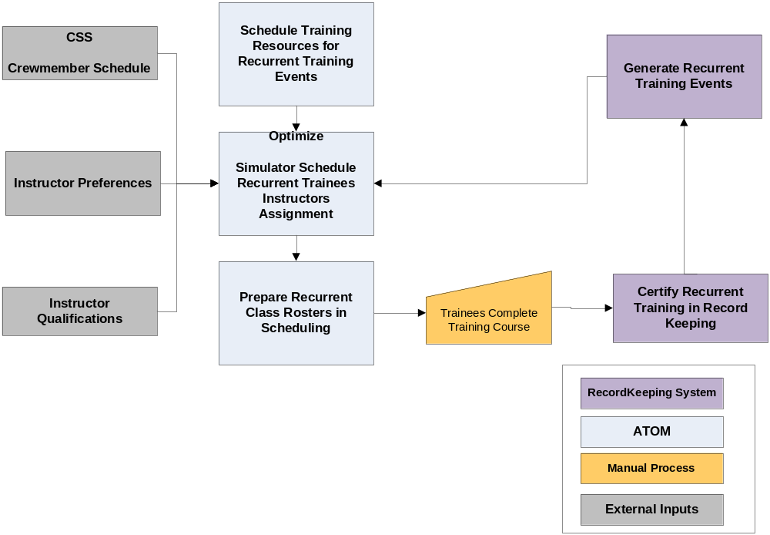
Training Category – Recurrent Training Events

Slide 9

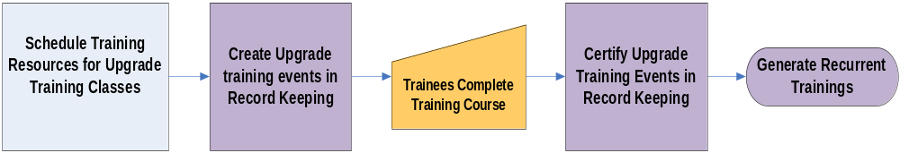
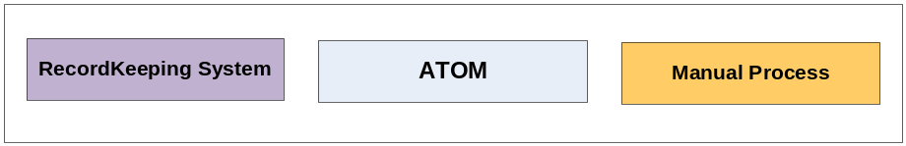
Training Category – Additional/Upgrade Training Events
Additional Trainings
Upgrade trainings

Slide 10
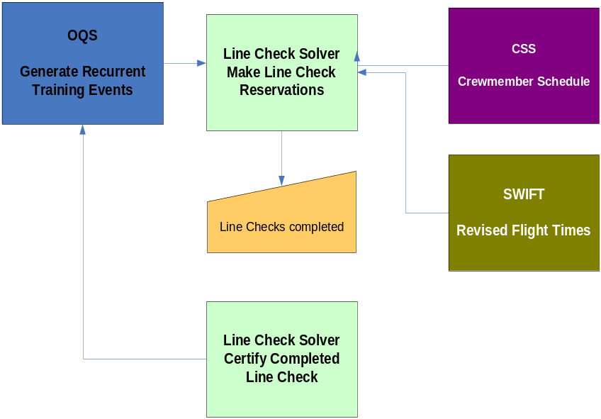
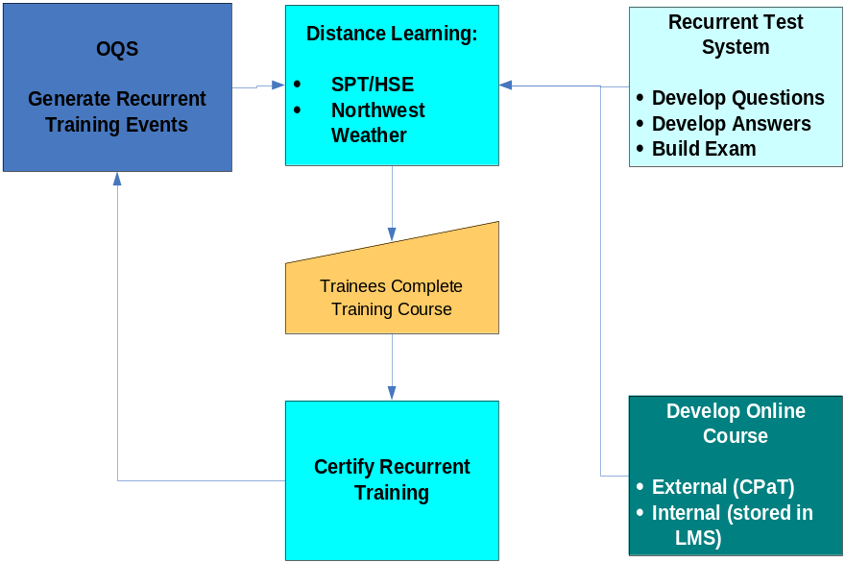
Training Category – Line Check/Distance Learning
Line Check Solver
Distance learning

Slide 11
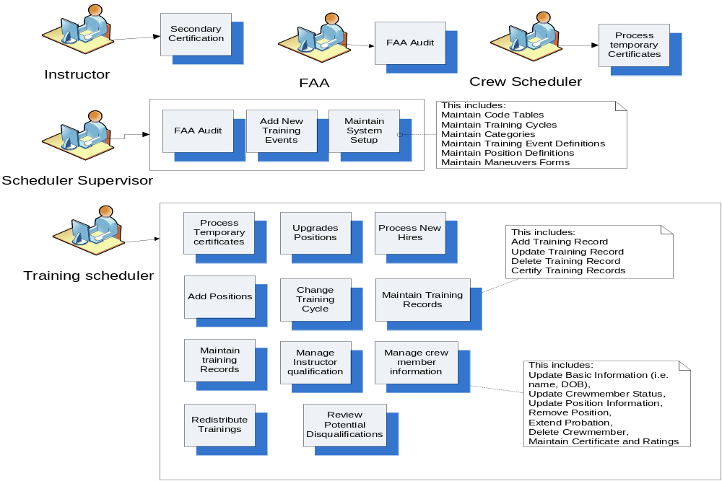
OQS - Users

Slide 12
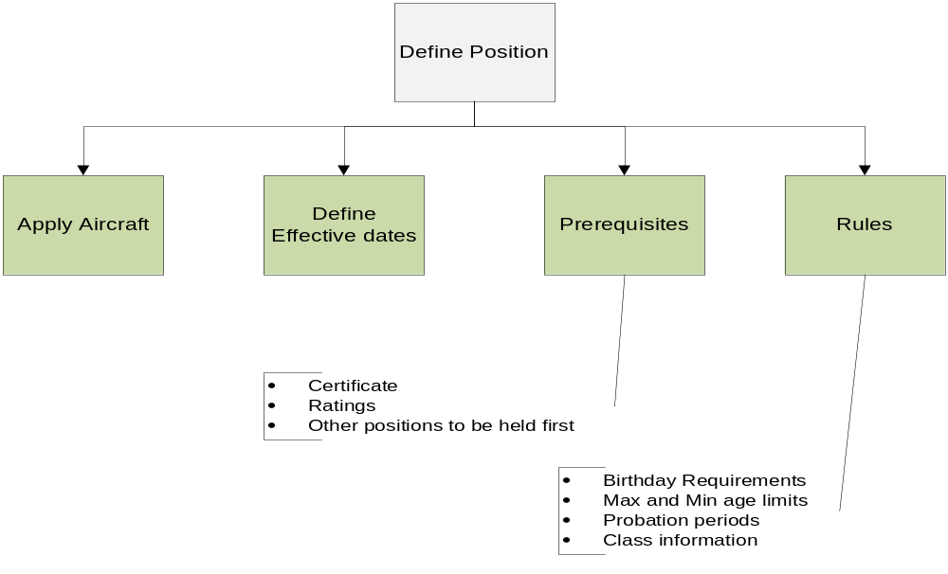
Define the Positions

Slide 13
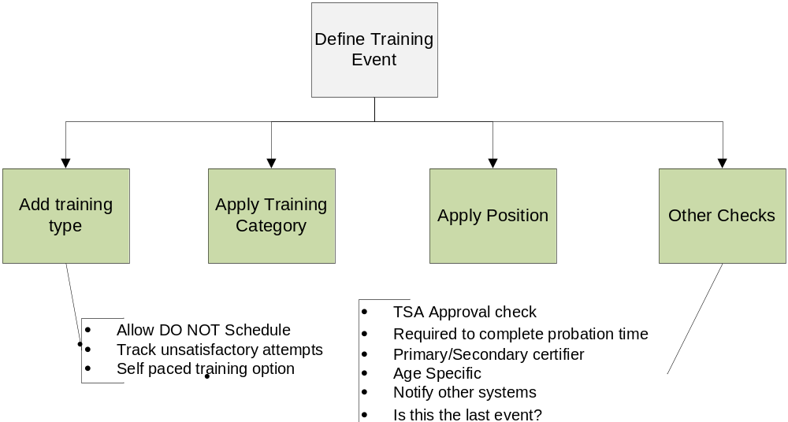
Define the training event – Initial Qualifying Category

Slide 14
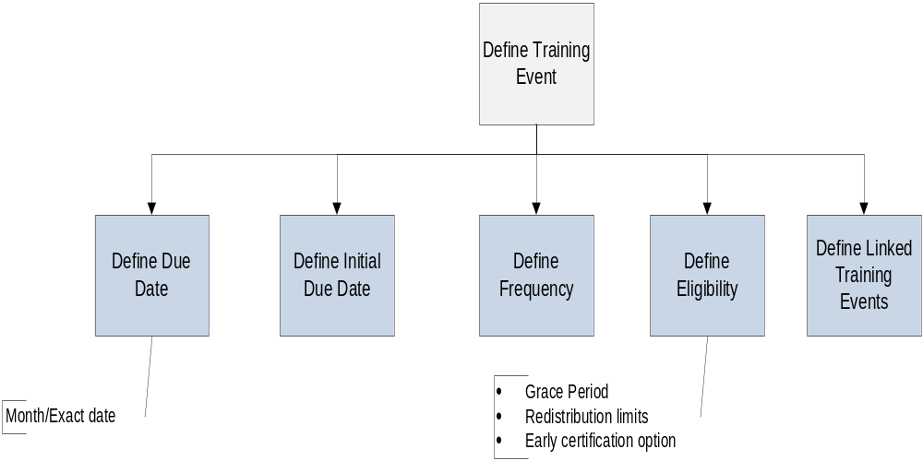
Define the training event – Recurrent trainings

Slide 15
Assign the training event
Order of trainings for Initial Qualifying Categories
Only one training can be last event
completion order
    with numbers
    with out numbers

Slide 16
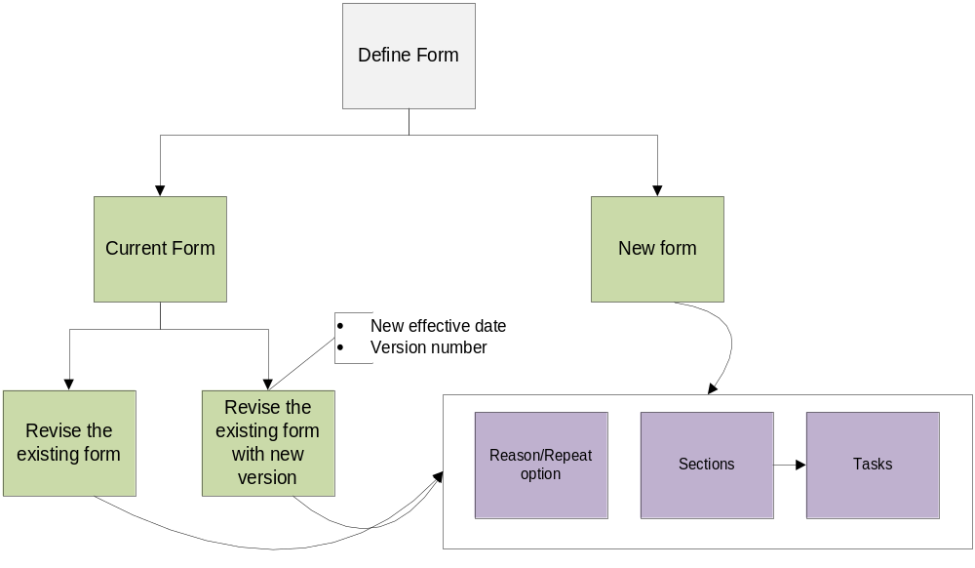
Define Maneuver Forms

Slide 17
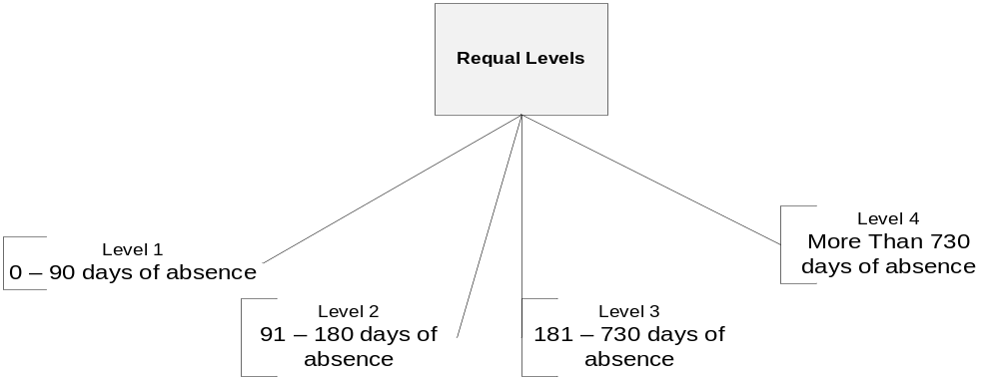
Define Requal Levels
First officer in – probation level 1 definition
- Check for 120 hrs of flying in probation period from CSS

Slide 18
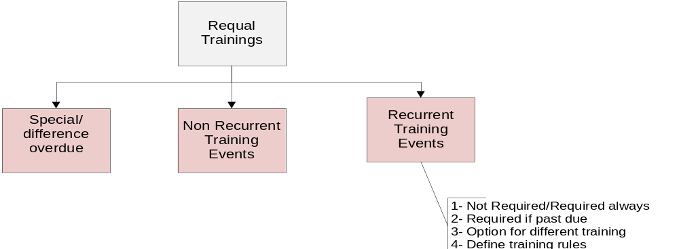
Requalification trainings and business rules
Once requal definition is used, it can’t be changed. To make change, the existing definition should be ended with a
new one created.

Slide 19
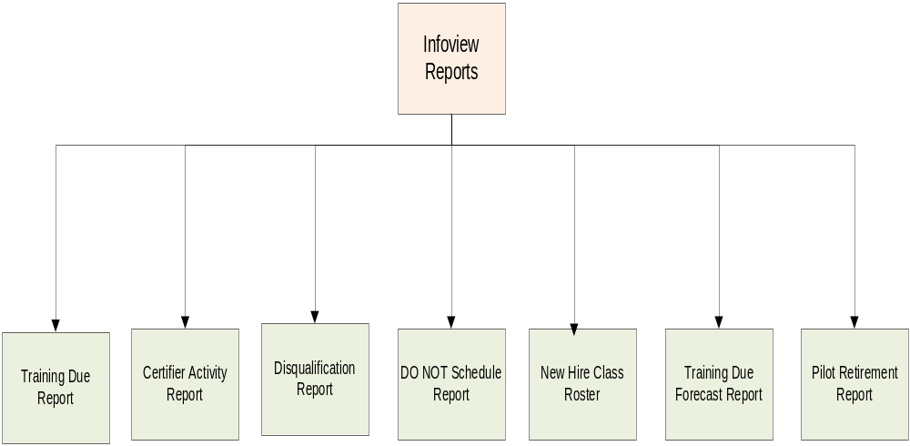
Reports

Slide 20
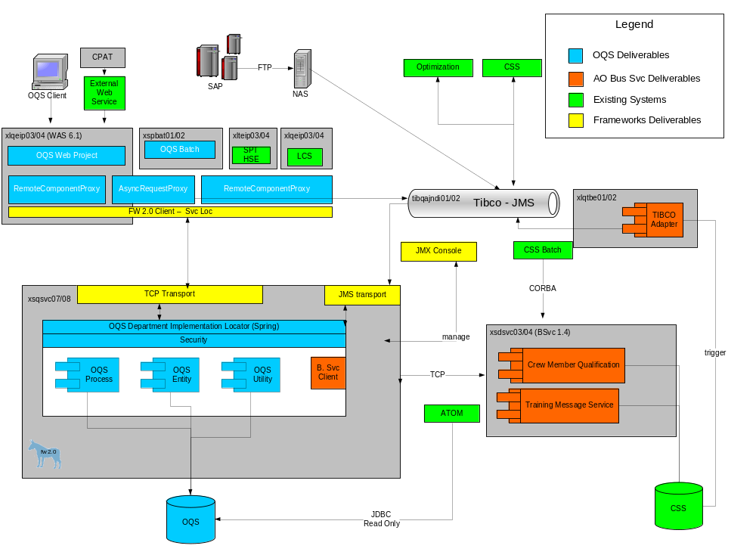
OQS Technical Diagram

Slide 21
OQS Operational Information
Application Usage (Client Perceptive)
6 AM – 6 PM CST including Weekends
SPT/Line Check Solver – 24 Hours/day including weekends
Quarterly Maintenance Releases
Maintenance Window – 2 hours After 6 PM CST
Production code deployment to SDC (Secondary data center)
OQS in SDC is SWAlife Independent and can be accessed via different URL.
OQS is “Critical To Business” Application.
SOX Compliance – NA PCI Compliance – NA
Critical Incident Report - None Reported BCP Event - None Reported

Slide 22
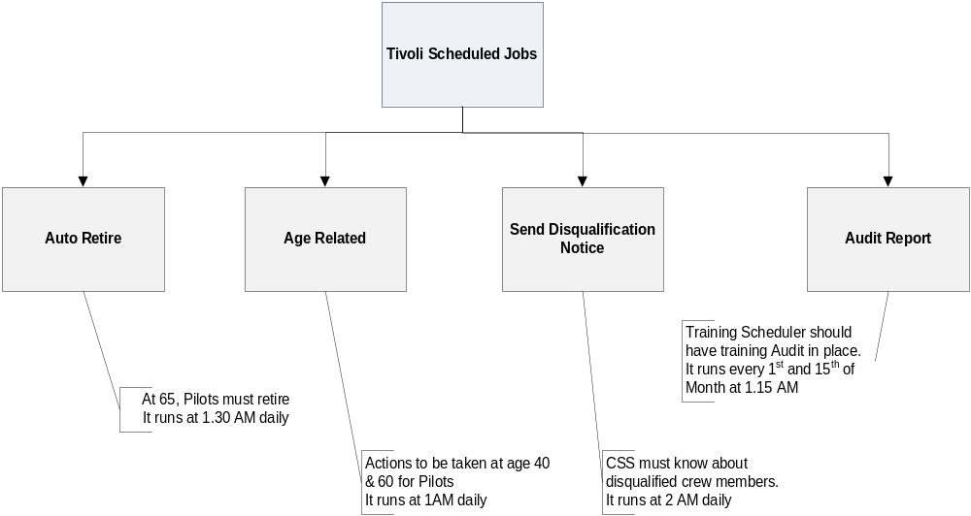
OQS - Batch Process

Slide 23
OQS - Ticket (Baseline Information)
Parameter | Urgent | High | Medium | Low
Yearly Ticket (Based on 2010) | 0 | 12 | 3 | 42
Queue Name – OQS Support
Majority of Tickets are from iTops Monitoring system.
URGENT/HIGH/MEDIUM tickets are paged and LOW tickets are emailed.

Slide 24
OQS - Inventory Status
Parameter | Details
Technical Documentation | https://wiki.swacorp.com/twiki/bin/view/Tech/OqsServices#asynch Clearcase – ifo/OQS/Documents
Functional Documentation | https://wiki.swacorp.com/twiki/bin/view/Tech/OqsServices#asynch Clearcase – ifo/OQS/Documents
Operational Documentation | https://wiki.swacorp.com/twiki/bin/view/Tech/OqsServices#asynch Clearcase – ifo/OQS/Documents
Database Technology (and version) | Oracle 10G
Web Server | Tomcat 5.5
Technology Platform | JDK 5.01
Production Server(s)/Mule Servers | Xlpeip03,xlpeip04/xspsvc21, xspsvc22
QA Server(s)/Mule Servers | Xlqeip03, xlqeip04/xsqsvc07, xsqsvc08
QA Database(s) | SHRTFRQ/xlqodb05, xlqodb06
Production Database(s) | SHRTFRP/xlprac11/xlprac12
ITest Server(s)/Mule Server | Xlteip04/xstsvc01, xstsvc02
ITest Database(s) | SHRTFRD/xldodb01/xldodb02/xldodb03/xldodb04
Dev Server(s)/Mule Server | Xldeip03/xsdsvc05, xsdsvc06
Dev Database(s) | SHRTFRD/xldodb01/xldodb02xldodb03/xldodb04
Source Code Repository & Configuration Mgmt | Clearcase
Developer's Toolset | Active MQ, Hypersonic, Mule, SQL developer, Eclipse 3.22
Code Generation Tool | Ant, Freemarker
Release Schedule | Quarterly

Slide 25
Thanks

