Slide 1

optimizing Delivery Process and Increasing Sales through PERSONALIZED MARKETING: TARGET CORP CASE STUDY
A Business Data Management Capstone Project focused on leveraging data insights and trends to optimize logistics efficiency and drive sales growth
Name: Kamal Kishor Chaurasiya
Roll no. : 21f2000804

Slide 2
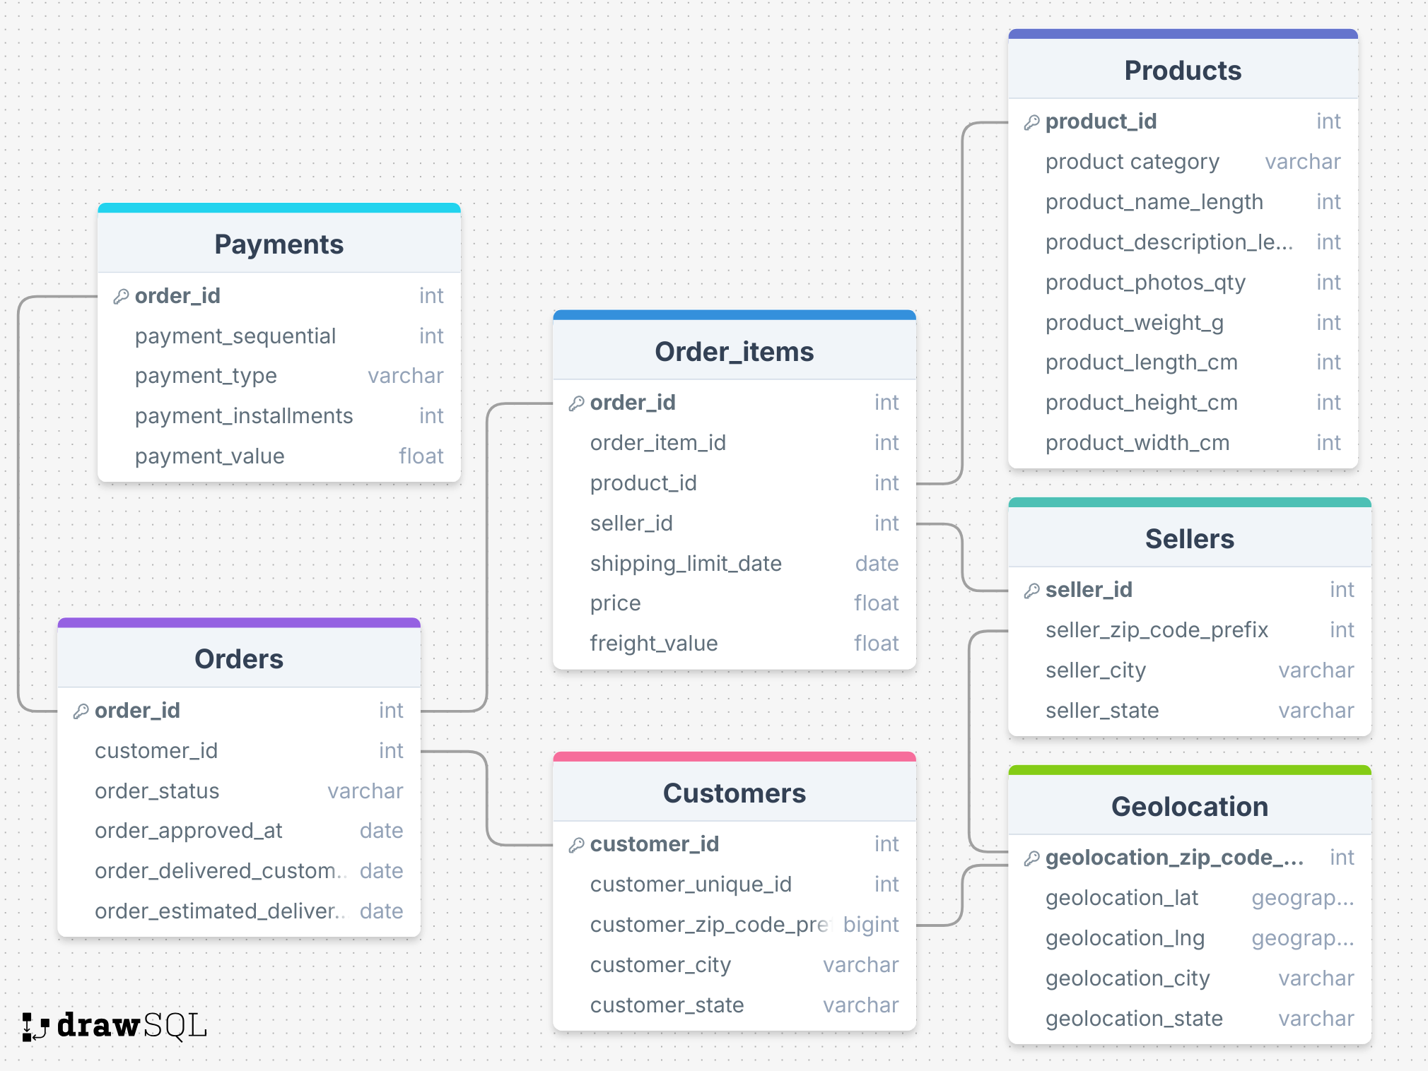
ABOUT THE BUSINESS
Target Corporation is a leading American retail chain headquartered in Minnesota.
It was founded in 1902 by George Dayton as Dayton Dry Goods Company.
It offers a wide range of products, including clothing, electronics, groceries, home goods, toys, and beauty products.
ABOUT THE DATA COLLECTED

Slide 3

THE PROBLEM STATEMENT
Logistic Bottleneck Optimization: identify delivery bottlenecks and streamline the process to improve efficiency and reduce delays
Boosting Sales through Personalized Marketing: boost sales by leveraging customer segmentation, behavior and preferences to implement personalized marketing strategies

Slide 4

DELIVERY PROCESS ANALYSIS
High Delivery Success Rate
Despite a 97% success rate, delivery issue exist-order remain in shipped and processed status
Top Order States
SP (41k), RJ(13k), MG(11k) – the top 3 states with the highest number of orders
Lowest Order States
Northern and less urbanized states like AC, AP, RR show minimal order volumes (< 100 orders)
Late Delivery Rate
Out of 96,478 orders, 7,826 were late, resulting in an 8.11% late delivery rate
Inter-Regional Delays
99.97% of late deliveries occur between different zip codes -> inter-regional delays
Delivery Time Comparison
Actual delivery time (12d, 13h) is much lower than the estimated time (23d, 17h)
Delivery process is largely efficient but room for improvement.

Slide 5
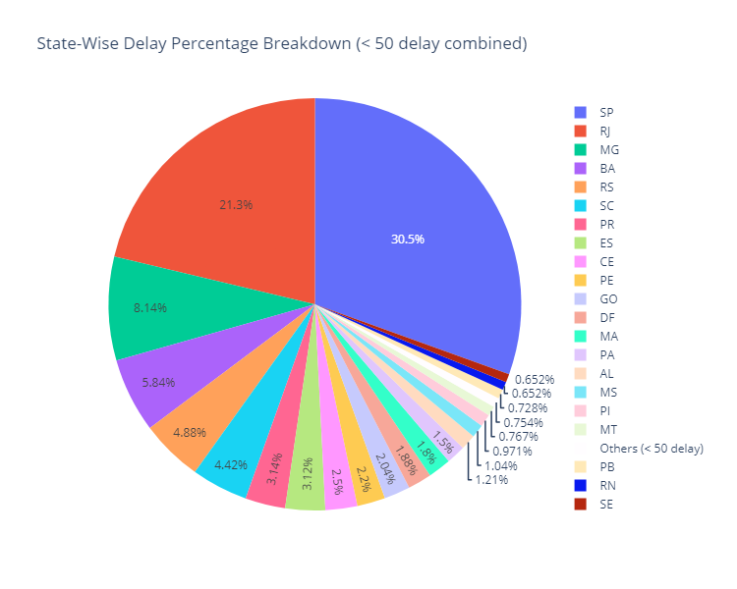
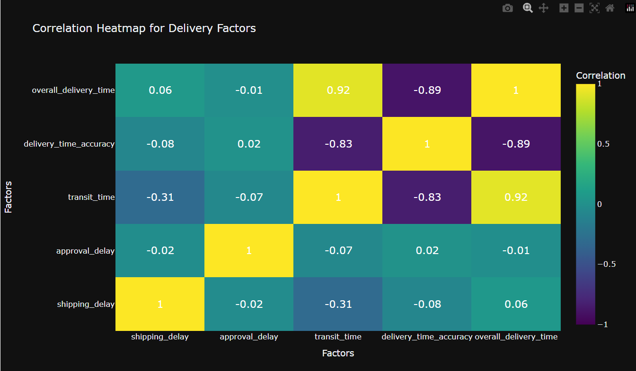
State-wise delay percentage
Correlation between delivery factors

Slide 6
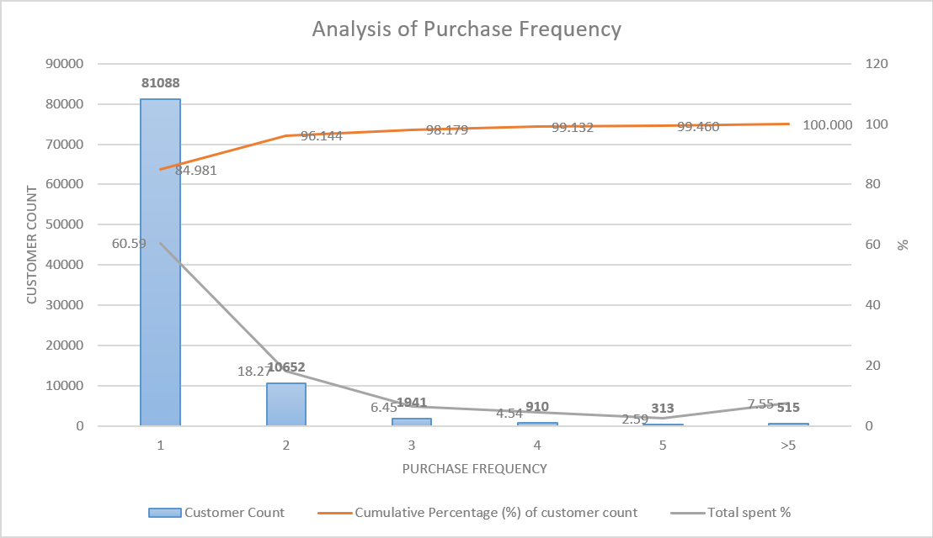

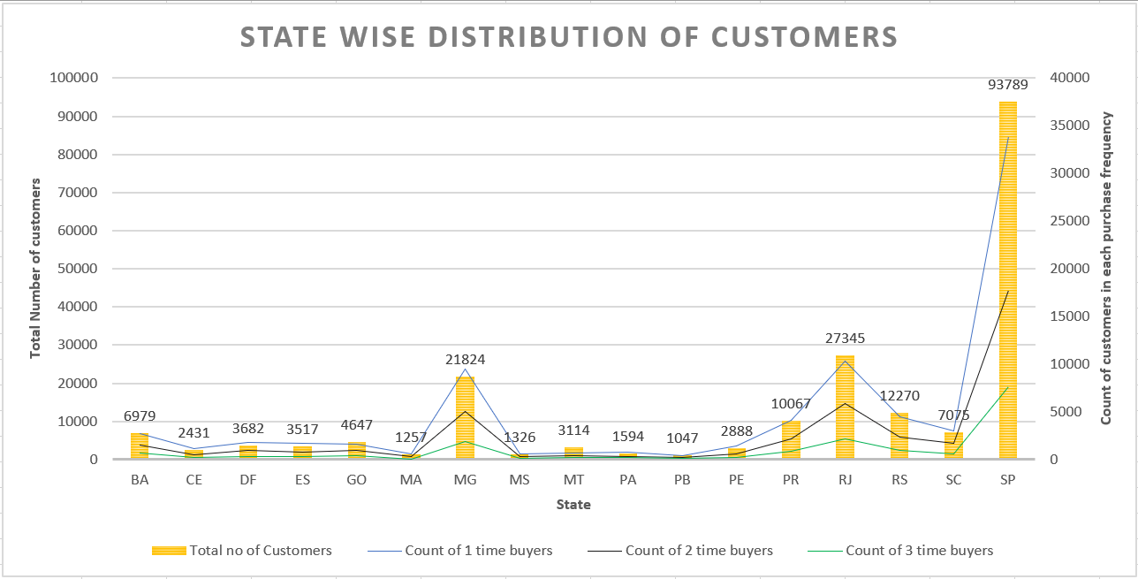
CUSTOMER INSIGHTS
Beyond first purchase, customer retention drops significantly.

Slide 7


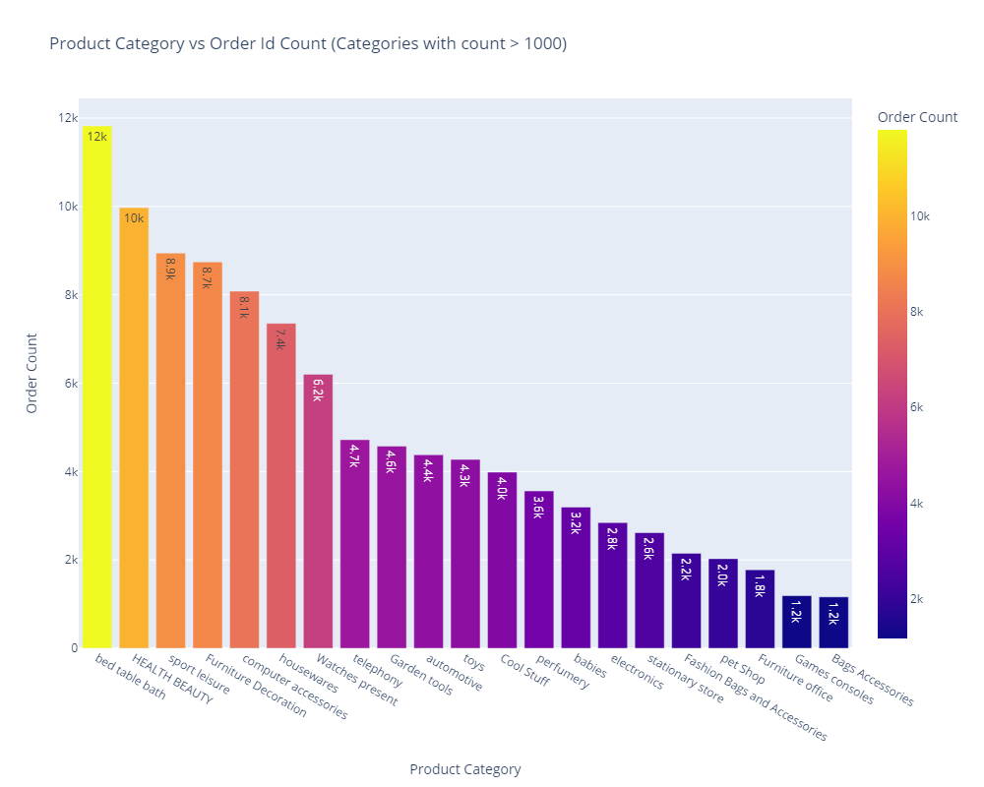
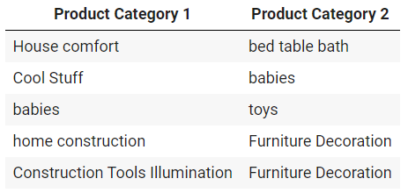
PRODUCT CHOICE ANALYSIS
PRODUCT AFFINITY ANALYSIS

Slide 8

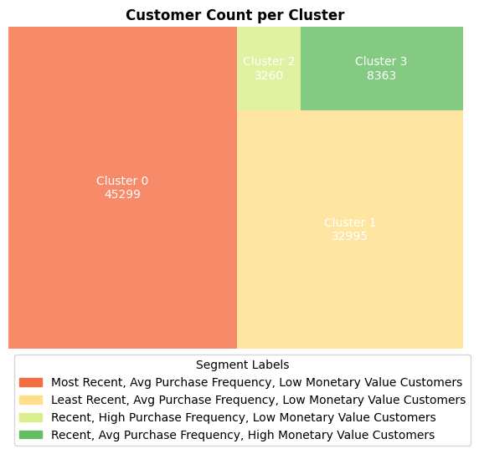
CUSTOMER SEGMENTATION
Most Recent
└── Avg Purchase Frequency, Low Monetary Value Customers
> Likely new customers who haven’t fully engaged yet
Recent
├── High Purchase Frequency, Low Monetary Value Customers
> Customers favor affordable or essential items
└── Avg Purchase Frequency, High Monetary Value Customers
> Premium customers preferring for higher-value products
Least Recent
└── Avg Purchase Frequency, Low Monetary Value Customers
> Inactive and disengaged customers

Slide 9

RECOMMENDATIONS
Improve process management and enhance software automation to reduce orders in processing, shipped, or unavailable stages.
Update delivery estimation models with real-time data, conduct regular audits, reduce overly conservative buffers, and use automated notifications for better customer expectation management.
Partner with high-demand sellers, scale delivery infrastructure, explore local fulfilment options and use AI-driven routing to optimize logistics and reduce inter-regional delivery delays.
Implement customer retention strategies, such as loyalty programs and personalized follow-ups, to bring customers back and increase repeat purchases.
Use AI-driven product recommendations and promote low-demand product categories with discounts, bundles, or targeted ads, and offer exclusive rewards and discounts to incentivize higher spending.

Slide 10
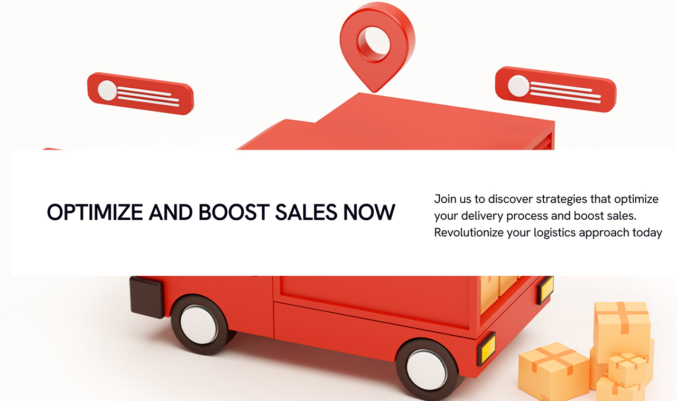
THANK YOU

