Slide 1



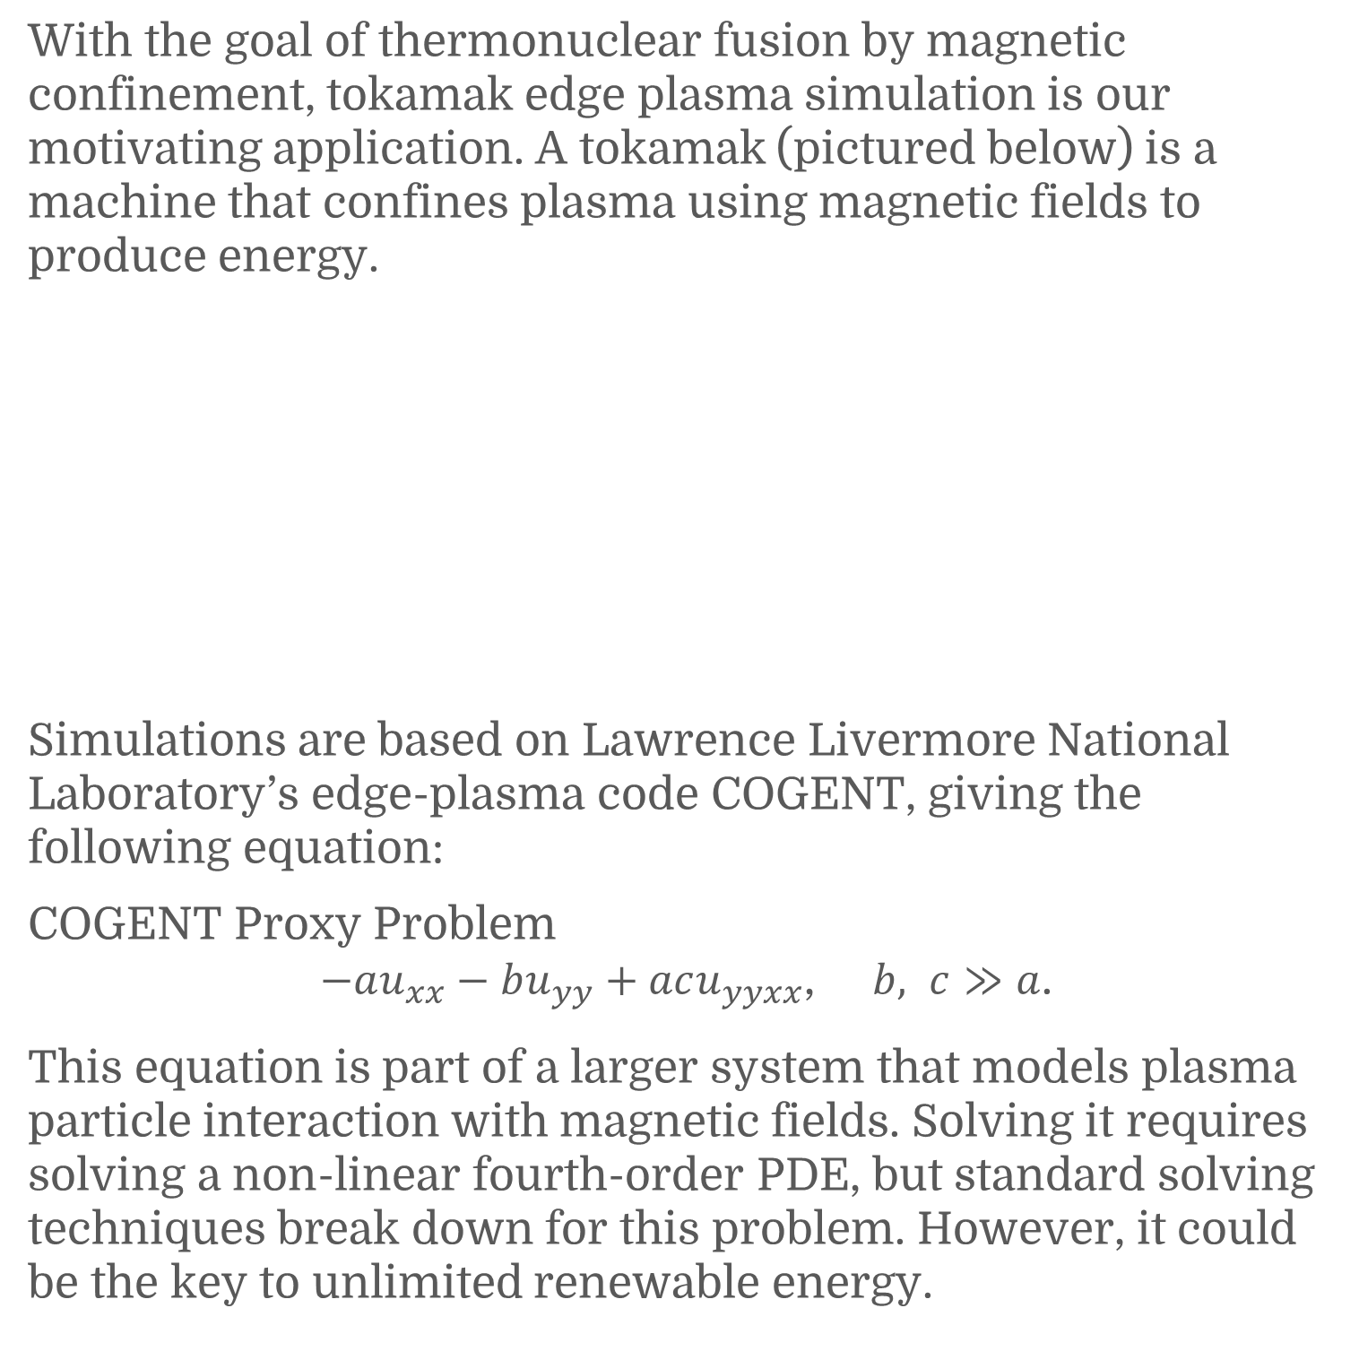
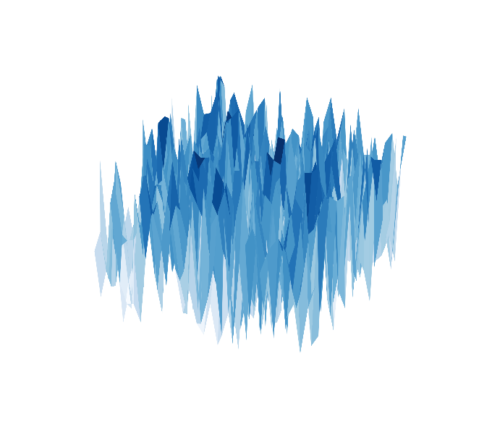
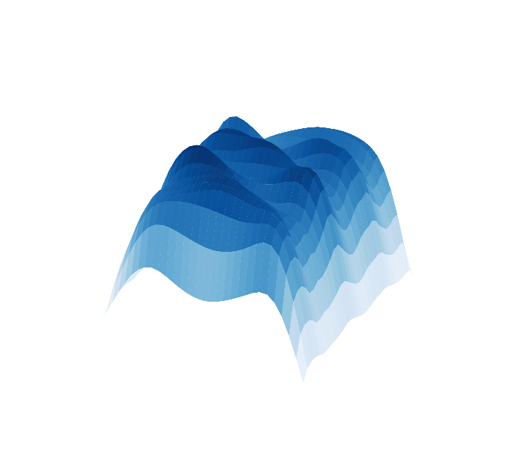
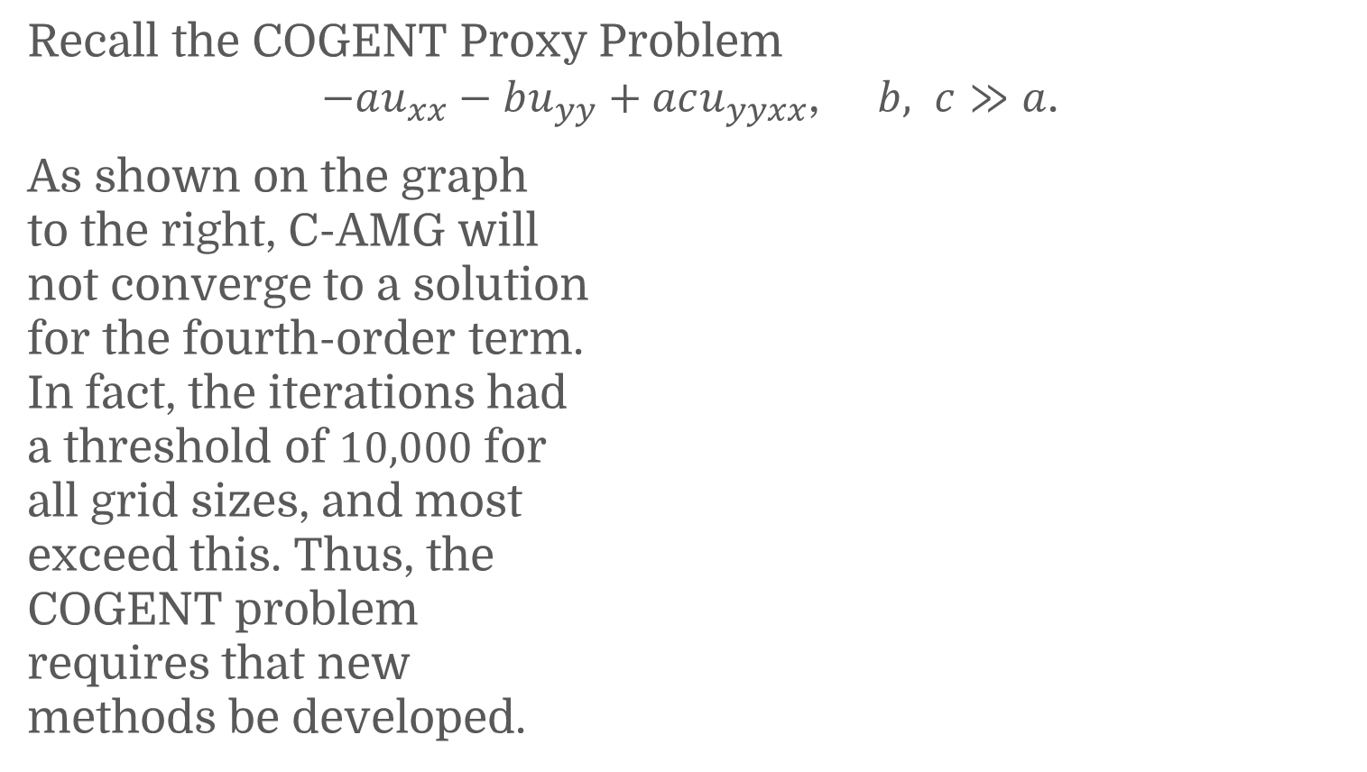
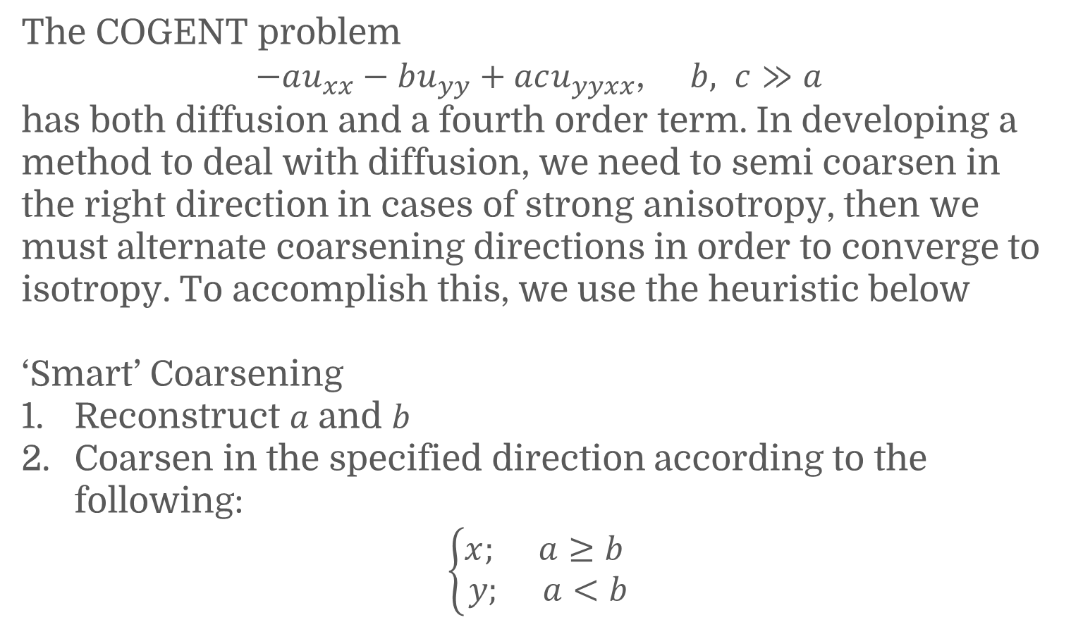
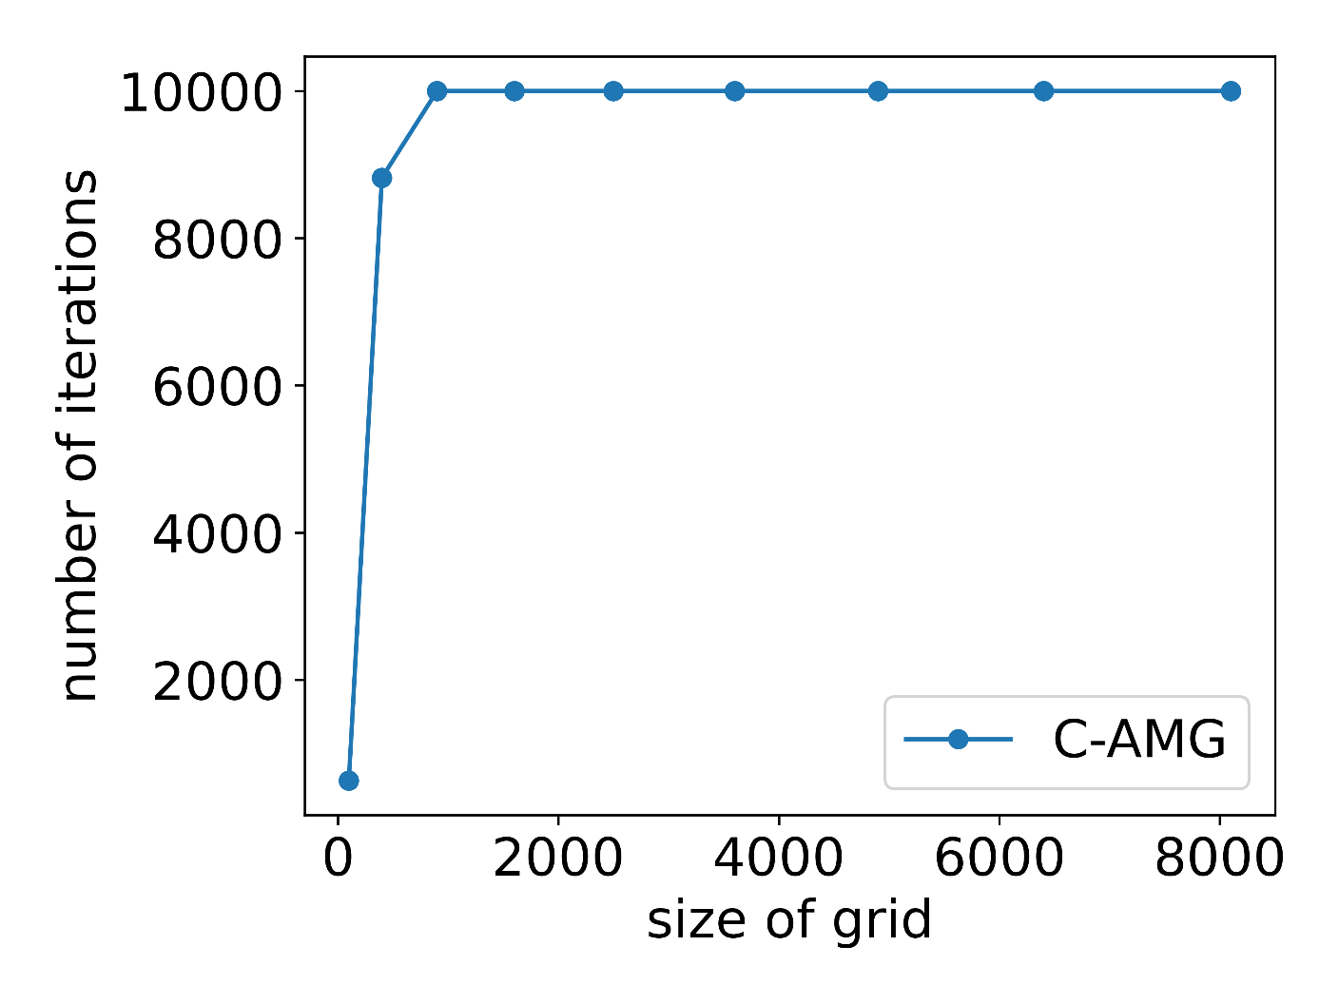
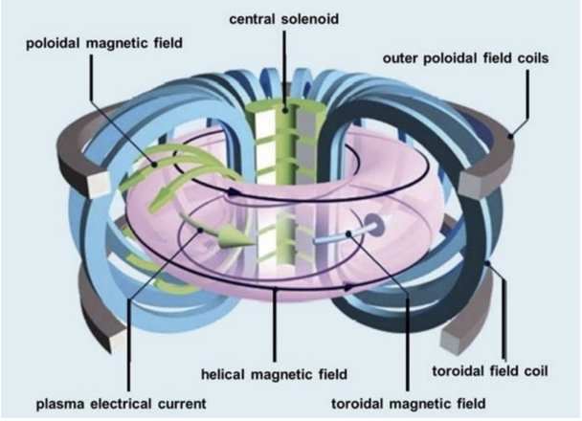
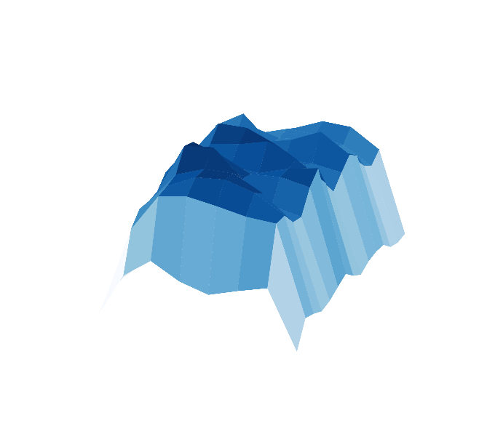
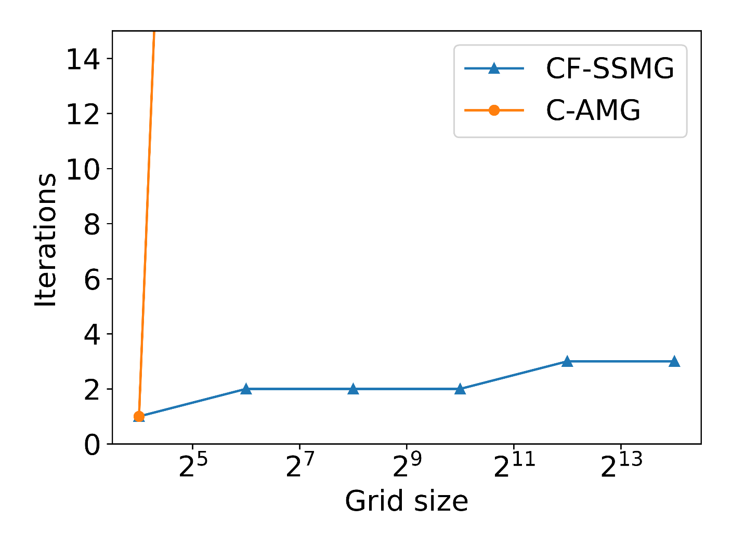
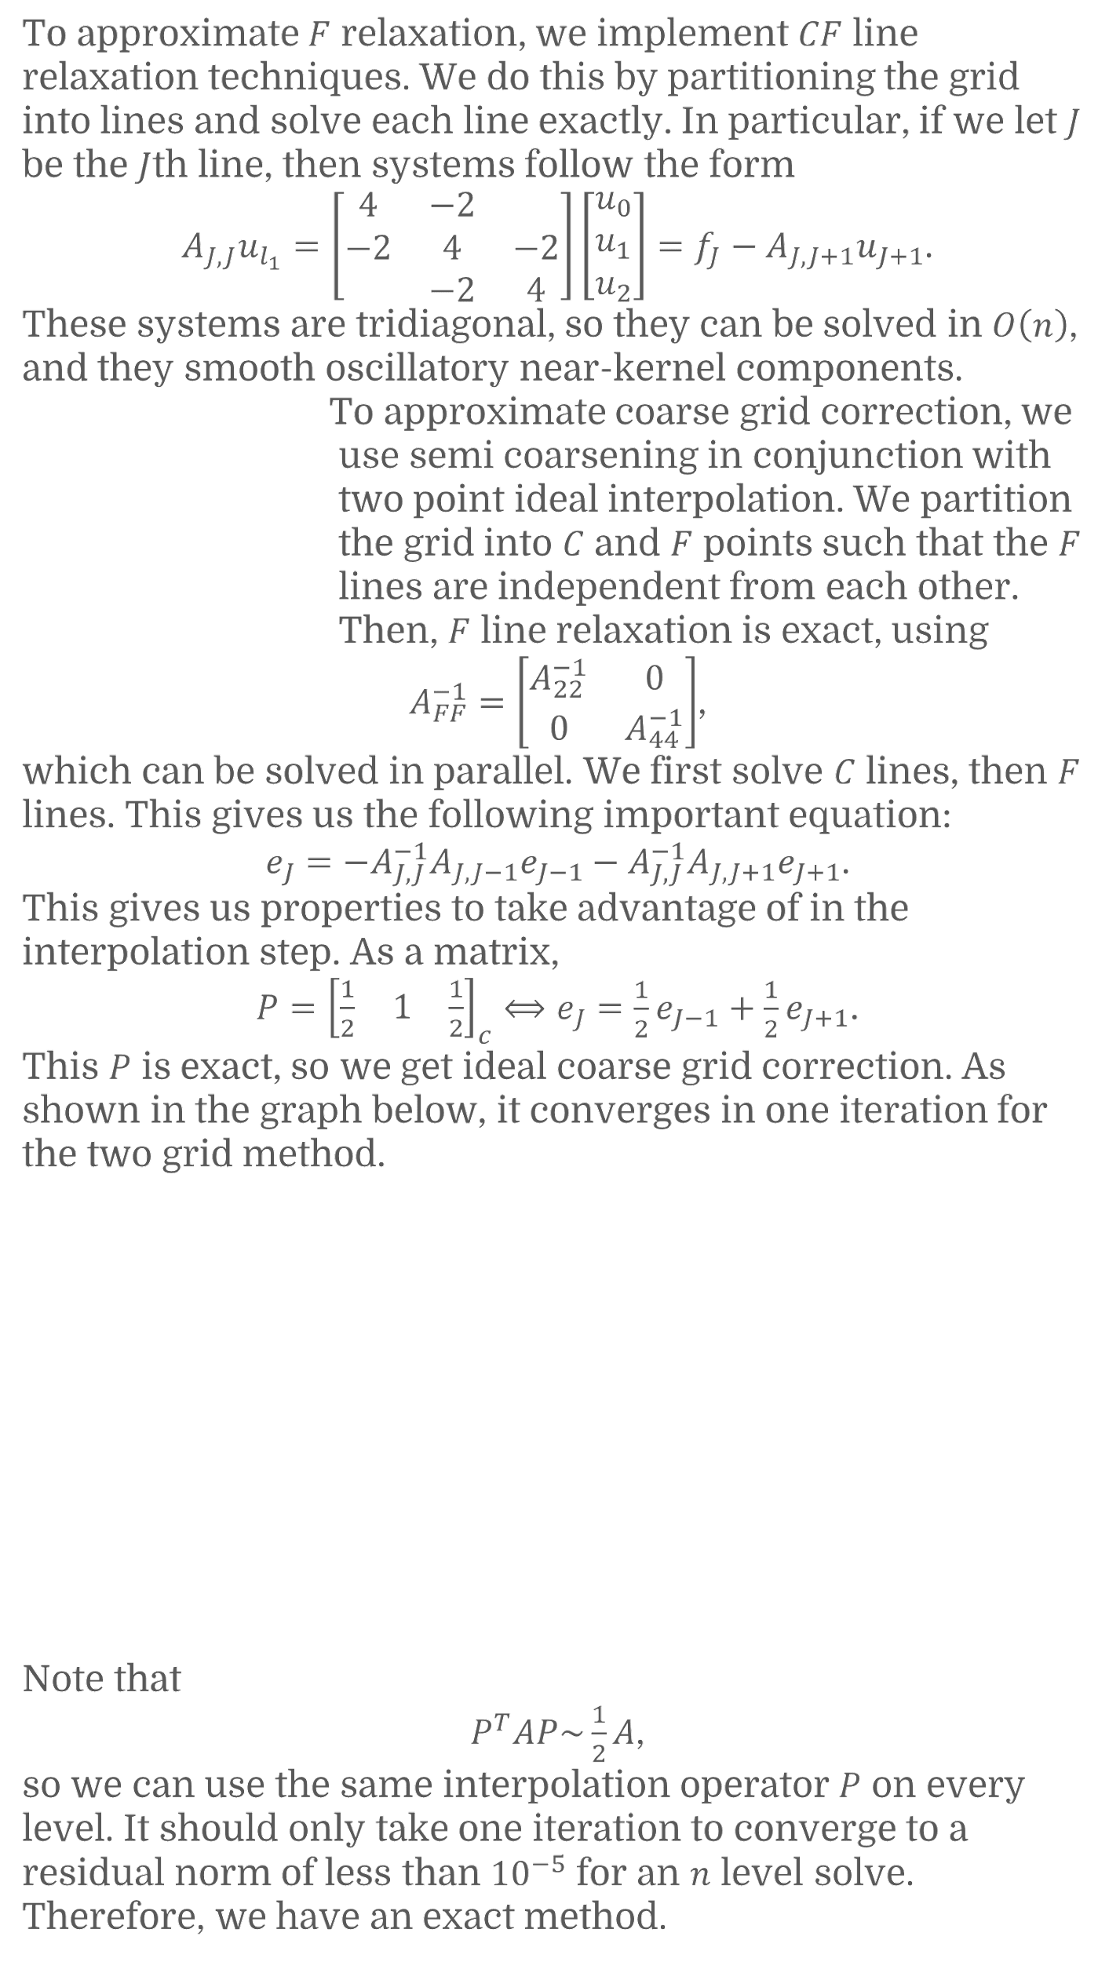
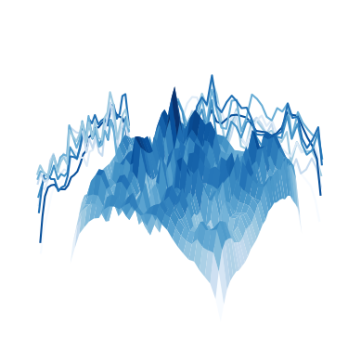
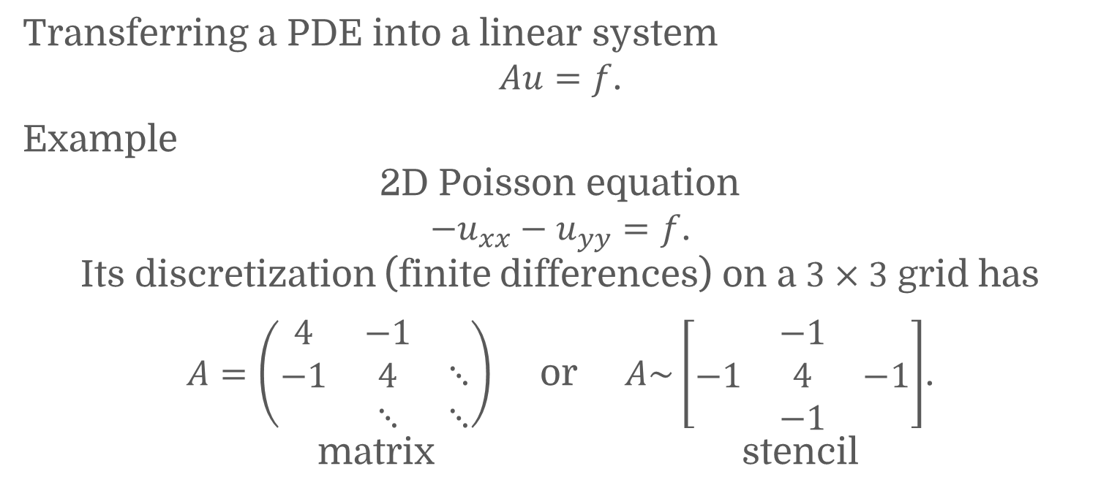

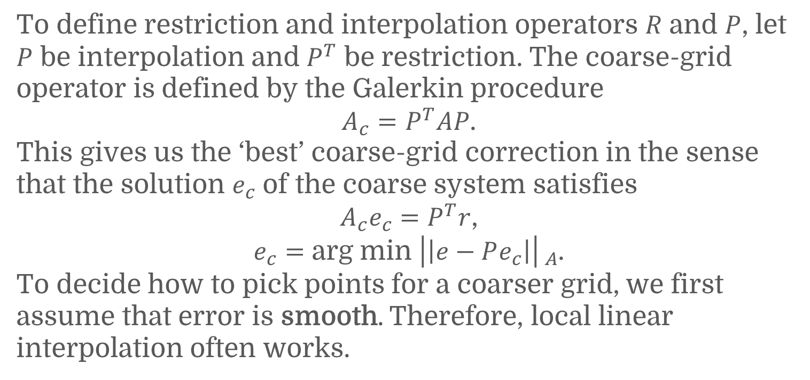

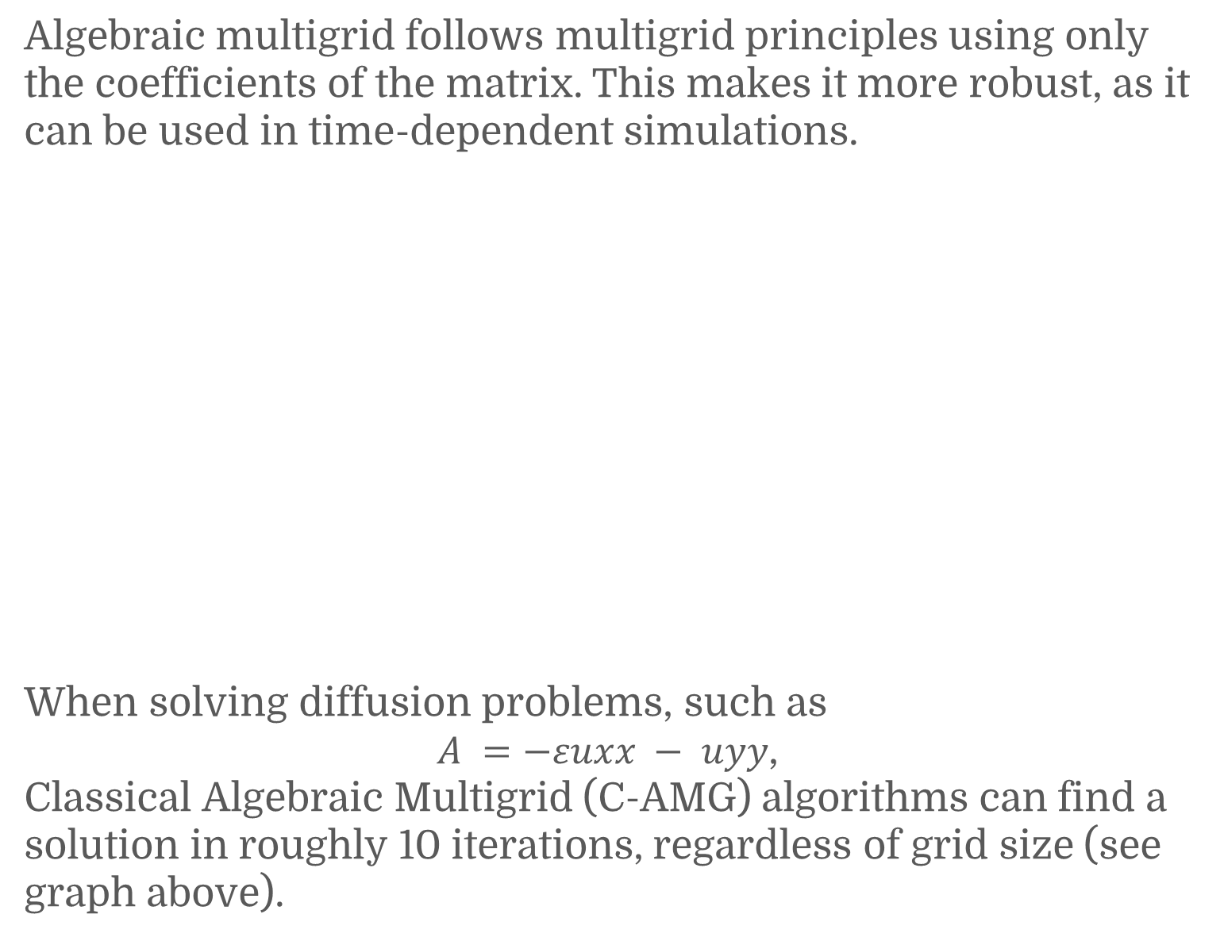
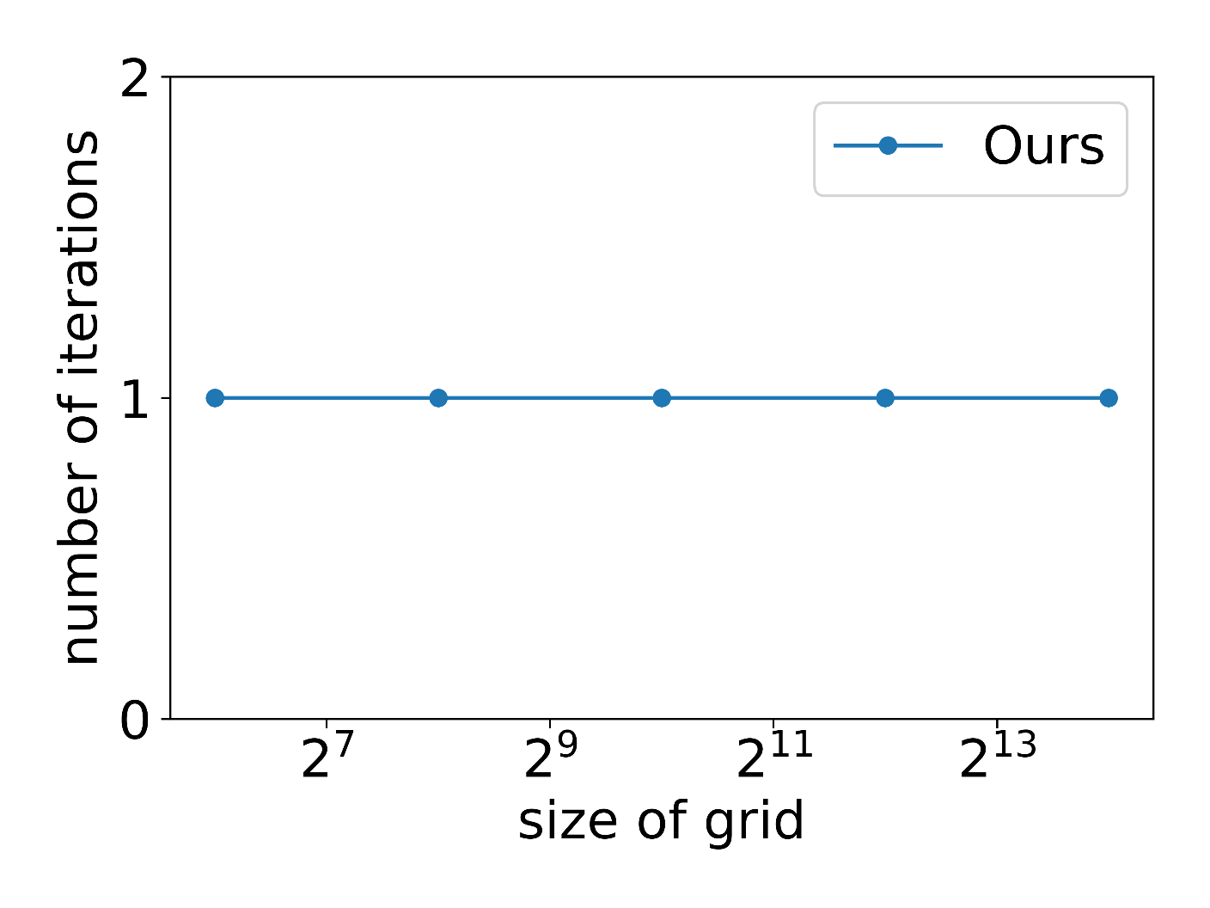
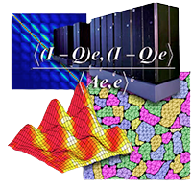
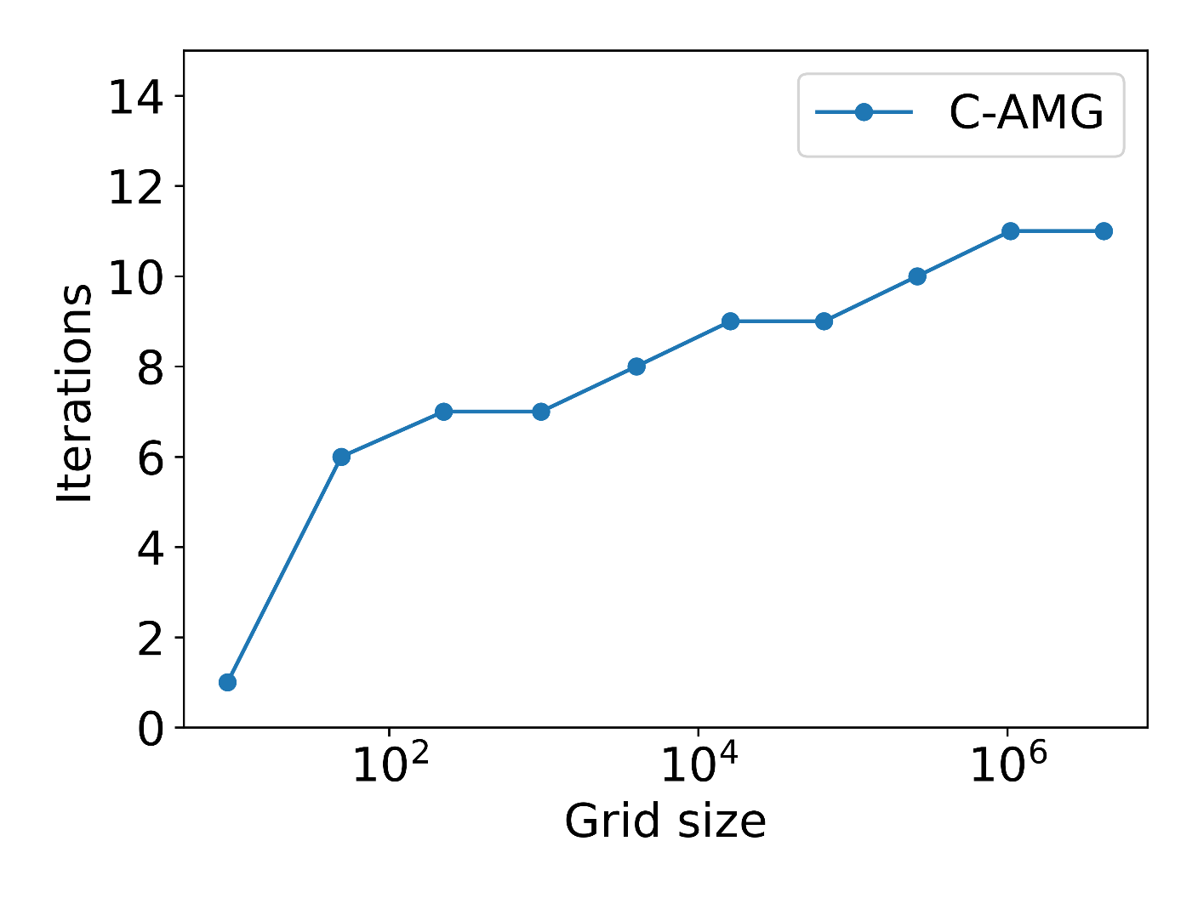
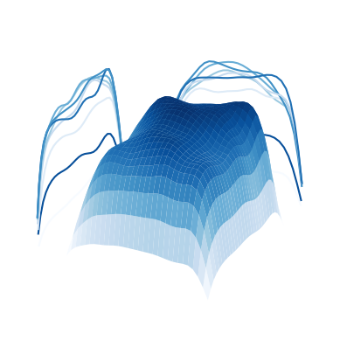

Parallel Algebraic Multigrid Methods for Fusion and Higher Order PDEs
Sophie Boileau, Atmik Das, Kellen Kanarios, Lucia Krajčoviechová
Mentor: Dr. Jean-Michel Maldague
Sponsors: Dr. Robert Falgout, Dr. Wayne Mitchell, Dr. Daniel Osei-Kuffuor
Motivation
COGENT Proxy Problem
Dealing with Diffusion
relaxation
restriction
interpolation
smaller grid
Let R be the restriction operator and P be the interpolation operator.
Two-level V-Cycle MG(A,b,v₁,v₂):
Do v₁ relaxation steps on Au ^{(k)} ＝ b.
Compute residual r ＝ f ー Au ^{(k)} ＝ Ae ^{(k)}.
Solve A_{c}e_{c} ＝ Rr;
can recurse via MG(A_{c} ,Rr,v₁,v₂).
Correct x ＝ x + Pe_{c}.
Do v₂ smoothing steps on Ax ＝ b.
Solving the Fourth Order Term
Comparison of our algorithm (CF-SSMG) against the prior state of the art algorithm (C-AMG) solving the COGENT problem.
Discretization
Boundary Conditions
COGENT problem - periodic boundary conditions in y-direction
u_{xxyy} with periodic boundary in y is singular.
COGENT converges to u_{xxyy} - must stop early.
Stopping one level early works good enough.
Issues with Iterative Methods
Algebraic Multigrid
Recommendations
Consider the linear system
Au ＝ b .
Iterative methods are of the form
u ^{(k+1)} ≔ u ^{(k)} + M ^{ー1}r ^{(k)} .
Error propagation is
e ^{(k+1)} ＝ (I ー M ^{ー1}A)e ^{(k)} ＝ ∑(I ー M ^{ー1}λ_{i} )c_{i}^{(k)}v_{i} .
Small eigenvalues → slow convergence.
Our recommendations for future directions of research in this problem are:
Developing a fully algebraic method
Removing the grid dependency
Extending into the 3D regime
Implementing in a parallel computing setting
N
i ＝ 1
Solution: Multigrid Methods
This works because for differential operators, the near-kernel consists of geometrically smooth functions. Thus relaxation error is smooth, which is easy to interpolate.
Acknowledgements
This project was jointly supported by Lawrence Livermore National Laboratory and NSF Grant DMS 1925919

