Slide 1
FLIGHT DELAY ANALYSIS TEAM 10

Slide 2
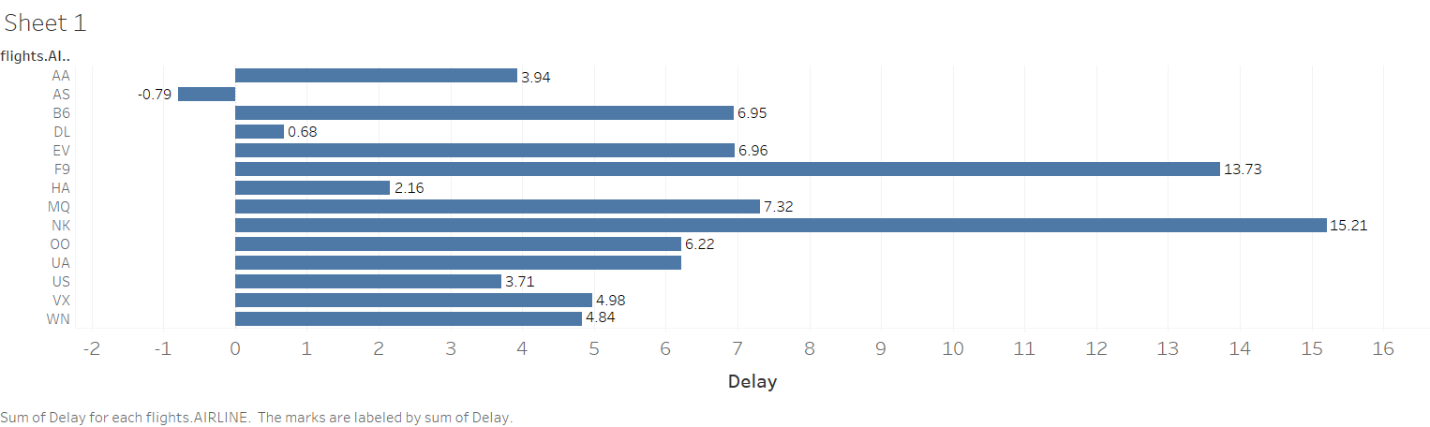
Average Delay for various airlines at destination

Slide 3
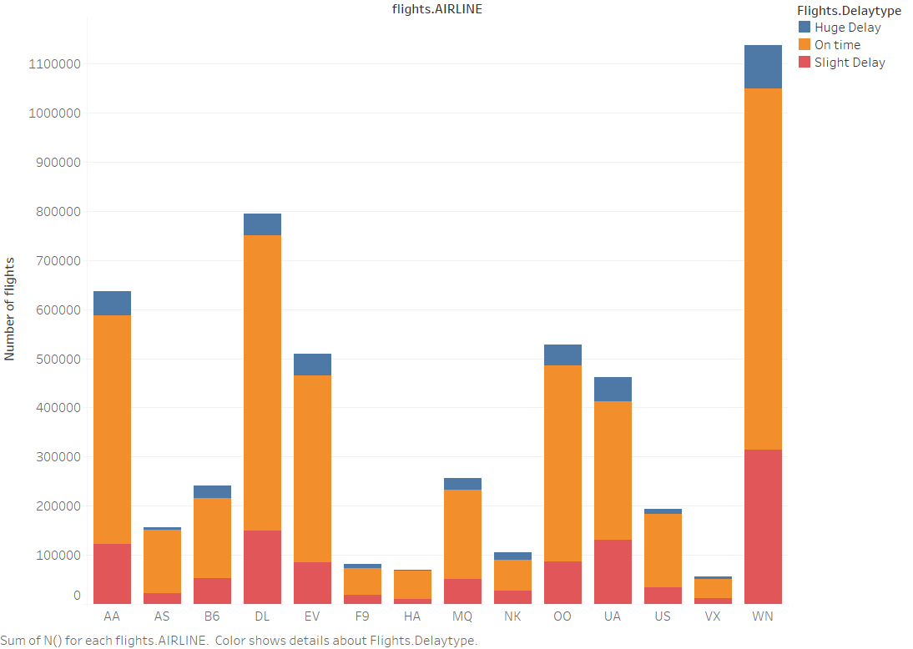
Visualizing flights based on delay type

Slide 4
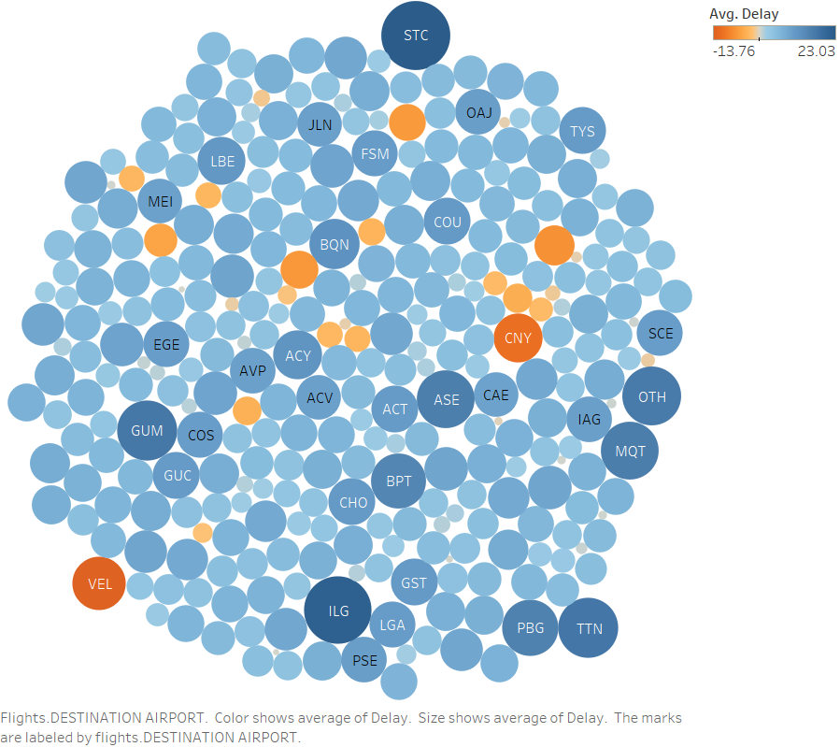
Average Delay for various airports

Slide 5
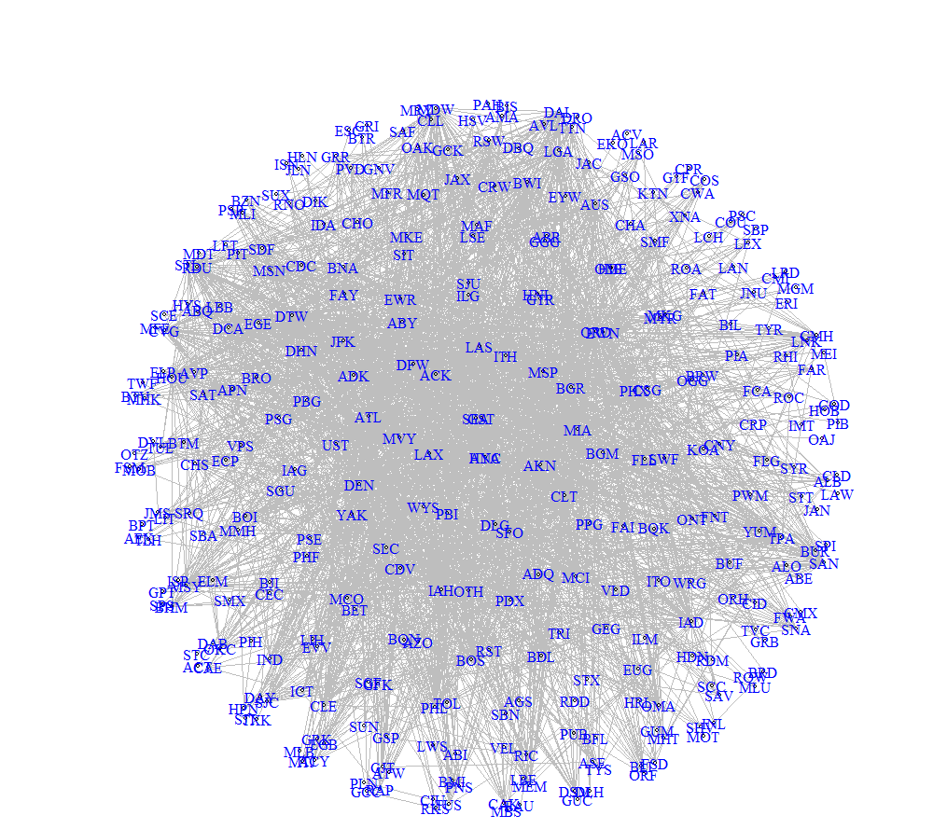

NETWORK GRAPH
NODES: AIRPORTS
EDGES: FLIGHT PATH
DIRECTED GRAPH

Slide 6
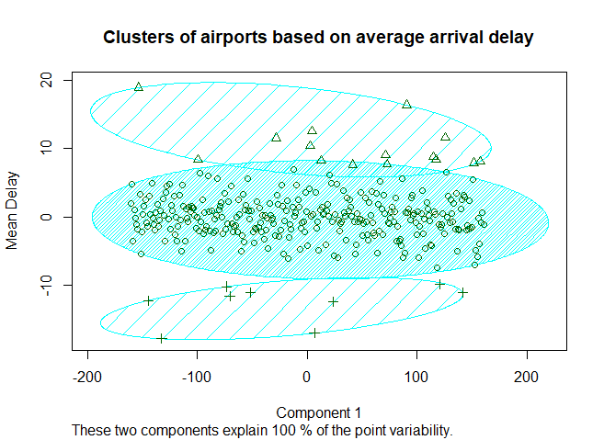
CLUSTERING
Airports are clustered based on the average arrival delay time.
Technique used:
Hierarchical clustering
Method: ward.d

Slide 7
REGRESSION
Arrival delays at Chicago(ORD) airport were predicted based on independent variables:
Various models used for prediction:
Random-Forest Regression
Multiple Linear Regression
SVM Regression
Departure Delay, Taxi-off time, Climatic condition, Temperature and Distance.

Slide 8
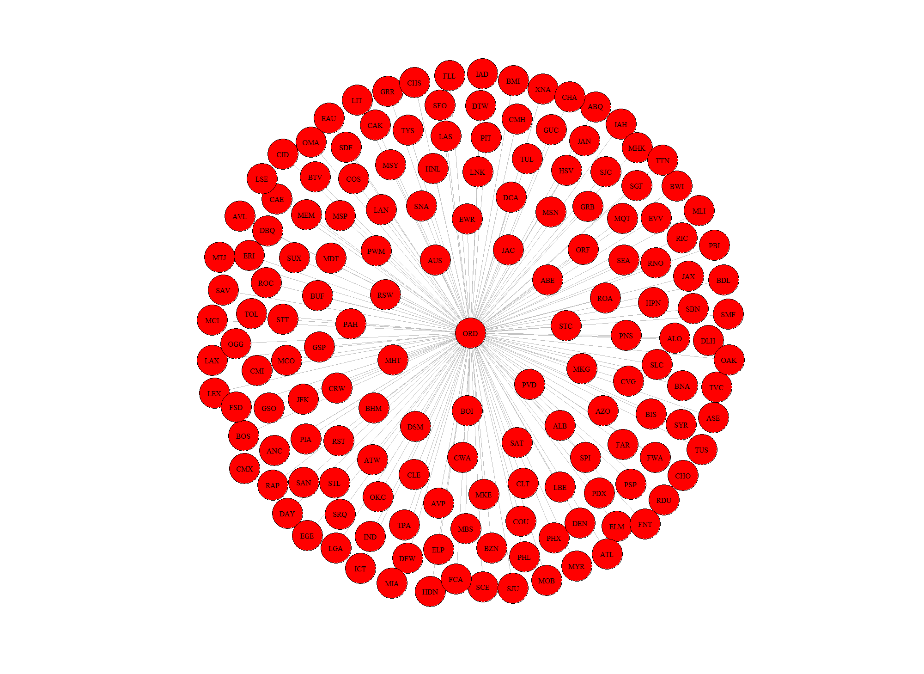
NETWORK GRAPH FOR REGRESSION MODEL

Slide 9
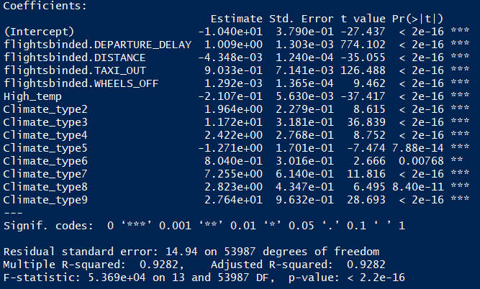
Linear Regression
Significance of independent variables:
Y= B₀ + B₁ X₁ + B₂X₂ + B₃X₃ + B₄X₄ + B₅X₅ + E
Y = Arrival Delay
X₁ = Departure Delay
X₂ = Taxi-off time
X₃ = Climatic type
X₄ = Temperature
X₅ = Distance

Slide 10
Random Forest Regression
Number of Trees = 10
SVM Regression
Kernel = Radial

Slide 11
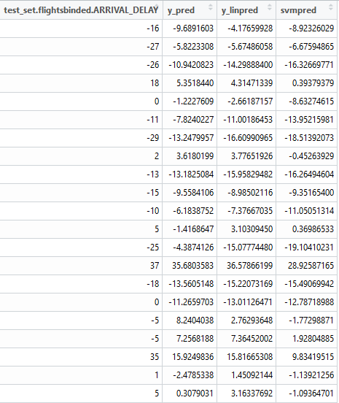
Sample Predictions from 3 regressors

