Slide 1
DOCKERS

Slide 2
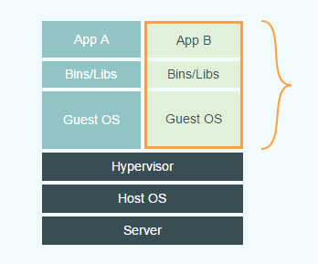
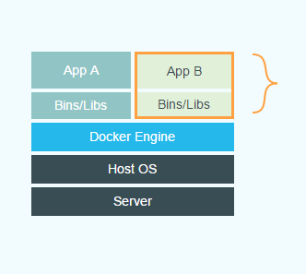
DOCKER - INtro
An open platform for distributed applications
Docker images are almost instantaneous even compared with the Images
VM DOCKER

Slide 3
DOCKER
Docker images are dependent on the Docker platform rather than the HW or Hypervisor
Docker images are available for most of the applications appliance
The images are available to public in dockerhub

Slide 4
DOCKER
For Ex:
How to run ubuntu on docker
docker run –it ubuntu
This will download the docker container from dockerhub (for the first time) take you to ubuntu console as ROOT
The second time when you run it will take you the console at almost instantaneous

Slide 5
DOCKER – Little FURTHER
create customized docker containers
If we need to customize little more with the generic ubuntu container
Create a file with the name Dockerfile
FROM ubuntu #this will download the ubuntu docker
RUN apt-get update && apt-get install apache2 # run the commands after creating the docker
Run the following command to build the customized docker container
docker build --tag=cust-ubuntu .
Run the following command to run the docker container
docker run -p 81:80 -d cust-ubuntu /usr/sbin/apache2ctl -D FOREGROUND

Slide 6
DOCKER – Little FURTHER
-p 81:80 is the port forwarding… Port 80 on the container will be forwarded to Port 81 on the host
/usr/sbin/apache2ctl -D FOREGROUND this command will be run after instantiating the docker container
we can access the Apache2 Ubuntu Default Page in the apache http://localhost:81 or http://<ip_addr_localhost>:81

