Slide 1
Visual Explanations
by Edward Tufte (1997)
Mike Gallaspy
Kevin Kannappan
Specifically Chapter 2: Visual and Statistical Thinking: Displays of Evidence for Making Decisions

Slide 2
Visualization as Life or Death
Tufte explores the magnitude of how important visualizing information can be, specifically through visuals developed to:
Stop a Cholera Outbreak in 1854
Launch the Challenger Shuttle in 1986

Slide 3
Cholera in 1854
At the time, Cholera was not known to be a waterborne illness
Testing the water yielded no suspicious impurities
Causal bacteria discovered in 1886
Visualization (and paper) provided the evidence to act
Within 10 days, more than 500 casualties occurred in a few block radius in London (specifically Broad St.)

Slide 4
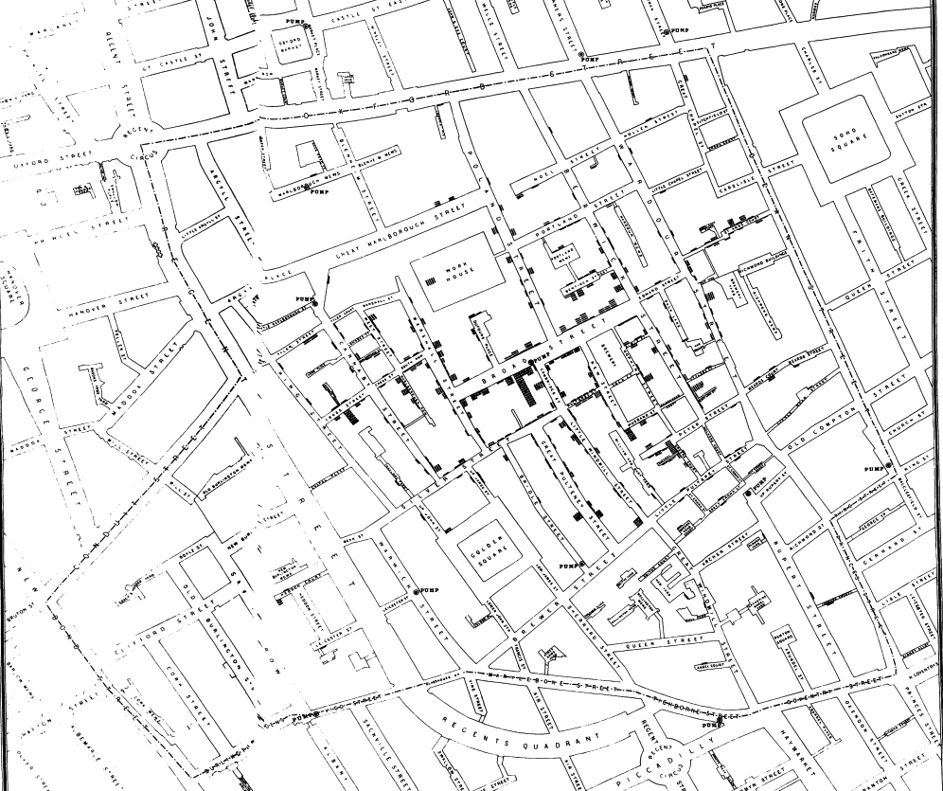
Cholera Outbreak
John Snow plotted the deaths of cholera in a spatial map of Broad Street
Bars – frequency of deaths
Dots – well pumps

Slide 5
Cholera in 1854: Tufte’s Analysis
Snow was effective because he followed a causal theory through visualization
What: Data & Derived
Why: Tasks
How: Encode
Scale
Data
Deaths from cholera during an outbreak in London in 1854
Water pump Locations
Derived:
Residences of victims
Explore spatial relationships of cholera death
Identify epicenter of the outbreak (Broad Street)
Number of deaths per residence drawn as proportional bars
From zero to tens of deaths per residence
Graph becomes busy if the number of deaths is too large
Notes:
Knowing the use cases for the viz is important: descriptive vs investigative
Comparison helps to add context to the viz – able to detect the brewery and workhouse
Additional information can explain outliers - investigating the sources of people farther from the Broad St pump

Slide 6
Challenger in 1986
Reasoning was rubber O-rings malfunction due to cold weather
Engineers who were aware of issue were unable to convince powers to postpone launch
Evidence clear but not communicated effectively
Needed to answer: in relation to what?
On January 28, 1986, the Challenger space shuttle took off from Cape Canaveral, FL and exploded killing all 7 astronauts onboard.

Slide 7
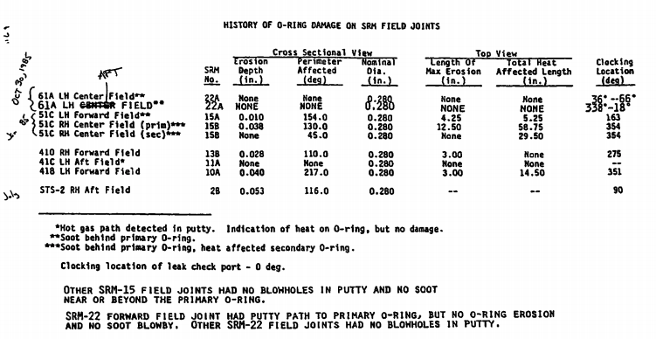
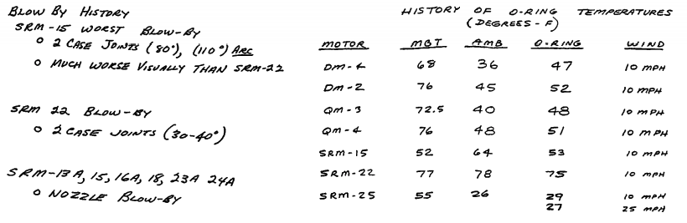
O-Ring Damage
Tables used to convey that O-Ring damage was present in testing.
Second table designed to convince launch temperature matters.

Slide 8
Challenger Shuttle Viz: Tufte’s Analysis
Not enough focus on the problem identified
Data not as a story
Missing data
Other issues
Relevant and irrelevant information on temperature
Univariate analysis insufficient:
Needed bivariate on temperature and O-Ring failure
Created illusion of lack of evidence, important to include all data possible!
Legend disappeared
Lack of cause and effect visuals
Lack of clarity (junk)

Slide 9
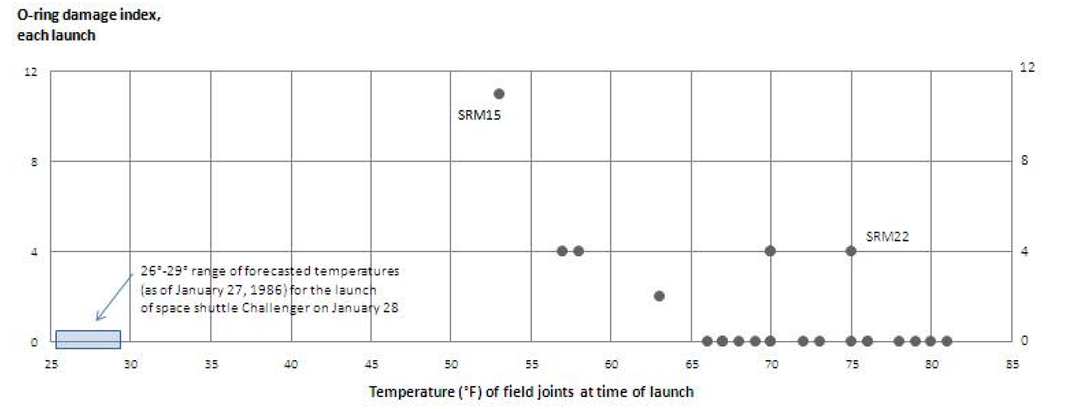
Challenger in 1986
Tufte’s visual might have resulted in a different ending…

Slide 10
Thank you

