Slide 1

Big Data Content Analytics,
Spring Semester
Professor: C.Papageorgiou
Student: Karala Aikaterini, I.N: p2821810

Slide 2
In our assignment we are going to train a model, which is able to recognize a word or a phrase which told from specific speaker at specific time. Below, you can see the word “PLEASE”

Slide 3
Our database is MIRACL-VC1 (downloaded from kaggle) which provides 3000 different videos, and 15 different speakers (5 men and 10 women) are talking in front of the camera . These specific words and phrases are represented below:
ID | Words |  | ID | Phrases
1 2 3 4 5 6 7 8 9 10 | Begin Choose Connection Navigation Next Previous Start Stop Hello Web |  | 1 2 3 4 5 6 7 8 9 10 | Stop navigation. Excuse me. I am sorry. Thank you. Good bye. I love this game. Nice to meet you. You are welcome. How are you? Have a good time.

Slide 4
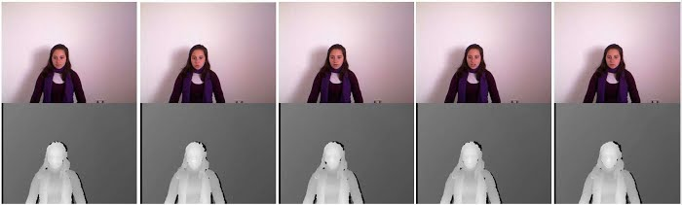
An example as far as our database is depicted below:

Slide 5

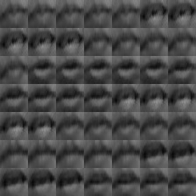
Preprocessing
In the first step we cropped the image and finally focuses on speakers’ lips only using the classifiers and dlib libraries.
Secondly, we order all these cropped images to only one and we have different frames from which image
We also use Keras library in order to train our model
A sequence of different frames is depicted below :

Slide 6
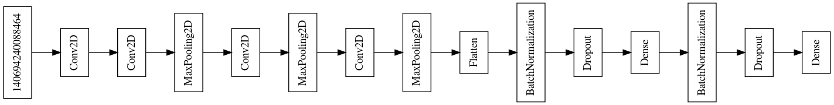
Method
Our architecture is represented below:
Our architecture is consisted of four levels , which includes max pooling layer which reduces dimension layers.
The batch normalization layer converts its inputs in order to have the mean equals to zero and the median equals to one.

Slide 7
Train the model
We divided our database into three parts : 1) train 2) test and 3)development. We used the Stochastic Gradient Descent .
We wrote our code in Python and we visualize our outputs with use of matplotlib library.

Slide 8
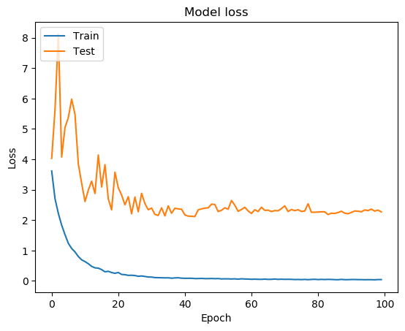
Outputs
Out diagram with model loss is represented:

Slide 9
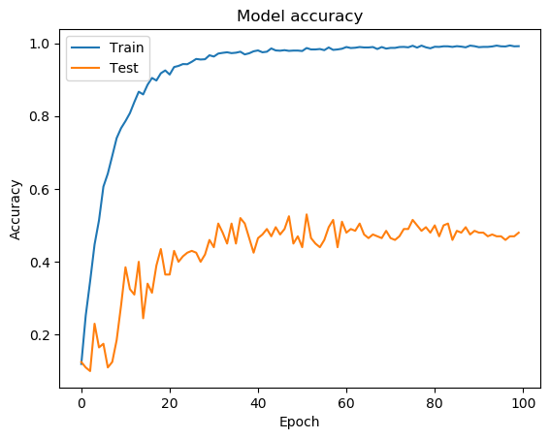
Outputs
Out diagram with model accuracy is represented:

Slide 10


