Slide 1
UNIT -I
Operating Systems: An Overview
The Architecture of Computer Hardware, Systems Software & Networking:
An Information Technology Approach
5th Edition, Irv Englander
John Wiley and Sons ©2013

Slide 2
Without an Operating System…
Program instructions must be loaded into memory by hand
No user interface except for I/O routines provided with executing program
System is idle when waiting for user input
No facility to store, retrieve, or manipulate files
No ability to control peripheral devices
Can run only one program at a time; computer halts at end of each program
15-<number>
AU

Slide 3
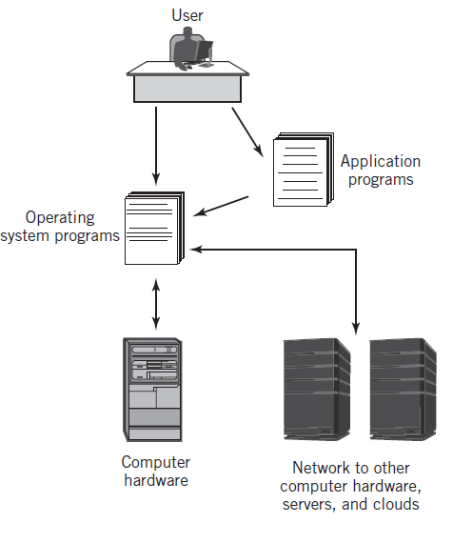
Integrated Computer Environment
AU
15-<number>

Slide 4
Definition of an Operating System
“A collection of computer programs that integrate the hardware resources of the computer and make those resources available to a user and the user’s programs, in a way that allows the user access to the computer in a productive, timely, and efficient manner.”
4,5,8,9,11,17,18,19,20,21,22,24,28,29,30,33,34,37,38,41,4,5,6,54,62,64,
LE-1,2,3,
15-<number>
AU

Slide 5
Operating System – Basic Services
Accepts commands and requests from users and users’ programs and responds with appropriate output results
Manages, loads, and executes programs
Manages hardware resources of the computer including interfaces to networks and other external parts of the system
Note: The operating system itself consists of hundreds or thousands of programs, each specialized for particular OS tasks
15-<number>
AU

Slide 6
Concurrent Operations
Multitasking (multiprogramming)
  Use of concurrent processing to simulate simultaneous execution of multiple programs even when using only a single CPU
  Supports multiuser systems
Multiprocessing
  Actual simultaneous processing of multiple programs using either multiple CPUs or multiple CPU cores
15-<number>
AU

Slide 7
Operating System – Additional Services
Provides interfaces for the user and the user’s programs
File management and support services
I/O support services
Means of starting the computer
  Bootstrapping or booting the computer or Initial Program Load (IPL)
Handles all interrupt processing
Network services
Services to allocate resources such as memory, CPU time, and I/O devices
Security and protection services
Systems administration
15-<number>
AU

Slide 8
Operating System Components
Memory Resident
  Always loaded in memory
  Commonly called the kernel
  Contains essential services required by other parts of the operating system and applications.
  Typically responsible for managing memory, processes and tasks, and secondary storage
Memory Non-resident
  Infrequently used programs
  Software tools
  Commands
Bootstrap program
15-<number>
AU

Slide 9
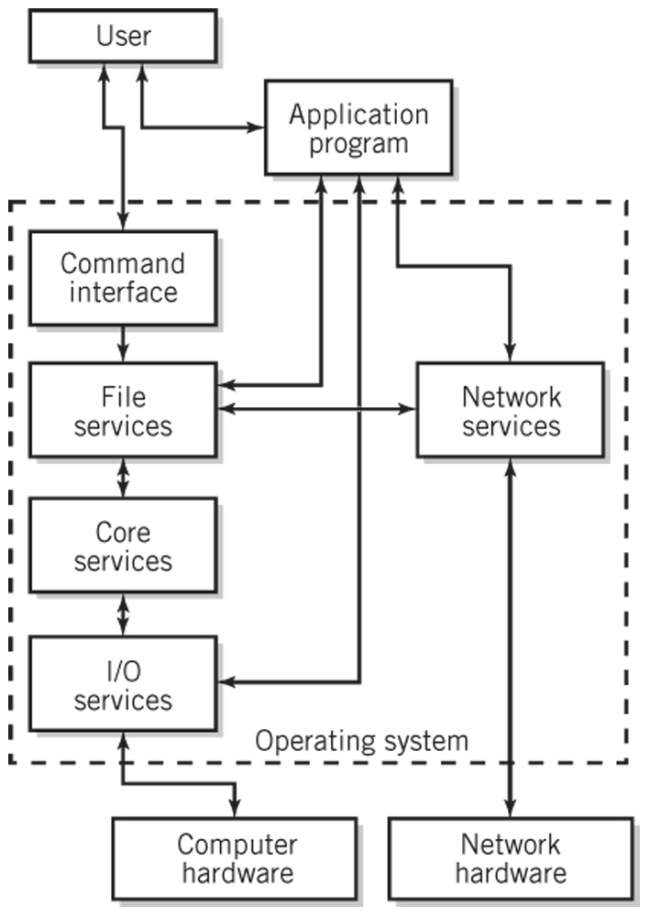
Simplified Diagram of Operating System Services
AU
15-<number>

Slide 10
General Purpose Computing Systems Categories
Single-user, single-tasking (essentially obsolete)
Single-user, multitasking
Mainframes
Operating systems for mobile devices
Distributed systems
Network servers
Embedded systems
Real-time systems
Presents: 1,2,3,4,5,6,7,8,9,10,11,12,15,16,18,19,20,21,22,24,25,27,29,31,35,36,40,41,50,53,58,59,60,61,63,65,Le-2,5,
15-<number>
AU

Slide 11
OS Degree of Activity
Interactive
  Also known as conversational systems
Batch processing
  User submits programs or jobs for processing
  Little to no user interaction
Event driven
  Interrupts or service requests
15-<number>
AU

Slide 12
Hardware and the OS
A hardware platform may support a variety of operating systems
An operating system may work on a variety of platforms
A standard operating system that works on different hardware
  Provides program and file portability
  Enables user efficiency through a recognizable interface
  Is implemented through a systems programming language like C++ or Java as opposed to assembly language
15-<number>
AU

Slide 13
Services and Facilities
Command processor
File management system
I/O control system
Process control management and interprocess communication
Memory management
Scheduling system
Secondary storage management
Network management, communication support, and communication interfaces
System protection management and security
System administration
15-<number>
AU

Slide 14
User Interface and
Command Execution Services
Types of user interfaces
  CLI – Command Line Interface
  GUI – Graphical User Interface
Shell
  User interface and command processor that interacts with the kernel
  UNIX/Linux: C, Bourne, bash and Korn shells
Command Languages
  IBM Mainframes – JCL
  MS Windows – .BAT files, Windows Powershell
  UNIX/Linux – shell scripts
15-<number>
AU

Slide 15
File Management
File – logical unit of storage
Basic file management system provides
  Directory structures for each I/O device
  Tools to copy, move, store, retrieve, and manipulate files
  Information about each file in the system and the tools to access that information
  Security mechanisms to protect files and control access
Additional file management features
  Backup, emergency retrieval, and recovery
  File compression
  Journaling
  Transparent network file access
  Auditing
15-<number>
AU

Slide 16
I/O Services
Startup configuration
  IBM-type PCs use BIOS (basic input/output system)
Device drivers that implement interrupts and provide other techniques for handling I/O
Plug-and-play
15-<number>
AU

Slide 17
Process Control Management
A process is an executing program
Interprocess messaging services
  Example: a pipe in UNIX or Windows that is a temporary software connection between two programs or commands
Thread
  An individually executable part of a process
  Shares memory and other resources with other threads of the same process
15-<number>
AU

Slide 18
Memory Management
Keeps track of memory
  Identifies programs loaded into memory
  Amount of space each program uses
  Available remaining space
  Prevents programs from reading and writing memory outside of their allocated space
Maintains queues of waiting programs
Allocates memory to programs to be loaded
Deallocates a program’s memory space upon program completion
Usually implemented with virtual storage
15-<number>
AU

Slide 19
Scheduling
High-level scheduling
  Placed in queue based on level of priority and eventually executed
Dispatching
  Actual selection of process(es) that will be executed at any given time
  Nonpreemptive: program voluntarily gives up control
  Preemptive: uses clock interrupt for multitasking
Context switching
  Transfer control to the process that is being dispatched
Processing requirements: CPU vs. I/O bound
15-<number>
AU

Slide 20
Achieving Multitasking
While one program is waiting for I/O to take place, another program is using the CPU to execute instructions
Time-slicing
  The CPU may be switched rapidly back and forth between different programs
Dispatcher
  is activated by I/O operation or real time clock interrupt
  selects next process to run
15-<number>
AU

Slide 21
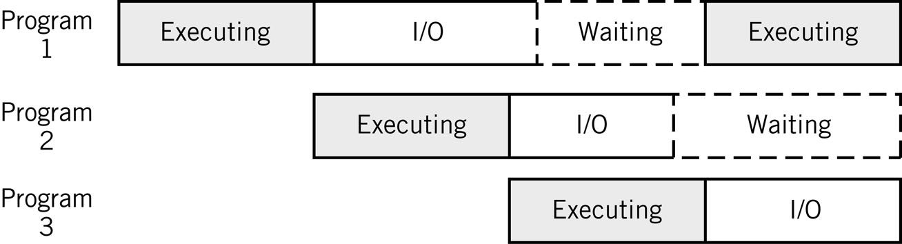
Sharing the CPU during I/O Breaks
I/O represents a large percentage of a typical program’s execution
15-<number>
AU

Slide 22
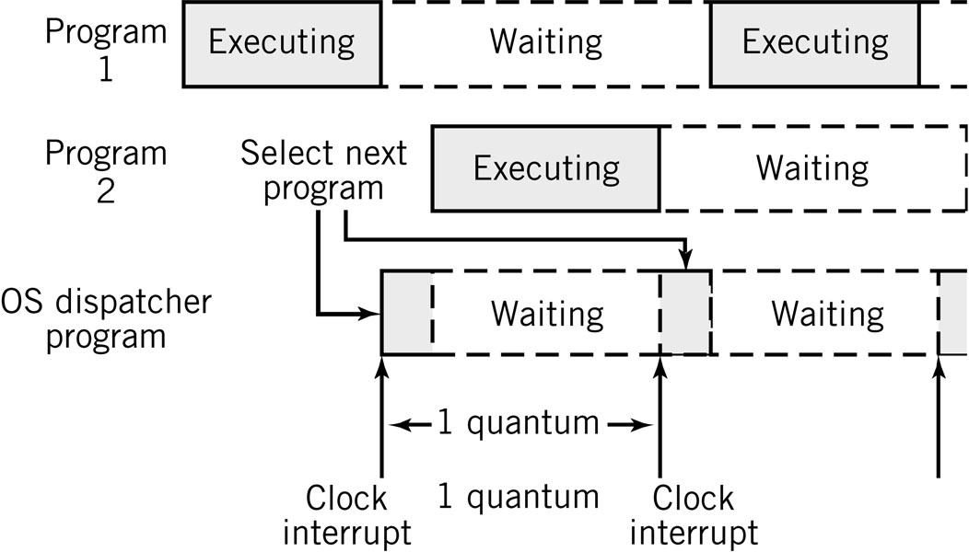
Time-sharing the CPU
Time slicing
AU
15-<number>

Slide 23
Secondary Storage Management
Keeps track of free secondary storage space
Maintains file system and directories
Optimizes completion of I/O tasks for efficient disk usage
Combination of hardware and software
15-<number>
AU

Slide 24
Network and Communication Services
TCP/IP protocol suite
  Locate and connect to other computers
  Pass application data in packets to other systems
  Access files, I/O devices, and programs from remote systems
  Support distributed processing
Network Applications
  Email, remote login, Web services, streaming multimedia, voice over IP telephony, VPN
Communication services
  Interface between communication software and OS I/O control system that provides network access
15-<number>
AU

Slide 25
Security and Protection Services
Protect OS from user processes
Protect processes from each other
Protect processes from outside world
Prevent unauthorized entry to system
Prevent unauthorized system use by authorized users
15-<number>
AU

Slide 26
System Administration Support
System configuration and setting group configuration policies
Adding and deleting users
Controlling and modifying user privileges
System security
Files systems management
Network administration
Backups
Software installations and upgrades
OS installations (system generation), patches, and upgrades
System tuning and optimization
Monitoring performance
Recovering lost data
AU
15-<number>

Slide 27
Systems Tools Examples
IBM z/OS
  sysgen: reconfiguration to incorporate new equipment
  Workload Manager: optimize system resources automatically
Unix/Linux
  superuser: system administrator account with privileges to override all restrictions and security built into the system
  adduser: administer user accounts
  mount/umount: mount and unmount a file system
  fsck: check and repair a file system
  ufsdump/ufsrestore: create and restore backups
Windows
  Control panel
  Task manager (Ctrl-Alt-Del menu)
15-<number>
AU

Slide 28
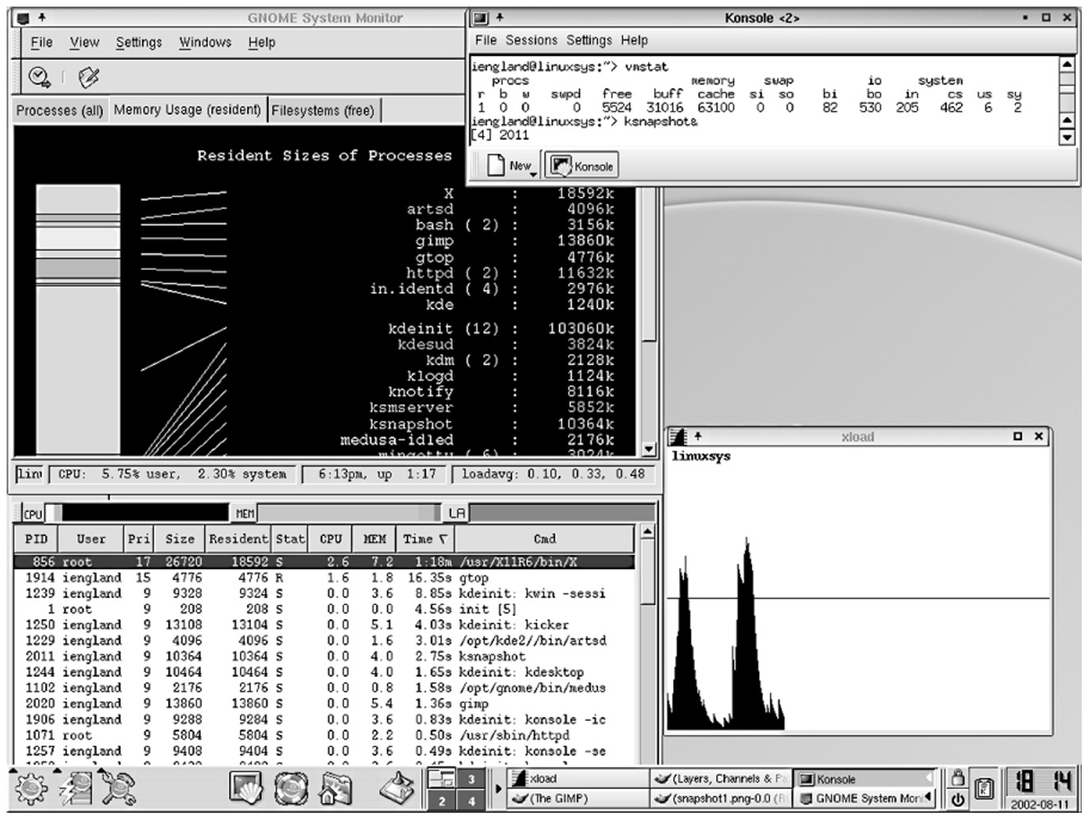
Typical System Status Report
15-<number>
AU

Slide 29
OS Configurations
Three main configurations for the organization of an operating system
  Monolithic configuration
    Unix/Linux
  Hierarchical (layered) configuration
    Multics
    Windows 2000 and later versions (approximately hierarchical)
  Microkernel
    Macintosh OS X
15-<number>
AU

Slide 30
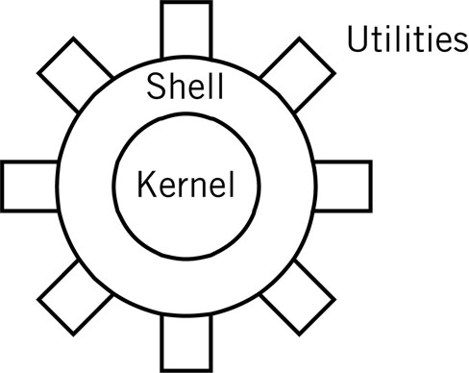
Monolithic Kernel
Drawback: stability and integrity must be managed carefully
Examples: UNIX, Linux
15-<number>
AU

Slide 31
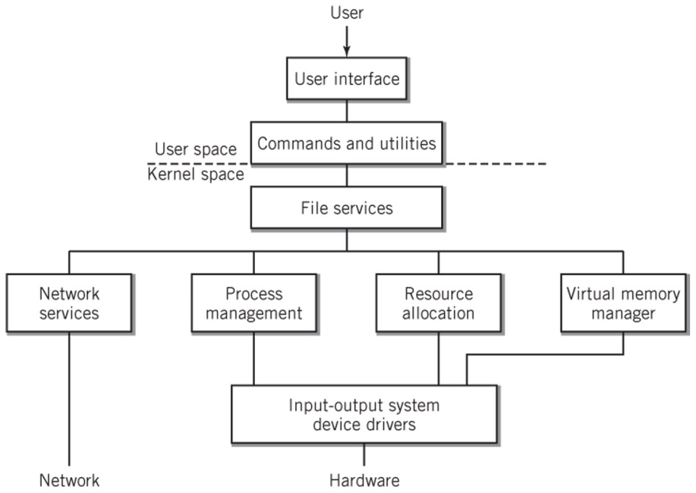
Hierarchical Model of an OS
Each layer is independent of the other layers
Requests are passed down to the layer immediately below it
AU
15-<number>

Slide 32
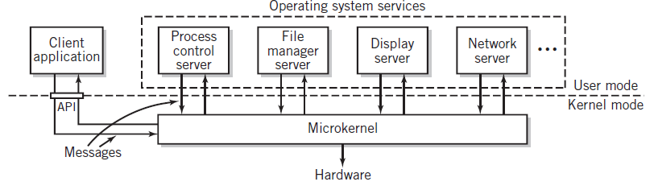
Microkernel
Minimum essential functionality
Client-server system on same system
  Clients request services from microkernel, which passes message onto appropriate server
15-<number>
AU

Slide 33
Seven Types of Operating Systems
Single-user systems and workstations
  Predominant systems in use
  Laptop and desktop computers and workstations
  Macintosh OSX, versions of Windows, Linux, and Sun Solaris
Mobile operating systems
  Designed for small hand-held devices such as smartphones
  Features of single-user multitasking systems but with constraints on memory, storage, CPU execution speed, and electrical power
  Touch screen capability, special keyboard handling, GPS, handwriting ,and voice recognition
  IOS, Android, E-readers, tablets
15-<number>
AU

Slide 34
Seven Types of Operating Systems
Mainframe systems
  Designed to manage large scale computing resources
  Extensive I/O capability to handle large numbers of transactions
  Support batch data processing operations, cloud computing and large Web services and database processing
  Consists of clusters made up of multiprocessor units
Network servers
  Focused on supporting clients connected to the server
  We services, file services, print services, application services, and/or database services to clients
  Improved security, high reliability, backup facilities
15-<number>
AU

Slide 35
Seven Types of Operating Systems
Real-time systems
  One or more processes must be able to access the operating system immediately
  Multitasking system where the real-time program’s interrupts have very high priority
  Examples
    Air controller systems, rocket propulsion control systems, car brakes
Embedded control systems
  Specialized systems designed to control a single piece of equipment such as an automobile or a microwave oven
  Software is usually provided in ROM
  Real-time system dedicated to the particular application
  Example: General Motors Delphi system
15-<number>
AU

Slide 36
Seven Types of Operating Systems
Distributed systems
  Growing in prominence and importance
  Processing power distributed among computers in a cluster or network
  Program components may be stored on different systems and executed upon request using .NET and CORBA standards
  Example: Distributed Computing Environment (DCE)
15-<number>
AU

Slide 37
15-<number>
AU

Slide 38
User Interface (UI)
Primary function
  Help the user use the computer system productively
  Make computer facilities accessible to the user to allow the user to get work done conveniently and efficiently
Secondary function
  Common look and feel for applications
  Provide consistent user interface tools to application programs to lower learning curves and increase productivity
16-<number>
AU

Slide 39
UI Access to Services
Three different approaches:
Command Interface
  Accepts commands directly from the user interface
  Either graphical (GUI) or command line (CLI)
Command language
  Accepts and executes groups of commands as a program
  Also known as scripting languages
Application Programming Interface (API)
  Accepts and performs requests directly from the user’s programs
16-<number>
AU

Slide 40
Typical OS User Services
Loading and execution of program files
File commands
User I/O services
Security and data integrity
Interuser communication and data sharing
System status and administration tools
I/O, file, and specialized services for user programs
16-<number>
AU

Slide 41
UI Utilities
Used in place of programs to manipulate the data within files and programs
Can be combined using a command language to create powerful programs
Examples
  Sorting data and files
  Retrieving data selectively from files
  Modifying data in files
16-<number>
AU

Slide 42
Program Execution
Operands
  Name of files passed to the program
  Parameters passed to the program that affect program behavior
Command Line Interface
  Type the name of the program and submit it to the operating system
Graphical User Interface
  Double-click or finger tap on a graphical icon
  Double-click on a data file icon. Program associated with the data file is executed with the data file as an operand.
Batch mode
  Run programs non-interactively
16-<number>
AU

Slide 43
File Commands
File command categories
  Storage
  Retrieval
  Organization
  Manipulation of files
Important features of a file management system
  Ability to treat files by a logical name without regard to physical characteristics or storage location
  Handle physical manipulation of files and translate between logical and physical representations
  Issue commands to the OS that store, manipulate, and retrieve files
  Ability to construct an effective file organization
16-<number>
AU

Slide 44
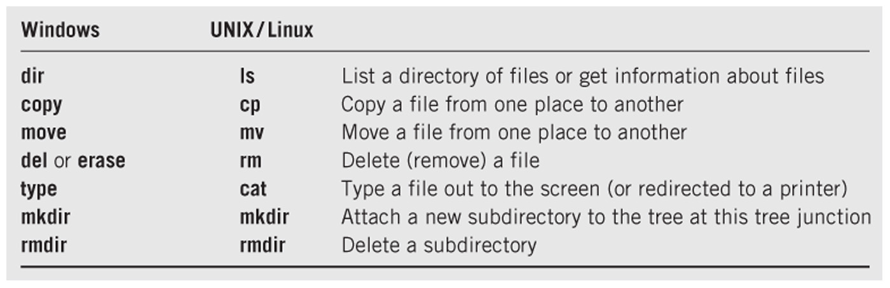
Common File Commands
16-<number>
AU

Slide 45
I/O Device Commands
Commands for direct operation on I/O devices
Formatting and checking disks
Copying entire disks
Sending output to a screen or printer
Queuing system for spooling output to a printer
Mounting or unmounting an I/O device
  Attaching or detaching a directory structure of a device to an existing directory structure
  Used in Unix/Linux
16-<number>
AU

Slide 46
Security and Data Integrity Protection
Protection from unauthorized read, write, or execution
Protection from deletion
Unix: three levels of security in form of read, write, and execute privilege for owner, group, and anyone else
Windows: access control lists (ACLs)
16-<number>
AU

Slide 47
Interuser communication and disk sharing operations
Program sharing
  Place shared program in a common memory space where all users can reach them
Data file sharing and data integrity issues
  Multiple users working on a single document
  Databases
OS message passing services
  E-mail, FTP, terminal facilities (telnet, ssh), http, instant messaging, audio and video conferencing
OS services to permit program to communicate with one another
  File redirection and pipe commands
16-<number>
AU

Slide 48
System Status Information and User Administration
Common system status commands
  Amount of available disk space
  Amount of available memory
  Number of users on the system and who they are
  % of time that CPU and I/O channels are busy
Logging facility that maintains a file of all keyboard and screen I/O
16-<number>
AU

Slide 49
System Status Information and User Administration
Tools for analyzing and controlling system
  Turn features on/off
  Set network connections
  Control programs
  Real-time graphs of dynamic performance such as CPU usage, I/O, memory
  Add/remove users, change permissions, limit disk usage, improve performance
16-<number>
AU

Slide 50
Program Services
Services the OS provides directly to programs
File services
I/O services
API (application programming interface)
  Library of service functions that may be called by a program
  Parameters are passed to the selected service function
  Service routine returns results to the calling program
16-<number>
AU

Slide 51
Interface Designs
Two major types of interface designs
  CLI – Command Line Interface
    Windows command prompt
    UNIX/Linux command prompt
    Batch system commands
  GUI – Graphical User Interface
    Supplanted the CLI for most day-to-day use
    Limited web browser interface for some combinations of Windows versions and browser versions
16-<number>
AU

Slide 52
Command Line Interface
command <operand1> <operand2> …
<switch1> <switch2> …
Operands
  keyword (switches) and/or positional
Windows example to save a directory listing in a file
  dir pathparta\pathpartb > putfilea
Equivalent Linux example
  ls –lF pathparta/pathpartb > putfilea
16-<number>
AU

Slide 53
Batch System Commands
Similar interface to command line interpreter
  command <operand1> <operand2> …
Specify location of programs to be executed and data to be used
Uses a Job Control Language (JCL)
Programs are executed with no human interaction
Example: IBM zOS/Job Control Language
How is this different from shell scripts?
16-<number>
AU

Slide 54
Graphical User Interfaces
Mouse or finger pointer-driven and icon-based
Examples: Apple Mac and Windows PCs; Iphone, Android, and Blackberry smartphones and tablets
WYSIWYG
Windowing Systems
  May vary in appearance but share similar graphical and operational elements
  Contain desktop or screens, icons, windows, title bar, task bar, clock, menu bar, and gadgets or widgets
16-<number>
AU

Slide 55
Interface Designs
Web browser as a user interface
  Not really part of the operating system
  Provides a consistent, simple interface well-suited to less experienced users
  Growing proliferation of applications with a web-based interface
16-<number>
AU

Slide 56
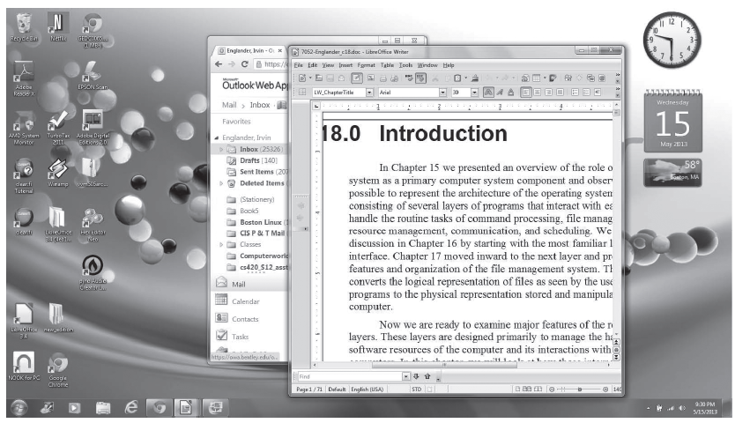
GUI Interface – Windows 7
AU
16-<number>

Slide 57
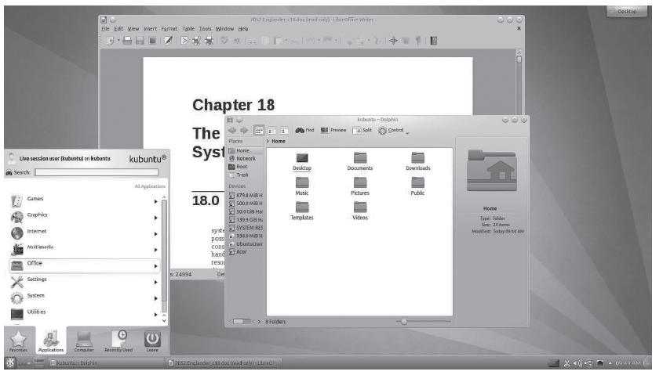
GUI Interface – Linux KDE
AU
16-<number>

Slide 58
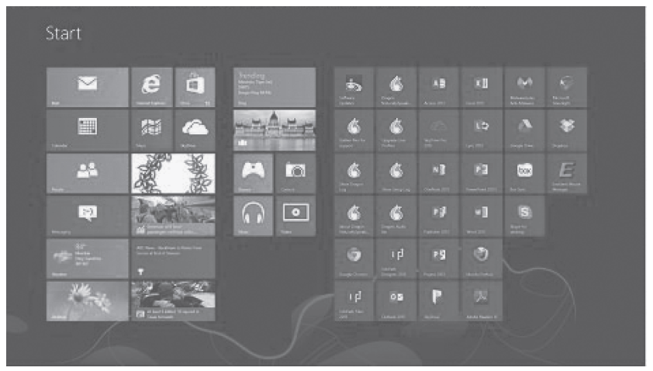
GUI Interface – Windows 8
AU
16-<number>

Slide 59
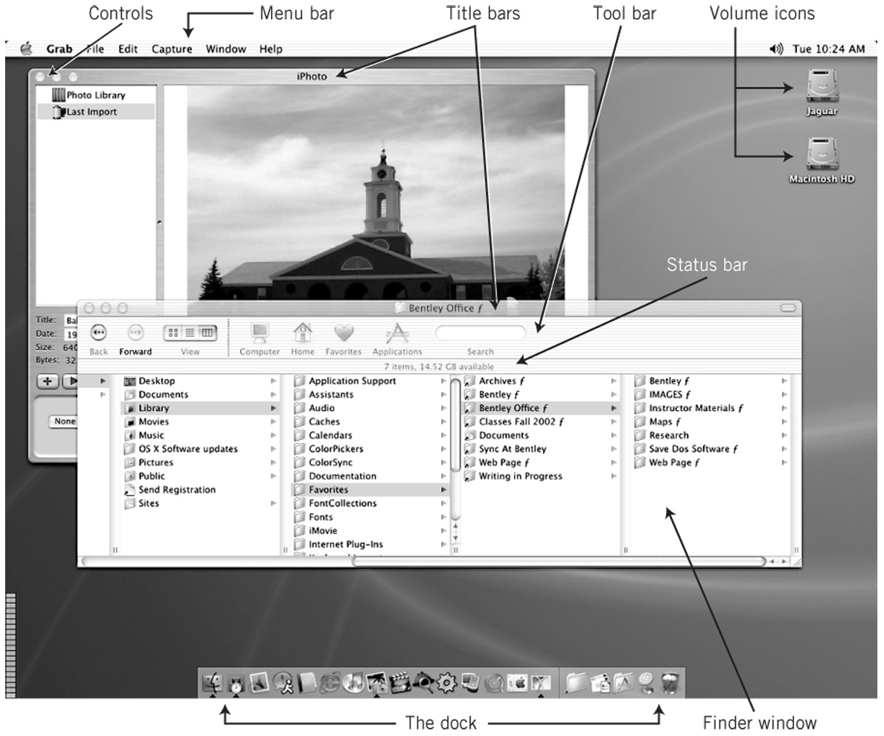
GUI Interface – MacIntosh OSX
AU
16-<number>

Slide 60
Touchless Gesture- and Voice-based Interfaces
Use of voice commands and gestures with no physical connection to the system is rapidly evolving
Originally designed for computer games but now applied to IT and general use
Examples:
  Body movement in Microsoft Kinect Xbox games
  Siri voice commands on Apple iPhones
  Eye-movement display on Samsung S4 smartphones
16-<number>
AU

Slide 61
GUI vs. CLI
GUI
Advantages
  Easy to learn and use
  Little training
  Amenable to multi-tasking
Disadvantages
  Harder to implement
  More HW/SW requirements
  Requires lots of memory
  SW is complex and difficult to write
CLI
Advantages
  More flexible and powerful
  Faster for experienced users
  Can combine commands
  Can use wild cards to apply a command to multiple files or directories
Disadvantages
  More difficult to learn and use
AU
16-<number>

Slide 62
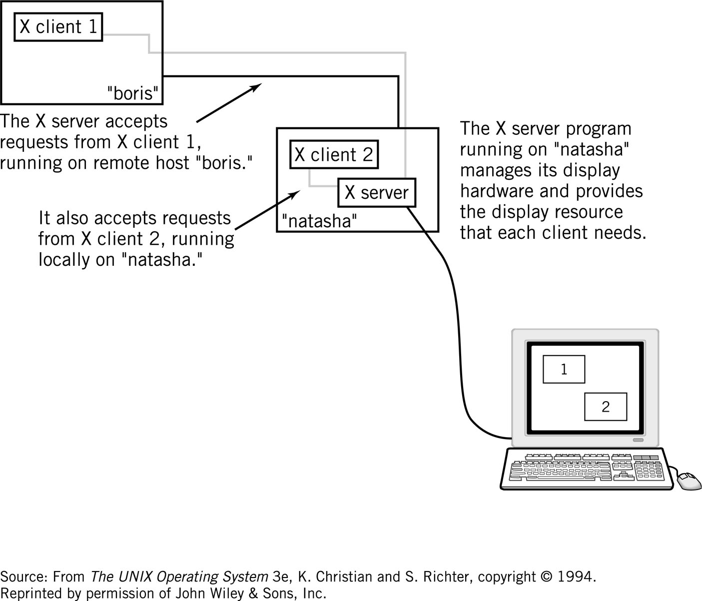
X-Windows
AU
16-<number>

Slide 63
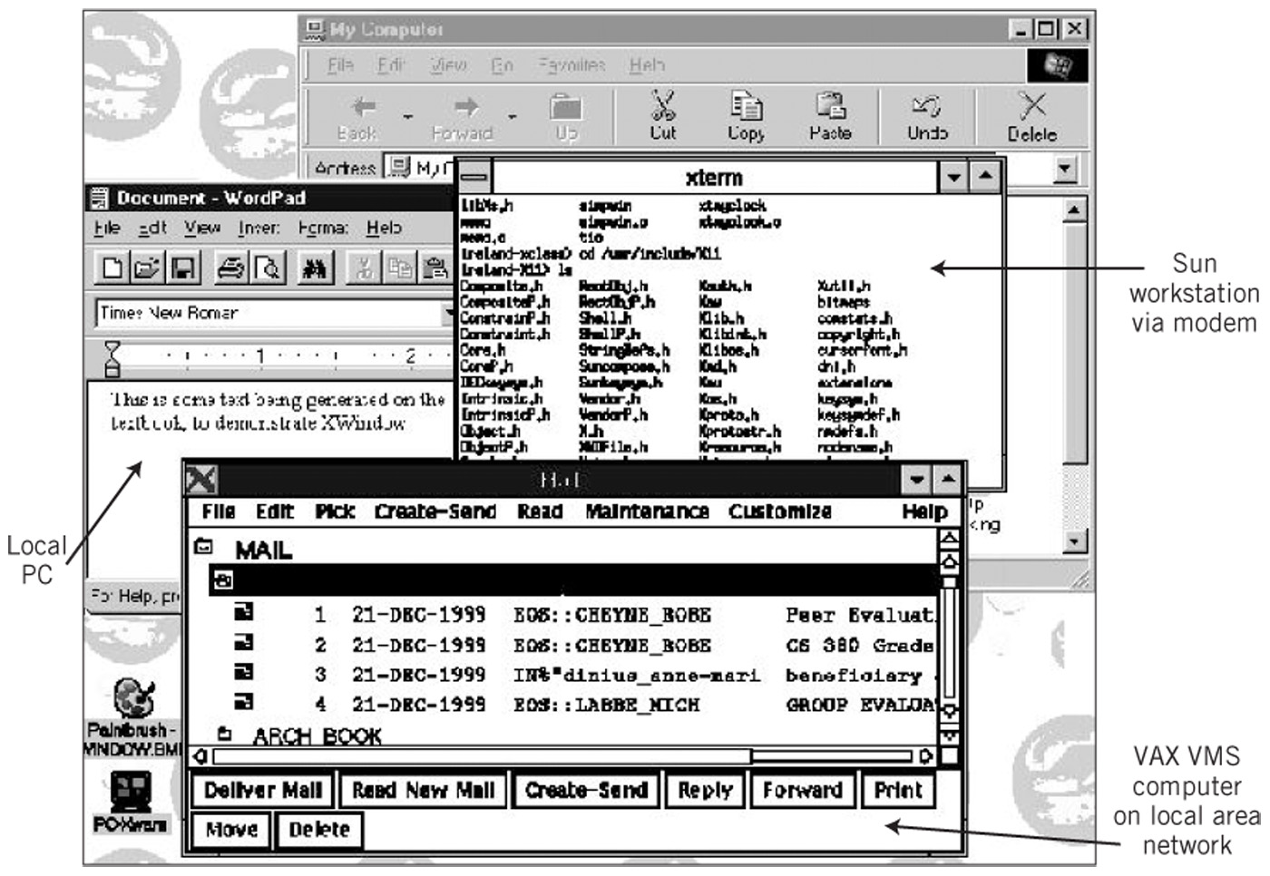
Multicomputer X-Window Display
16-<number>
AU

Slide 64
Command Languages
Provide a mechanism to combine sequences of commands together. These pseudo-programs are known as scripts or batch files.
Startup files – OS configuration, user preferences
Features of Command Languages
  Can accept input from the user and can output messages to I/O devices
  Provide ability to create and manipulate variables
  Include the ability to branch and loop
  Ability to specify arguments to the program command and to transfer those arguments to variables within the script
  Provide error detection and recovery
16-<number>
AU

Slide 65
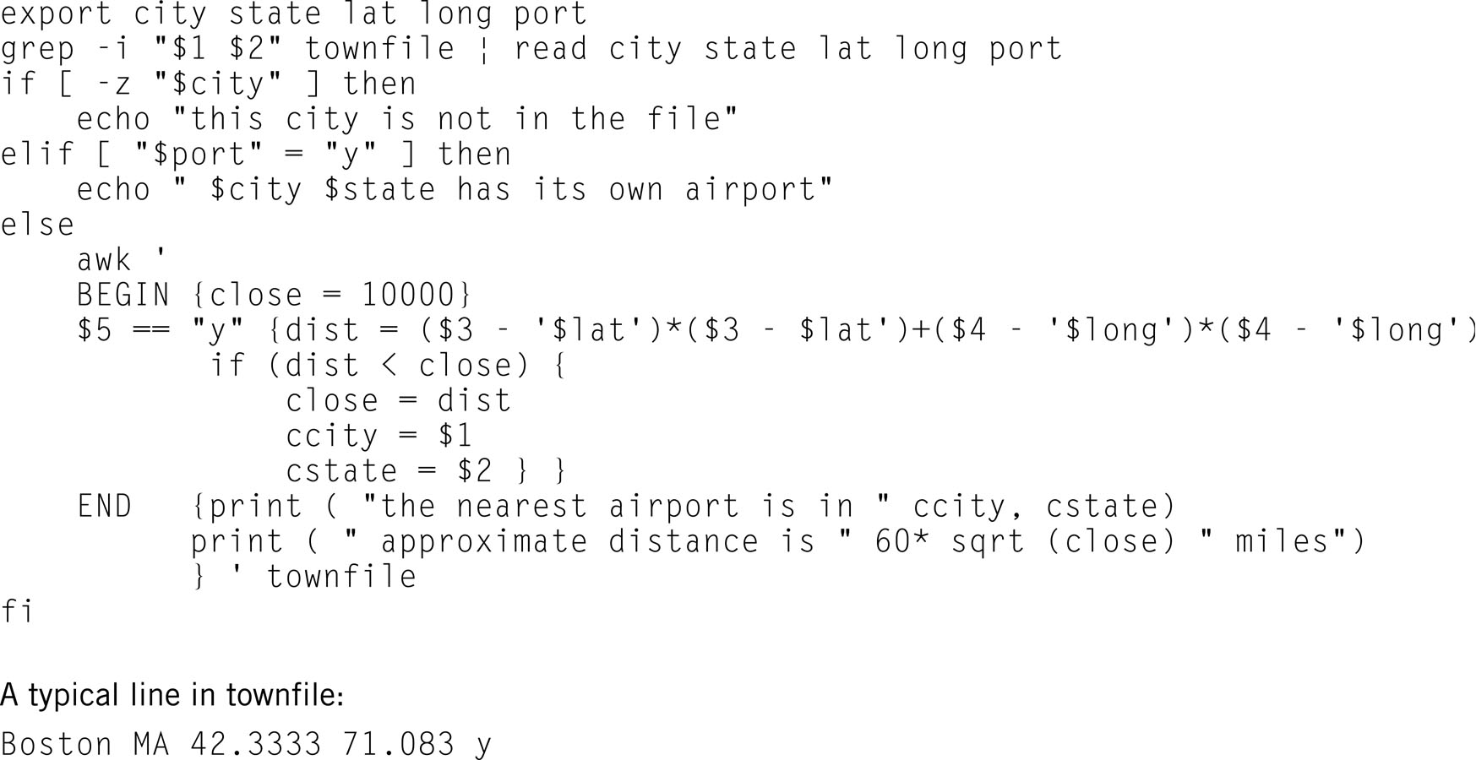
Example: Linux Shell Script
AU
16-<number>

Slide 66
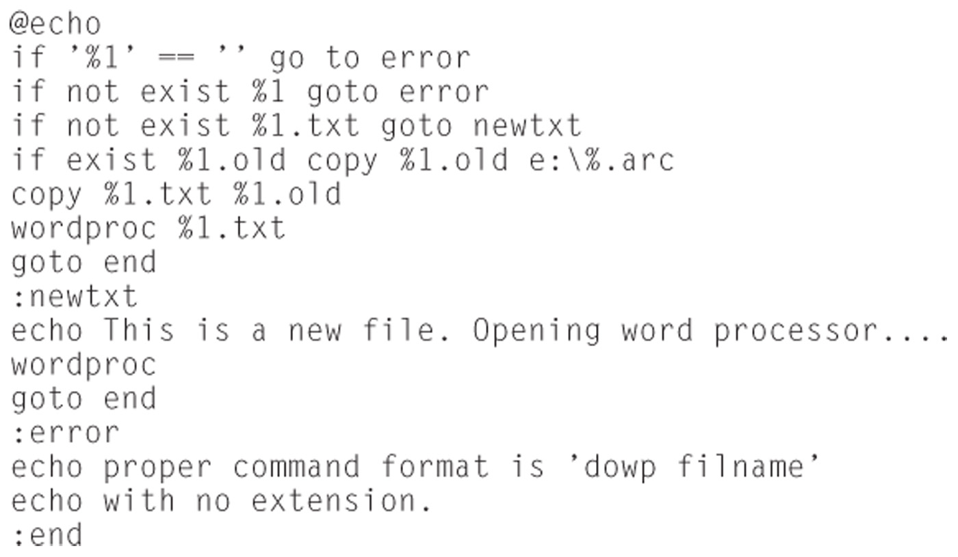
Windows Program DOWP
16-<number>
AU

Slide 67
Services to Programs
Allow programs to locate and share objects, often across a network
Ease a programmer’s task in creating new programs by providing commonly required program objects
  .NET
  CORBA
  Remote Procedure Call (RPC)
16-<number>
AU

