Slide 1
HP at a Strategic Crossroad: Leadership Lessons from Carly Fiorina’s Tenure
Notes:
Welcome everyone. Today, we will discuss the leadership lessons from Carly Fiorina’s tenure at HP, focusing on the strategic crossroads the company faced in 2005.

Slide 2
Background & Context
1999: Carly Fiorina appointed CEO
2004: HP misses profit projections; Fiorina fires top executives; Tom Perkins retires
2005: Fiorina ousted; Mark Hurd appointed CEO
2003: Dell enters printer market; leads PC shipments
2000: Fiorina named chairwoman, PWC consulting deal failed
2001: HP-Compaq merger announced; Walter Hewlett opposed the merger
2002: HP-Compaq merger completed; President resigned
HP’s Legacy: Founded in 1939, HP was a pioneer in computing and printing, known for its innovation and the “HP Way” – a culture of decentralization, employee empowerment, and integrity.
Challenges by Late 1990s:
Missed internet opportunities.
Losing market share to IBM and Dell.
Bureaucratic inefficiencies and cultural stagnation.
Notes:
HP, founded in 1939, was a pioneer in computing and printing. By the late 1990s, it faced challenges such as missed internet opportunities, losing market share, and bureaucratic inefficiencies.

Slide 3
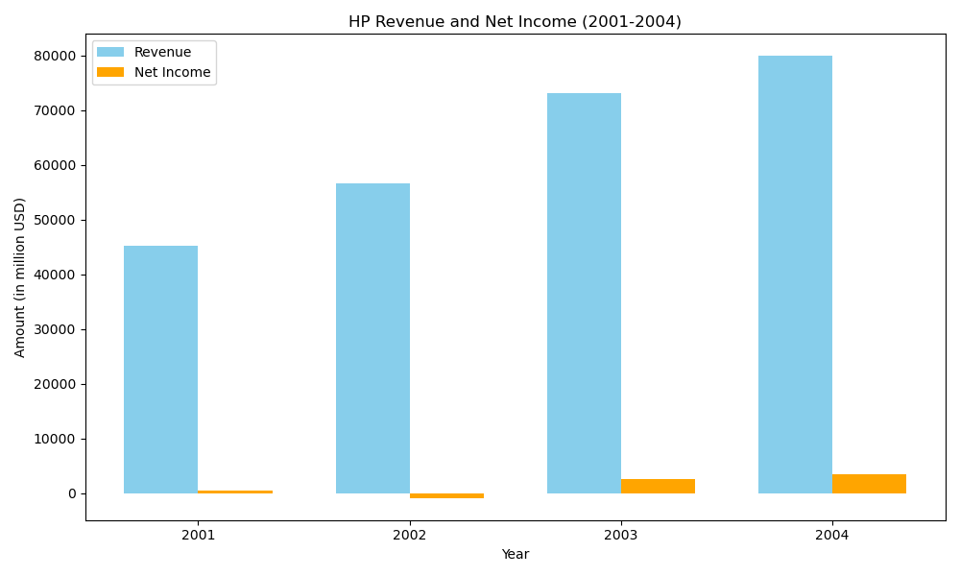
Leadership Shift – Enter Carly Fiorina
Appointed in 1999: First outsider and woman CEO of a Fortune 100 company.
Background: Stellar rise at AT&T and Lucent Technologies.
Mandate: Revitalize HP, drive growth, and modernize its culture.
Notes:
In 1999, Carly Fiorina was appointed as the first outsider and woman CEO of a Fortune 100 company. She had a stellar rise at AT&T and Lucent Technologies and was tasked with revitalizing HP.

Slide 4
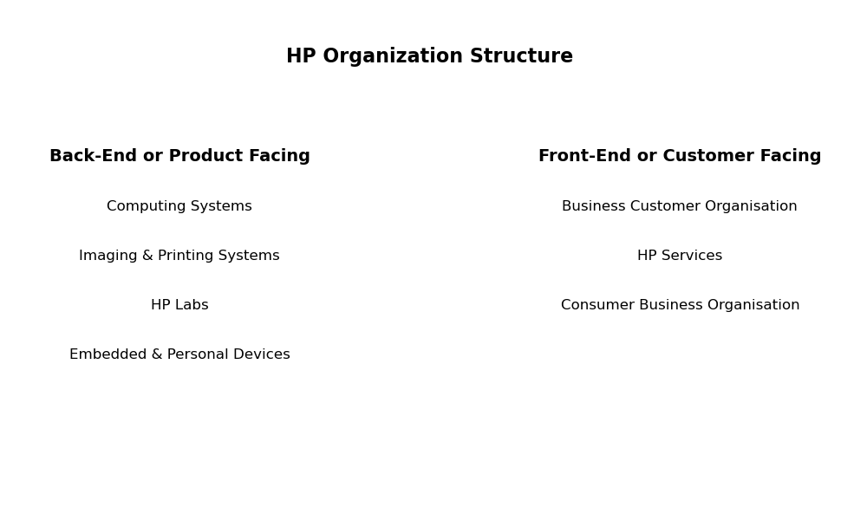
Strategic Moves by Fiorina
Reorganization: From 83 units to a streamlined front-end/back-end model.
Cultural Overhaul: Introduced performance-based culture, dismissed underperformers, and replaced the “HP Way” with “Rules of the Garage.”
Brand Revamp: Shifted from “Hewlett-Packard” to “HP” with bold marketing campaigns.
Notes:
Fiorina reorganized HP from 83 units to a streamlined front-end/back-end model, introduced a performance-based culture, and revamped the brand from “Hewlett-Packard” to “HP”.

Slide 5
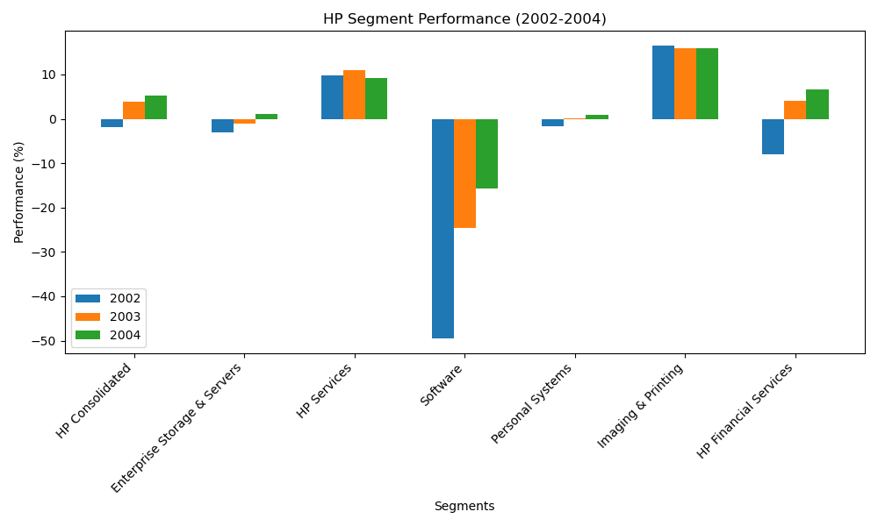
The Compaq Merger – A Bold Bet
$19B Acquisition in 2002: Aimed to create a full-spectrum tech giant.
Opposition: Fierce resistance from HP family shareholders.
Outcome:
Short-term cost savings ($3.5B).
Long-term value questioned.
Cultural clash and morale issues.
Notes:
In 2002, Fiorina spearheaded the $19B acquisition of Compaq to create a full-spectrum tech giant. Despite fierce resistance, the merger aimed for short-term cost savings and long-term value.

Slide 6
Leadership Style – Strengths & Pitfalls
Strengths:
Charismatic, visionary, media-savvy.
Strong strategic thinker.
Pitfalls:
Autocratic, centralized decision-making.
Alienated HP’s traditional workforce.
Execution gaps and internal resistance.
Notes:
Fiorina was charismatic and visionary but also autocratic and centralized in decision-making. Her leadership style alienated HP’s traditional workforce and led to execution gaps.

Slide 7
Performance & Fallout
Financials:
Revenue grew post-merger, but margins remained thin.
PC division underperformed; printer division subsidized losses.
Boardroom Tensions:
Fiorina resisted calls for a COO.
Fired top executives amid poor results.
Ousted in Feb 2005 with a $21M severance.
Notes:
Despite revenue growth post-merger, margins remained thin. The PC division underperformed, and the printer division subsidized losses. Fiorina was ousted in 2005 with a $21M severance.

Slide 8
Leadership Lessons
Cultural Alignment Matters: Strategy must resonate with organizational values.
Execution is Key: Vision without operational excellence leads to failure.
Stakeholder Management: Ignoring internal and external voices can be costly.
Balance Charisma with Humility: Leadership is not just about visibility but trust and collaboration.
Notes:
Key leadership lessons from Fiorina’s tenure include the importance of cultural alignment, execution, stakeholder management, and balancing charisma with humility.

Slide 9
Aftermath & New Leadership
Mark Hurd Appointed (April 2005):
Known for operational discipline.
Board retained Fiorina’s strategy but sought better execution.
Strategic Question: Can the same strategy succeed under different leadership?
Notes:
Mark Hurd was appointed as CEO in April 2005. He focused on operational discipline and retained Fiorina’s strategy but aimed for better execution. The strategic question remained whether the same strategy could succeed under different leadership.

Slide 10
Discussion Points
Was Fiorina the right leader for HP at the time?
Could a more culturally sensitive approach have yielded better results?
What leadership traits are essential during transformational change?
Notes:
In conclusion, Fiorina’s tenure at HP highlights the clash between visionary leadership and entrenched culture. It underscores the importance of strategic alignment, execution capability, and adaptive leadership in corporate transformation.

Slide 11
Schein’s Organizational Culture Model
Theory: Edgar Schein identifies three levels of culture
Artifacts
Espoused Values
Basic Assumptions.
Relevance: Leaders who challenge deep-seated assumptions (e.g., HP’s “HP Way”) without aligning with core values may be perceived as outsiders or threats.
Insight: Cultural change must address all three levels, especially the invisible assumptions that drive behavior.

Slide 12
Lewin’s Change Management Model
Theory: Kurt Lewin proposed a three-stage model
Unfreeze
Change
Refreeze.
Relevance: Entrenched cultures resist the “unfreezing” stage. Leaders like Carly Fiorina, who attempt rapid transformation without adequately preparing the organization, often face backlash.
Insight: Successful change requires disrupting the status quo gradually and building readiness for change.

Slide 13
Conclusion
Carly Fiorina’s tenure at HP is a compelling case of visionary leadership clashing with entrenched culture.
It underscores the importance of strategic alignment, execution capability, and adaptive leadership in navigating corporate transformation.
Notes:
Thank you for your attention. Let's open the floor for any questions or discussions.

