Slide 1
Hr Analysis case study
Sicheng Yang
DSI
Dec 05
github.com/kkarzyang/Presentation

Slide 2
RECAP
- Predict promotion or not
- Sociology research, junior employees, current students
- Classification problem
- Kaggle
- Preprocessing: mixed features with missing values
- EDA: imbalanced data, winning awards ✓ no_training✗

Slide 3
Cross validation
Split the data:
train test split with test size = 20% (stratified)
the other 80% data points go into StratifiedKFold with n_splits = 4
Imbalanced, you might not have class 1 points in one of sets by chance
General way of optimize hyperparameters and effectively utilize data
Experiment on 10 fixed random seed, reduce variance from randomness
CV pipeline
    1) preprocessor (discussed last time)
    2) classifier we want to use (optional fixed random state)
GridSearchCV (accuracy as scoring method)

Slide 4
Cross validation
Algorithms:
  K nearest neighbors
    n_neighbors, weights
  Random forest
    max_depth, max_features, n_estimators
  Xgboost
    learning_rate, max_depth, min_child_weight, subsample
  Logistic Regression classifier with elasticnet
    C, l1_ratio

Slide 5
Cross validation
 | Linear? | Non-deterministic?
K nearest neighbors | No | No
Random forest | No | Yes
Xgboost | No | Yes
Logistic Regression classifier with elasticnet | Yes | Yes

Slide 6
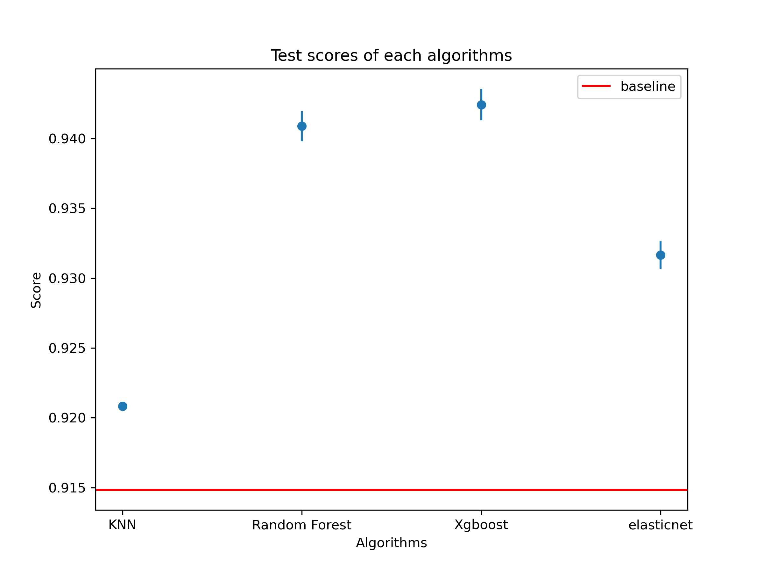
Results
Accuracy as scoring metric
Baseline for binary classification: 0.9148
Most predictive
Compare

Slide 7
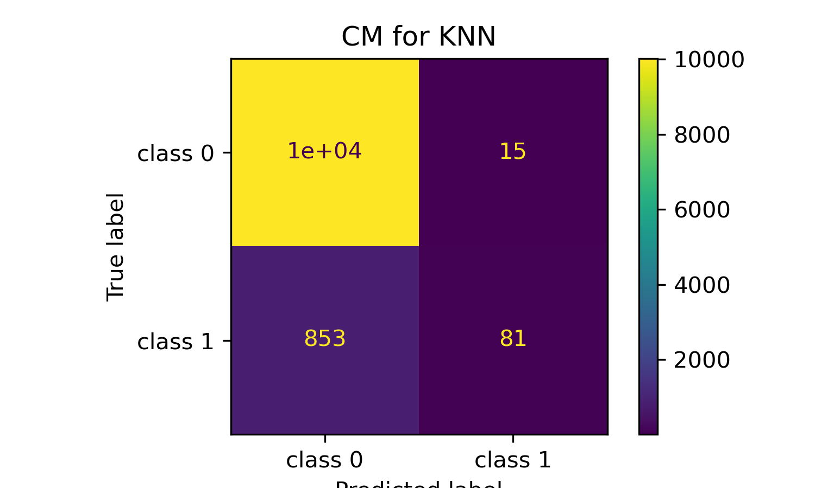
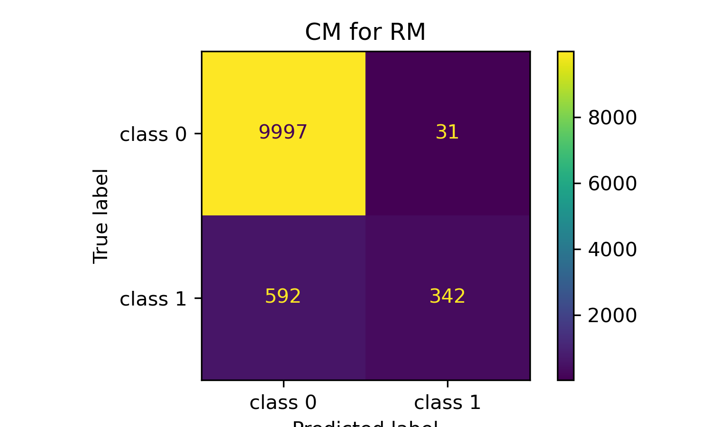
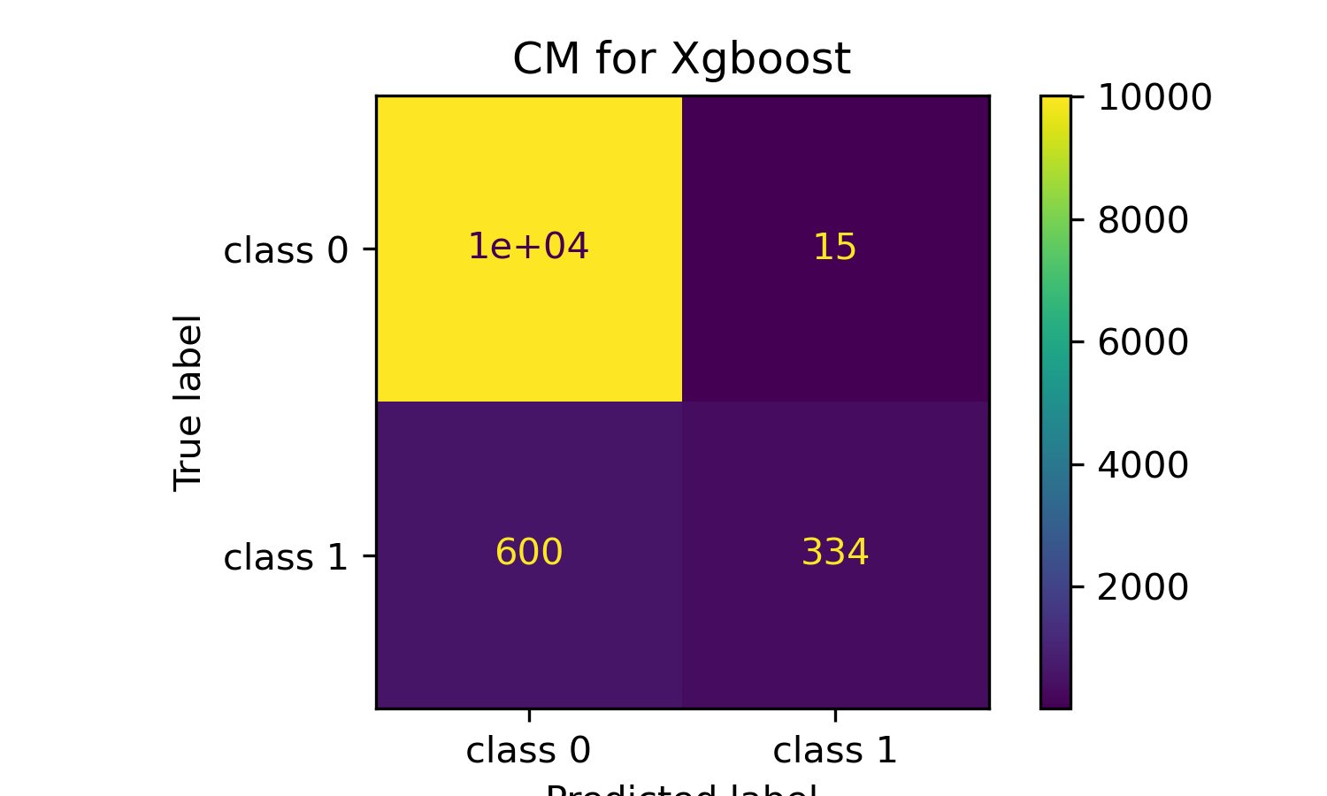

Results

Slide 8
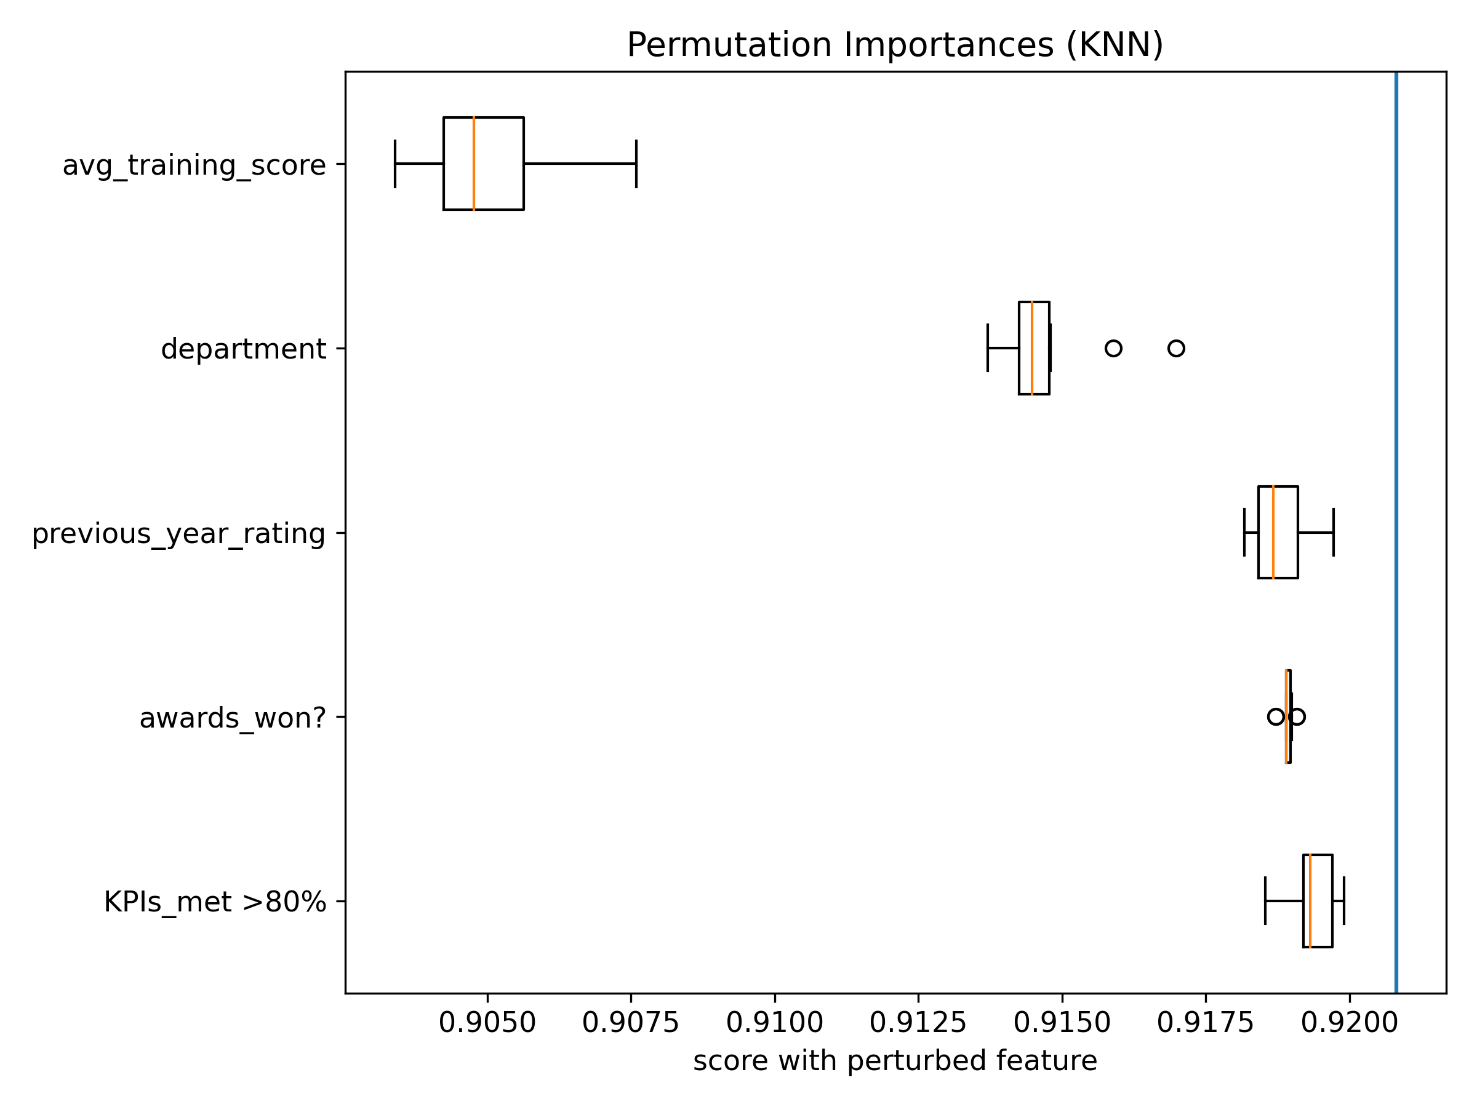
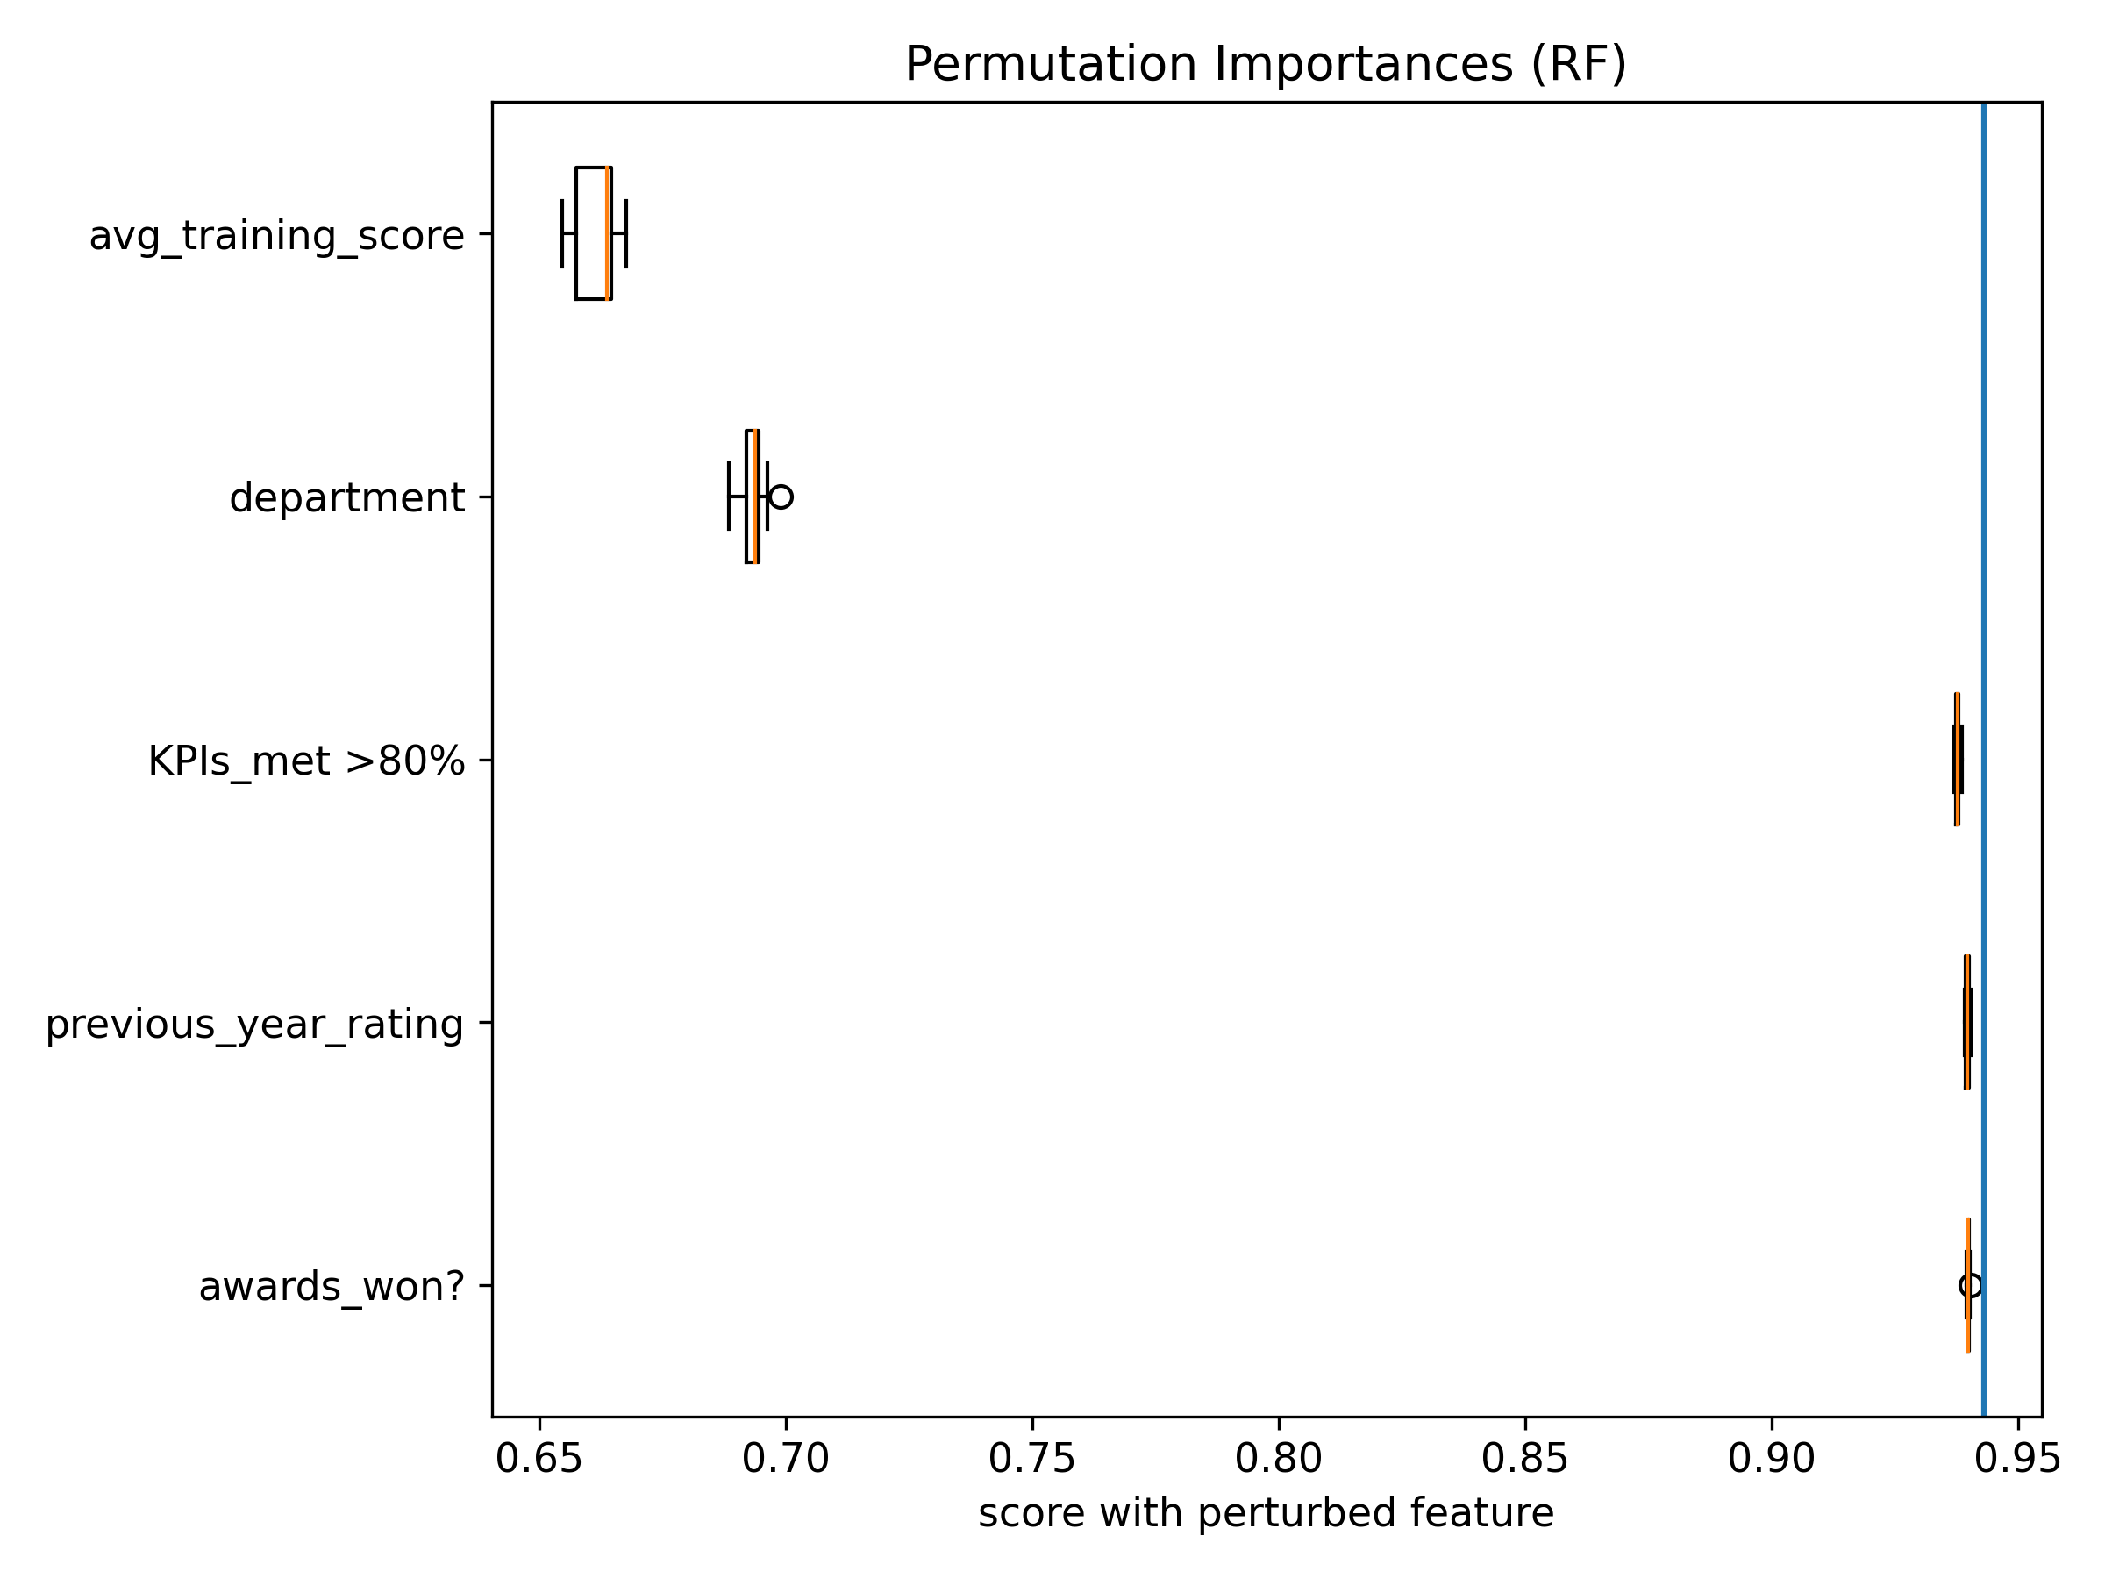
Results
What steps to make models interpretable (global)
Permutation importance

Slide 9
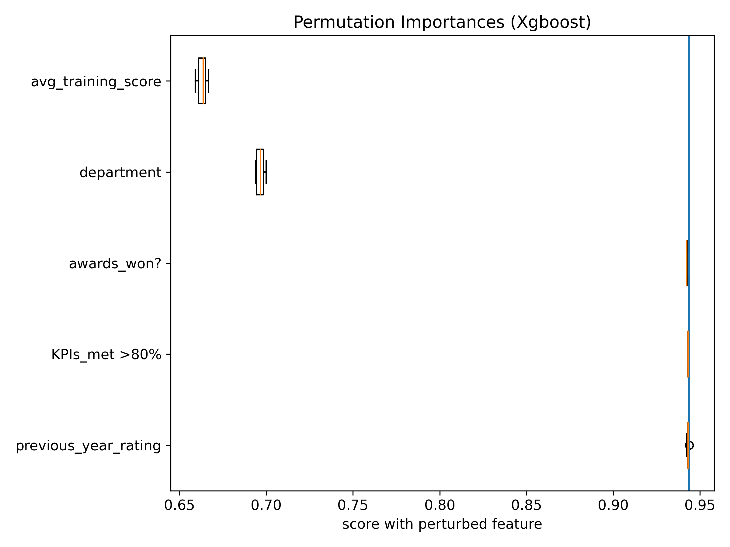
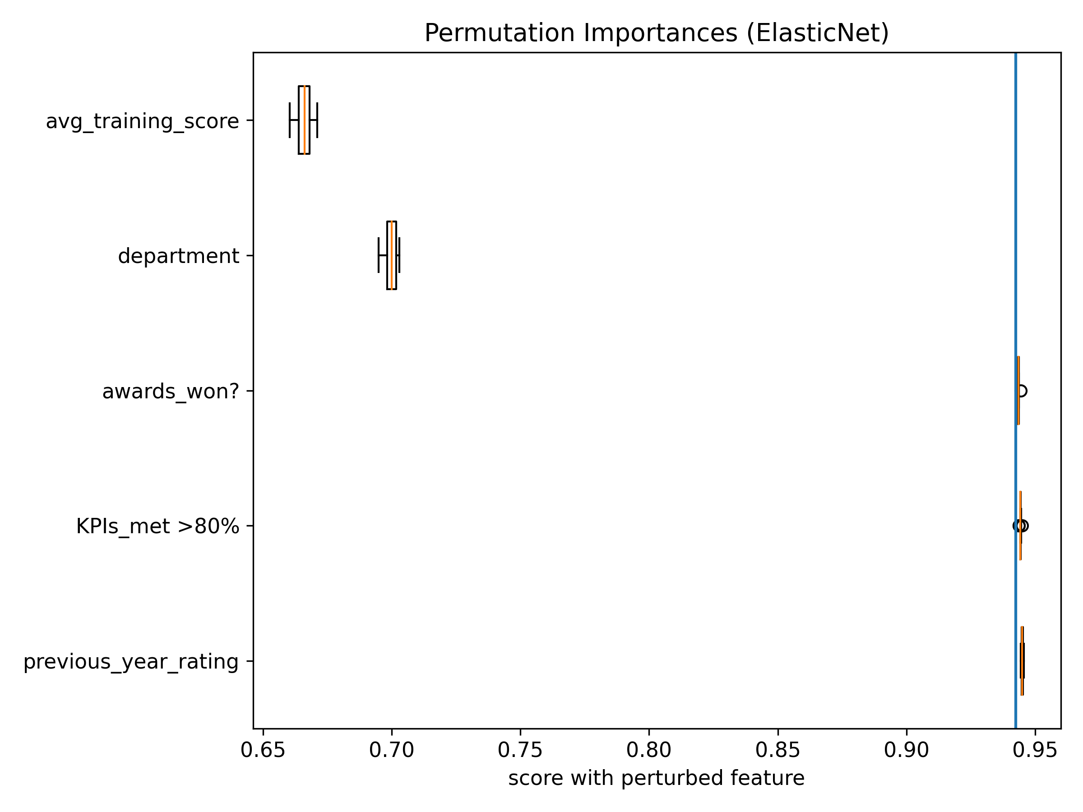
Results
What steps to make models interpretable (global)
Permutation importance
Learn? EDA view

Slide 10
Overlook
Try to tune other hyperparameters/wider range of hyperparameters
Try other models (e.g. SVC, deep neural networks)
Try to resample/augment the dataset
    SMOTE (Synthetic Minority Over-sampling Technique)
    Result may be misleading
Try to draw a force plot on specific points (with shap)

Slide 12
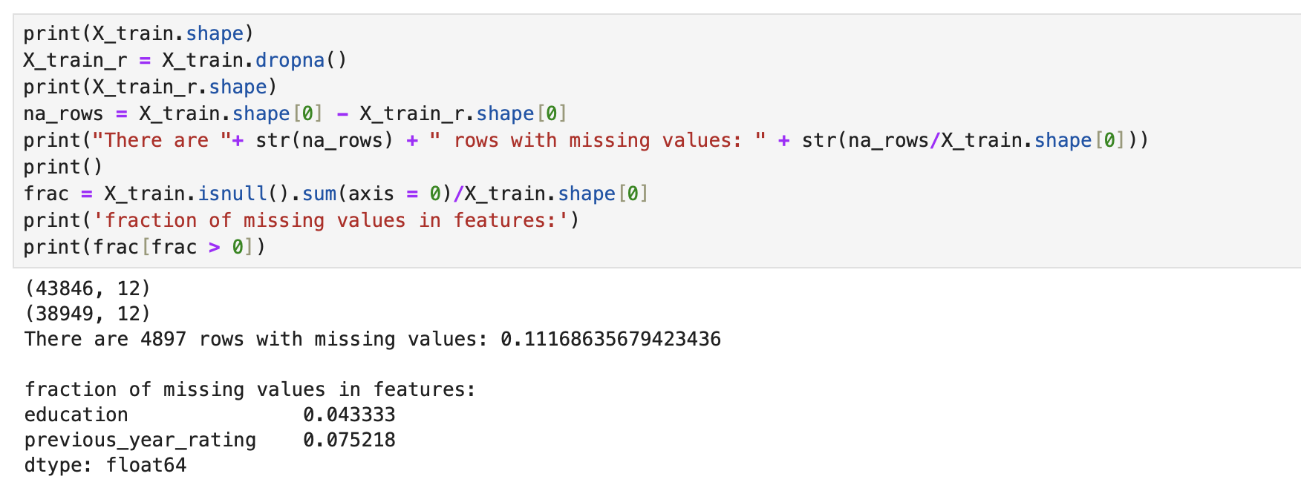
PREPROCESSING
Missing values

Slide 13
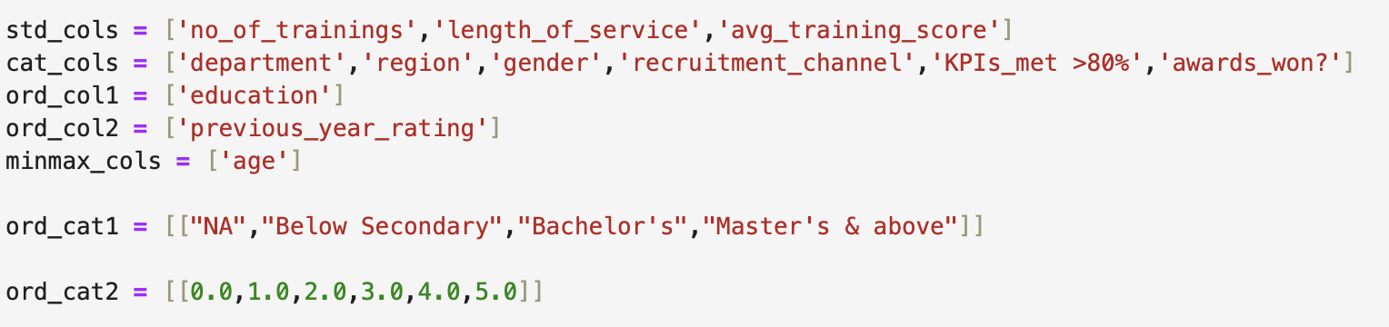
PREPROCESSING
WHAT & WHY

Slide 14
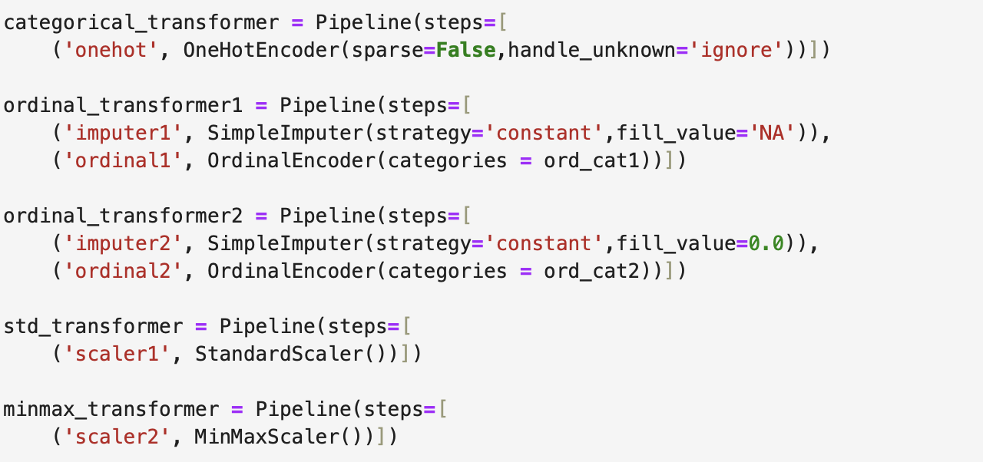
PREPROCESSING
WHAT & WHY

Slide 15
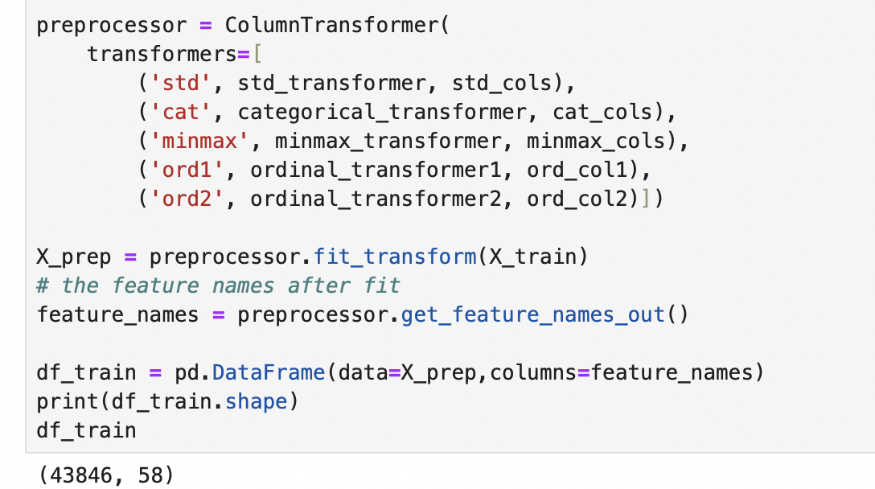
PREPROCESSING
WHAT & WHY (Apply transform on val/test datasets)

Slide 16
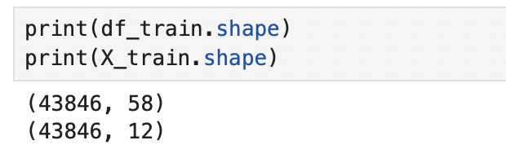
PREPROCESSING
BEFORE & AFTER

