Slide 1
Human Activity Recognition
Kavya Kasala | Rithika Baroor
Group 4

Slide 2
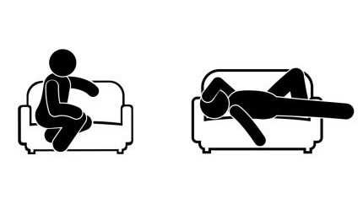

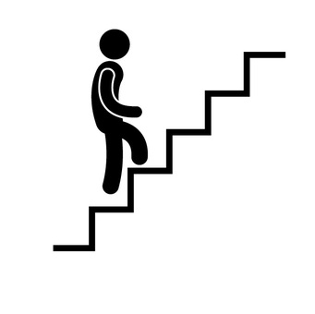
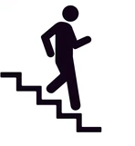
Introduction
Motivation: Significant applications in enhancing human-technology interaction across various industries.
We utilized advanced machine learning techniques to classify activities accurately using sensor data from smartphones

Slide 3
Dataset Overview
Data collected from 30 volunteers carrying a waist-mounted smartphone
Volunteers performed activities within their daily routines.
The six monitored activities are WALKING, WALKING_UPSTAIRS, WALKING_DOWNSTAIRS, SITTING, STANDING, and LAYING.
Each activity was recorded in sessions, and volunteers’ actions were video-monitored for accurate labeling.
The data was preprocessed, and 561 features were extracted.

Slide 4
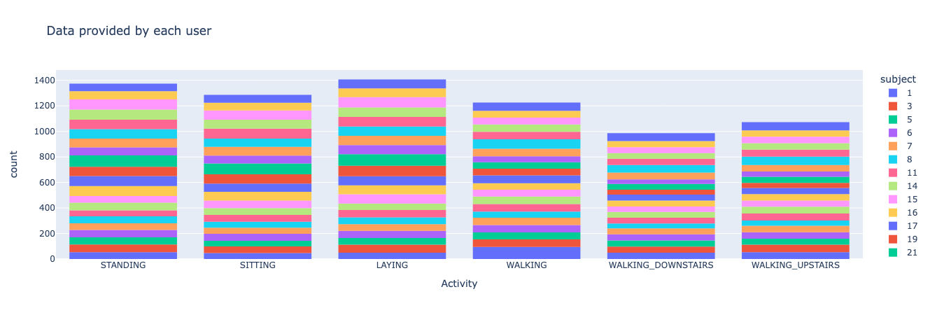
Data Preprocessing
Checked for Null Values and Duplicates.

Slide 5
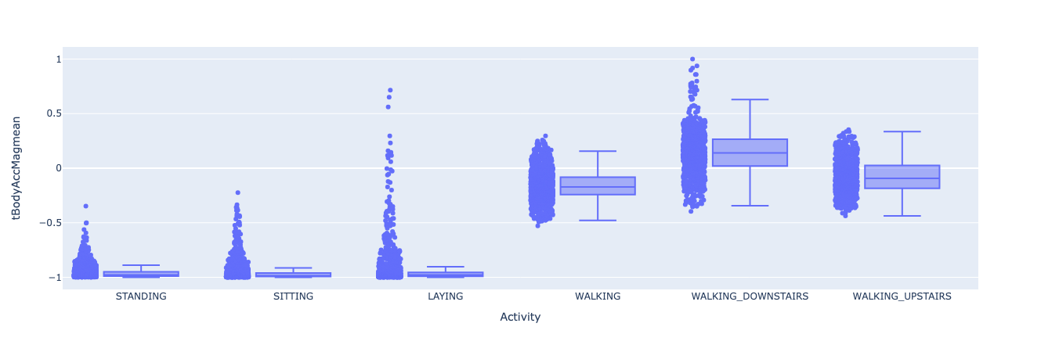
EDA

Slide 6
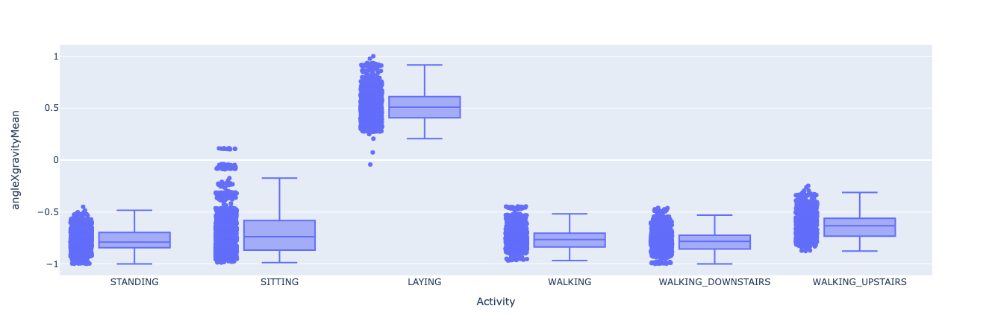
EDA

Slide 7
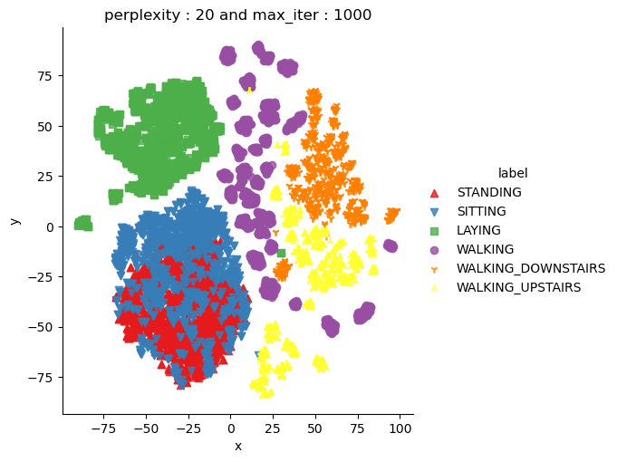
t-SNE for Visualization
To visualize high-dimensional data in two dimensions.
Each cluster represents data points close to each other
Distinct clusters for each activity.

Slide 8
PCA
Reduced the dataset to a principal component space that retains 99% of the variance.
This reduced dataset can be used for faster and potentially more effective training of machine learning models.
Original number of features 561
Reduced number of features 155

Slide 9
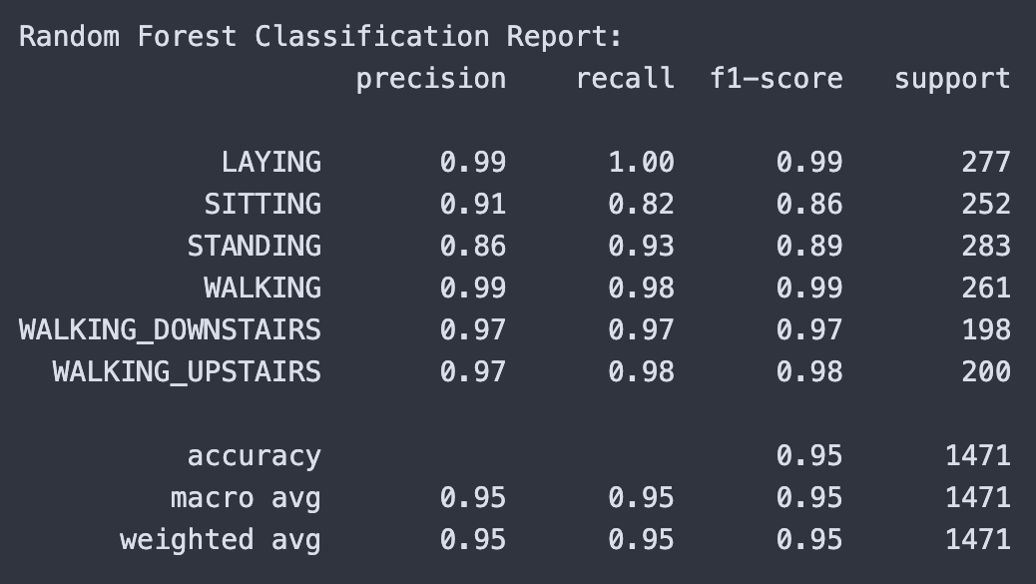
Model Training
Random Forest:
We chose the Random Forest algorithm for its exceptional ability to handle complex, high-dimensional datasets

Slide 10
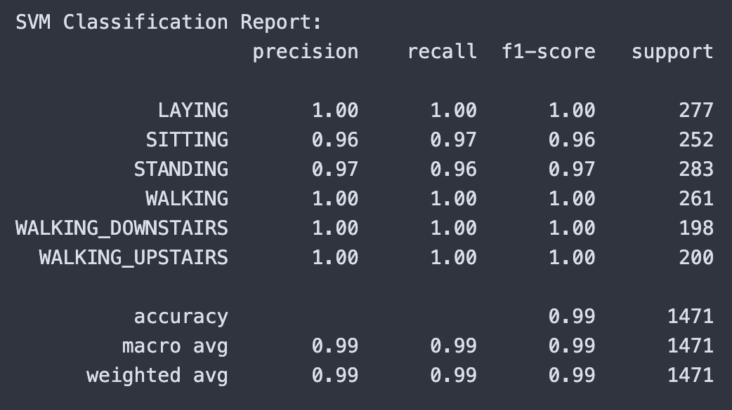
Model Training
SVM:
The kernel trick in SVM allows it to adapt seamlessly to the non-linear relationships that are typical in human activity patterns, by transforming data into a higher dimension where a hyperplane can be used to separate classes more clearly

Slide 11
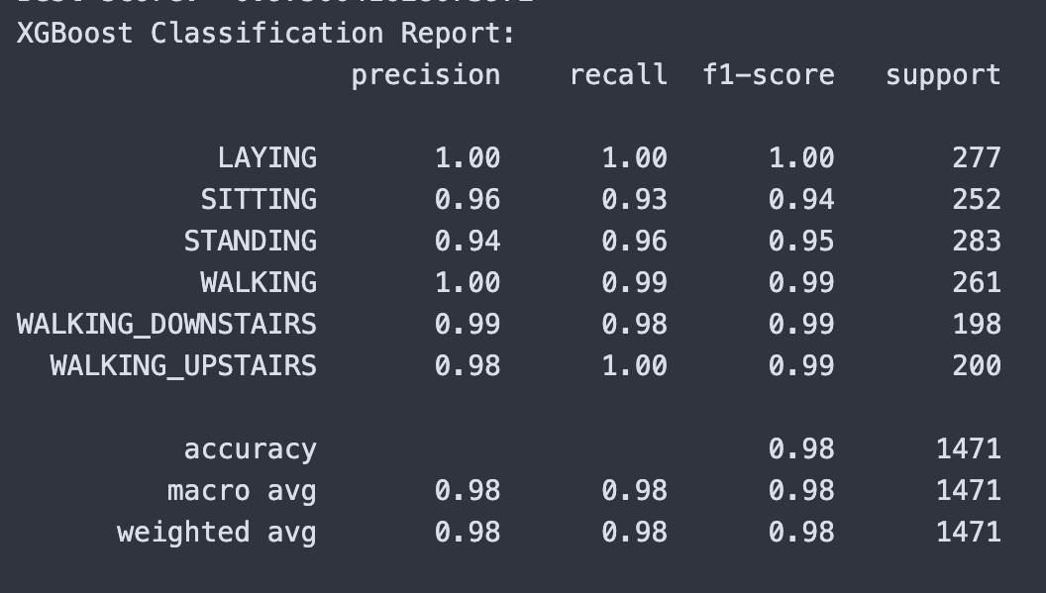
Model Training
XGBoost:
Its built-in regularization (L1 and L2) helps prevent overfitting, enhancing the model’s generalizability.

Slide 12
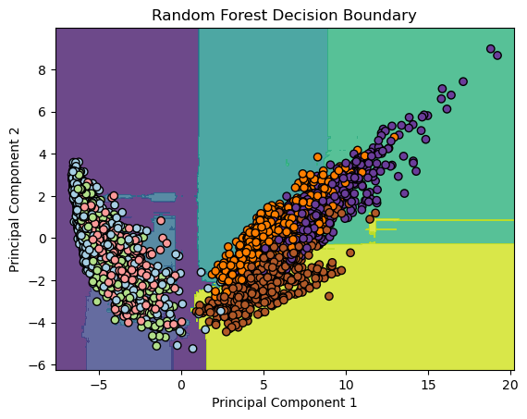
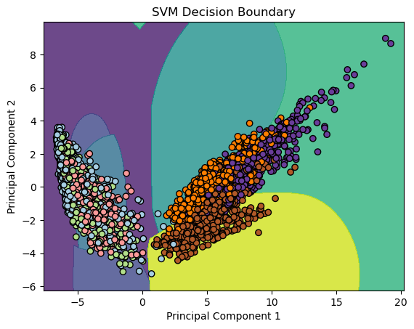
Decision Boundary

Slide 13
Conclusion
In our project, we aimed to classify physical activities from sensor data using advanced machine learning models—SVM, Random Forest, and XGBoost—each chosen for their unique capabilities in handling complex, high-dimensional data.
Our project provides solid foundation for further research and development, like Exploration of Deep Learning Techniques, Implement more rigorous cross-validation techniques.

Slide 14
References
https://www.semanticscholar.org/paper/Human-Activity-Recognition-on-Smartphones-Using-a-Anguita-Ghio/4f605b3bb3ce574f4053f19264434baa522305b7
https://www.sciencedirect.com/science/article/pii/S1877050915018141
https://www.datacamp.com/blog/curse-of-dimensionality-machine-learning
https://link.springer.com/chapter/10.1007/978-981-15-5421-6_34

Slide 15
THANK YOU

