Slide 1
System Screenshot Test
Testing OCR text extraction

Slide 2
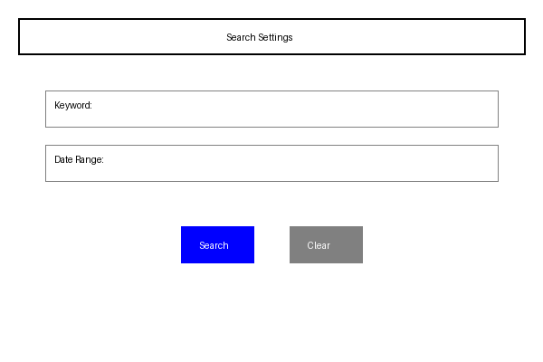
Application Interface
This shows the search interface with keyword and date range fields

