Slide 1
AI Mode Test Presentation
Testing MarkItDown with LLM Integration

Slide 2
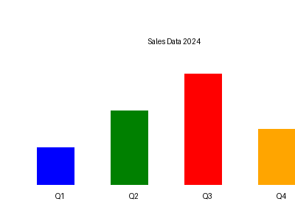
Sample Chart Analysis
This chart shows quarterly sales performance

Slide 3
Key Findings
• Sales increased by 25% in Q4
• Best performance in Q1
• Need to improve Q3 results

