Slide 1

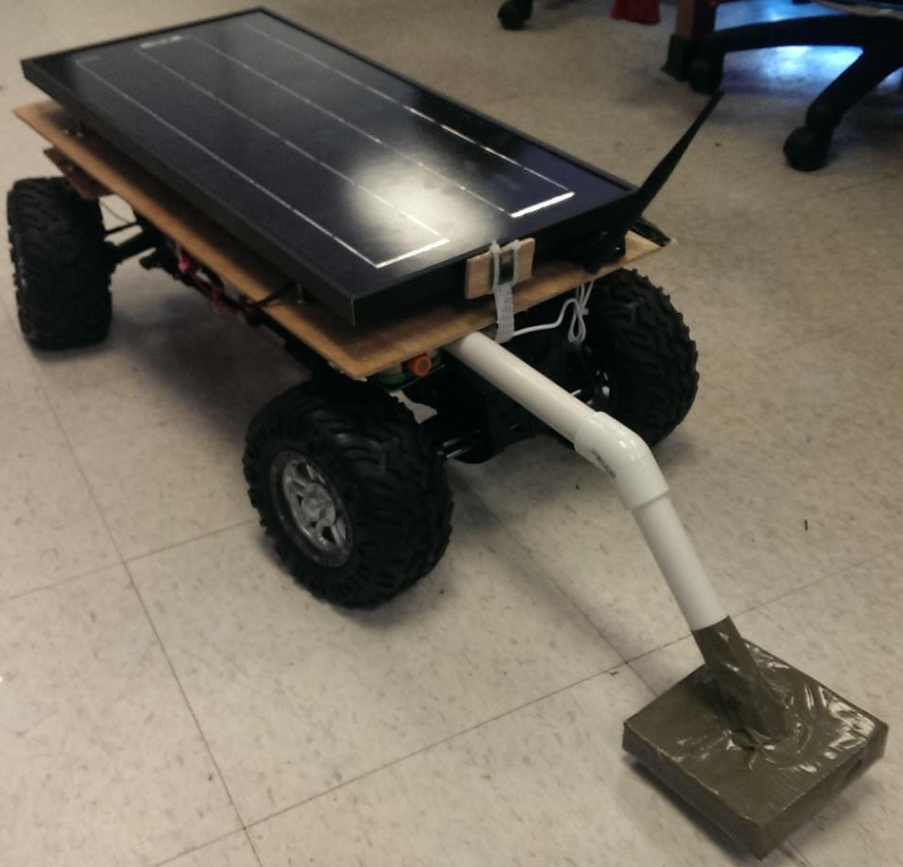
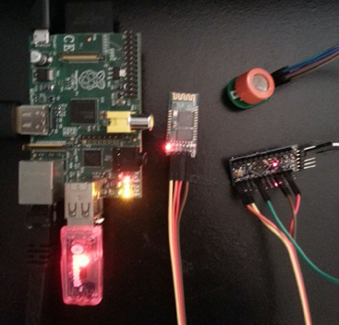
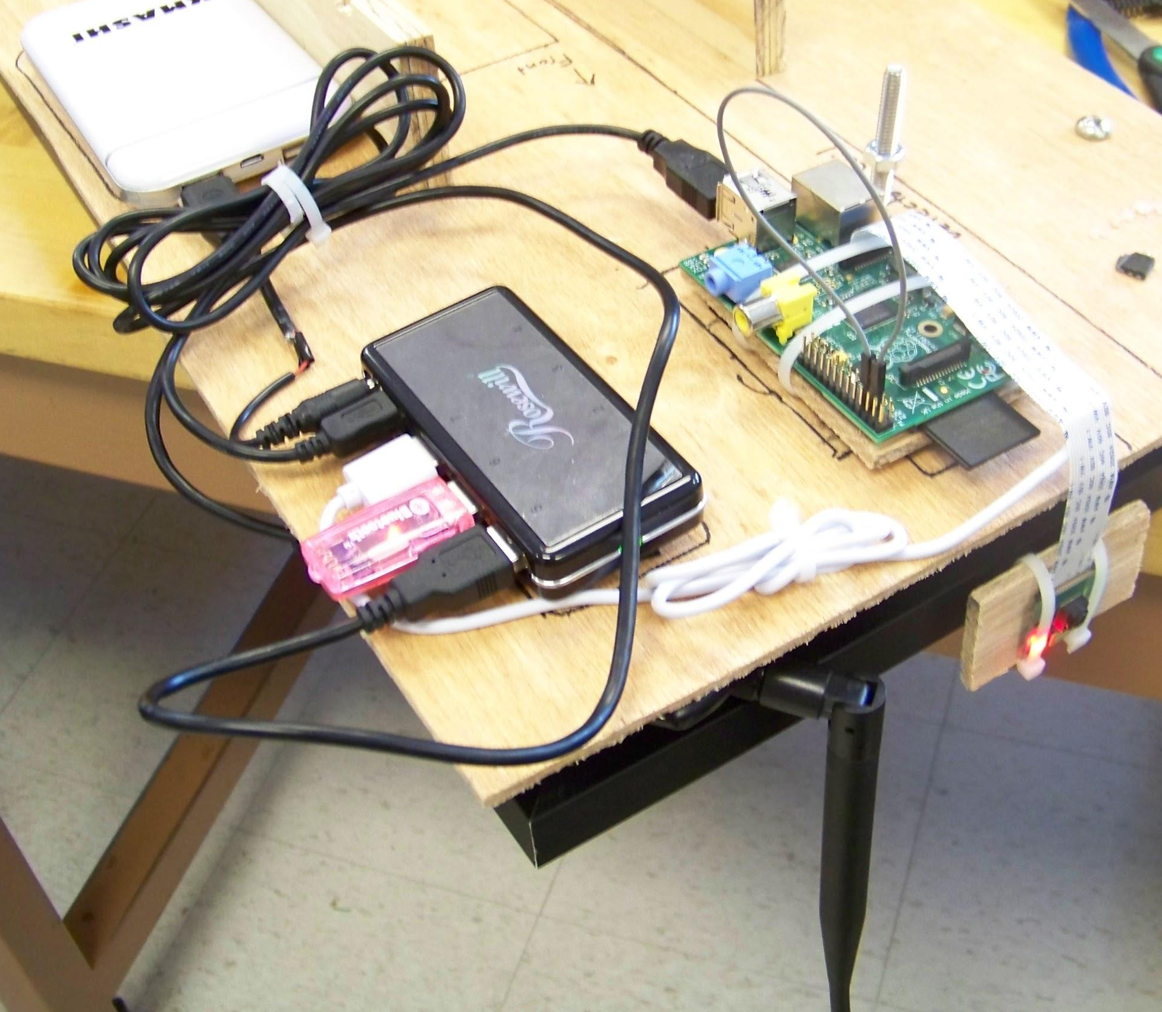
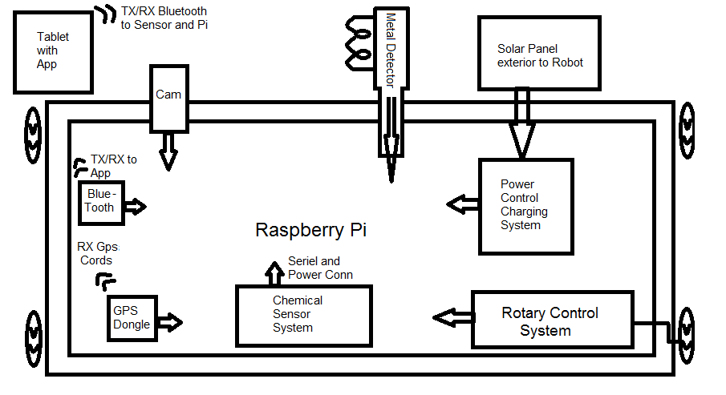
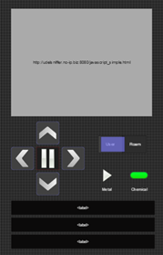

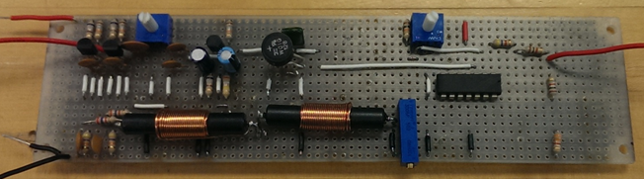
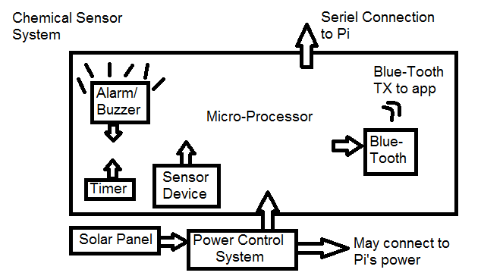
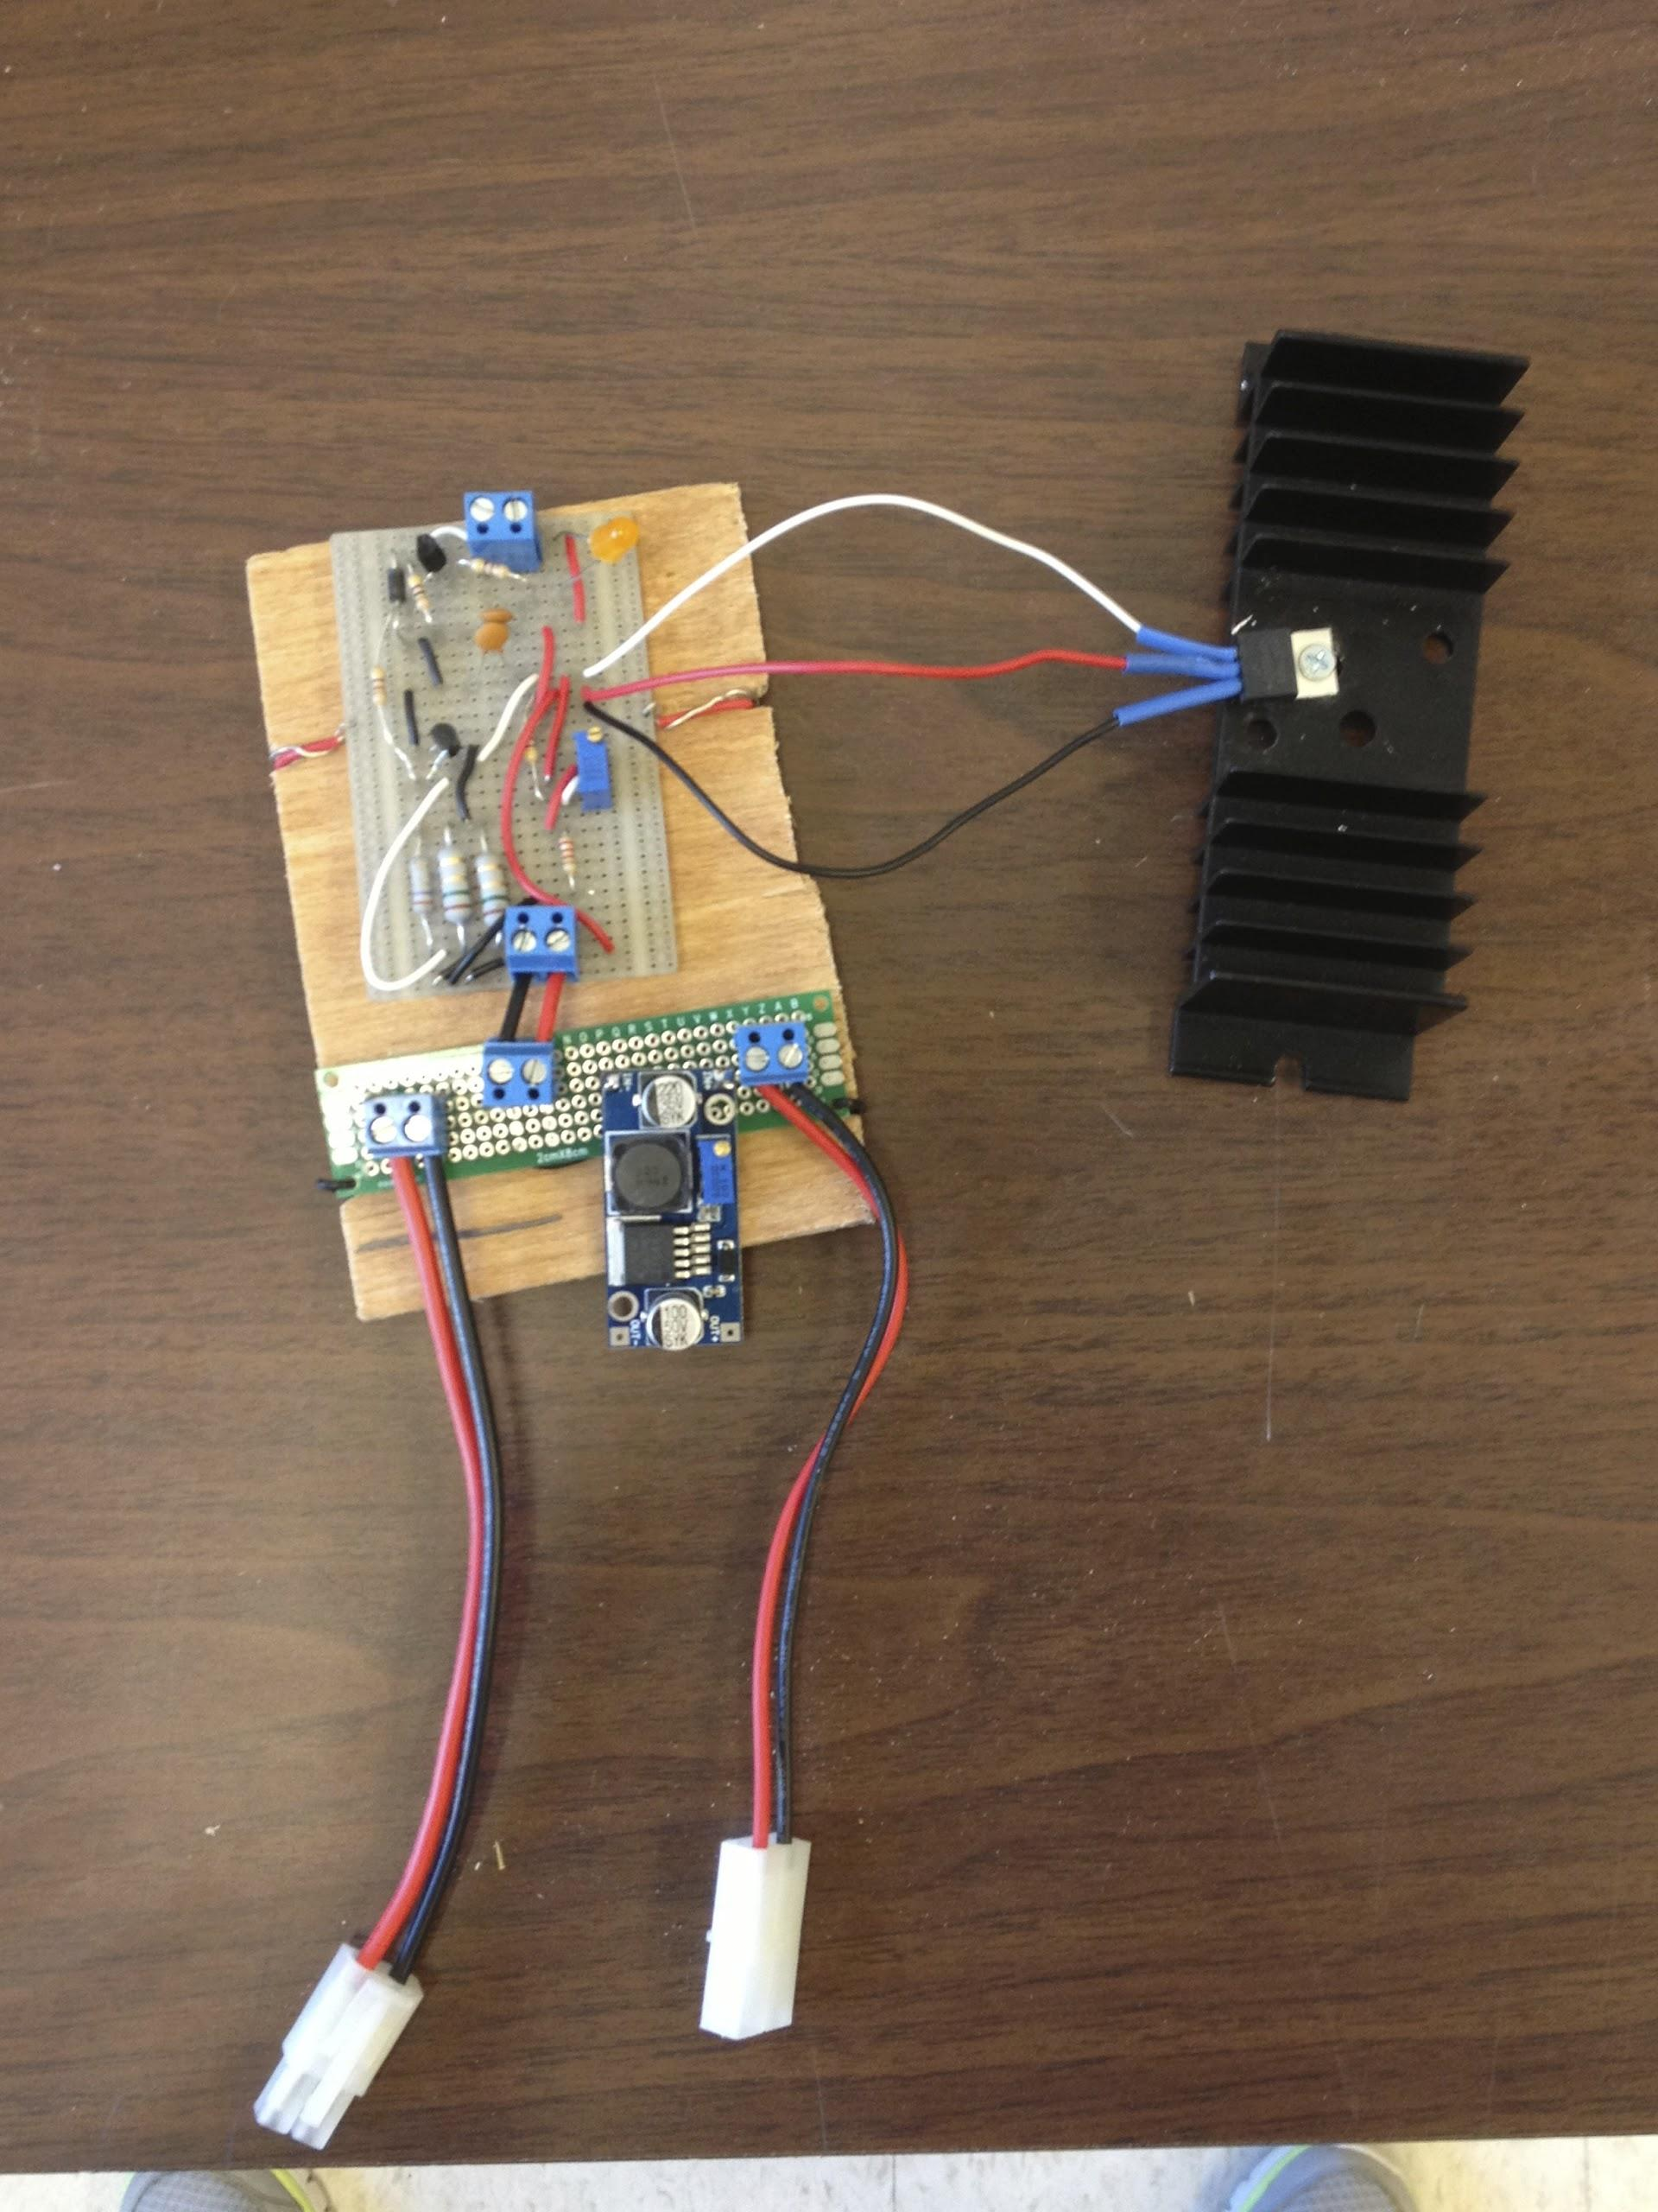
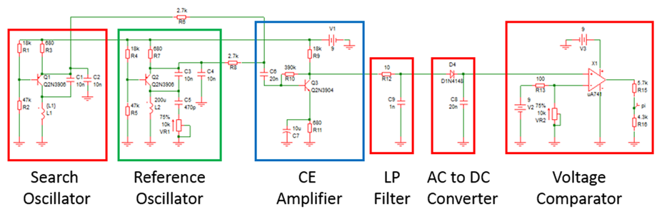
SNIFFER: Wireless network controlled
chemical and metal sensing rock crawler
D. Alleyne, C. Barnes, V. Carey, V. Mest, M. Mills, and I. Murgescu
CAPSTONE Senior Design 2013-2014, Department of Electrical and Computer Engineering, University of Delaware
PROBLEM STATEMENT
APPROACH
COMPONENT and SYSTEM TESTING
Team SNIFFER was brought together
to design and fabricate a solar powered
rock crawler with metal detection
capabilities and a detachable chemical
sensor. The sensor will be wearable,
in order to support chemical development
environments. This ability to attach and
detach the sensor from the rock crawler
will also support military and defense
applications. For instance, sending the
rock crawler into an environment to clear
safety concerns. Metal detection serves in
the defense application, also, as detecting
land mines. Data acquired through the detector and sensor will be relayed through a communications network established by a Raspberry Pi and Android phone application. Location data will appear on a map in the application, such as the rock crawler’s current location and “mine” locations. Throughout the progression of the project, a controller function will be established allowing the user to visually see where the rock crawler is roaming, through streaming video, and control its movement via the smart phone.
The idea of our project is to treat each sector of the project as an independent entity. Meaning, the team will split into sub-teams of the five defining areas: chemical sensor, metal detector, rotary controls, software and communications, and solar power and charging. Team members will focus on their specific area, but will not be confined to it. Major design specifications will be tackled as a group, such as circuit prototyping and component integration, but implementation of these design specifications will be carried out by the respective responsible sub-team.
Chemical Sensor
The sensor being used is an MQ-3
alcohol sensor. All MQ sensors use
a heater with an electrochemical
sensor. We’re using the MQ-3 because
alcohol is the easiest “chemical” to use
for testing the sensor.
The sensor is controlled with an
Arduino Pro Mini.
A 6V, 0.5W solar cell, and a 3.7V,
500mAh LiPo Battery power the sensor.
Software & Communications
The chemical sensor communicates with
the Pi via bluetooth and the Arduino
via USB serial connection.The metal detector
communicates with the Pi via a high or low
on a GPIO.
NetIO Controller Application runs on a
smartphone regulated by a python script on the Pi
The connection between the app and the Pi is via
Wi-Fi and defined through a DDNS host..
Rotary Controls
The Arduino on the rotary system is used to control the
rock crawler’s turning and acceleration control servos.
The program was designed to run a raster scan on its
own using GPS coordinates that it could then be sent.
In addition, it was connected to a Pi serially to be controlled remotely with an Android app.
Metal Detector
Our Metal detector circuit utilizes
a BFO. This allows us to take a
signal from our search coil and
compare it to a reference coil.
We then take the difference
between the oscillators. We then have a beat frequency that can be
modified to give a high or low to the Raspberry Pi.
Solar Power & Charging
For our project we will use a 20W solar
panel to recharge the robot’s 2-cell 7.4V LiPo
battery (1600mAh).
The solar panel successfully charged the battery
from 7.4V to 8.4V in 45 minutes in good weather
conditions.
DESIGN
At the heart of this system will be Arduino and Raspberry Pi processors. Their input, output, and microcontroller features will enable
the system to be programmed to
respond to specific data (input) in
a specific way (output).This
includes data storage and/or
transference of data to other
mediums such as an Android
application via Wi-Fi.
Every device will communicate
with the Raspberry Pi which will
then communicate with the
smartphone application. Data to
be communicated includes: states
of the chemical sensor and the
metal detector, directional
commands to control the rock crawler,
and location (GPS coordinates).
The detachable sensor will ideally use a low
power microcontroller, such as a MSP430.
Sensor readings will be accumulated and
stored until they can be transmitted to the
rock crawler. The sensor will have two
methods of data transmission, a direct serial
line to the rock crawler and Bluetooth. Most
or all of the power for the sensor will come
from a solar cell. A battery will be necessary,
as the sensor will also be able to charge when
connected to the rock crawler.
The metal detection circuit we
implemented utilizes a beat
frequency oscillator (BFO). The
BFO circuit will utilize 2 oscillators,
a reference oscillator and a search
oscillator. The search oscillator will
be located near the ground and
extended in front of the rock
crawler.
GOALS and REQUIREMENTS
The rock crawler will cycle through
on and off states via a solar panel
charging network and include two
modes of operation: Free Roam and
Controller. Power will be split between
rotary and processor functions for
system optimization and stabilization
(longest possible running time without
data loss, for example). Wi-Fi
communications will be enabled through
the UDel network and wireless adapters,
allowing for peer-to-peer connections between the Pi and external devices. One such device will be an Android application. This will present data and status, such as position, in a visual, user-friendly environment.
The sensor system will be entirely self sustainable when not attached to the rock crawler. A discrete solar panel will be used to either directly power the sensor network or to charge a battery that will power the network. Its design will be practical with respect to size, as it is to be worn, and capable of data accumulation over time. Communication of the data accumulated will be via Bluetooth between the sensor and a Raspberry Pi, located on the rock crawler.
A successful project would include a functional Free Roam rock crawler with every feature discussed. This would serve the U.S. Military in chemical warfare and land mine detection applications. The addition of Controller Mode is the ultimate goal, along with the integration of further data collecting capabilities.
PROJECT STATUS
Team SNIFFER has completed the individual sections of the project. We brought all of our components together and were able to make the system work for a short period of time.

