Slide 1

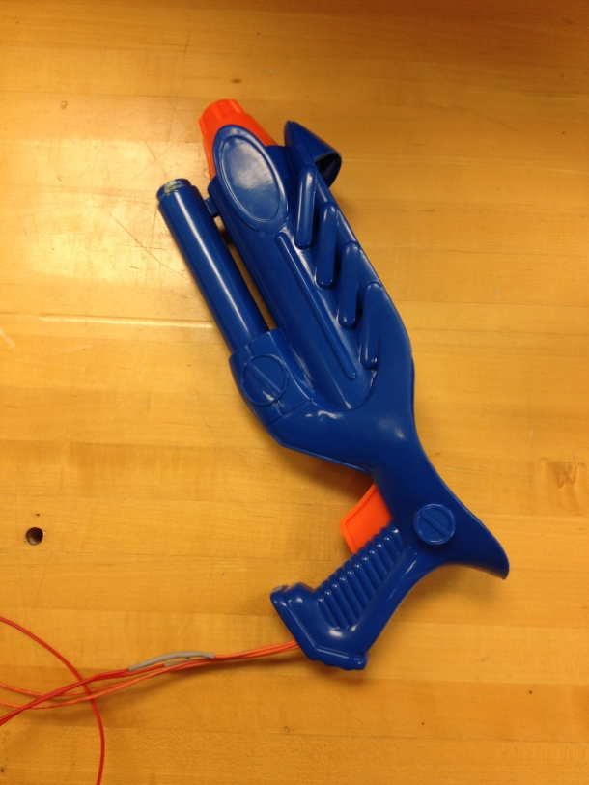
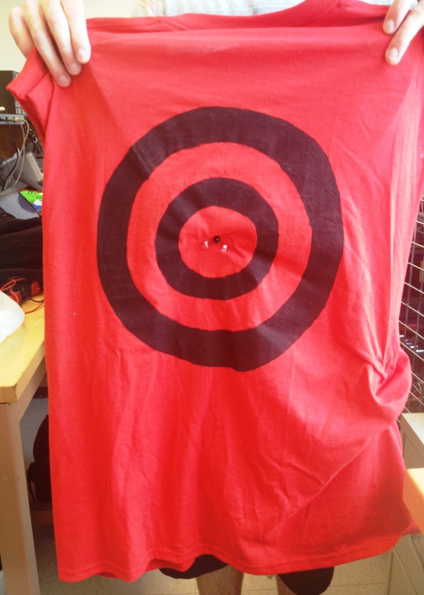
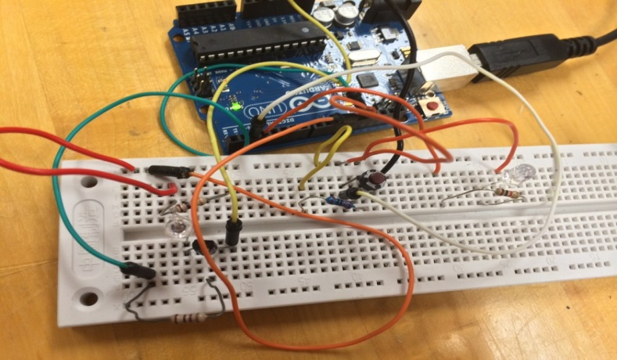
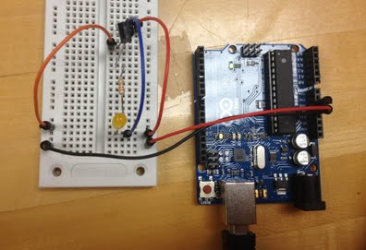
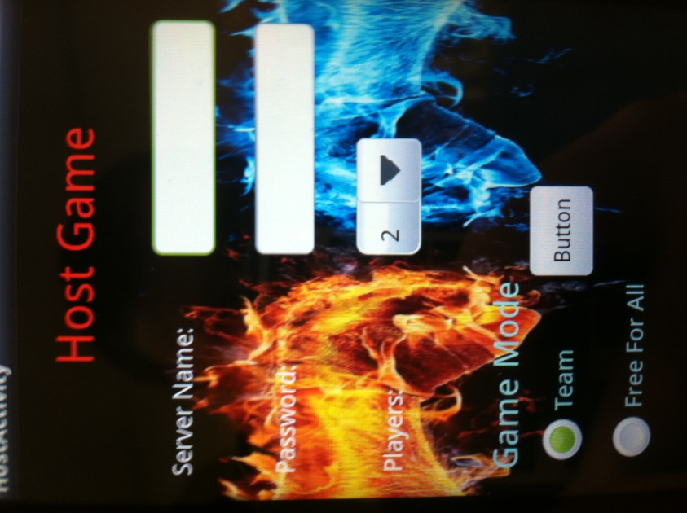
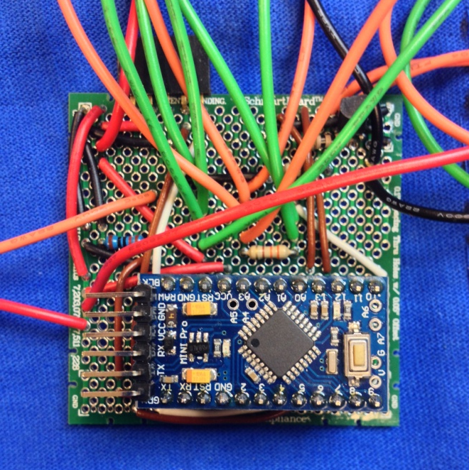
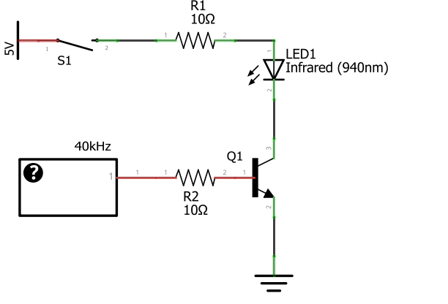
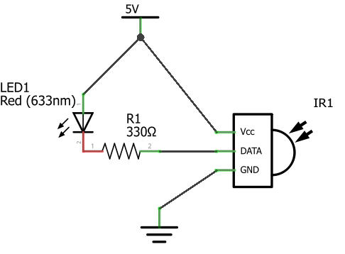
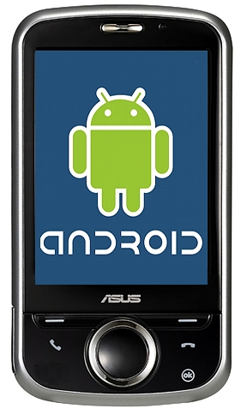
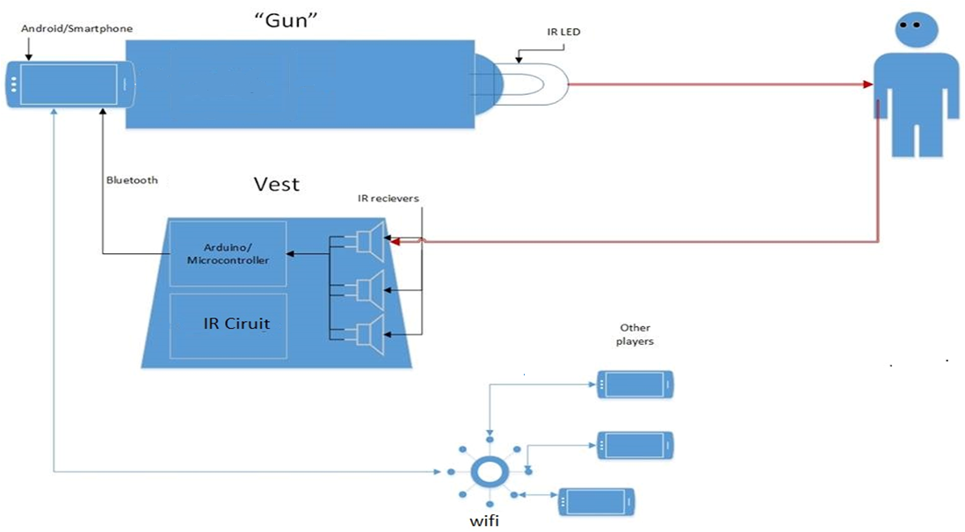
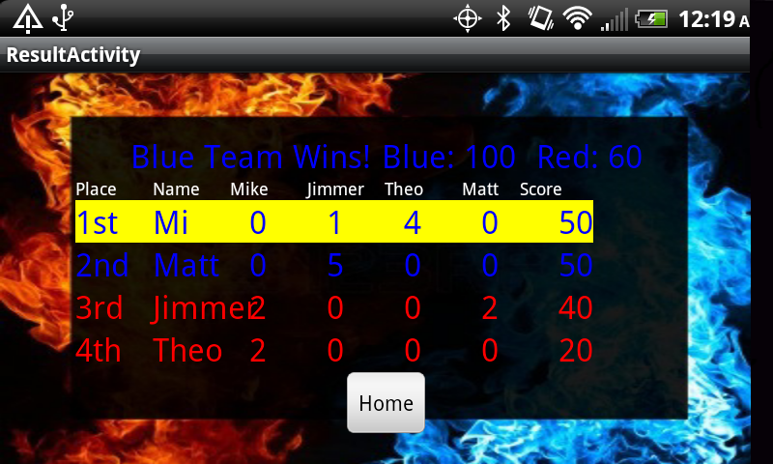
LASER: Laser tag Android application with
corresponding game hardware
T. Dorotheos, M. Fischetti, A. Luppino, A. McHale, M. O’Donnell, E. Schaffling
CAPSTONE Senior Design 2013-2014, Department of Electrical and Computer Engineering, University of Delaware
PROBLEM STATEMENT
APPROACH
COMPONENT and SYSTEM TESTING
Laser tag is an excellent form of entertainment and a valuable commodity that society does not have easy access to. There is a market gap for smart phone game applications that use hardware attachments and require physical activity.
There are two main components of our project -- the hardware and the software. Our initial approach is to divide our efforts between these two sides. Specifically, we have three teams of two people to work on (1) the IR transmitter, (2) the IR receiver, and (3) the Android application. The transmitter and receiver teams first need to program their circuits to work with corresponding Arduino software, while the Android team needs to establish the back-end structure of the application to allow games to be hosted on a central server.
When both the hardware and software are ready, we will connect the two components
Via Bluetooth. At this point, the hardware teams will build their circuits into the game's
Laser guns and receiver vests while the software team will continue to join the Arduino
And Android software. The final steps involve tweaking the laser aiming, possibly using
lenses, and debugging the software.
Intensive testing was conducted on our hardware during all stages of implementation. In regards to IR transmitter testing, we were able to increase the IR transmitter range by a larger distance each week until we reached our desired range. We reached our final distance by implementing a common emitter amplifier design using a NPN BJT. We tested this functionality by placing the transmitter and receiver close together and slowly moving them apart until the connection was broken.
Once the IR transmitter worked properly, we performed serial communication testing by repeatedly sending 8 specific bits from each transmitter to an Arduino IR receiver, representing a player number. We determined the accuracy of this feature by comparing the received 8 bits to the player's actual number. After introducing a button press, our accuracy drastically decreased, so we chose to add in a debouncing function to allow the IR sequences to be fully received and not interfere with each others.
The original beam of our IR transmitters had a very large angle range, which bounced off walls and could therefore hit a small target when aiming in a completely different direction. This was an issue for laser tag because we wanted each player to tag another player only when they are aiming within their body width. To fix this issue, we decided to use a brass tube that we strategically placed around our IR transmitters. The brass tube redirected the IR transmitter beam and constrained it to a much smaller angle. We needed to perform several tests with brass tubes in order to determine the optimal tube length. The longer the brass tube, the smaller the IR beam angle became. After much testing on different length tubes, we decided on a length of approximately 4 inches. This specific length provided us with an IR beam angle that allowed a player to be tagged when an IR transmitter aims at an area within their body width.
Figure 1 (left):
“Gun” Prototype
Figure 2 (right):
“Vest” Prototype
In a world where laser tag is growing in popularity, players need the option of being able to practice from the comfort of their home. Traditional laser tag facilities are both sparse and expensive. These games usually last for less than 30 minutes and can cost up to around $20 per person. Our possible customers include Android cell phone owners, particularly of adolescent and young adult ages.
DESIGN
The hardware design consists of 2 main circuits, infrared transmitting and receiving, both of which use an Arduino as the microprocessor. The first part of the transmitting circuit consists of a resistor and button. When the button is pressed, this represents pulling the trigger on the laser tag gun, it activates the other half of the transmitter. The second half consists of an npn-BJT connected in common emitter mode. This circuit has a resistor going into the base and an IR LED and resistor connected to the collector. The IR LED oscillates at 40 kHz using the Arduino software, which turns on and off the IR LED. The transmitter sends the player’s ID numbers through pulses. The receiving circuit consists of an IR receiver and resistor. The pins on the receiver are connected to a 3 volt source, ground, and the Arduino. The Arduino converts the received pulses to binary.
The software design consists of a back end WAMP server and a front end Android application written in Java. In the back end there are several MySQL tables which contain game statistics and player information. In the front end the app runs on an Android phone and acts as an interface for the player. The app connects via WIFI to a laptop running the server and updates the MySQL tables as players create, join, start games and during game play when players are hit.
Figure 3: PCB Prototype
GOALS and REQUIREMENTS
Figure 6 (left): IR
Transmitter Schematic
Our goal is to make a Laser Tag application for android
Smart phones that will utilize additional hardware as well
as the phone itself. The phone will function as an interface
For game statistics as well as a GPS map, while the
Hardware will be used as a physical gun and receiver vest.
The game will be hosted on a server and the phones will
communicate with this server via WIFI. This will allow the
transfer of statistics which will be displayed in the application
interface. Players will be able to "shoot" each other by
Sending IR signals from the gun to opponents' receiver
vests. This hardware will then transfer this information
back to the phone via Bluetooth.
Addition features will include:
The ability to start a new game specifying number of players and whether teams or free for all
Communication between the android phones and IR guns and vests through Bluetooth to count hits and shots
A unique ID based in binary that is sent through the IR gun when shooting
Ability for vest to receive binary code and have the android phone identify the player
Include bonus features such as motion controls for reloading, recharging, power-ups, and GPS based map.
Figure 7 (right): IR
Receiver Schematic
PROJECT STATUS
By the end of the project we have created four
functioning laser tag gun and vest combos. When
a player creates a game, other players are able to
join and everyone is given a unique ID and name.
Each player then clicks a ready button and
when everyone is ready the game start. The app
connects to the Arduino Bluetooth module and
sends the players ID over. When The game begins
a timer is started and players are now able to shoot
each other. Players shoot by pressing the guns trigger which sends there player ID. When a player is hit that ID number is received via serial communication, then sent to the Android app via Bluetooth. Each time the app updates the server we add onto each player score which is then displayed on the phone. When hit the red LEDS on the players vest will also light up and their phone vibrates for a short period. While playing our app displays other player locations on a radar every second by retrieving their coordinates from the server. Once the game ends a final screen is shown with all the stats of who shot who and how many times.
Figure 4: Sample compatible Android phone
Figure 8: Final Screen Seen When Game is Over
Figure 5: Overall design diagram of our laser tag system

