Slide 1
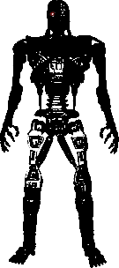
Mobile Self-Balancing Robot
Team SEGWAY
William Bednar, Brian Gonzalez, Ye Xin, Adam Stein, and Zachary Lowe

Slide 2
Outline
Introduction and Background
Prototype
Demo
Control Software
Tuning
Communication
Manual Control
Challenges
Potential Improvements

Slide 3
Project Description
Built a self-balancing robot as an exercise in control systems engineering as well as hardware/software integration

Slide 4
Goals
Stable, upright robot
Fast movement
Travel over various terrains and inclines
Position awareness
Functional application such as serving food and drinks
Line following

Slide 5
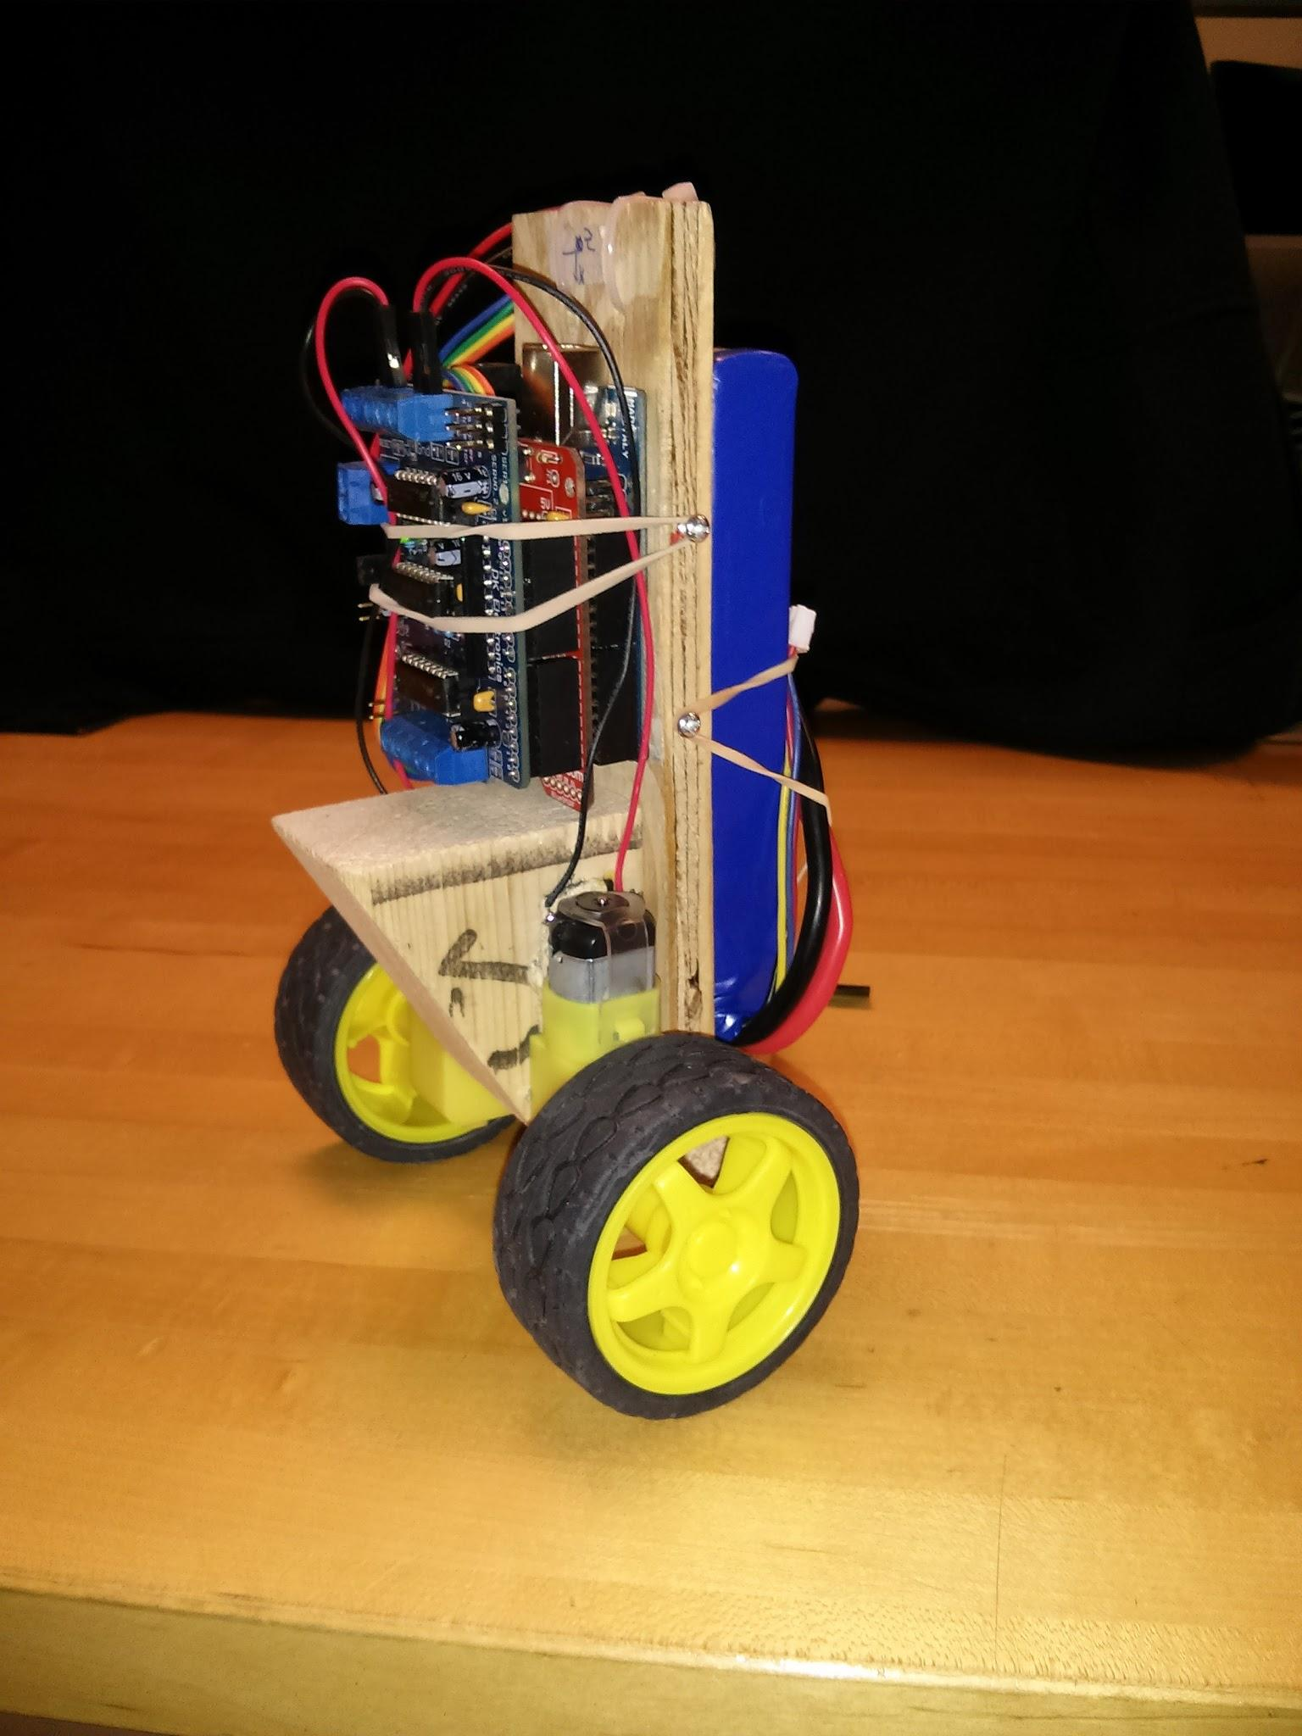
Last Semester
Collected resources
Learned about similar projects online
Prototype

Slide 6
Video: old prototype in action
https://www.youtube.com/watch?v=1i9Vt7IHzNo

Slide 7
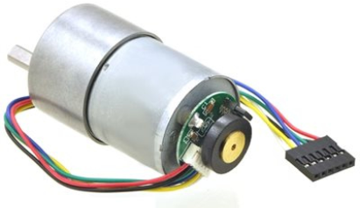
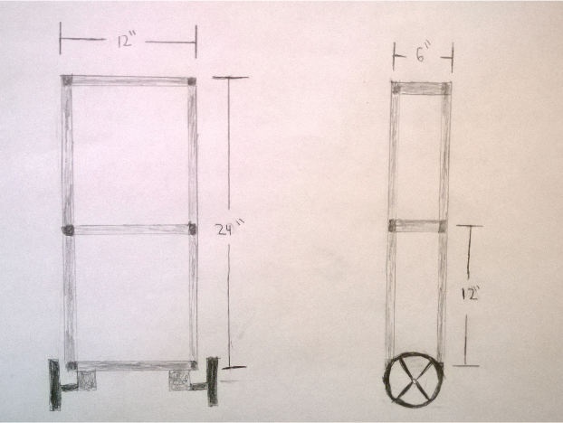
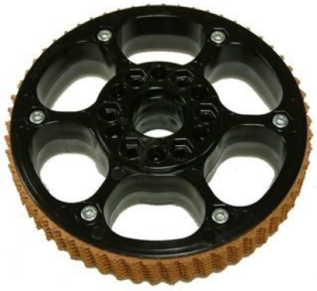
Scaling Up

Slide 8
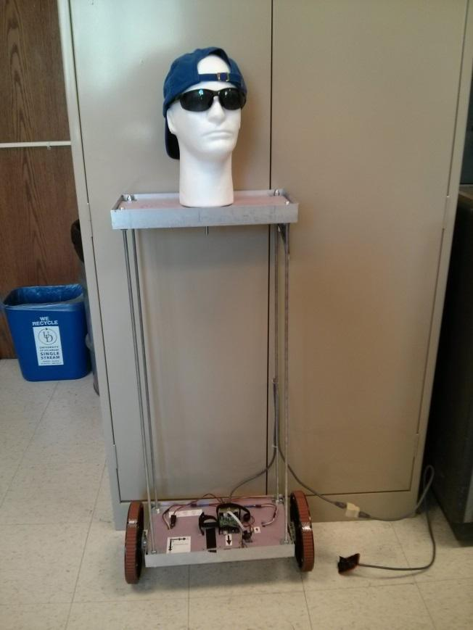
Current Version
Important Features
Large wheels with treads
Lightweight frame
Metal brackets
Foam board
Better motor shield
Head, hat, and sunglasses

Slide 9
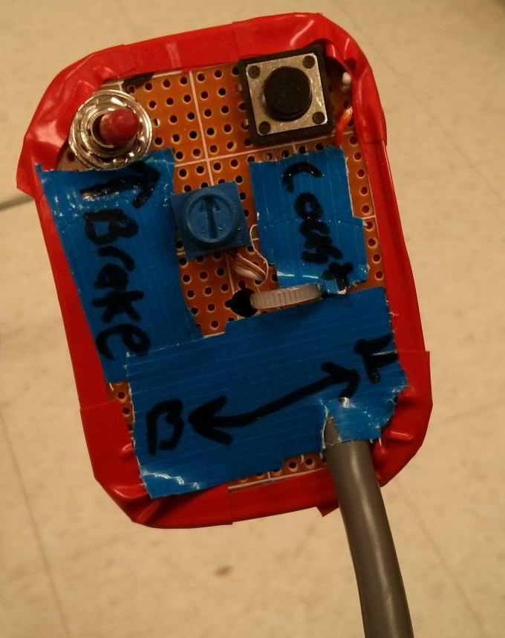
Remote
Wired
Kill switch
Knob
Manual “PID”
Parameter adjustment
Steering
No longer used
Button
Previously coast
Hold to transmit telemetry data

Slide 10
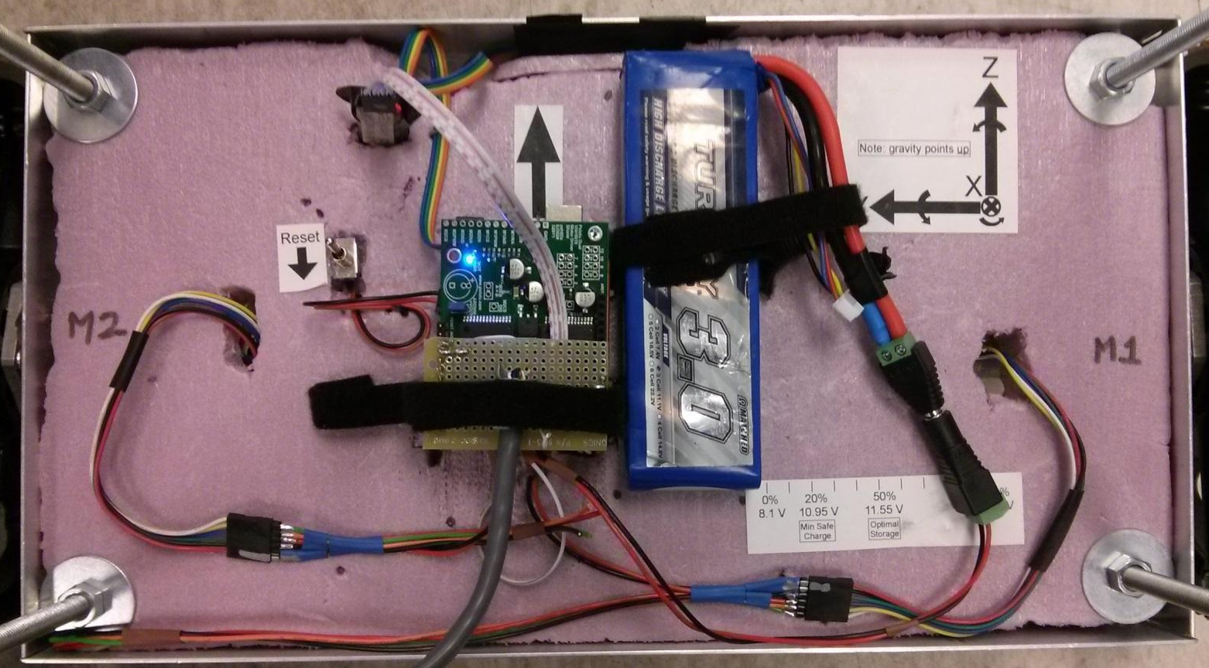
Hardware Layout

Slide 11
Cost
Frame - $60
Wheels & motors - $160
Motor controller - $50
Existing parts - $95
Arduino
Sensor and Bluetooth modules
LiPo battery
Total $365

Slide 12
Demo
A brief live demo
Videos from outside
https://www.youtube.com/watch?v=a9SOppzgmxc

Slide 13
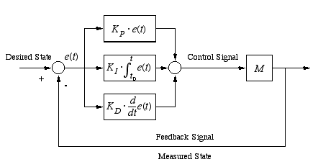
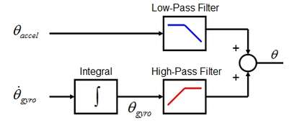
Control Concepts
Negative feedback - error calculation
Complementary filter
cs.brown.edu
ChrisMarion.net

Slide 14
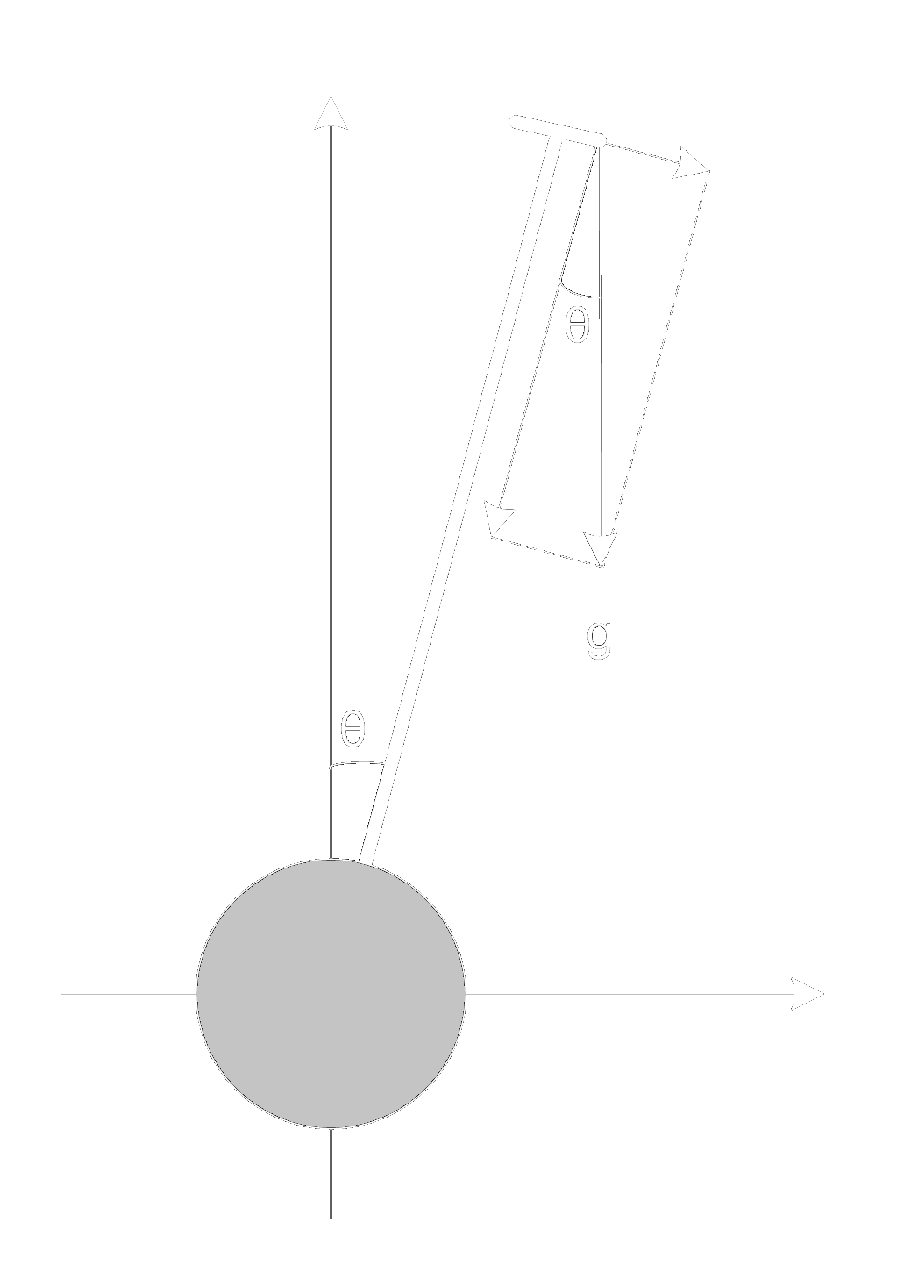
Control Software
thetaDotG = -gyro.g.y / gyro_scale;
thetaA = asin(-accel.getZ() / 9.81) - accelOffset;
// Calculate new theta/error estimates
float dThetaG = thetaDotG * dt; // integrate gyro reading
estTheta = highpassCoeff * (estTheta + dThetaG); // high-pass gyro
estTheta += lowpassCoeff * thetaA; // low-pass accelerometer
estError = estTheta - targetAngle;
// Compute & limit the error integral
errorInt += estError * dt;
// Calculate PID output
output = Kp*estError + Kd*thetaDotG + Ki*errorInt;
KerryWong.com

Slide 15
PID Controller – Tuning
We manually tuned the PID controller by setting K_{i} and K_{d} to zero and adjusting K_{p} until the system oscillated.
K_{p} was set to half that value, and K_{i} was then increased until the oscillations were reasonably small.
K_{d} was then increased until the system responded fast enough.

Slide 16
PID Controller – Tuning
Effects of increasing parameters independently:
Parameter | Rise time | Overshoot | Settling time | Steady-state error | Stability
K_{p} | Decrease | Increase | Small change | Decrease | Degrade
K_{i} | Decrease | Increase | Increase | Eliminate | Degrade
K_{d} | Minor change | Decrease | Decrease | No effect in theory | Improve if K_{d} small

Slide 17
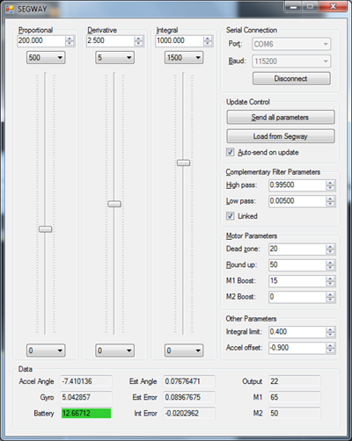
Tuning Program
Made tuning much easier
Also displays data sent from the Segway
Written in C# utilizing the .NET Framework
Probably Windows only
Might run under Mono

Slide 18
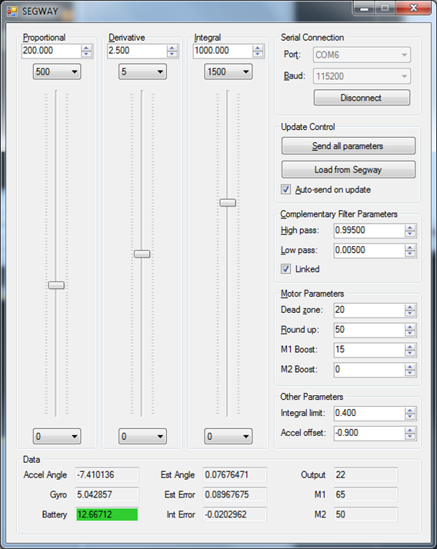

Slide 19
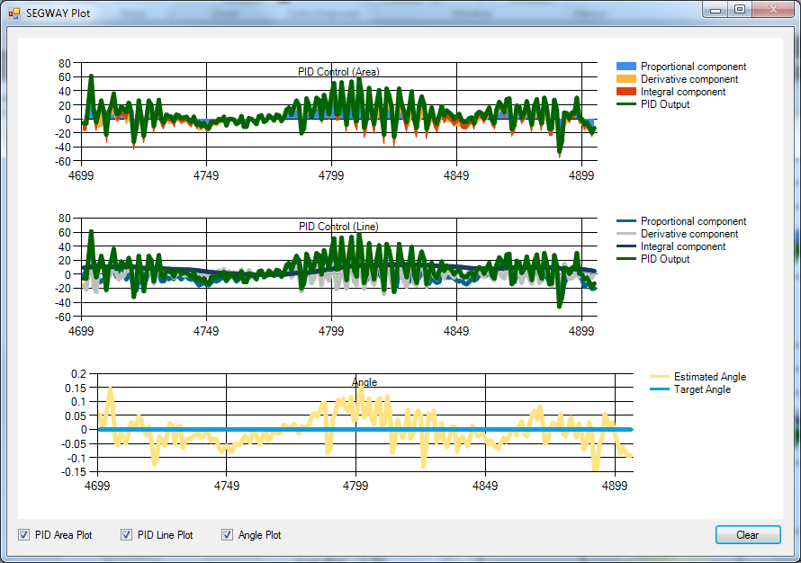

Slide 20
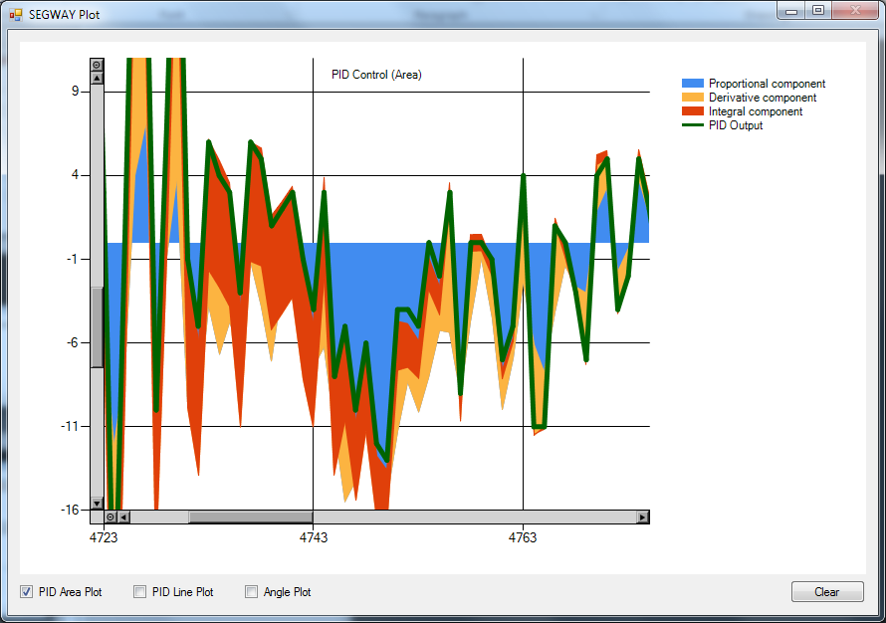

Slide 21
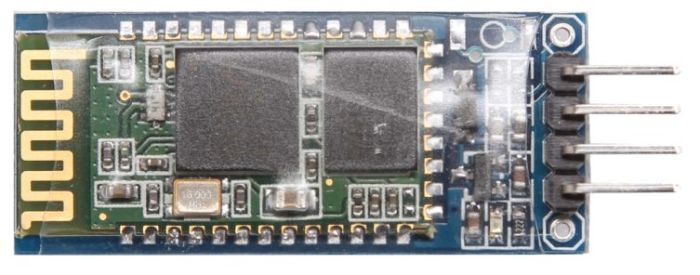
Communication
Bluetooth serial module
Transparent serial cable replacement
Binary protocol for efficiency
1 byte message code followed by data
Data length varies by message code
8-bit CRC
Unambiguous framing
No acknowledgements or retransmission

Slide 22
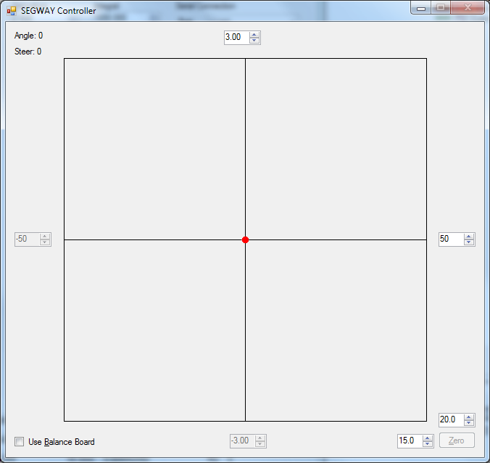
Mouse Control
GUI for mouse control
Click to move the dot
Vertical axis is angle (acceleration)
Horizontal axis is steering

Slide 23
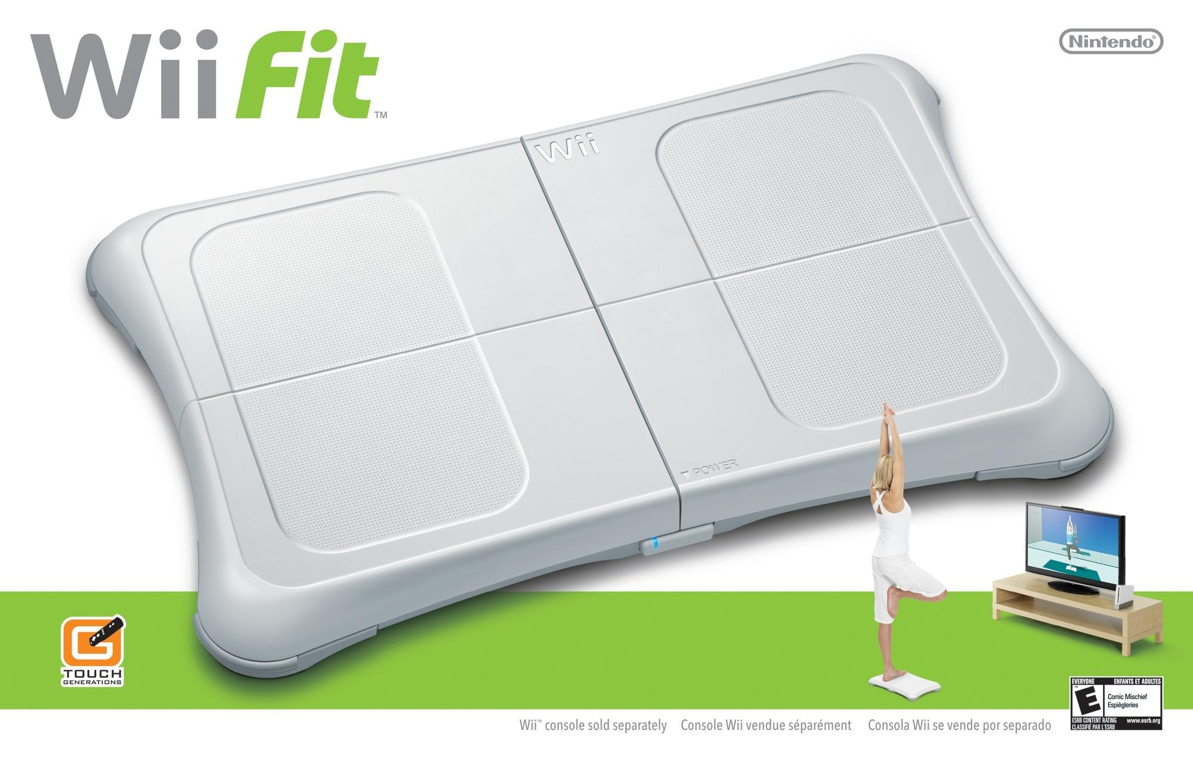
A better controller?

Slide 24
Challenges
Sensor limitations
Vibrations in frame cause jitter in sensor readings
Target angle is affected if the sensor comes loose or shifts position
Hard to mount – unusable screw holes and no flat side due to through hole connector
Motor limitations
Identical voltages produce different speeds on each motor

Slide 25
Potential Improvements
Speed limiting
Lean back to reduce speed before falling over
Maintain position
Wheel encoders – need more pins
Second PID controller to control the target angle
Improved remote control protocol
Functional tasks such as serving food and drinks
Autonomous movement
Phone app

Slide 26
Conclusion
Robot was ultimately able to balance and recover from most disturbances.
Maintains its position relatively well when undisturbed.
User control interfaces allowed some direct control of robot movement.
We did not end up having time to implement autonomous movement heuristics like line following.

Slide 27
Questions?
https://www.youtube.com/watch?v=-faroIVwW9g

