Slide 1
Gun Culture in the USA
GROUP-6
Karthik Katepally
Samyog KC
Sai Lalitesh Pothukuchi
Vishal Daroor

Slide 2
AGENDA
Introduction​
Research Questions
​Data Sources
EDA
Research Results
Problems Encountered
​Summary​

Slide 3
Introduction
Gun culture in the USA can be described as the American’s unique belief in the notion that the people’s right to bear arms is the greatest protection of their rights and a safeguard of their democracy.
But due to this, over the course of several decades, the increase of gun culture resulted in the loss of several lives in the United States.
Gun regulation is a well-known debated subject that has been in the news for several years, and there have been many ongoing discussions about whether to implement strict gun control laws to decrease gun violence.
Our motive for this research is to analyze the data along with the insights and forecasts from the chosen data to better understand how to control gun violence incidents.
For this, we have examined the evolution of gun sales in the United States along with the shooting occurrences to evaluate the U.S. gun culture and its influence on millions of people over the years.

Slide 4
Research questions
Our research will be focused on answering:
How have the sales of firearms evolved?
Where do most firearms purchases occur?
Is there a relationship between the number of guns owned by citizens and the number and location of shooting incidents?
Will there probably be a rise in gun sales?

Slide 5
DATA Sources
https://data.world/angatiabenson1/nics-firearm-check
This dataset will be presented as a CSV file and it provides information on the various types of firearms and the permits required to possess them in each of the 50 states in the United States.
We will download the CSV data from the above URL and upload the same to the git repository for our analysis.
https://www.gunviolencearchive.org
This is a website run by a non-profit group called GVA(Gun Violence Archive) which consists of data related to gun violence in the United States.
We have used a web-scraping technique on the data present on this website for our analysis, where we dump the data into our integrated MySQL server Database and retrieve the same data, and also convert the same to a data frame for our research.
https://data.world/associatedpress/mass-killings-public
This dataset will be presented as a CSV file and it provides information on the killings and injuries in each of the 50 states in the United States.
We will download the CSV data from the above URL and upload the same to the git repository for our analysis.

Slide 6
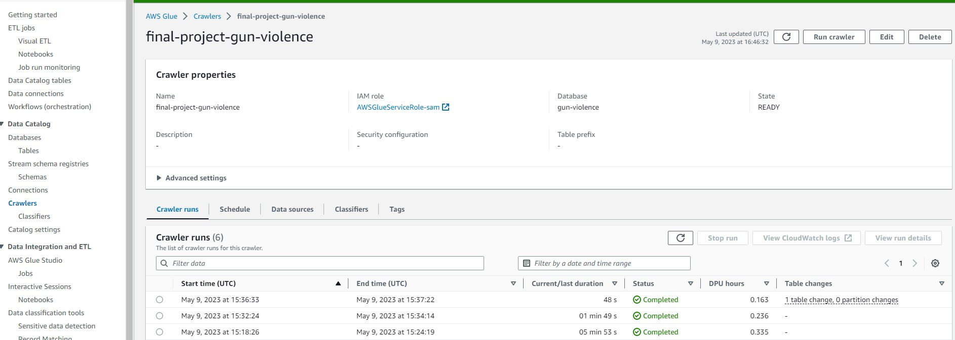
ETL USING AWS GLUE
GLUE CRAWLERS

Slide 7
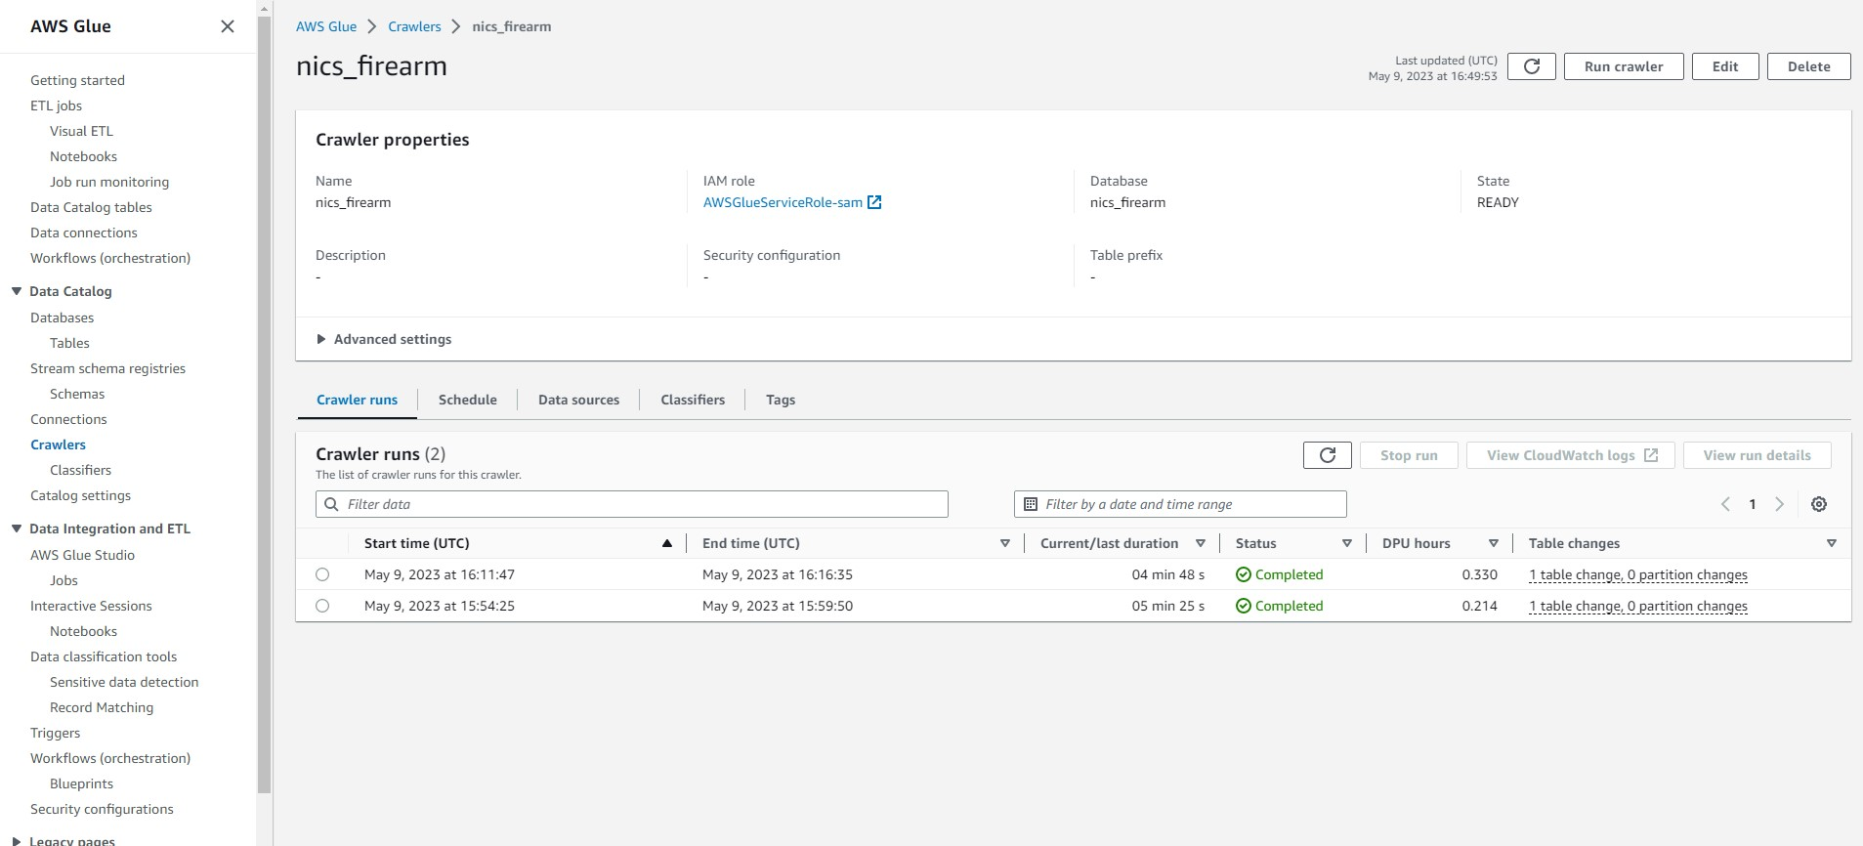
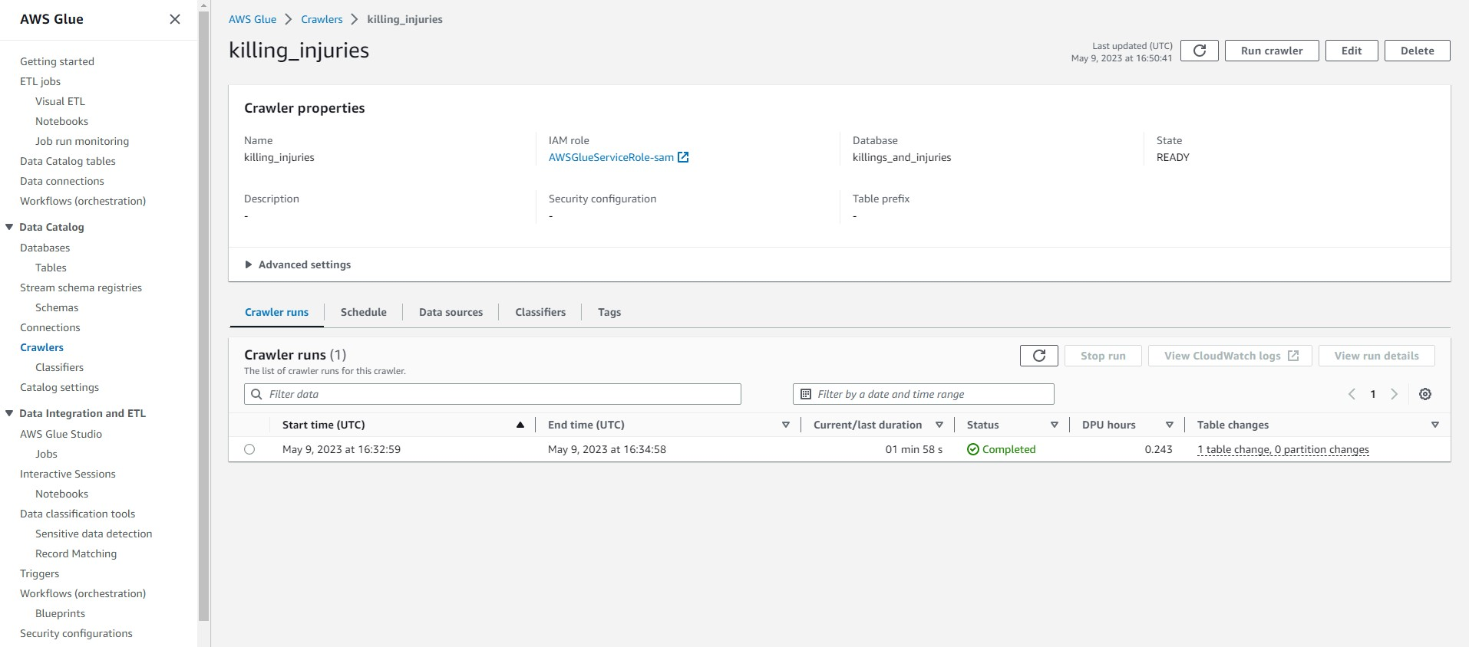

Slide 8
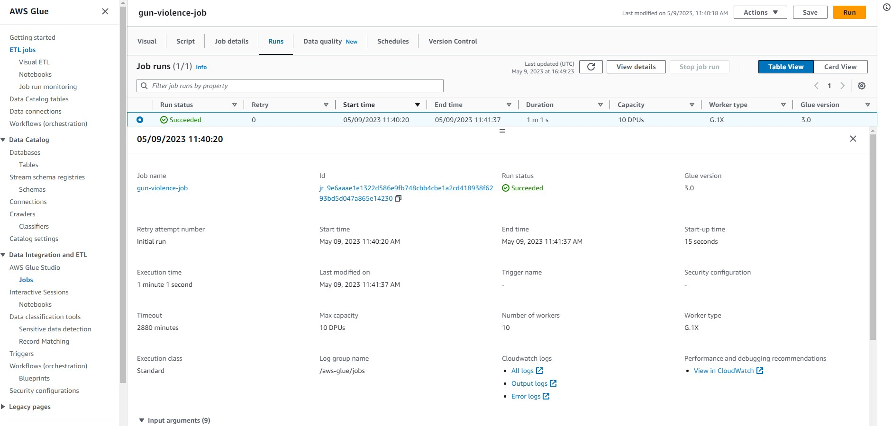

Slide 9
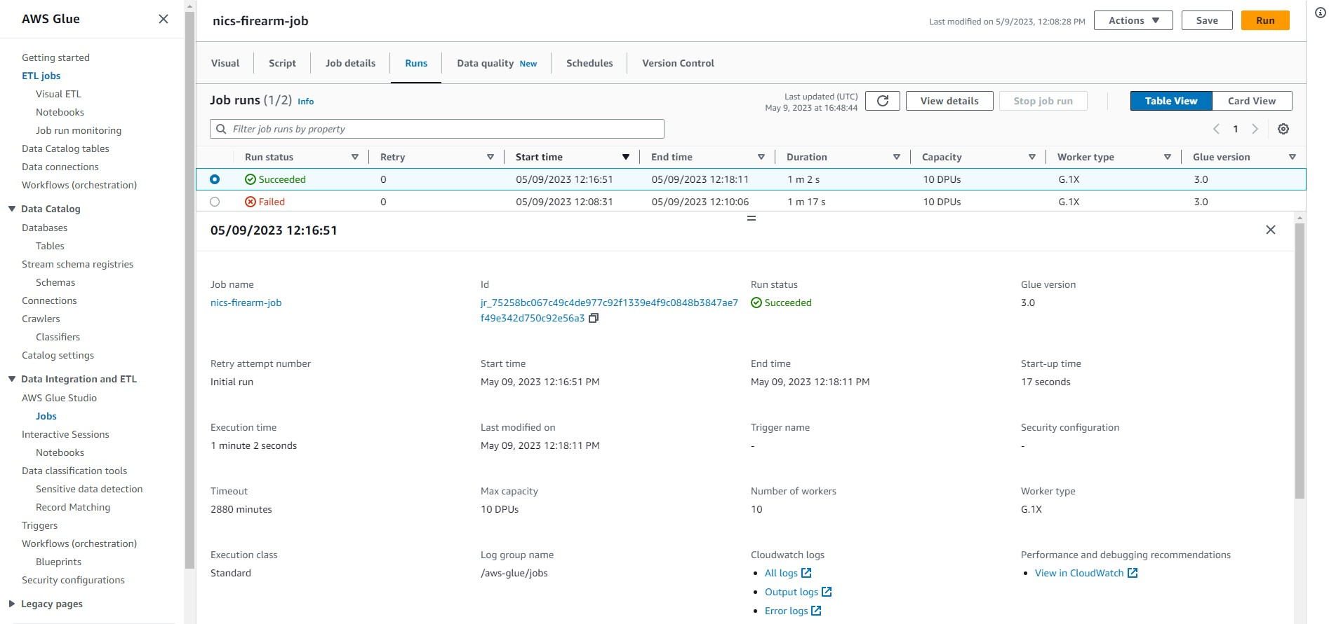
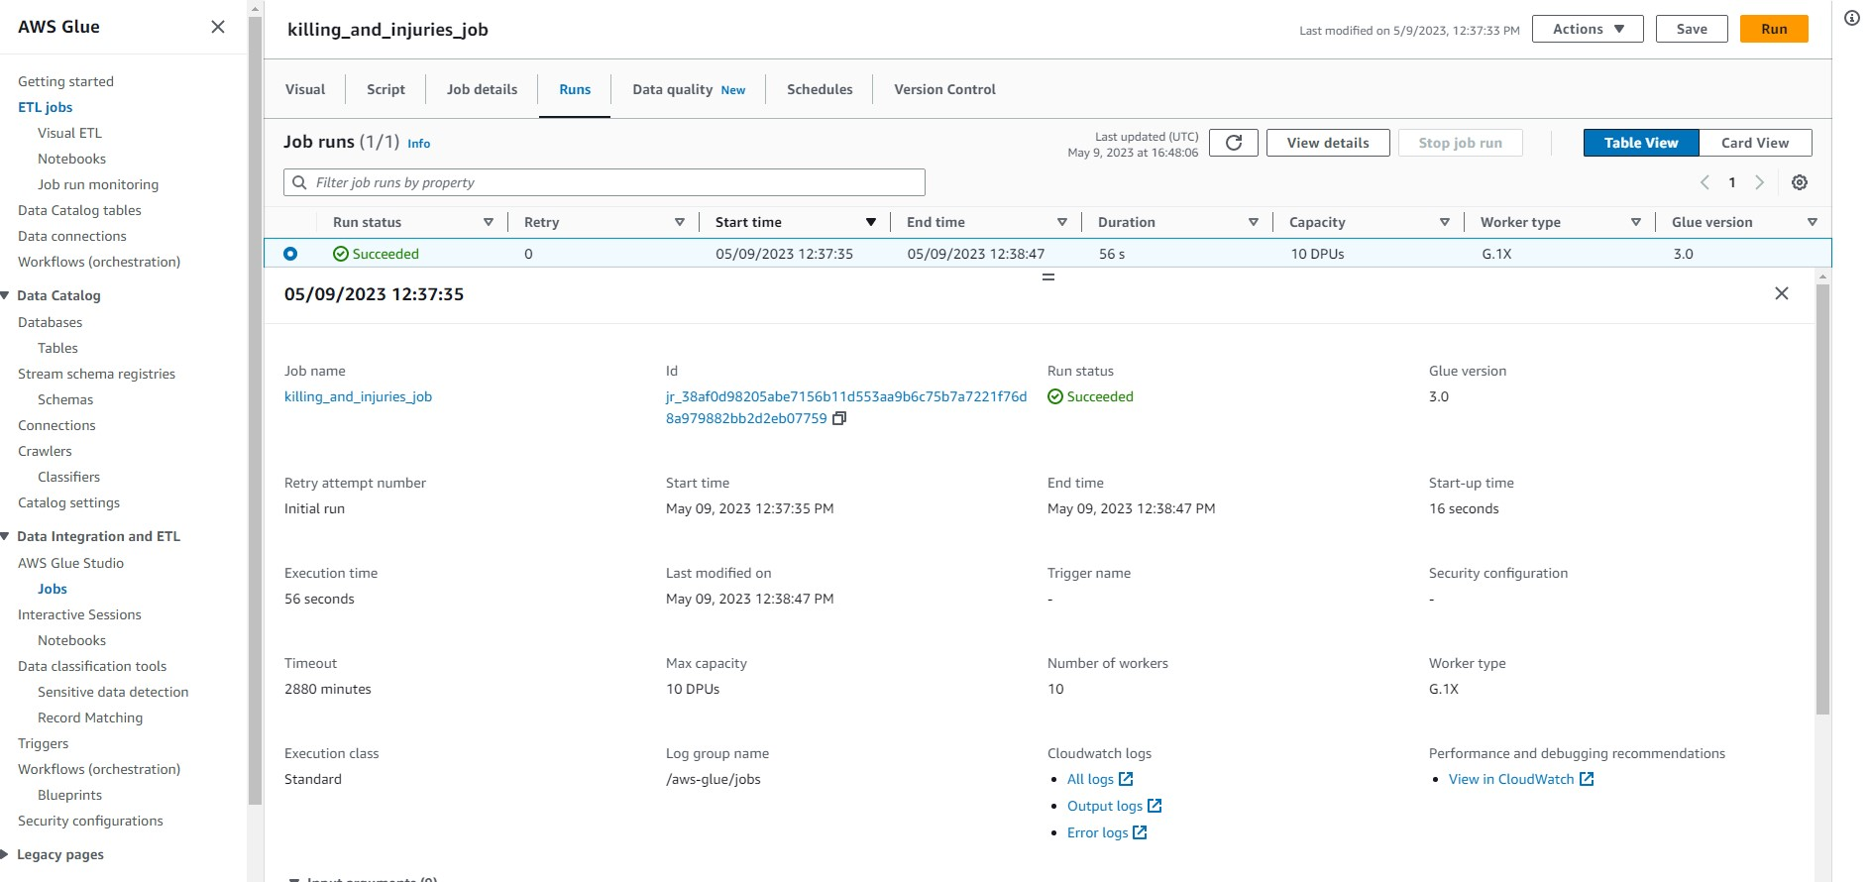

Slide 10
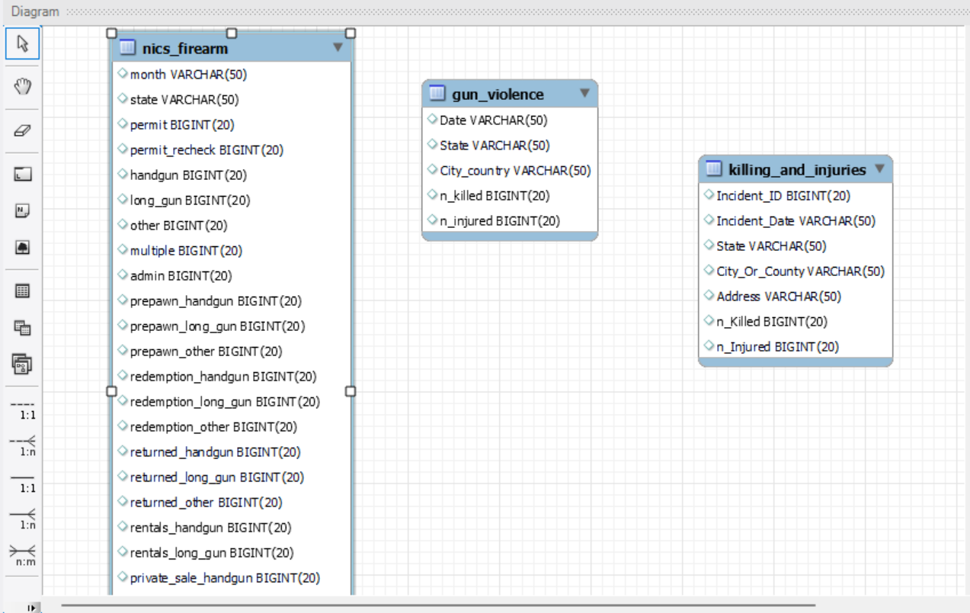
Logical diagram

Slide 11
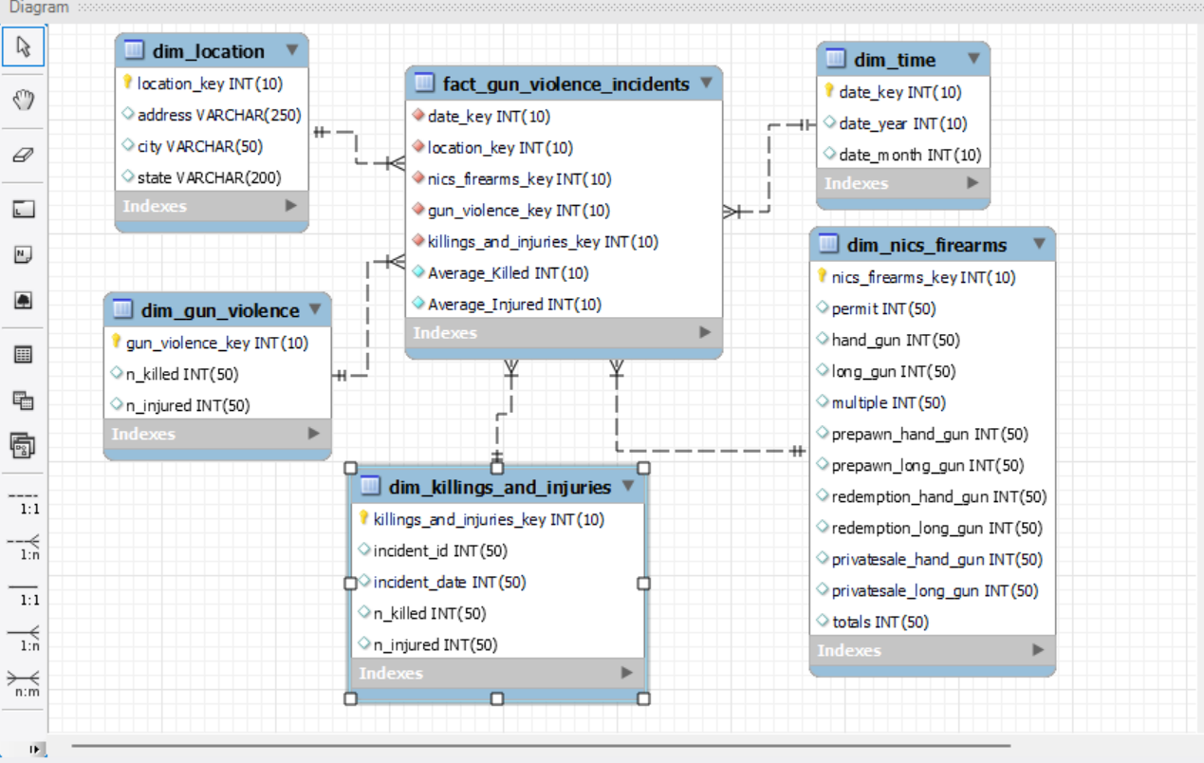
Dimensional modelling

Slide 12
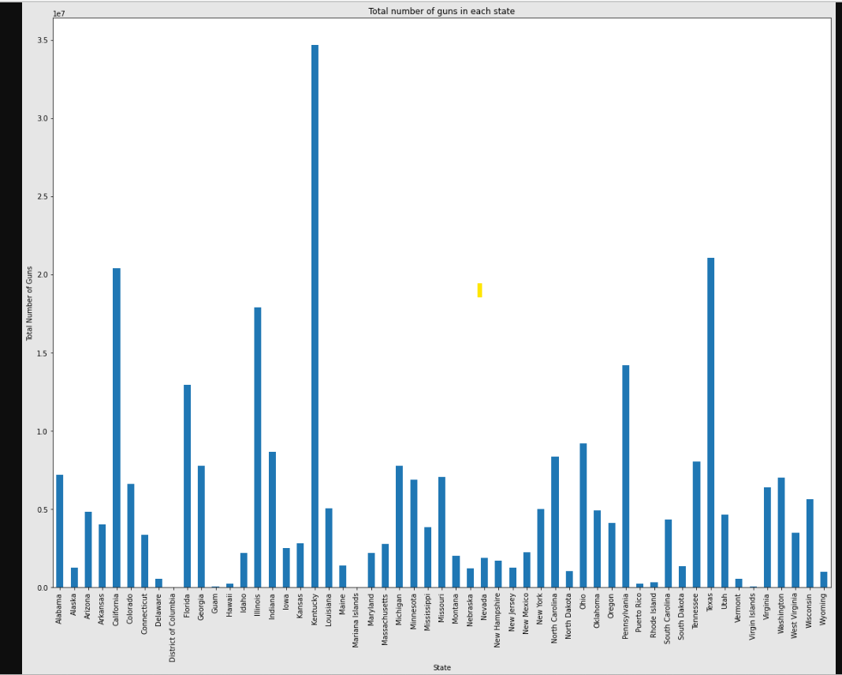
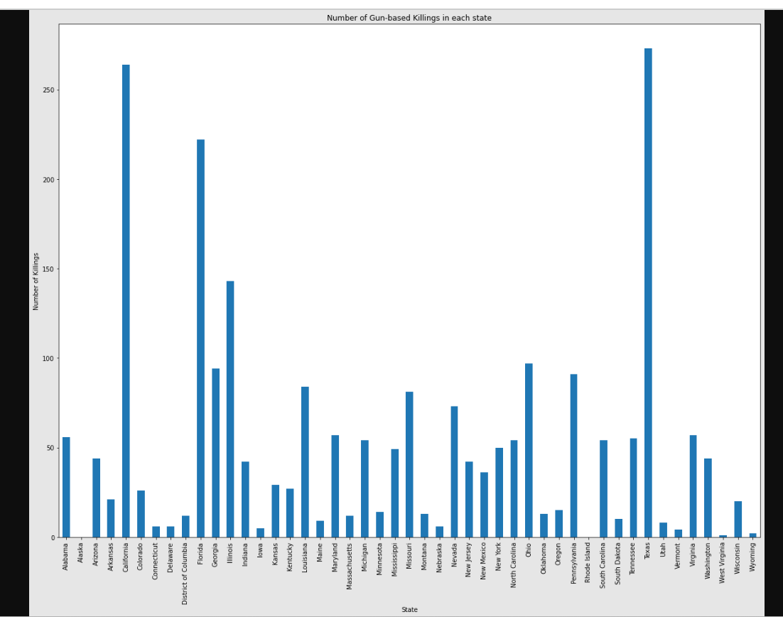
Data profiling & analysis

Slide 13
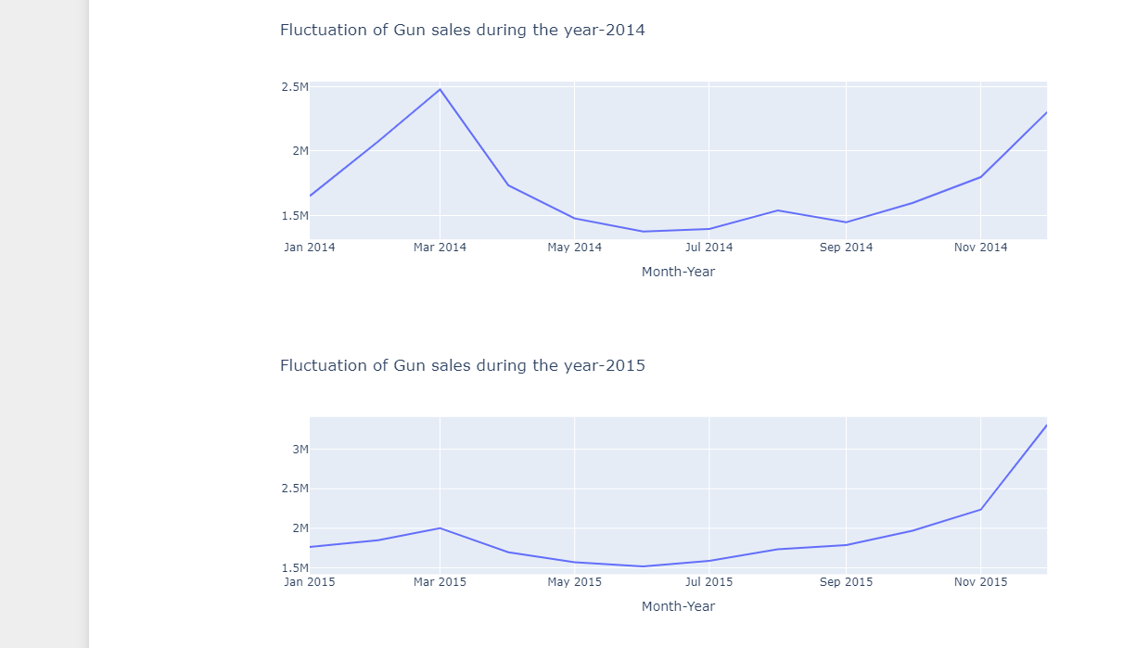
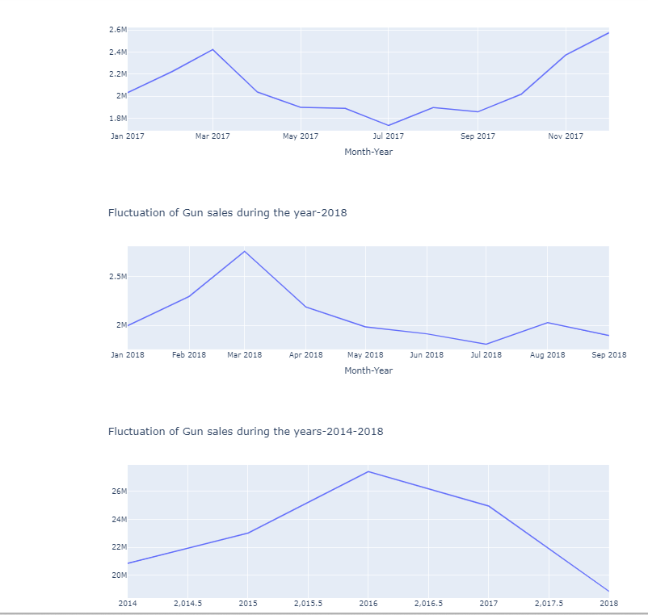
Research analysis
RQ1: How have the sales of firearms evolved?

Slide 14
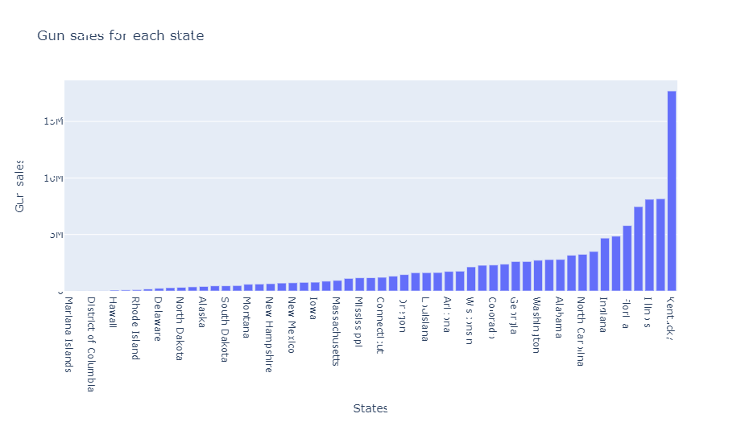
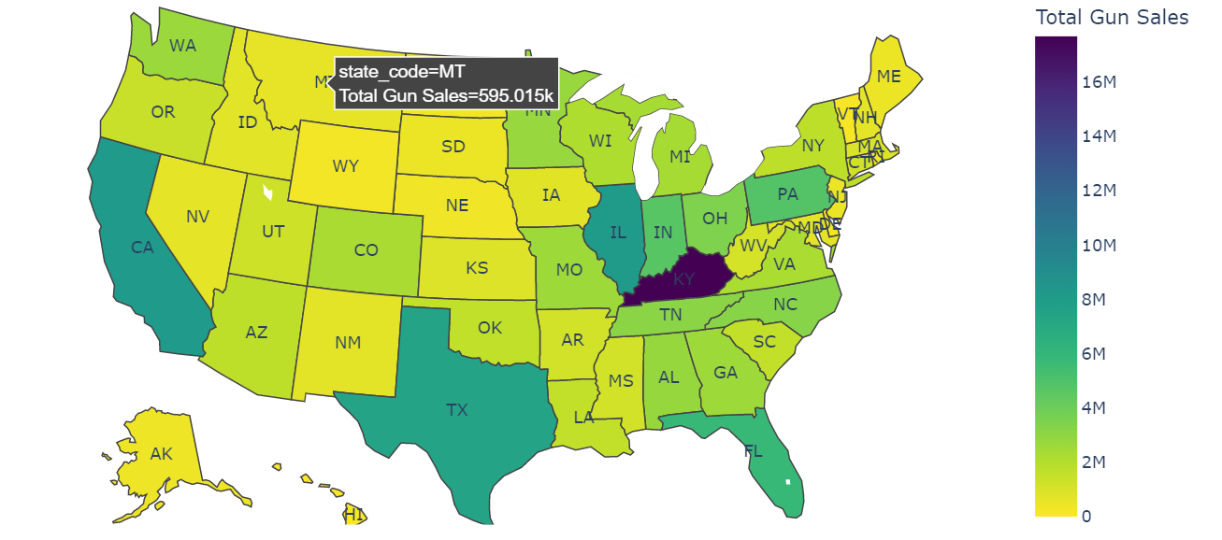
RQ2: Where do most firearms purchases occur?

Slide 15
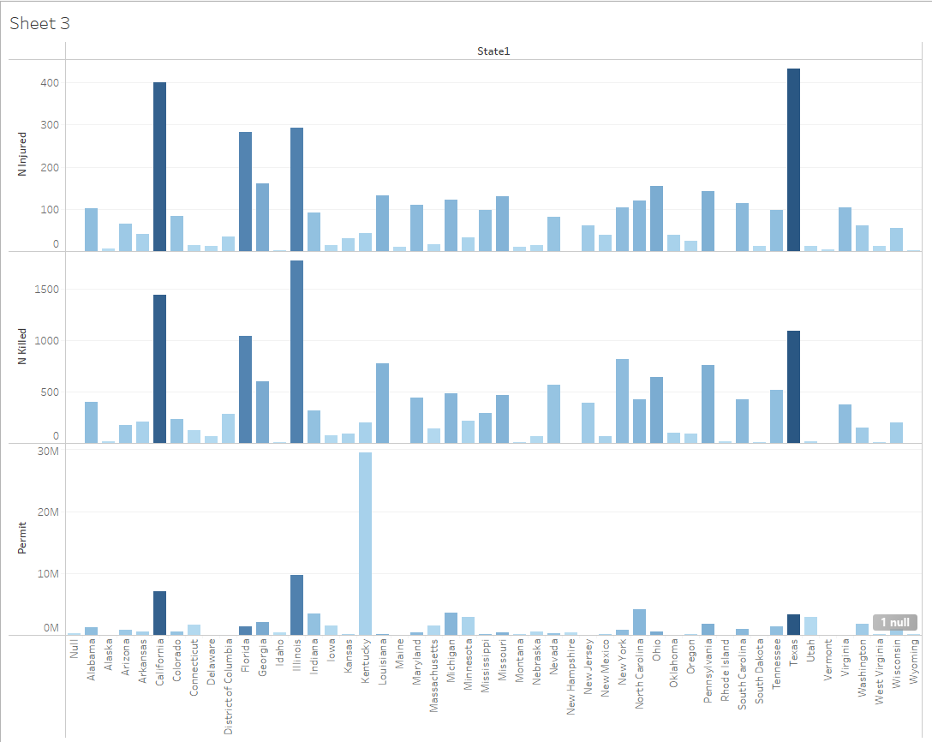
RQ3: Is there a relationship between the number of guns owned by citizens and the number and location of shooting incidents?

Slide 16
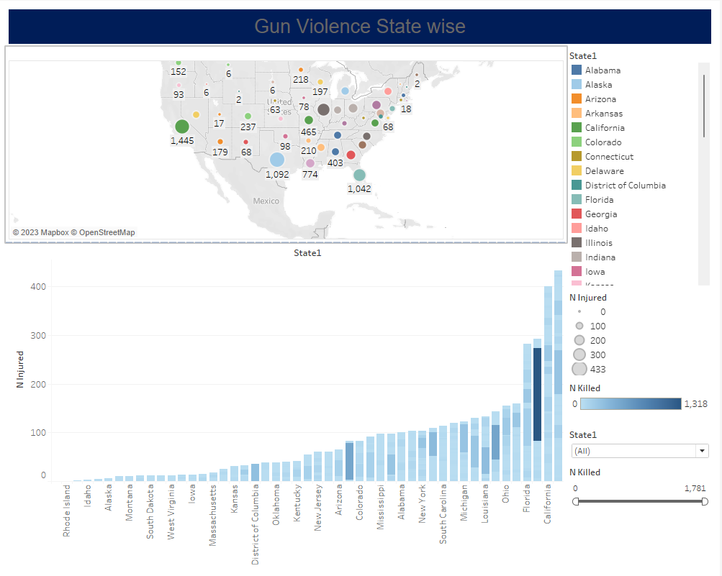

Slide 17
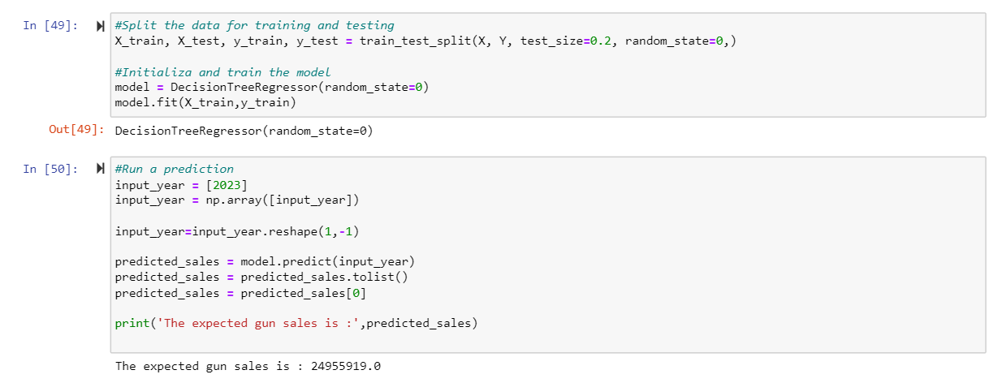
Will there probably be a rise in gun sales?
According to the decision tree's prediction, there will be a 6.1 million rise in the number of firearms purchased.

Slide 18
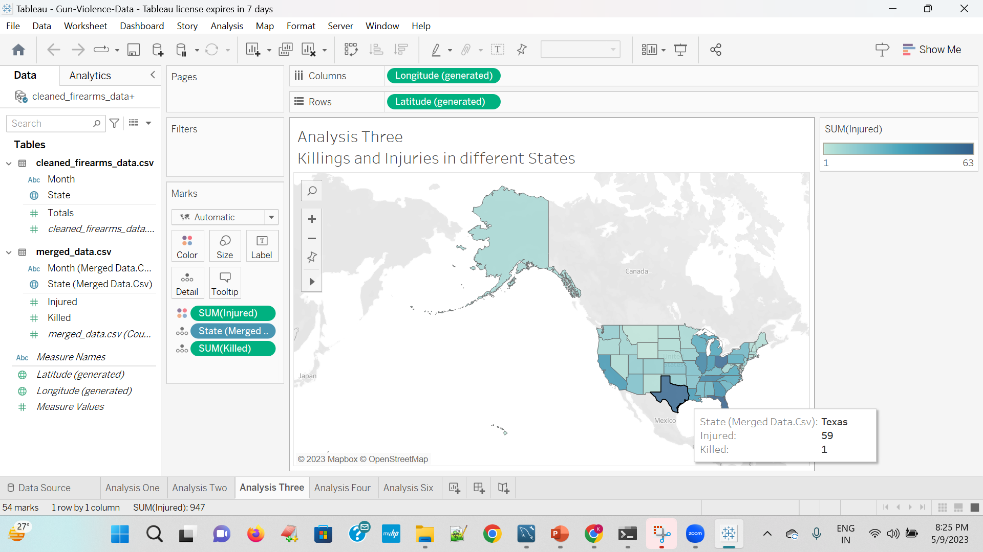
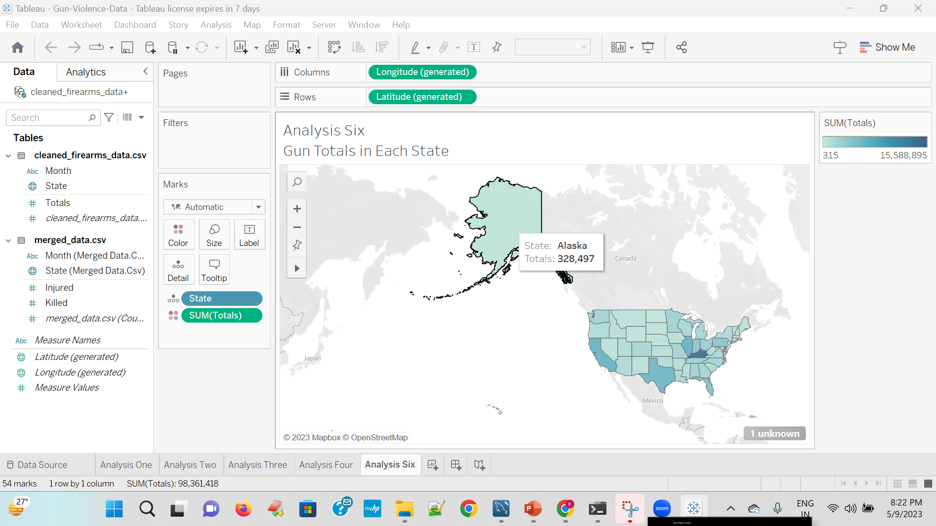
Tableau visualizations

Slide 19
Problems encountered & Addressed
We faced difficulty in integrating the ETL Glue Jobs, establishing a successful connection to MySQL data source
Secondly we found it hard working with the choropleth map to visualize it with the states embedded in the map and also showing the animation in the Gun Sales.

Slide 20
SUMMARY
To summarize, we utilized three distinct gun sales and gun violence databases in this research effort. Each dataset was scrutinized and evaluated. we have also effectively utilized the decision tree approach of machine learning.
However, according to this research, Kentucky is the state with the most gun purchases, followed by California. It was obvious from the time series that gun purchases had decreased over time. Using decision trees to estimate sales for the following year, the model predicts an increase in the purchase of weapons.
This research may be broadened, and additional data can be gathered to aid in analysis so that we can thoroughly understand the gun culture in the United States.

Slide 21
THANK YOU
GROUP-6
Karthik Katepally
Samyog KC
Sai Lalitesh Pothukuchi
Vishal Daroor

