Slide 1
DAV 6150 Module 2 Assignment : Predicting Curb Weight of Cars: Linear Regression Analysis
Karthik Katepally

Slide 2
AGENDA
Introduction​
Exploratory Data Analysis
​Regression Models
​Conclusion​

Slide 3
Introduction
The aim is to predict the curb weight of cars based on various attributes such as make, fuel type, engine size, and horsepower.
I will use linear regression models and perform K-fold cross-validation to evaluate their performance. The steps include:
Exploratory Data Analysis (EDA): I'll analyze the dataset to understand the variables and their relationships, identify any missing values, and derive insights for predictive modeling.
Regression Model Construction & Evaluation: Furthermore, I'll select explanatory variables, split the dataset, construct linear regression models, and evaluate their performance using K-fold cross-validation.
Conclusions: Lastly I'll summarize the findings, discuss the score of the models, and provide preference between the two models.

Slide 4
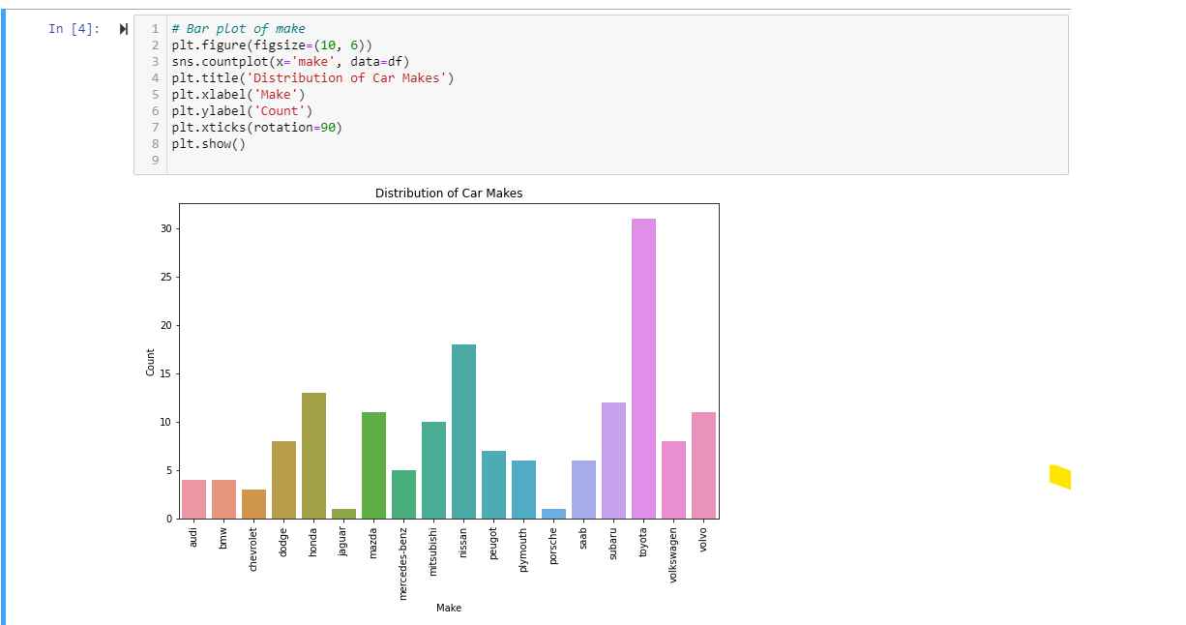
Exploratory data analysis
Dispersion Of Vehicle Makes With Population

Slide 5
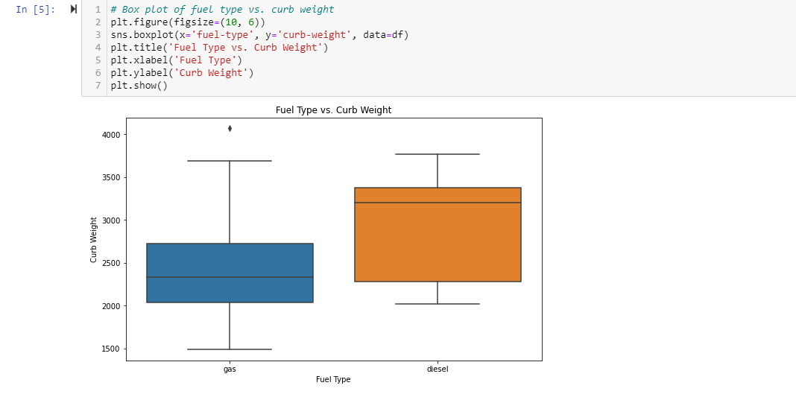
Fuel Type vs Curb Weight

Slide 6
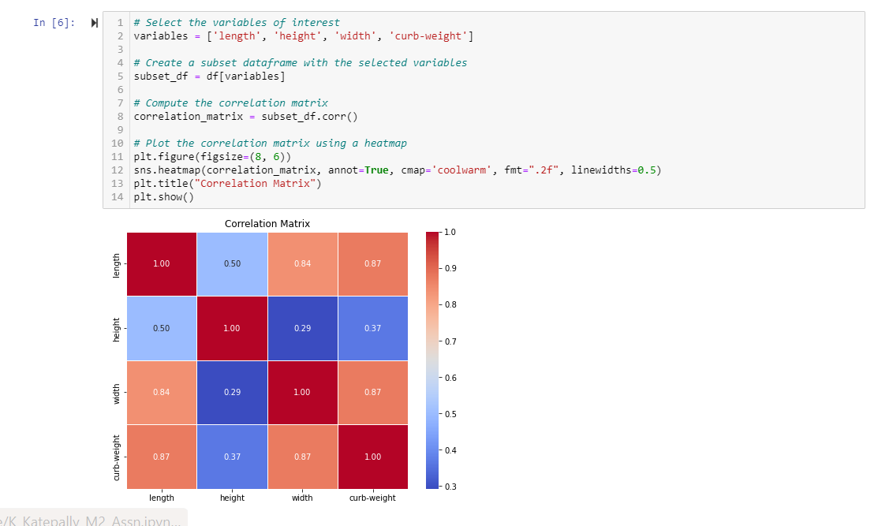
Correlation Matrix Plotting Relationship B/W Length, Width, Height, & Curb Weight

Slide 7
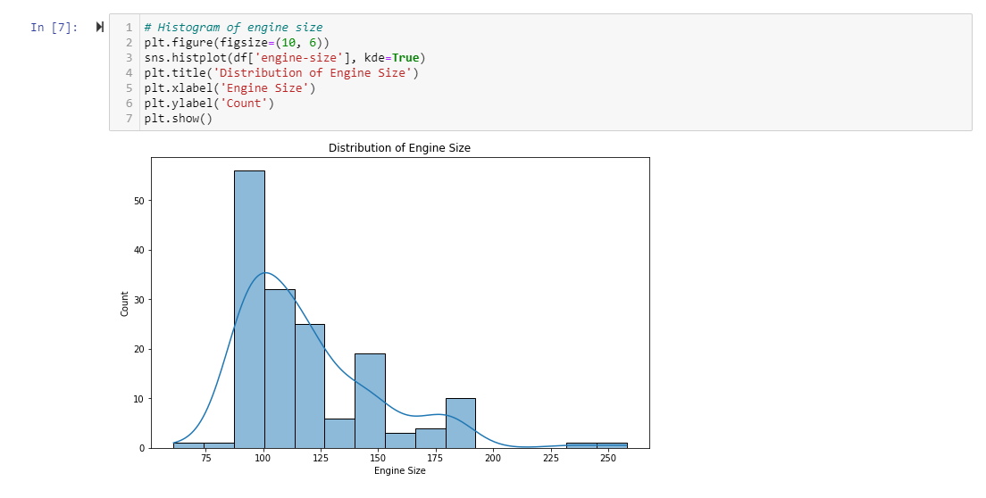
Distribution Of Engine Sizes

Slide 8
Regression Model Construction & Evaluation
We aim to develop robust regression models that can effectively estimate the curb weight based on the given set of predictors.
The evaluation process will involve assessing the performance of the models through various metrics and techniques, such as K-fold cross-validation, to ensure their reliability and accuracy in capturing the relationship between the explanatory variables and the curb weight.
In the first model, we have chosen 'engine-size', 'horsepower', and 'fuel-type' as our predictors, considering their potential influence on the curb weight.
For the second model, we have opted for 'length', 'width', and 'height' as the explanatory variables, based on their expected impact on curb weight.
This approach will enable us to derive more robust and meaningful models that have better potential for predicting curb weight accurately.

Slide 9
Linear regression
To develop predictive models for curb weight based on the provided explanatory variables, we employ a linear regression approach.
The linear regression models are trained using the available training data, enabling them to learn the underlying patterns and relationships between the independent variables and the target variable.
By fitting the models to the training data, we aim to estimate the coefficients that define the linear relationship between the explanatory variables and curb weight.
Model1 = 'engine-size', 'horsepower', and 'fuel-type’
Model2 = 'length', 'width', and 'height'

Slide 10
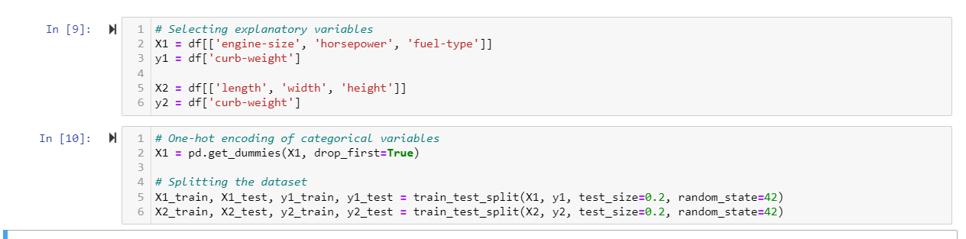
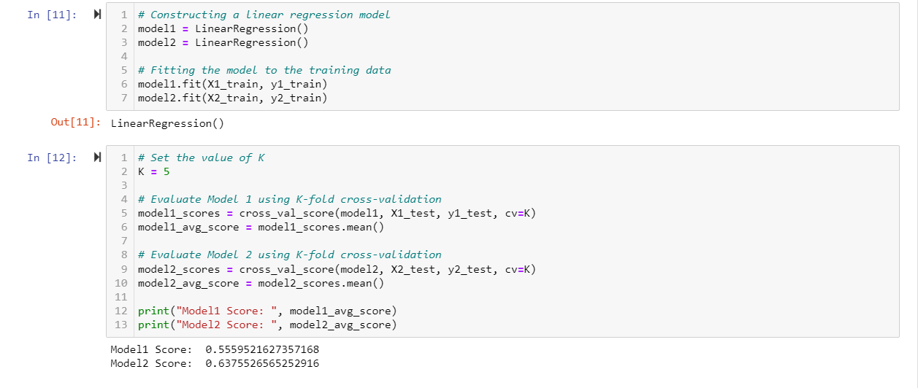

Slide 11
conclusion
Through the analysis, we discovered a positive correlation between horsepower and curb weight.
Additionally, we identified that the length and width of the curb significantly contribute to its weight and that most people use Toyota.
To predict the curb weight, we developed two linear regression models using different sets of independent variables.
To assess the models' performance, we employed K-fold cross-validation and calculated the average R^2 scores.
Based on the evaluation, we determined that Model 2 outperformed Model 1. Model2 attained an average R^2 score of 0.6376, surpassing Model1's average score of 0.3714. As a result, we deemed Model2 to be the preferred choice over Model1.

Slide 12
THANK YOU
Karthik Katepally

