Slide 1
Welcome
MRA Tax payer registration Application

Slide 2
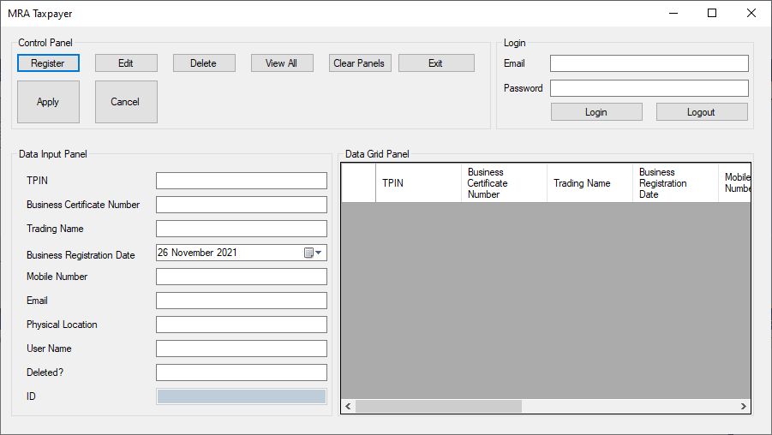
The first screen is a mock-up of how the Screen will eventually look like.

Slide 3
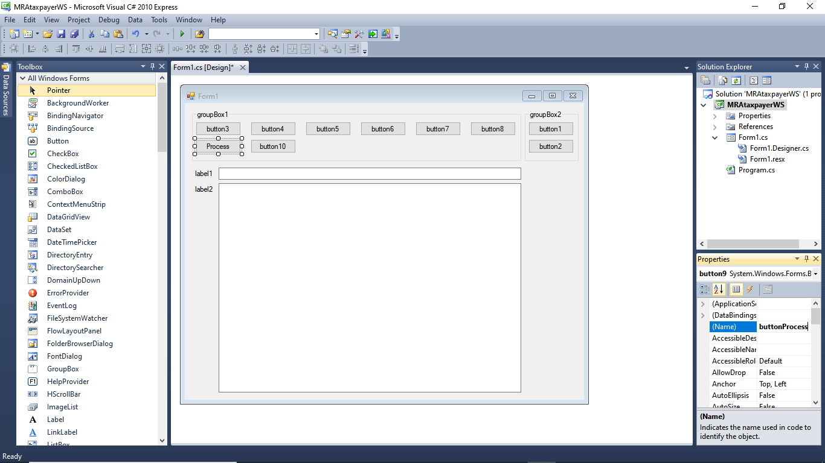
The first designs were quite different. they show the evolution to the final design. See the next few slides.

Slide 4
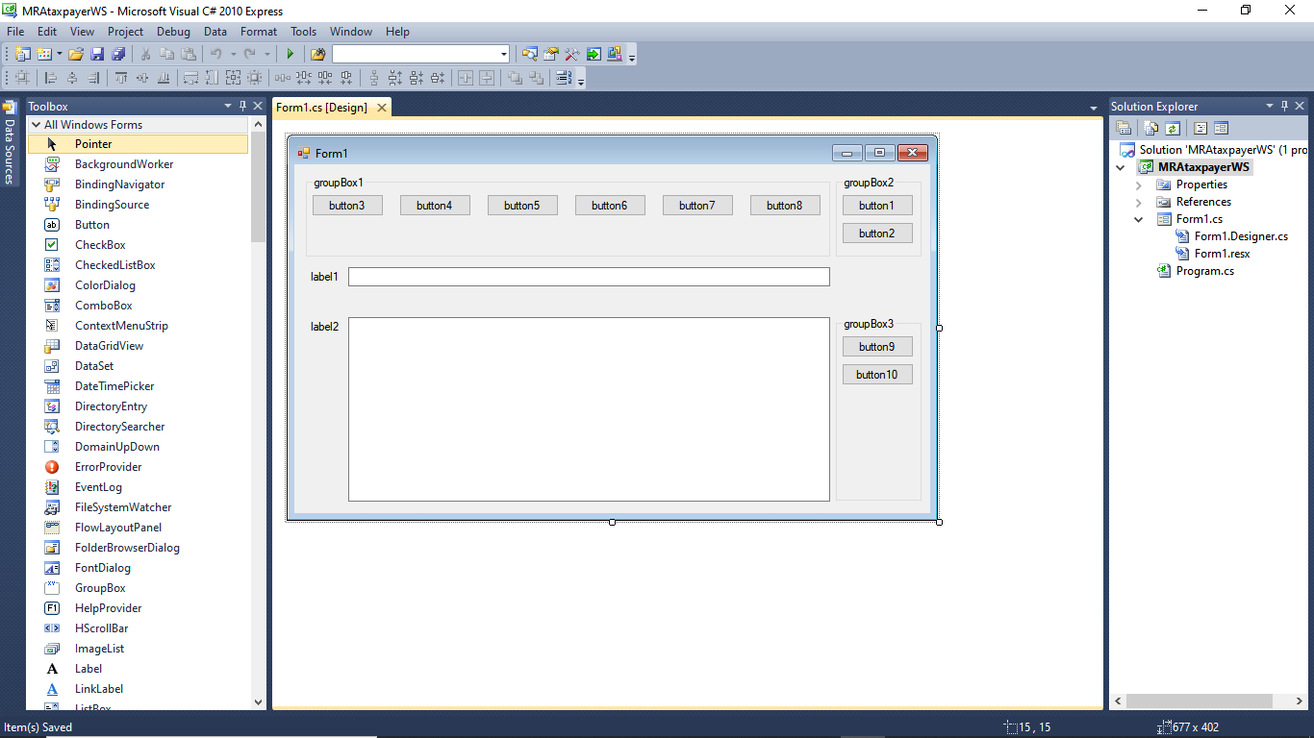
The first designs were quite different. they show the evolution to the final design. The App was developed in Visual Studio 2010.

Slide 5
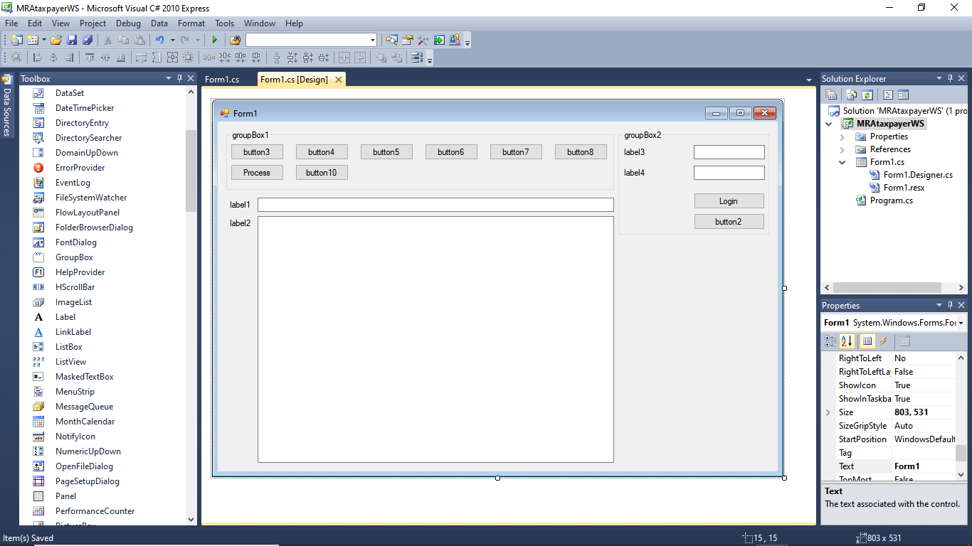
The first designs were quite different. they show the evolution to the final design. The App was developed in Visual Studio 2010.

Slide 6
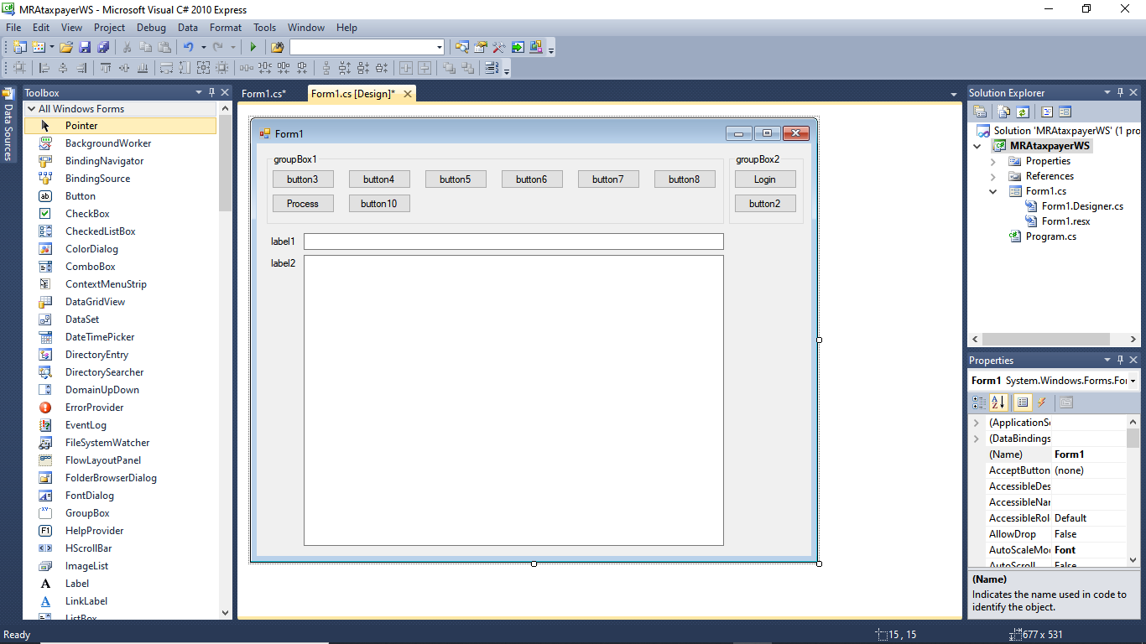
The first designs were quite different. they show the evolution to the final design. The App was developed in Visual Studio 2010.

Slide 7

The first designs were quite different. they show the evolution to the final design. The App was developed in Visual Studio 2010.

Slide 8

The first designs were quite different. they show the evolution to the final design. The App was developed in Visual Studio 2010.

Slide 9
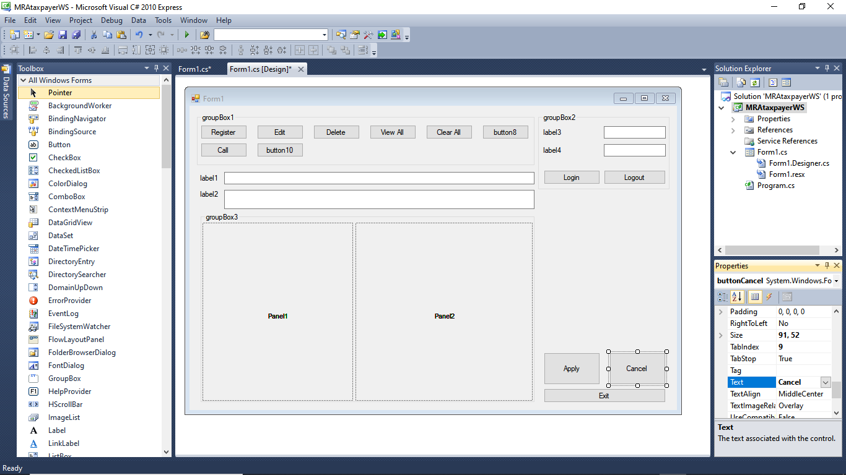
The first designs were quite different. they show the evolution to the final design. Using a pen and paper is also a good option to design.

Slide 10
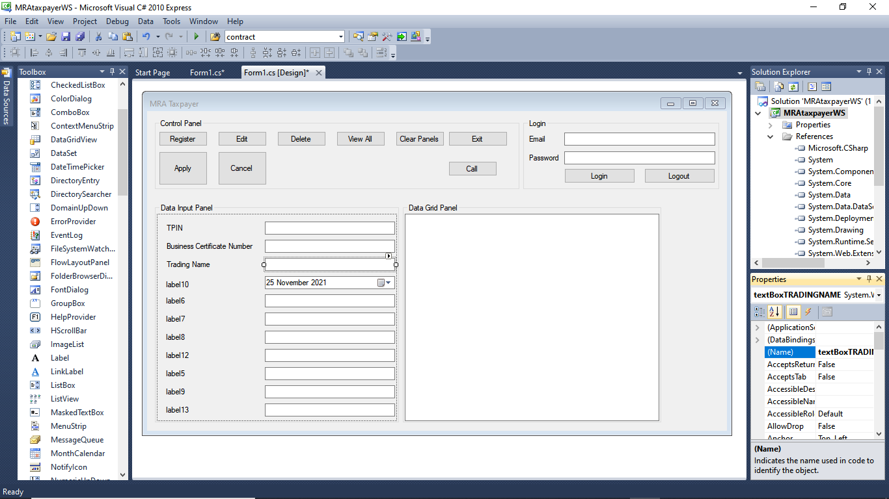
The first designs were quite different. they show the evolution to the final design. Critical assessment of the user process flow also helps.

Slide 11
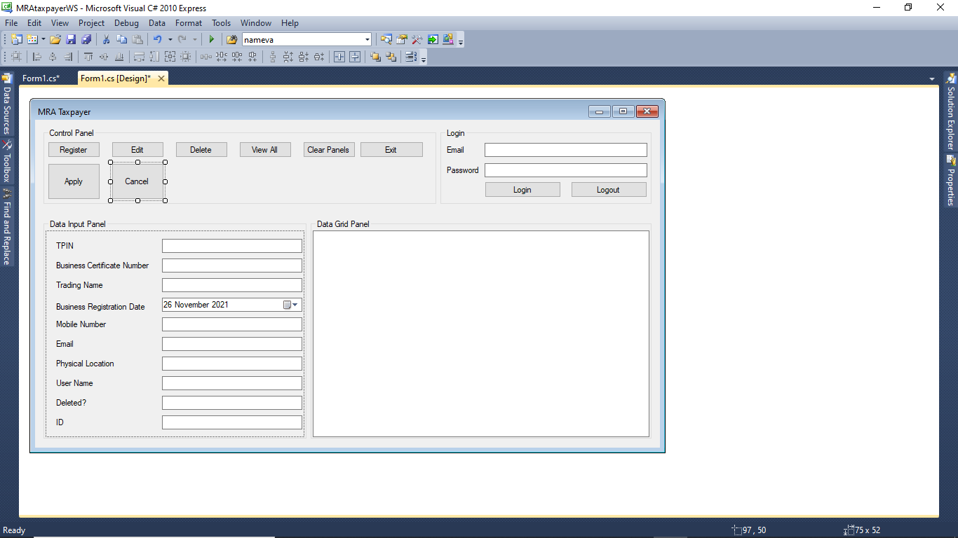
The first designs were quite different. they show the evolution to the final design. Critical assessment of the user process flow also helps.

Slide 12
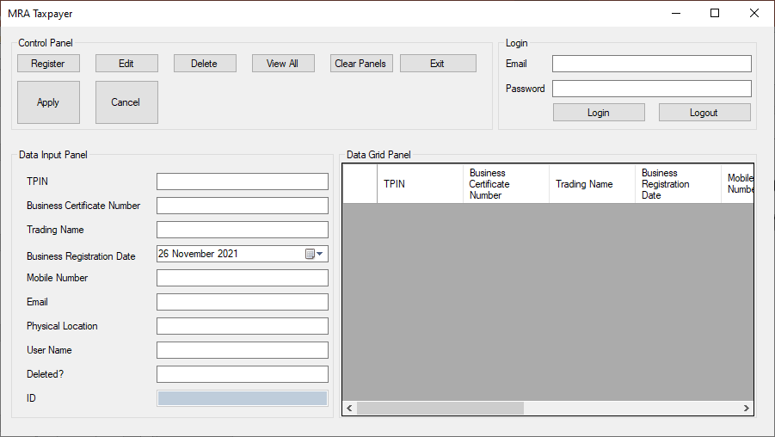
The first designs were quite different. they show the evolution to the final design. The final design. At least version 1.0.

Slide 13
Check the documentation to see how the various parts of the User Interface work.
Thank you.

