Slide 1
Welcome
MRA Tax payer registration Application

Slide 2
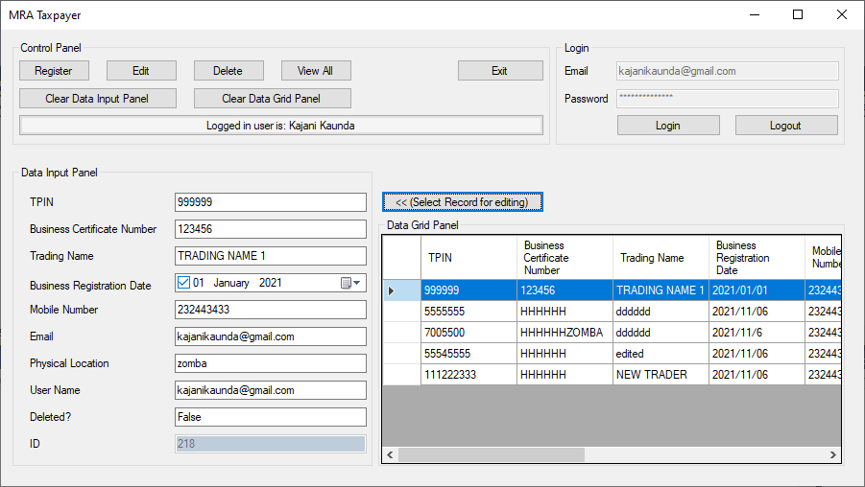
Final Screen Design

Slide 3
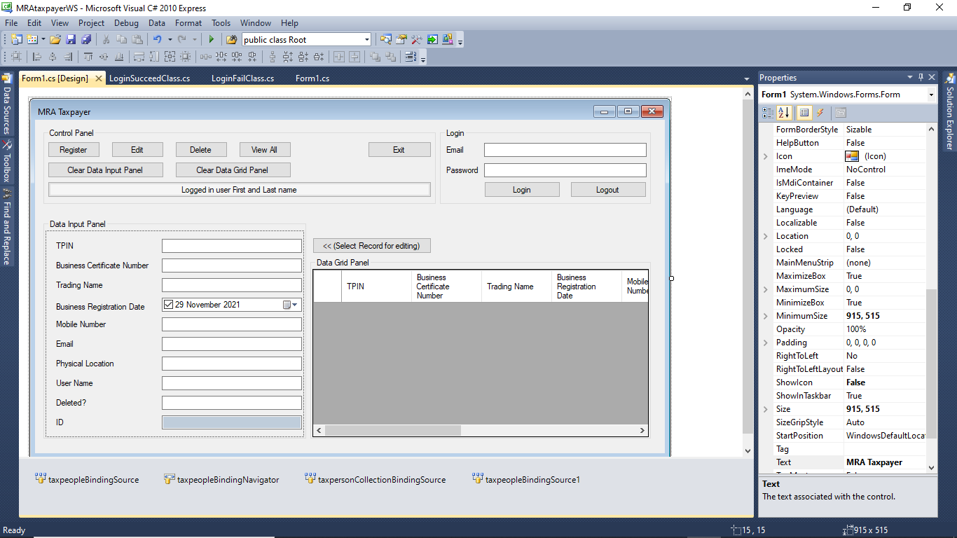
Final Screen Design

Slide 4
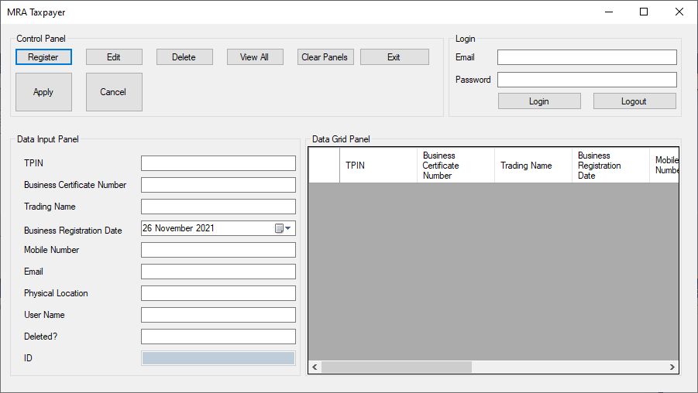
The first screen is a mock-up of how the Screen will eventually look like.

Slide 5
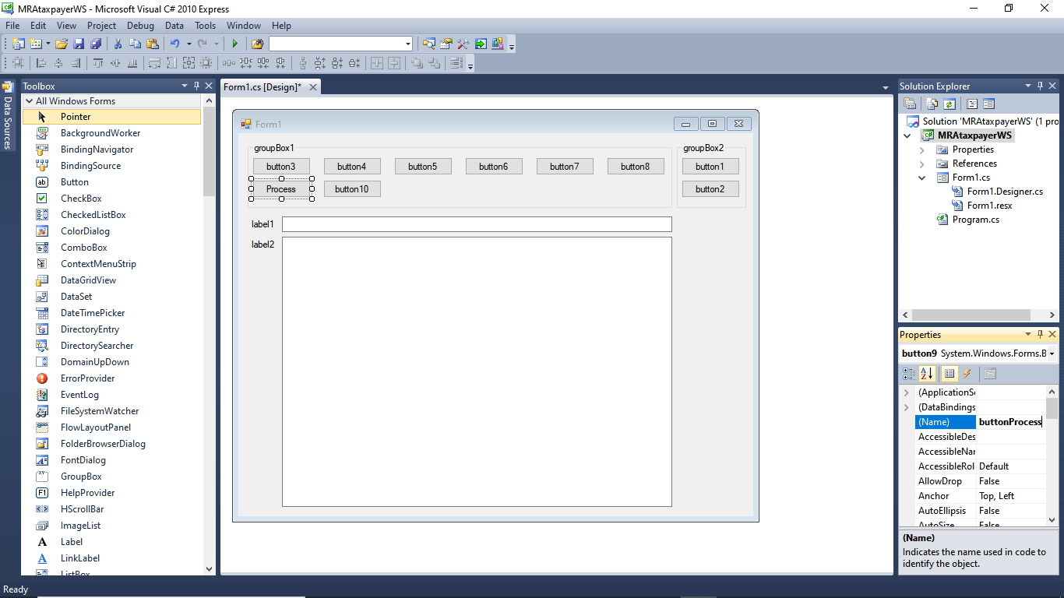
The first designs were quite different. they show the evolution to the final design. See the next few slides.

Slide 6
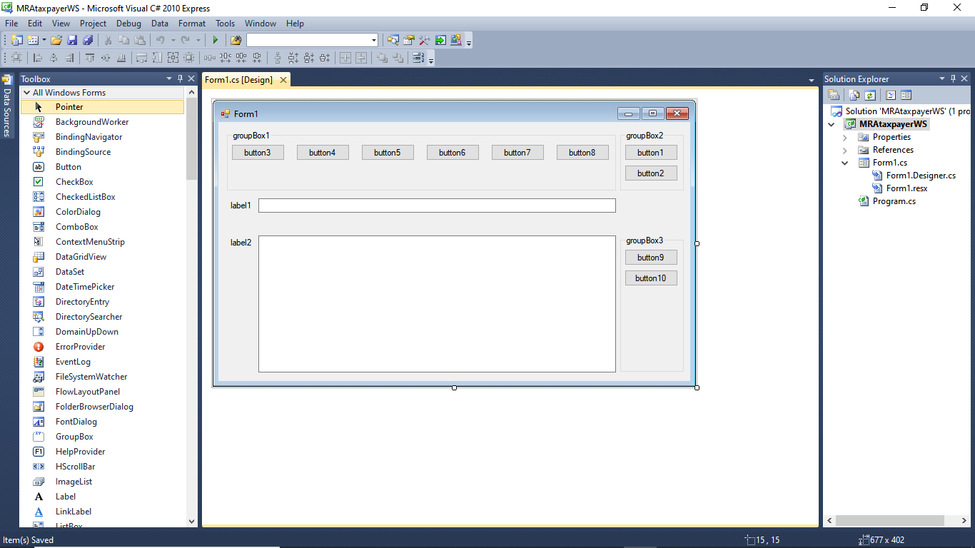
The first designs were quite different. they show the evolution to the final design. The App was developed in Visual Studio 2010.

Slide 7
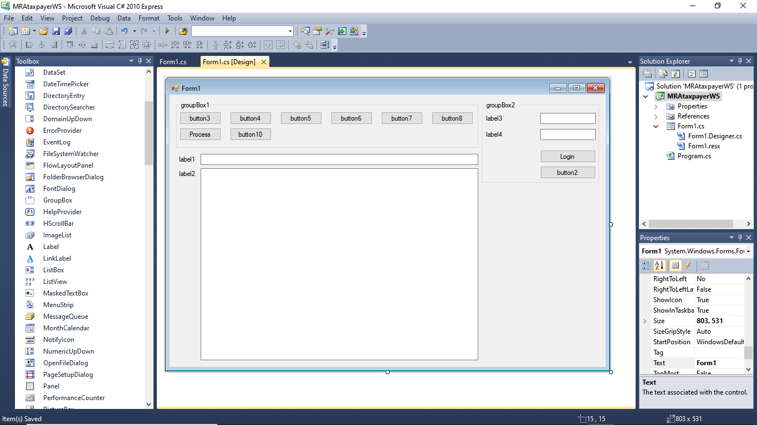
The first designs were quite different. they show the evolution to the final design. The App was developed in Visual Studio 2010.

Slide 8
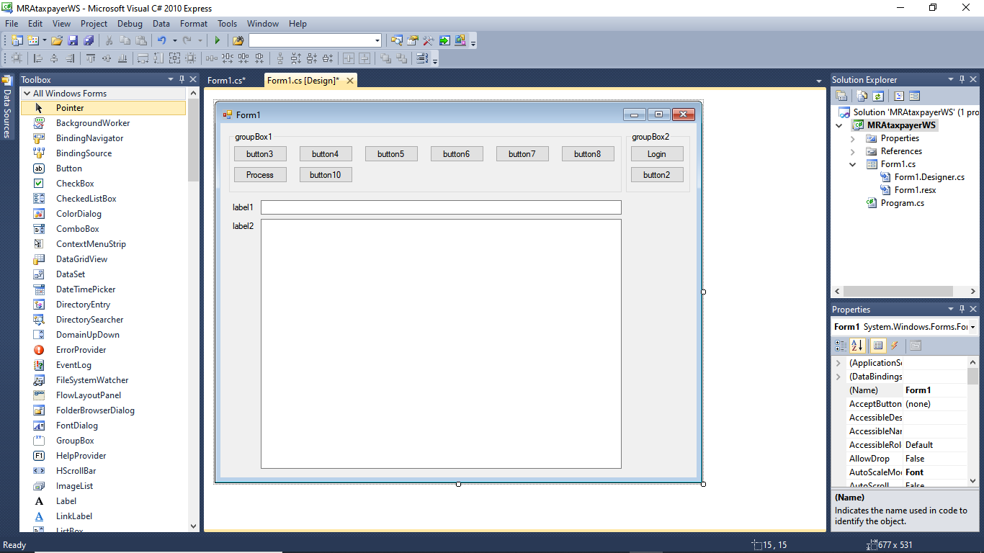
The first designs were quite different. they show the evolution to the final design. The App was developed in Visual Studio 2010.

Slide 9

The first designs were quite different. they show the evolution to the final design. The App was developed in Visual Studio 2010.

Slide 10

The first designs were quite different. they show the evolution to the final design. The App was developed in Visual Studio 2010.

Slide 11
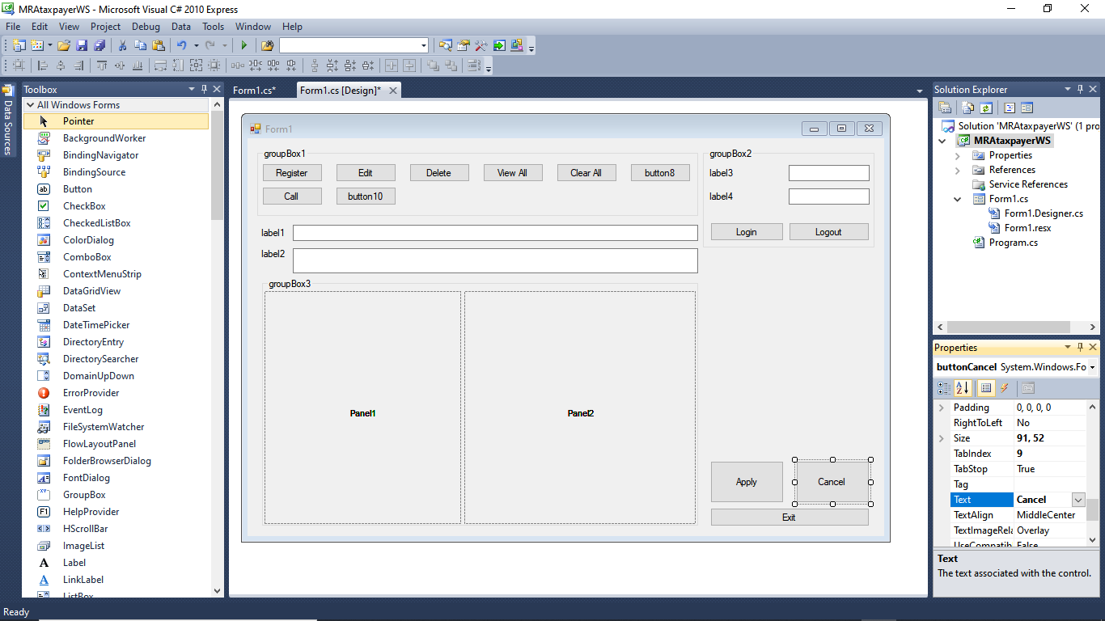
The first designs were quite different. they show the evolution to the final design. Using a pen and paper is also a good option to design.

Slide 12
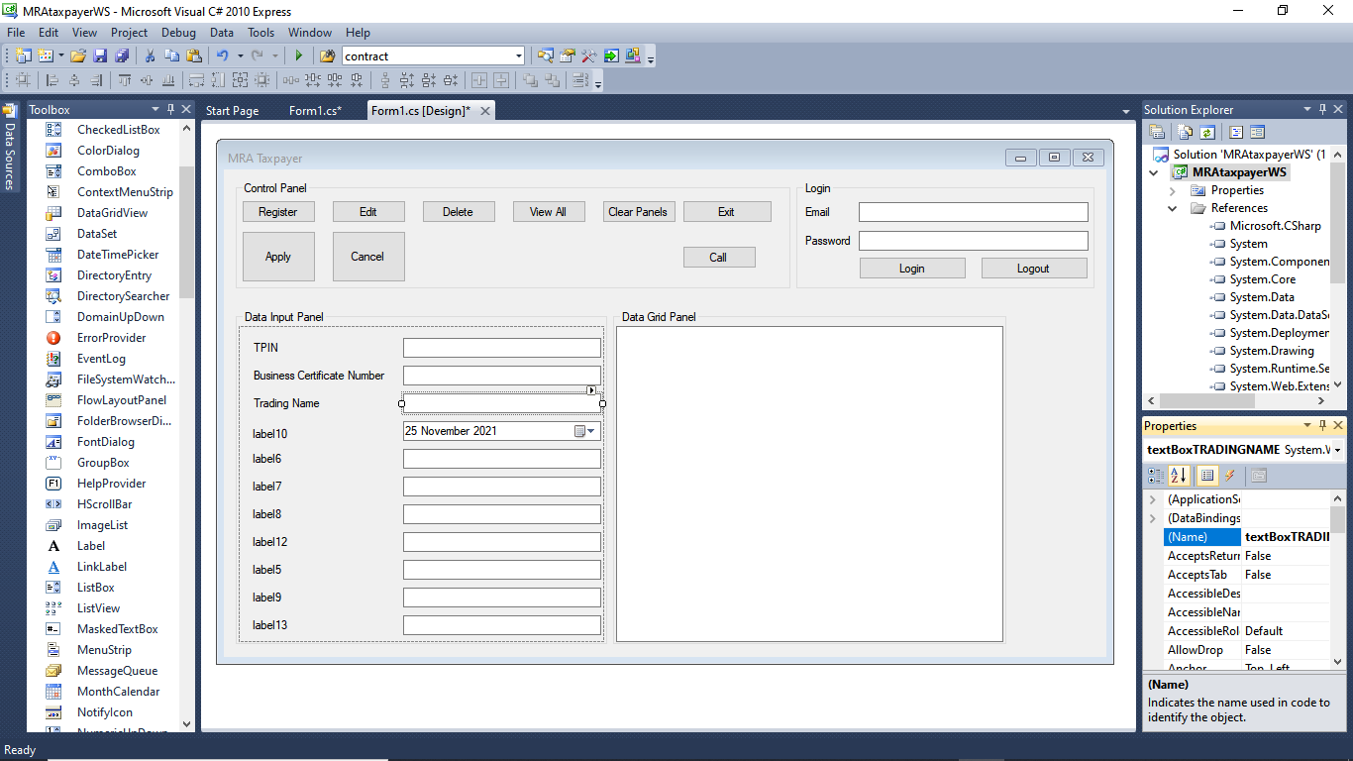
The first designs were quite different. they show the evolution to the final design. Critical assessment of the user process flow also helps.

Slide 13
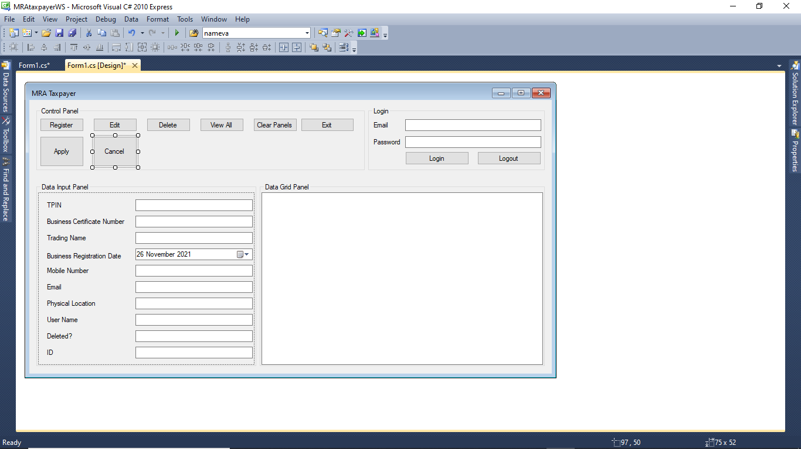
The first designs were quite different. they show the evolution to the final design. Critical assessment of the user process flow also helps.

Slide 14
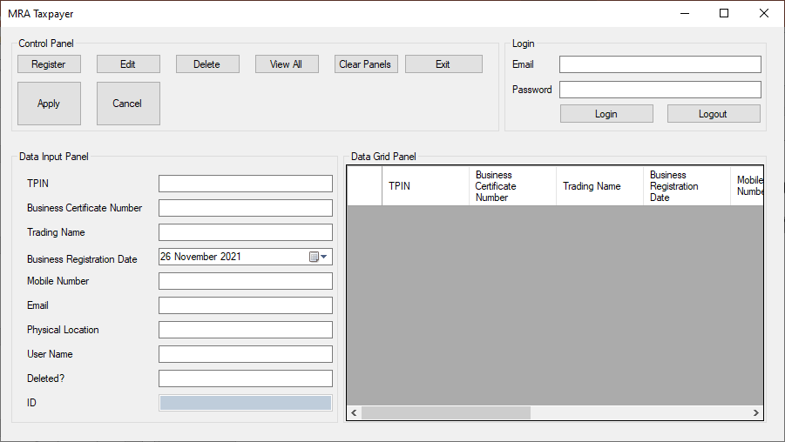
The first designs were quite different. they show the evolution to the final design. The final design. At least version 1.0.

Slide 15
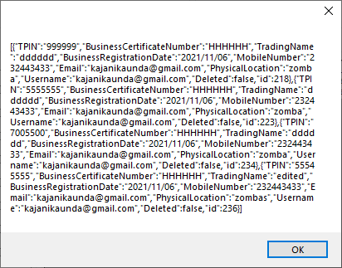
Showing json data from the getall web service. This data then goes into a table then bound to a grid view. The user can then use it to select records to edit etc. this is unfinished…

Slide 16
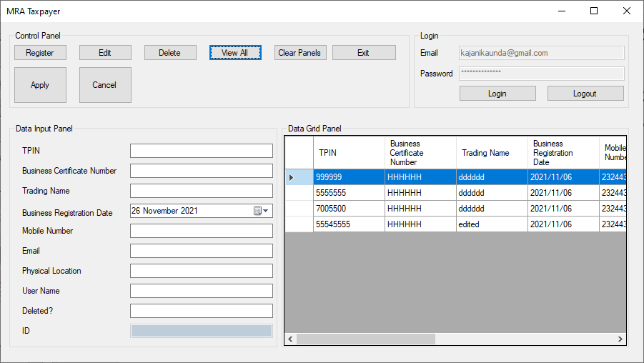
Showing json data from the getall web service. The data is now in the grid view. The idea is that when the user selects the data, the data input panel on the left gets automatically updated ready for edit!

Slide 17
Showing json data from the getall web service. The data is now in the grid view. The idea is that when the user selects the data, the data input panel on the left gets automatically updated ready for edit!
All the functions were tested and they work in this beta version. The user credentials are hardcoded though.
Just need to deserialise the json data to extract token etc as demonstrated with the getall web call that works. Then use the token in the other function calls delete edit etc.
Out of time, I hope this meets with your considerate review…

Slide 18
Check the documentation to see how the various parts of the User Interface work.
Thank you.

