Slide 1
PYTHON PROGRAMMING
GROUP-6
TOPIC: Doctor Scheduler System
KAVYA.S-2016CSE289

Slide 2
DEVELOP DOCTOR SCHEDULER SYSTEM FOR A HOSPITAL.THE PROGRAM SHOULD HAVE THE DATABASE OF DOCTOR DEPARTMENT AND THE AVAILABILITY TIMINGS.THE PROGRAM SHOULD ALLOW 1)ADMIN LOGIN 2)ENTER INFORMATION OF DOCTOR 3)ENTER PATIENTS DETAILS SUCH AS NAME,AGE,GENDER,DISEASE etc… 4)ALLOT TOKEN FOR THE PATIENT 5)PAYMENT 6)TO GENERATE VISUALIZATION ABOUT THE NUMBER OF PATIENT WITH A PARTICULAR DISEASE.

Slide 3
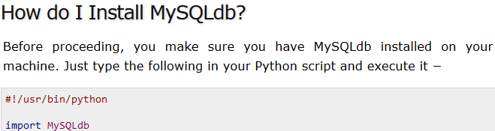
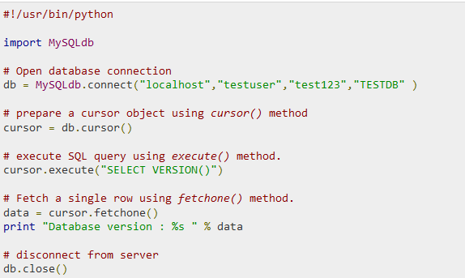
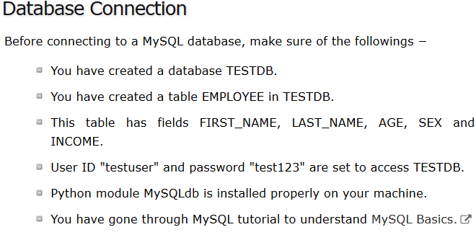

Slide 4
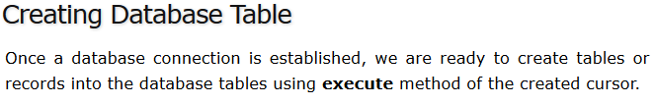
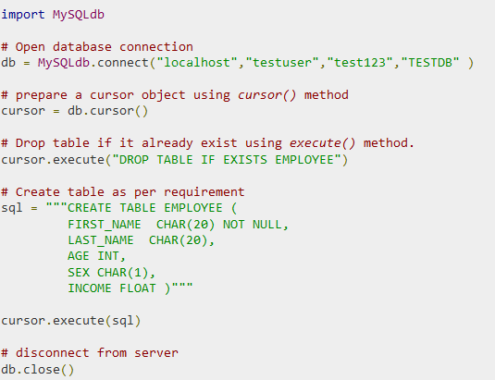

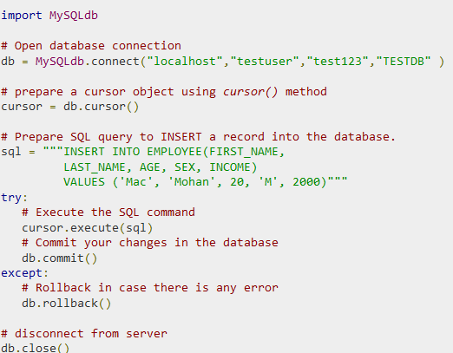

Slide 5
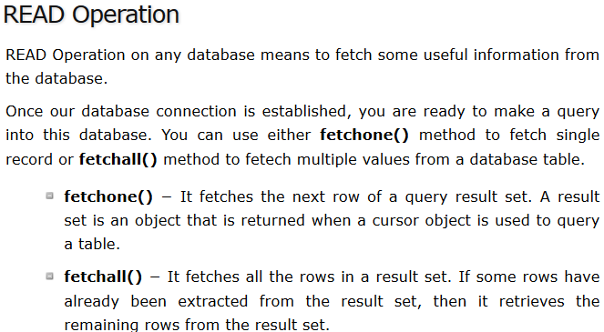
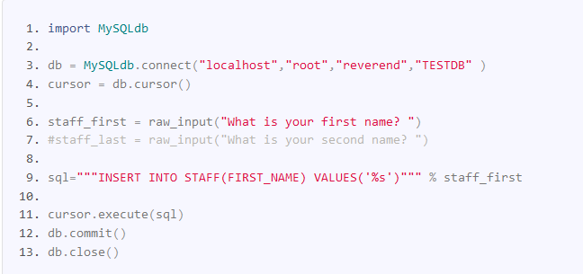
User input into table

Slide 6
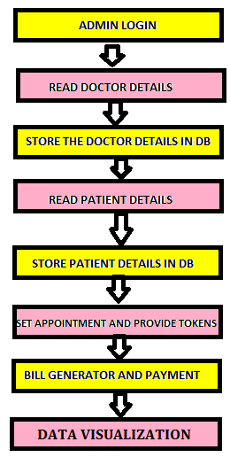
FLOW CHART DOCTOR SCHEDULER

Slide 7
CREATING ADMIN LOGIN correctusername="admin" correctpassword="admin@123" loop='true' while(loop=='true'): username=raw_input("userid") if(username==correctusername): password=raw_input("password") if(password==correctpassword): print("login succeesful"+username) loop='false' else: print("password incorrect") else: print("userid incorrect")

Slide 8
CONNECTING MYSQL WITH DATABASE (PYTHON(X,Y)) import MySQLdb db=MySQLdb.connect('localhost','root','kavya@123') cursor=db.cursor(); cursor.execute("CREATE DATABASE IF NOT EXISTS DOCTOR_SCHED") cursor.execute("USE DOCTOR_SCHED")

Slide 9
CREATING DOCTOR TABLE AND INSERT VALUES INTO TABLE GIVEN BY USER cursor.execute("CREATE TABLE IF NOT EXISTS DOCTOR(D_ID VARCHAR(20) PRIMARY KEY,D_NAME VARCHAR(20),D_AGE INT,D_DIS VARCHAR(20),D_NUMBER INT)") d_id=raw_input("enter doctor id") d_name=raw_input("enter doctor name") d_age=int(input("enter doctor age")) d_dis=raw_input("enter doctor SPECIALISATION") d_num=int(input("enter doctor number")) cursor.execute("INSERT INTO DOCTOR(D_ID,D_NAME,D_AGE,D_DIS,D_NUMBER) VALUES('%s','%s','%d','%s','%d')"%(d_id,d_name,d_age,d_dis,d_num)) cursor.execute("CREATE TABLE IF NOT EXISTS DOCTORA(D_ID VARCHAR(20),START VARCHAR(10),END VARCHAR(10),SNO INT NOT NULL AUTO_INCREMENT,TOKEN INT,FOREIGN KEY(D_ID) REFERENCES DOCTOR(D_ID),PRIMARY KEY(SNO))") d_id1=raw_input("enter id") if(d_id==d_id1): print("1)ADD SLOT") while(1): choice1=int(input("enter your choice")) if(choice1==1): d_start=raw_input("enter slot from ") d_end=raw_input("enter slot to ") d_token=int(input("enter token number")) cursor.execute("INSERT INTO DOCTORA(D_ID,START,END,TOKEN)VALUES('%s','%s','%s','%d')"%(d_id1,d_start,d_end,d_token)) else: break

Slide 10
CREATING PATIENT TABLE AND INSERTING USER INPUT INTO THE TABLE cursor.execute("CREATE TABLE IF NOT EXISTS PATIENT(P_ID VARCHAR(20) PRIMARY KEY,P_NAME VARCHAR(20),P_AGE INT,P_DIS VARCHAR(20),P_NUMBER INT,P_SEX VARCHAR(10),START VARCHAR(10))") p_id=raw_input("enter PATIENT id") p_name=raw_input("enter PATIENT name ") p_age=int(input("enter PATIENT age ")) p_dis=raw_input("WHICH DOCTOR HE/SHE WANTS TO MEET") p_num=int(input("enter PATIENT number ")) p_sex=raw_input("enter PATIENT sex ") p_start=raw_input("enter PATIENT arrival time ") cursor.execute("INSERT INTO PATIENT(P_ID,P_NAME,P_AGE,P_DIS,P_NUMBER,P_SEX,START) VALUES('%s','%s','%d','%s','%d','%s','%s')"%(p_id,p_name,p_age,p_dis,p_num,p_sex,p_start))

Slide 11
SET APPOINTMENT cursor.execute("CREATE TABLE IF NOT EXISTS HAMP AS (SELECT D.D_ID,P.P_ID,DA.SNO,D.D_DIS,P.P_DIS,DA.START,P.START AS P_A FROM DOCTOR D JOIN PATIENT P ON D.D_DIS=P.P_DIS JOIN DOCTORA DA ON DA.D_ID=D.D_ID AND DA.START=P.START) ") cursor.execute("SELECT P_ID,SNO FROM HAMP") for x in cursor: print(x)

Slide 12
BILL GENERATOR AND PAYMENT cursor.execute("CREATE TABLE IF NOT EXISTS BILL(SNO INT PRIMARY KEY AUTO_INCREMENT,P_ID VARCHAR(10),AMT FLOAT,AMT_PAID FLOAT,AMT_DUE FLOAT,AMT_CHANGE FLOAT,FOREIGN KEY(P_ID) REFERENCES PATIENT(P_ID))") p_id=raw_input("enter patient id") total_amt=0 consult=float(input("enter consultancy fee")) amt=float(input("enter treatment fee")) total_amt=amt+consult print('TOTAL AMOUNT TO BE=',total_amt) amt_paid=float(input("enter amount paid=")) amt_due=float(input("enter amount due=")) amt_change=float(input("enter balance to be given by you=")) cursor.execute("INSERT INTO BILL (P_ID,AMT,AMT_PAID,AMT_DUE,AMT_CHANGE) VALUES('%s','%f','%f','%f','%f')"%(p_id,total_amt,amt_paid,amt_due,amt_change))

Slide 13
GENERATING DATA VISUALIZATION cursor.execute("SELECT P_DIS,COUNT(P_DIS) FROM PATIENT GROUP BY P_DIS") tup=cursor.fetchall() print(tup) d=dict(tup) print(d) list1=d.keys() list2=d.values() print(list1,list2) import matplotlib.pyplot as plt plt.pie(list2,labels=list1,startangle=90,shadow=True) plt.legend() plt.show()

Slide 14
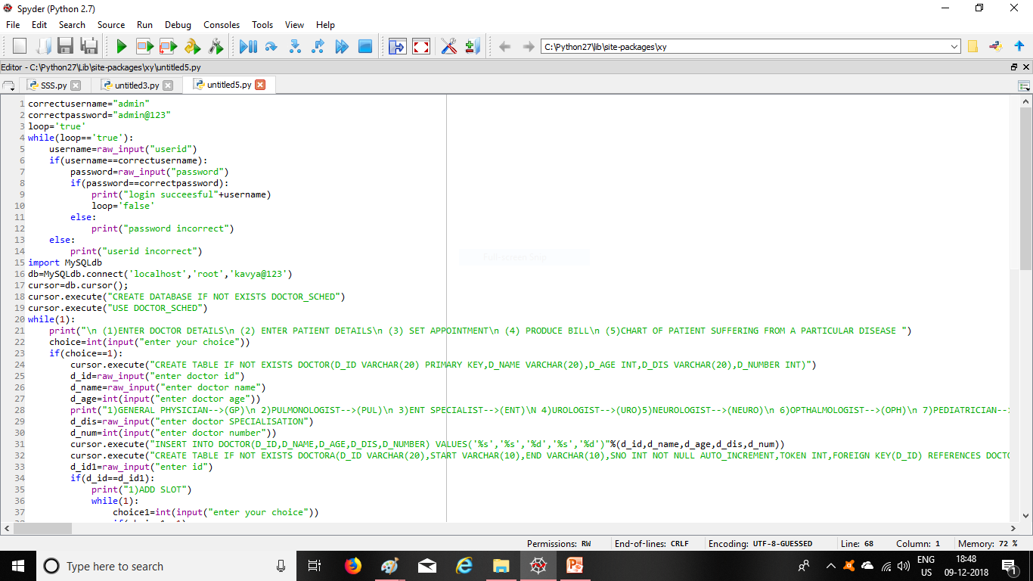

Slide 15
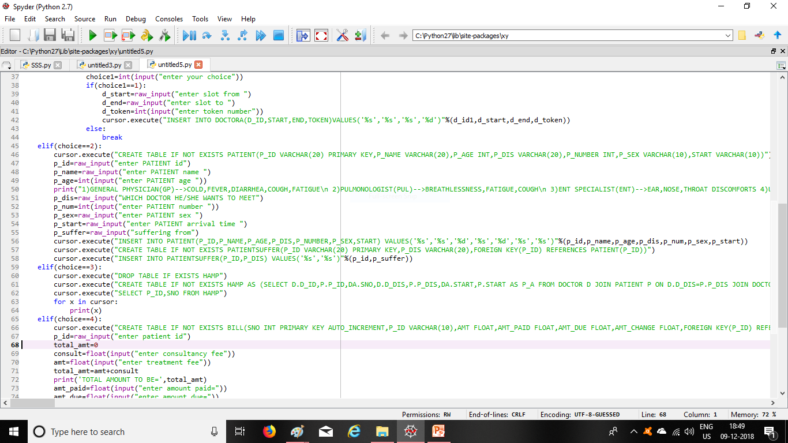

Slide 16
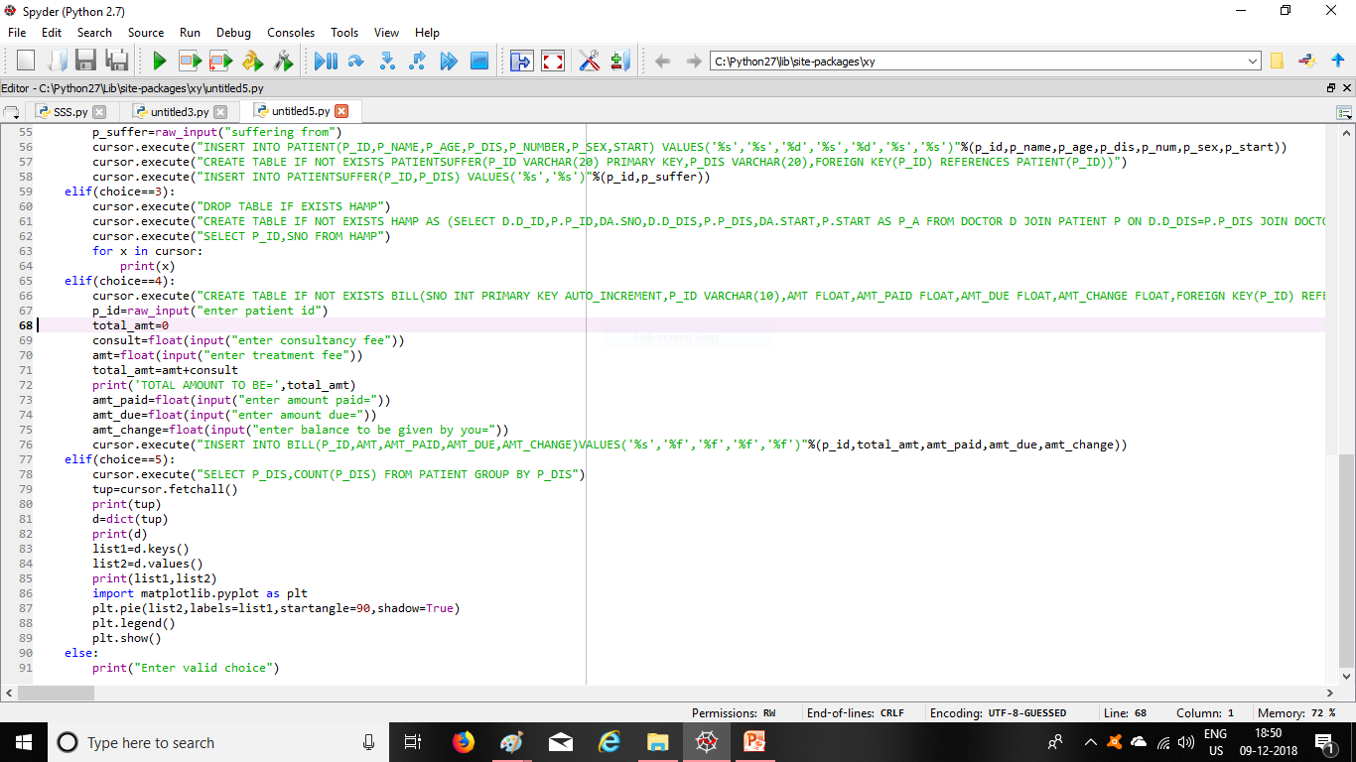

Slide 17
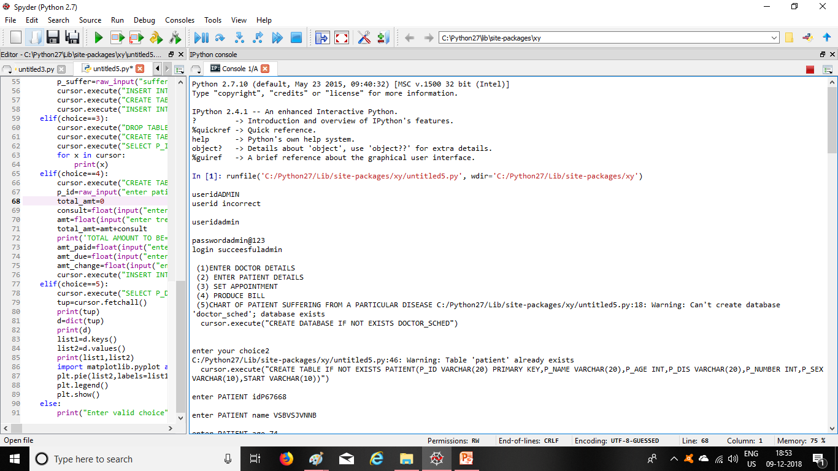

Slide 18
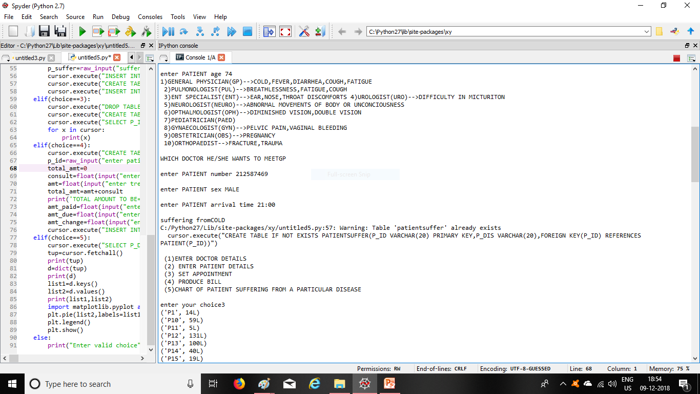

Slide 19
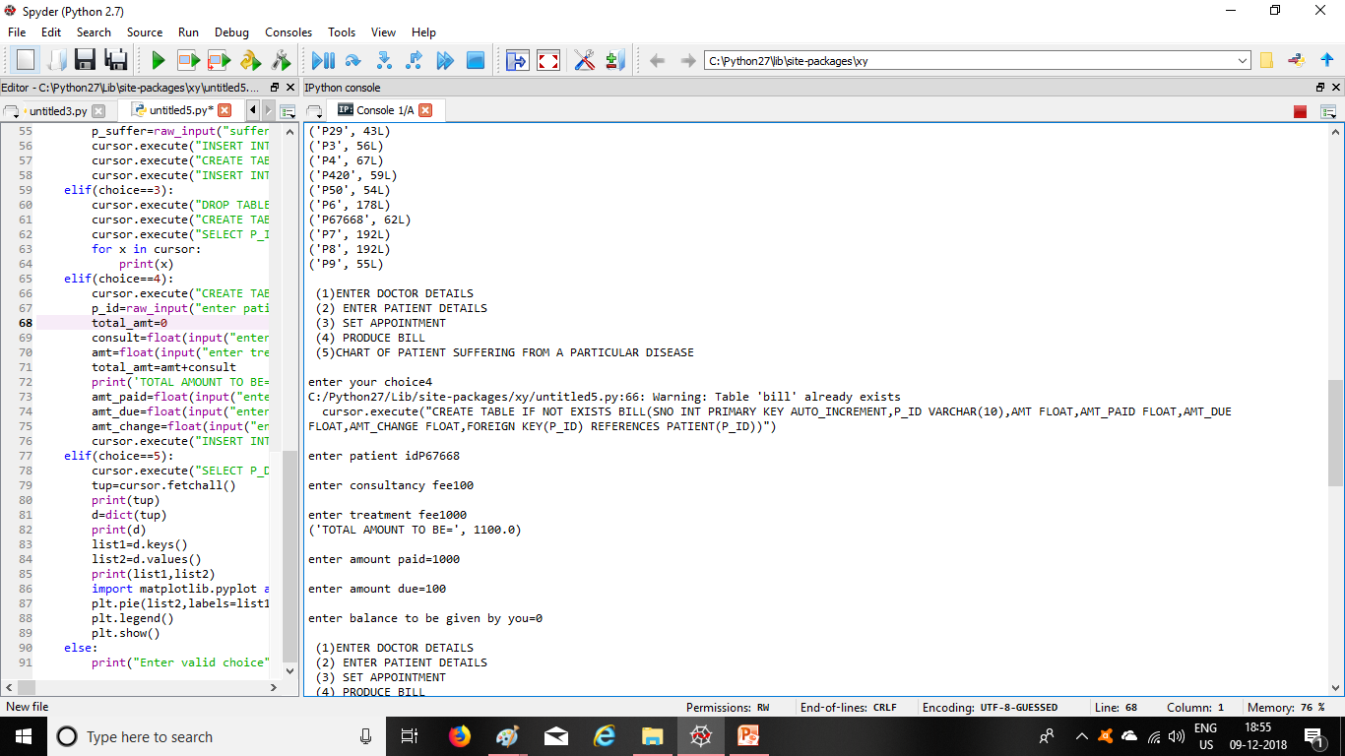

Slide 20
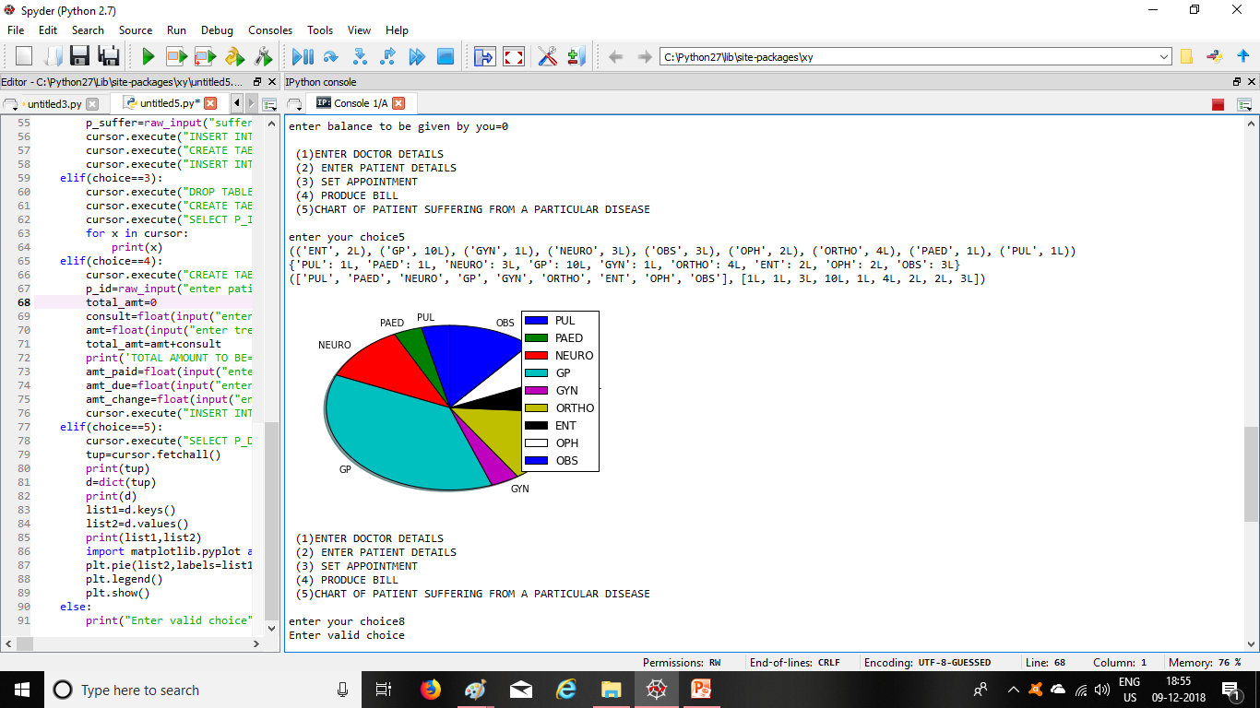

Slide 21
DOCTOR SCHEDULER IS DEVELOPED
THANK YOU

