Slide 1
MI300A BabelStream
HBM Bandwidth
CPX vs TPX vs SPX Partition Modes
HLRS — High Performance Computing Center Stuttgart
BabelStream · double-precision · arraysize=2²⁸ · numtimes=1500
Theoretical peak: 5.3 TB/s per APU · 21.2 TB/s per node

Slide 2
Full-Node Results at a Glance
CPX
TPX
SPX
24 × 1 XCD
12 × 2 XCD
4 × 6 XCD
16.4 TB/s
16.7 TB/s
14.6 TB/s
Triad (77% of peak)
Triad (79% of peak)
Triad (69% of peak)
Dot: 62% of peak
Dot: 71% of peak
Dot: 51% of peak
★ TPX wins on aggregate bandwidth

Slide 3
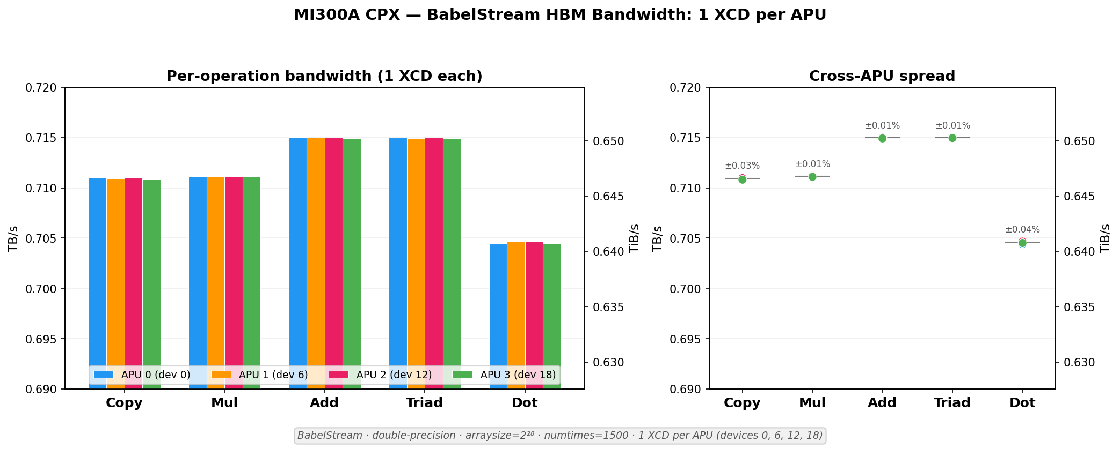
1. Isolated Baseline: Zero Contention
1 XCD per APU — cross-APU spread < 0.04%
Every XCD: ~711 GB/s Copy, ~715 GB/s Triad, ~704 GB/s Dot
Confirms identical per-XCD HBM bandwidth across all APUs when uncontested
Establishes the performance ceiling for all subsequent experiments

Slide 4
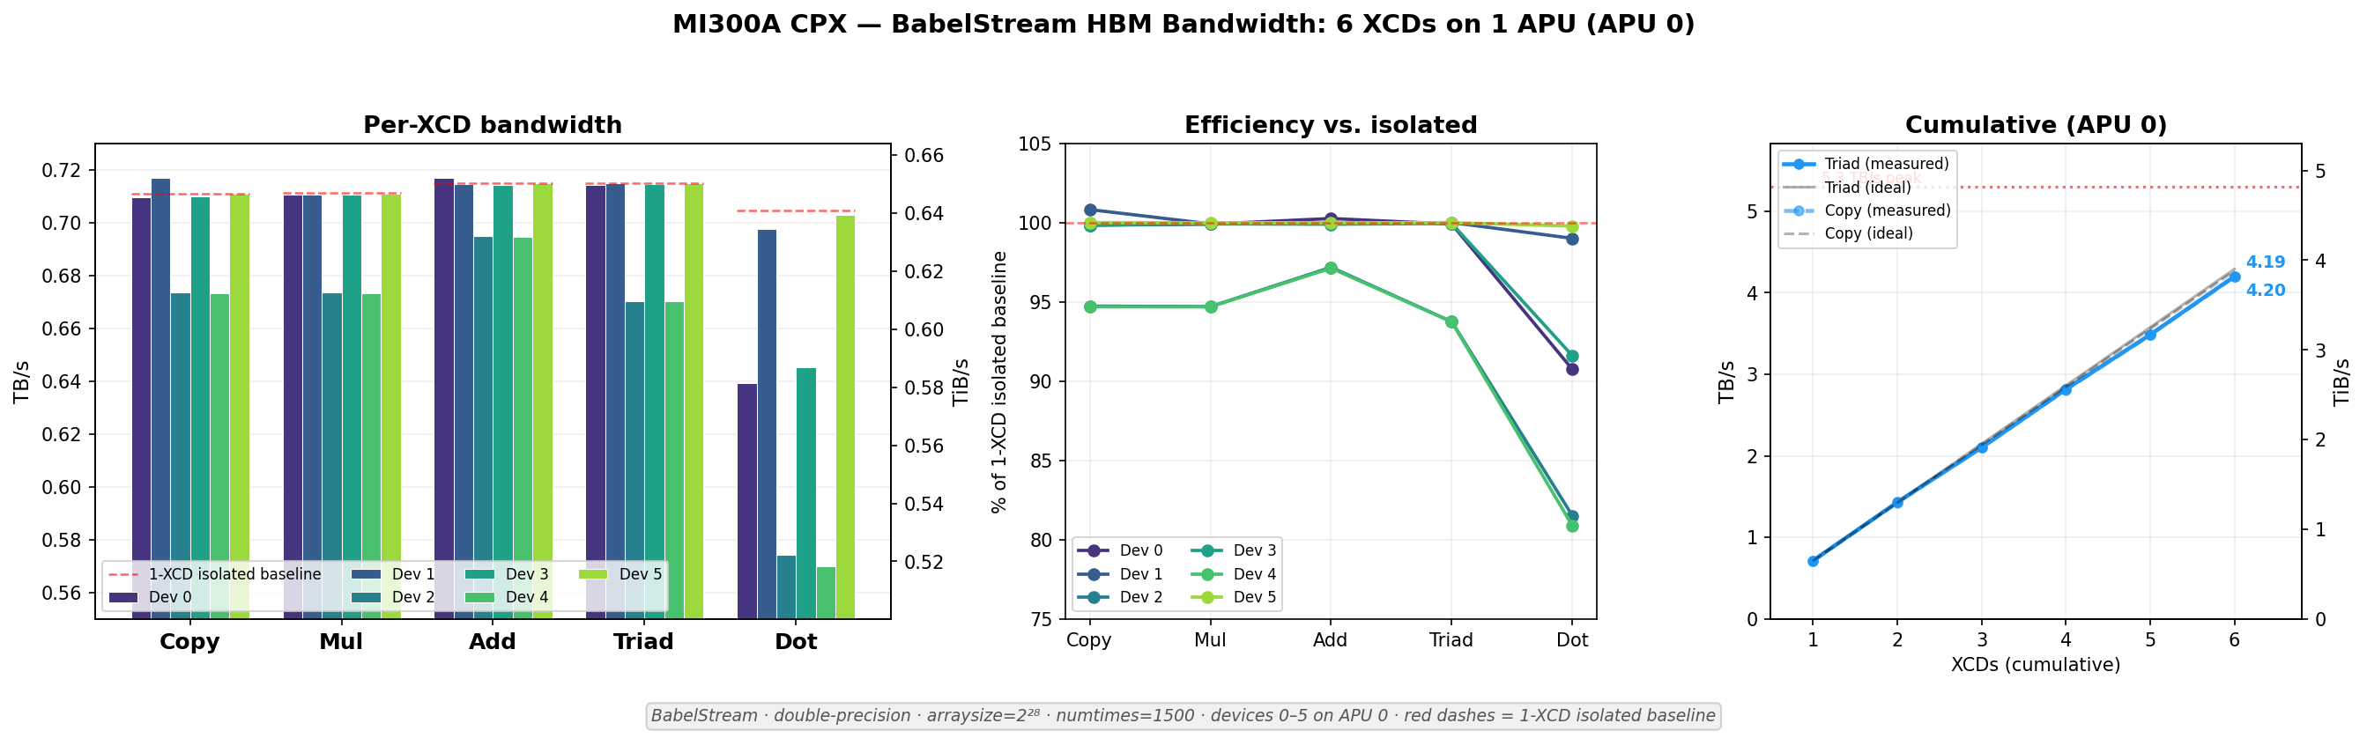
2. Intra-APU Contention: 6 XCDs on 1 APU
Devices 2 & 4 consistently drop to ~95% streaming, ~80% Dot
Hardware-intrinsic asymmetry — same devices underperform every run
Devices 0, 1, 3, 5 maintain near-baseline (~100% efficiency)
Cumulative APU 0 still reaches 4.19–4.20 TB/s Triad

Slide 5
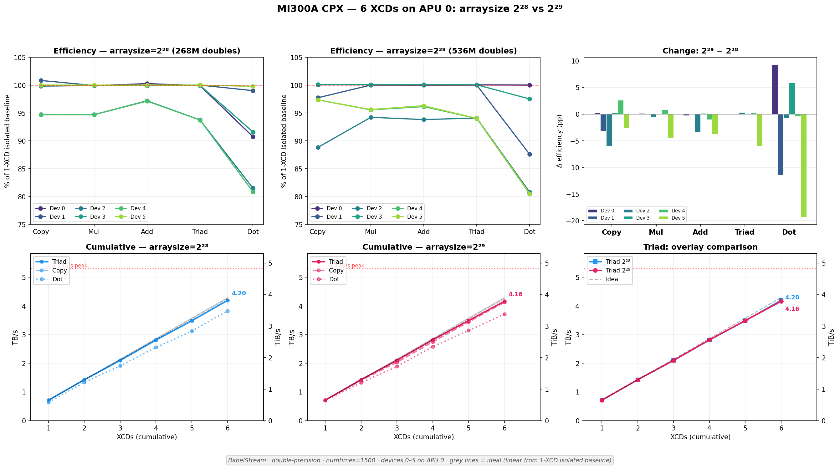
3. Larger Arrays Amplify Contention
2²⁸ → 2²⁹: weak devices degrade further (95% → 89%)
Previously strong devices (1, 5) also begin to suffer
Aggregate Triad drops only 1% — strong devices compensate
Larger memory footprints increase HBM controller contention

Slide 6
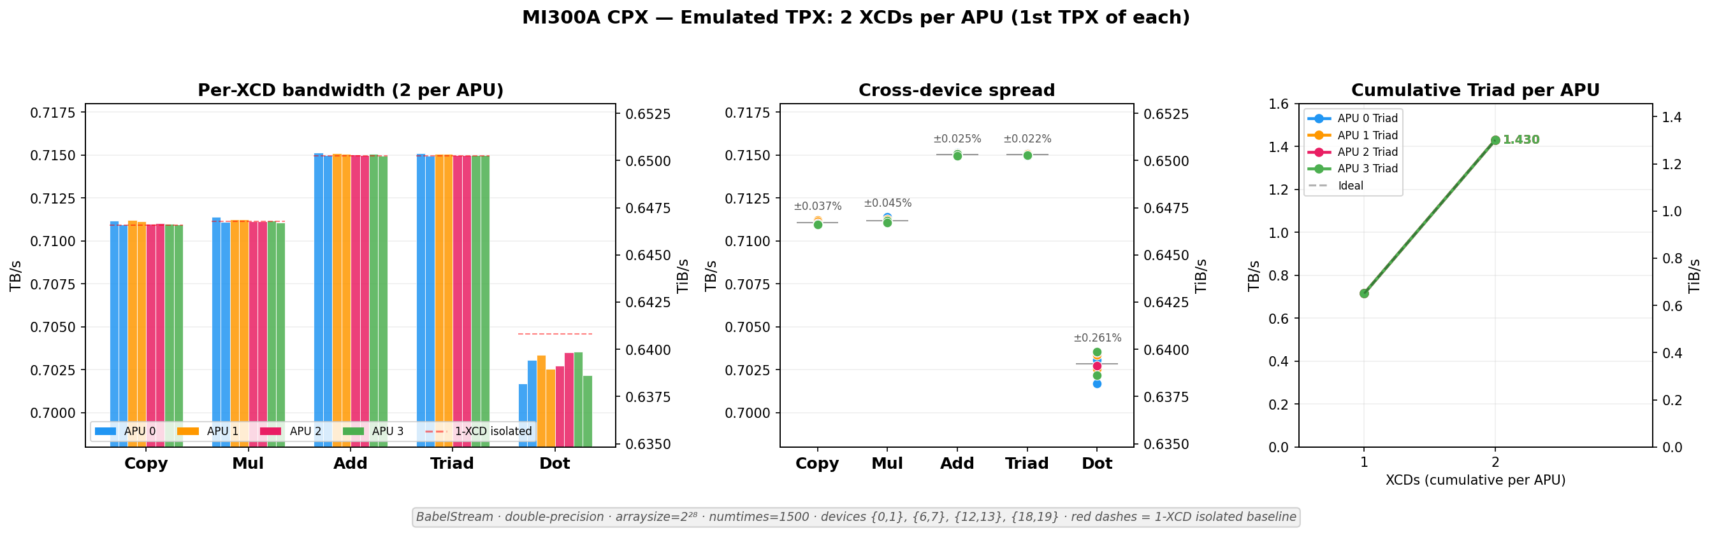
4. 2 XCDs per APU: Contention Onset Threshold
2 XCDs per APU = zero measurable contention
Cross-device spread < 0.05% — identical to isolated baseline
HBM controller handles 2 concurrent streams perfectly
Degradation starts at 3+ XCDs — explains why TPX mode performs well

Slide 7
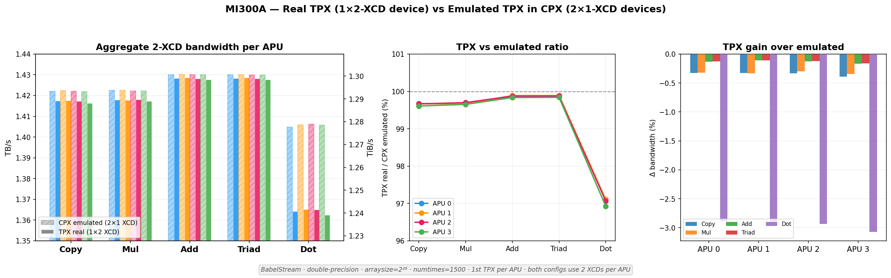
5. Real TPX vs Emulated: Fused Device Overhead
Real TPX ~0.3% slower on streaming vs CPX emulated
Dot gap widens to ~2.5–3% (cross-XCD reduction overhead)
Two independent 1-XCD processes slightly beat one fused 2-XCD device
Difference is negligible for most practical applications

Slide 8
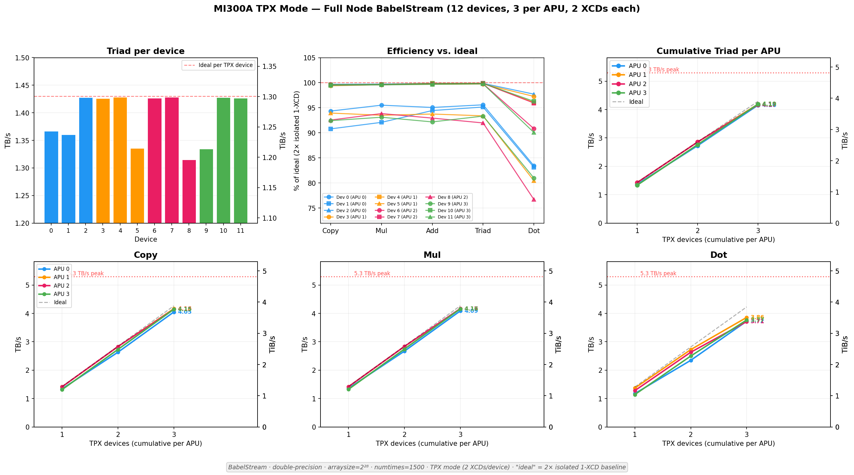
6. Full-Node TPX: 3rd Device is the Bottleneck
12 devices, 3 per APU — contention mirrors CPX pattern
3rd TPX device drops to 80–93%, especially on Dot
Per-APU Triad: 4.10–4.19 TB/s (77–79% of 5.3 TB/s peak)
Dot product shows the widest device-level spread

Slide 9
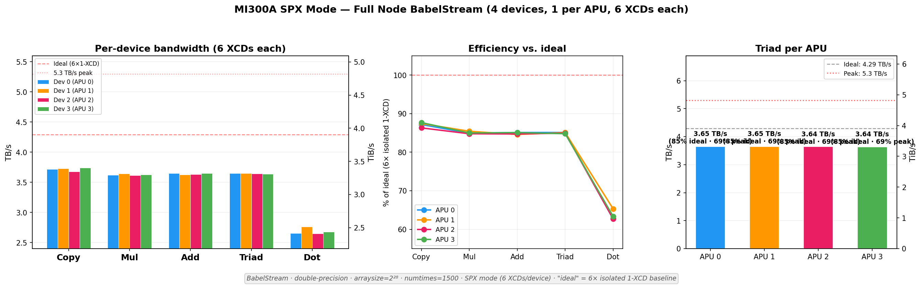
7. Full-Node SPX: Uniform but Inefficient
4 devices (6 XCDs each) — most uniform (<0.4% spread)
Only 69% peak on Triad, 51% on Dot
Single-process coordination overhead across 6 XCDs dominates
Best suited for workloads requiring unified address space

Slide 10
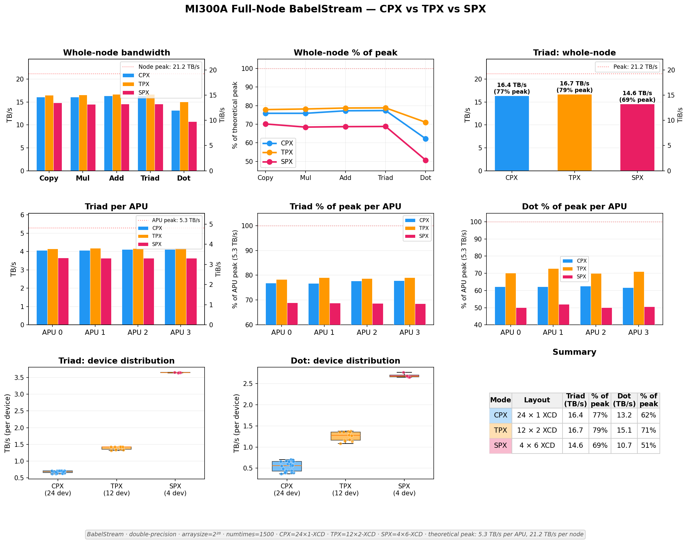
8. Closing the Loop: CPX vs TPX vs SPX
TPX: 16.7 TB/s (79%)
CPX: 16.4 TB/s (77%)
SPX: 14.6 TB/s (69%)
Triad whole-node
(% of 21.2 TB/s peak)

Slide 11
Key Takeaways
TPX wins on aggregate bandwidth
CPX is competitive but variable
79% peak Triad — best balance of parallelism and coordination
77% peak, but 15–20% device-to-device spread hurts predictability
SPX trades efficiency for uniformity
Contention onset at 2+ XCDs per APU
69% peak Triad, 51% Dot — intra-device overhead dominates
2 concurrent streams = zero degradation; 3+ causes measurable drops
Dot (reductions) most affected
Device asymmetry is hardware-intrinsic
Cross-XCD coordination makes Dot the most sensitive contention indicator
Same XCD positions underperform across runs — physical HBM topology effect

