Slide 1
Shortly: architecture and deployment
Shortly · FastAPI / Redis / Kubernetes / Prometheus / Grafana / Ansible
Shortly API pods
HPA 2–5 · PDB min 1
ServiceMonitor → Prometheus
Grafana dashboard · Alertmanager
User
nginx Ingress
short.local
ClusterIP
Service
Redis
shared state
1 Gi PVC
AOF
GitHub Actions
hosted checks → self-hosted deploy
Ansible
Debian / Ubuntu host configuration
Key choices: stateless API + Redis · readiness checks Redis; liveness does not
maxUnavailable: 0 · one Redis replica in this local demo
Metrics scrape the app Service; the local Alertmanager uses a null receiver.
Harsh Ledwani (23070122100) | Shivam Kapure (23070122113) | Kashyup Gaud (23070122114) | Kisna Kanti (23070122116)
1
Notes:
Shortly is a small FastAPI URL shortener. A request enters through the local nginx Ingress, passes through a Kubernetes Service, and can reach either API pod. The API pods keep no link state locally; Redis stores links, click counts, rate limits, recent links, and shared demo controls. Redis writes use an append-only file on a persistent volume, although this project runs only one Redis replica. The HPA keeps at least two and can scale to five pods, while the PDB asks Kubernetes to keep one available during disruptions. Liveness checks whether the process is alive; readiness also checks Redis. Prometheus scrapes the service through a ServiceMonitor, Grafana displays the metrics, and Alertmanager evaluates the rules. GitHub Actions builds and scans releases, while Ansible configures the supported runner host. Point at the path from User through Ingress to Redis, then at the monitoring band and the two automation boxes.
Group: Harsh Ledwani (23070122100) | Shivam Kapure (23070122113) | Kashyup Gaud (23070122114) | Kisna Kanti (23070122116)
Current verification: docs/evidence/CURRENT-STATUS.md. Windows source-demo rollouts change the pod-template configuration; the regular deployment uses Dockerfile-built images. Historical scenario results are explicitly identified.

Slide 2
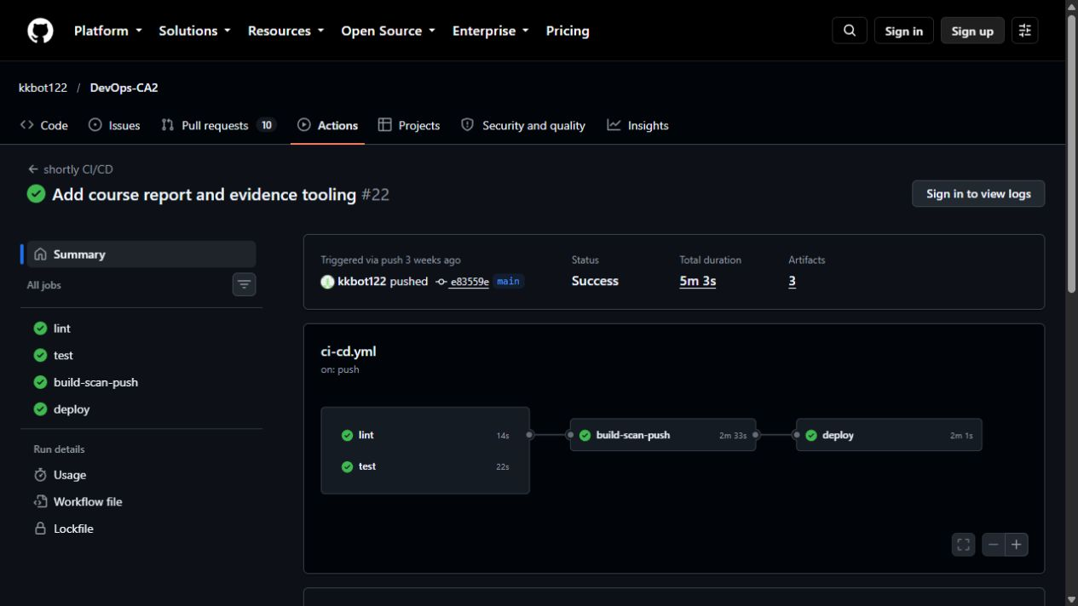
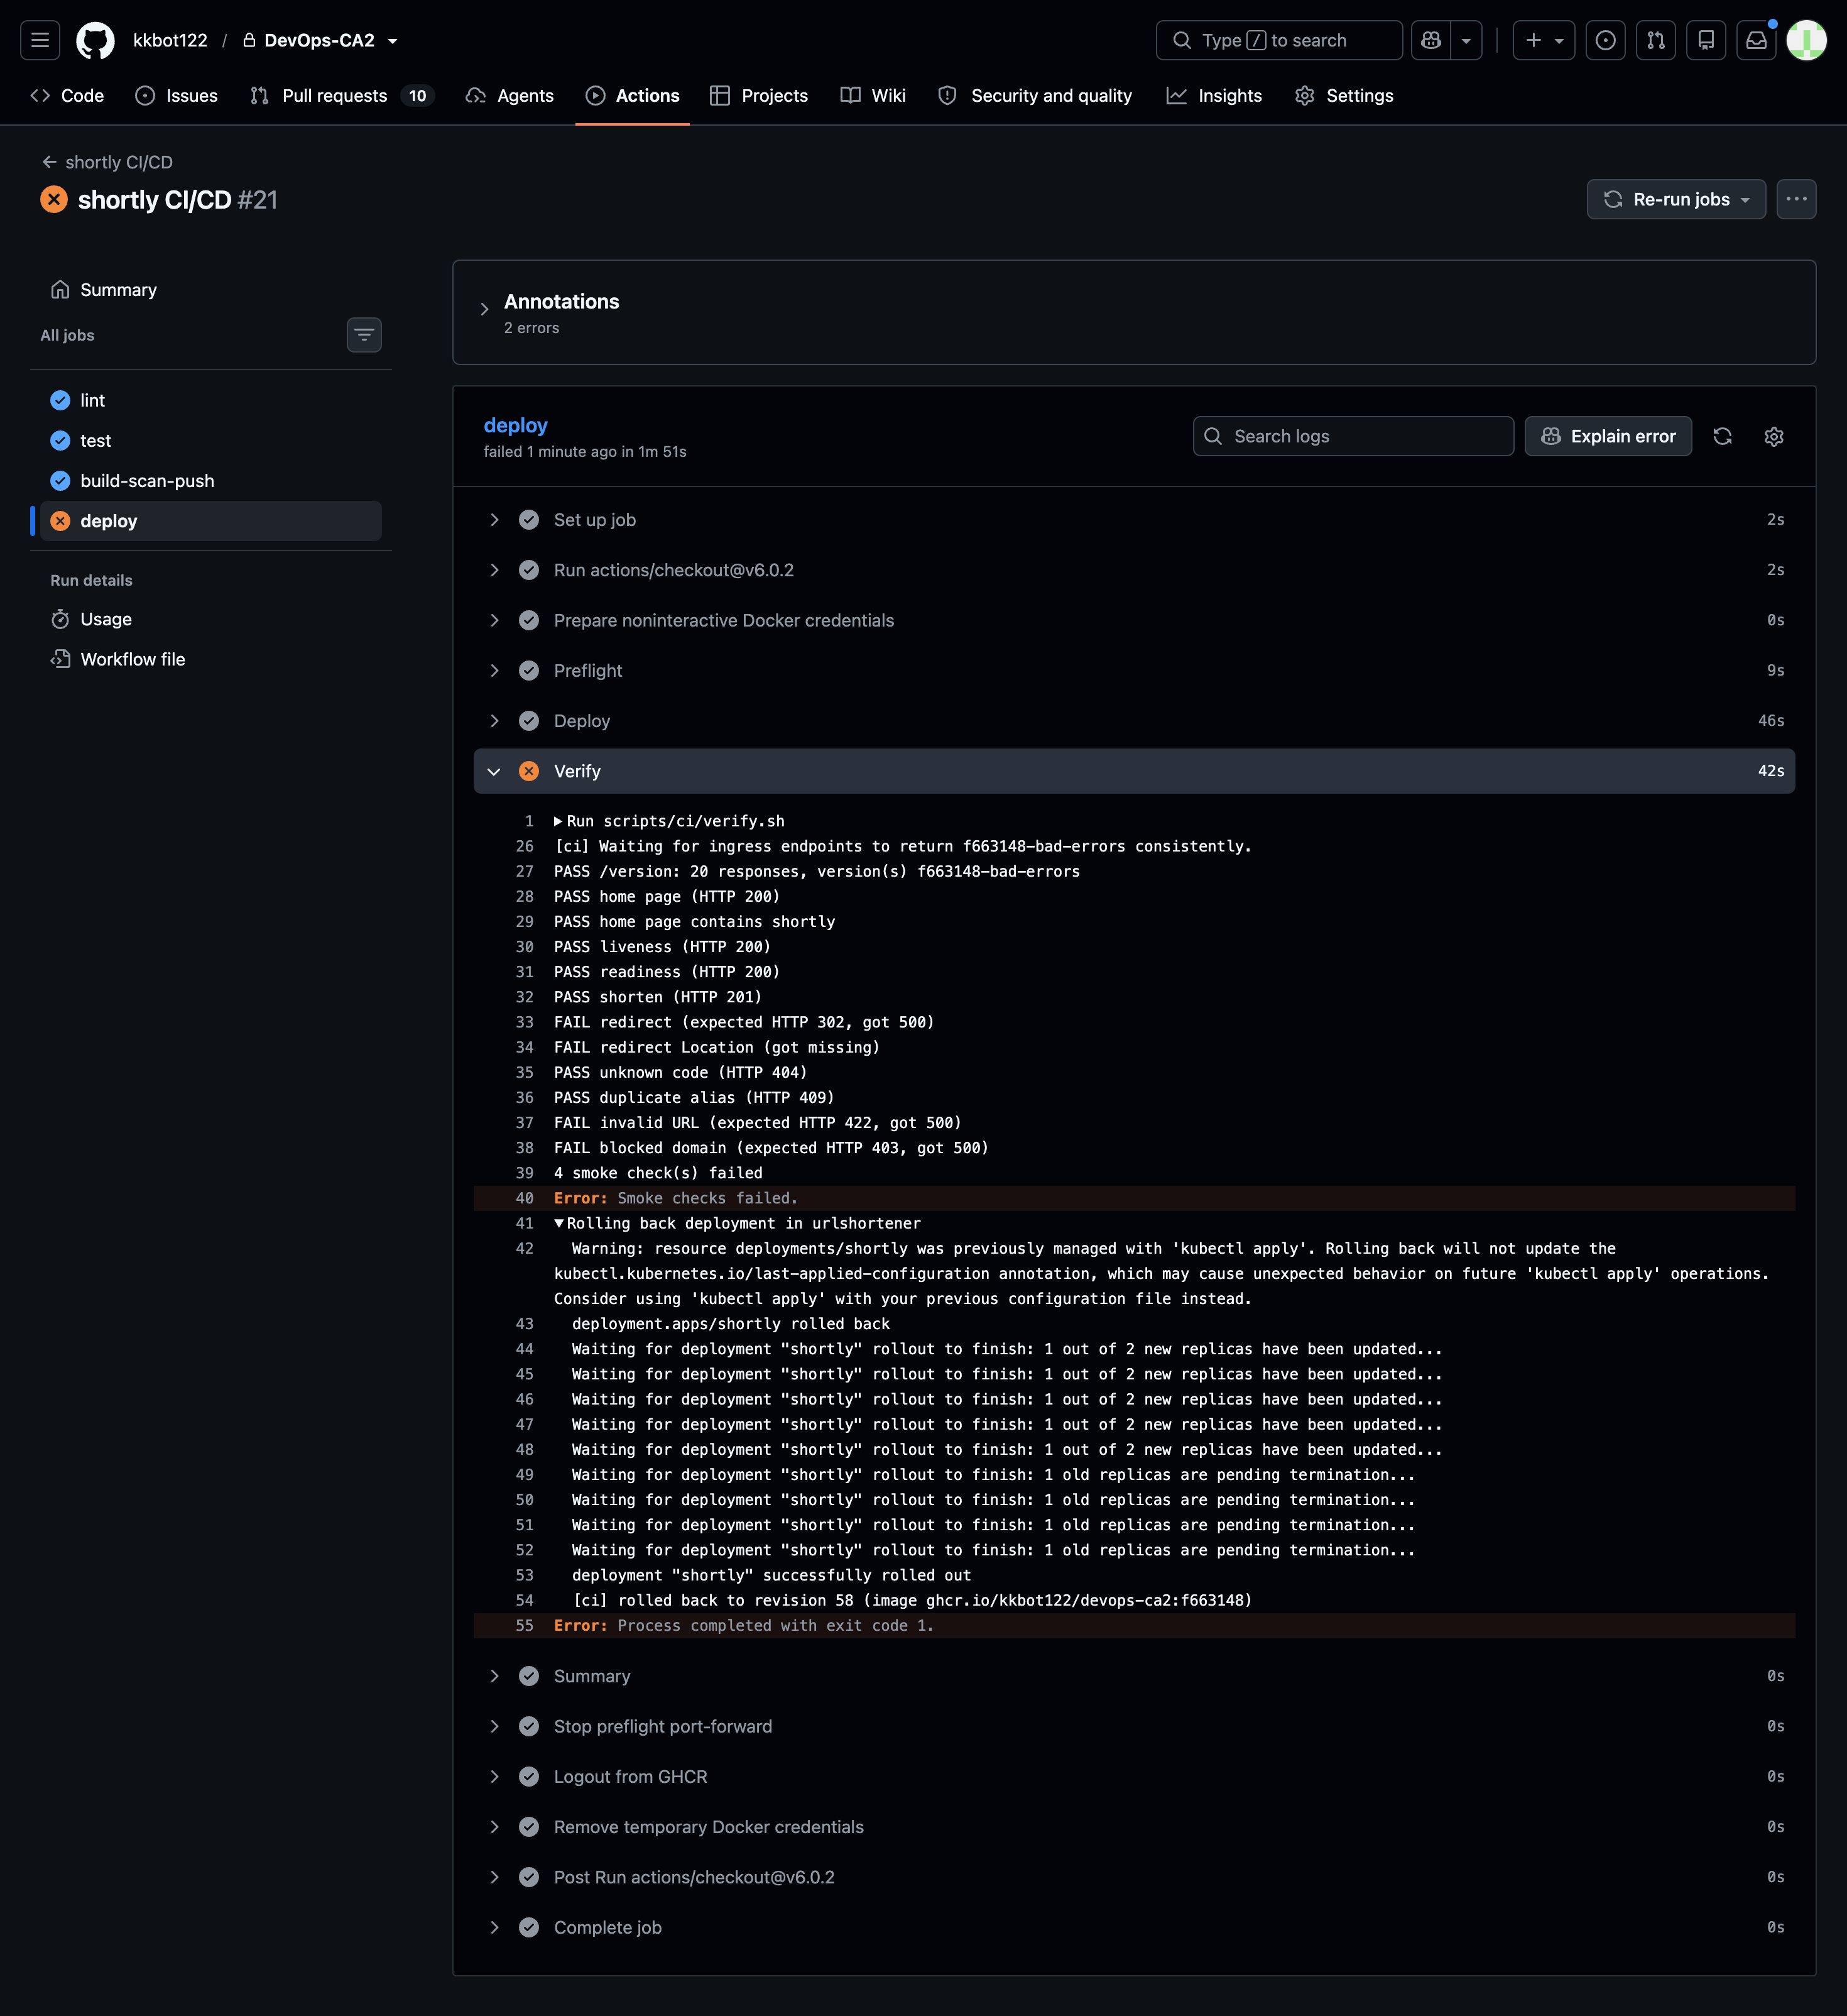
GitHub Actions: build, scan, deploy and verify
Hosted checks protect builds; a guarded self-hosted runner updates Minikube.
GITHUB-HOSTED RUNNERS
Push
Lint ∥ test
Build image
Trivy + SBOM
Push to GHCR
Preflight +
context guard
Verify image
digest
Load + deploy
overlay
Rollout probes
smoke + version
PASS → deployed
FAIL → automatic undo
release job remains red
Verified workflow run: 5 min 3 s (run 37209744711)
Green workflow run
Failed release with automatic rollback
Harsh Ledwani (23070122100) | Shivam Kapure (23070122113) | Kashyup Gaud (23070122114) | Kisna Kanti (23070122116)
2
Notes:
This workflow separates hosted checks from deployment to the local cluster. Lint and tests run in parallel. A successful build is scanned by Trivy and produces a CycloneDX software bill of materials; only then is the image pushed to GHCR. The self-hosted runner runs only on trusted main-branch release events, not pull requests. Before changing the cluster it checks the context and prerequisites, then pulls the image and verifies that its digest matches the hosted build. It loads that exact image, applies the CI overlay, waits for rollout probes, and verifies smoke requests and release version. A failure triggers automatic rollback, but the workflow remains red so the bad release is visible. The runbook estimates a typical pipeline takes seven to fifteen minutes; that is a documented estimate, not a measurement from GitHub history. Point from lint and tests through GHCR to preflight and digest verification, then show the success and rollback branches.
Group: Harsh Ledwani (23070122100) | Shivam Kapure (23070122113) | Kashyup Gaud (23070122114) | Kisna Kanti (23070122116)
Current verification: docs/evidence/CURRENT-STATUS.md. Windows source-demo rollouts change the pod-template configuration; the regular deployment uses Dockerfile-built images. Historical scenario results are explicitly identified.

Slide 3
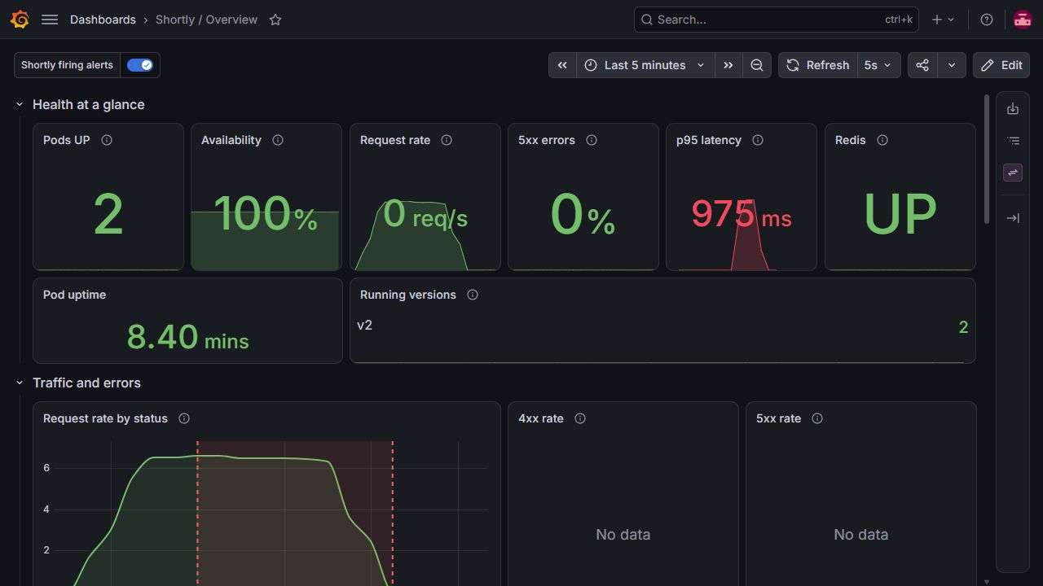
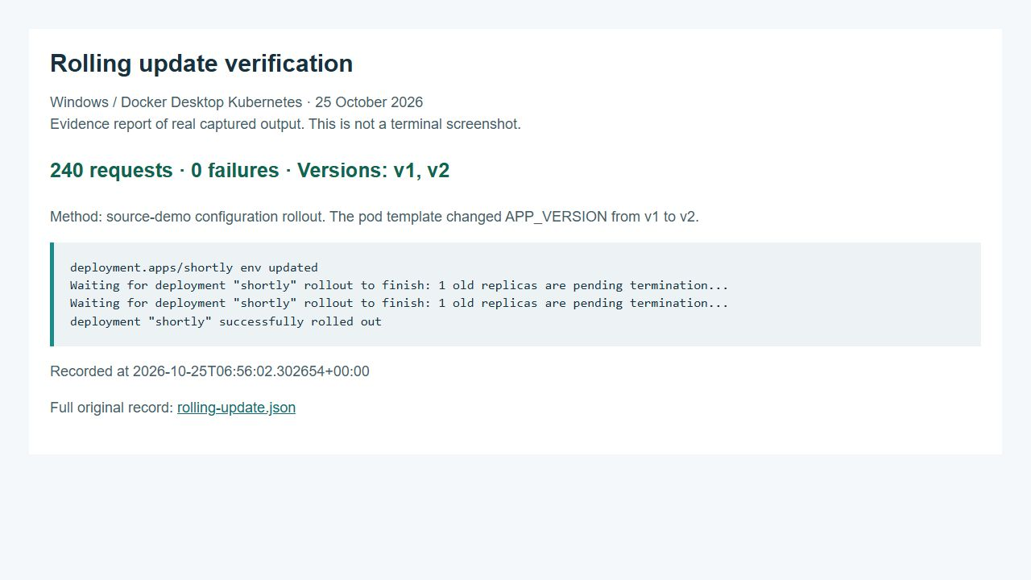
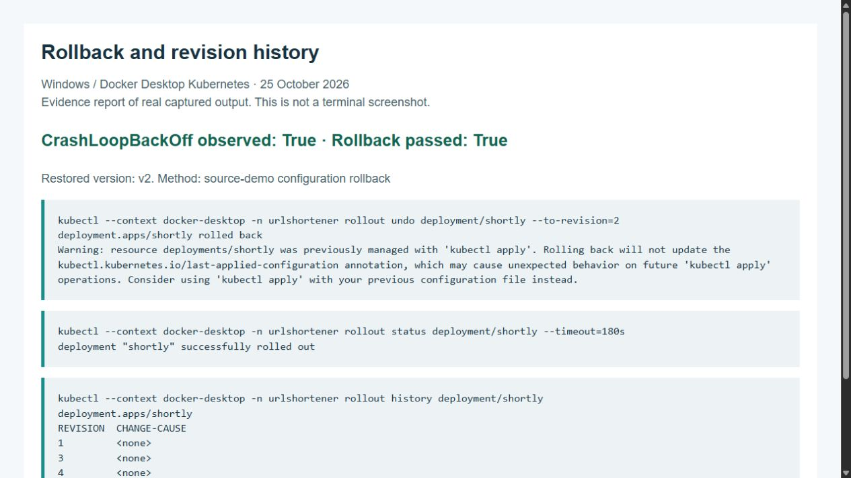
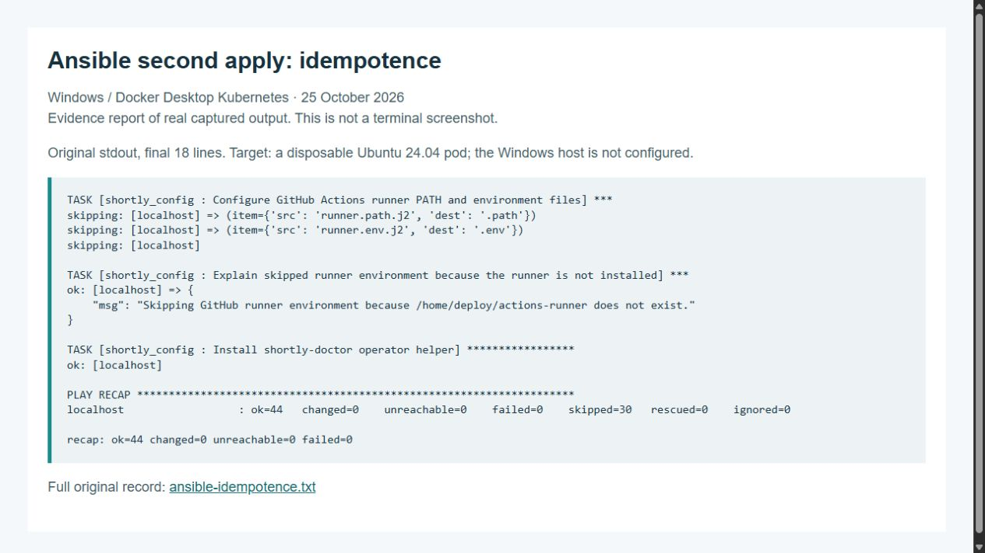
Evidence from deployments and failure scenarios
Fresh Windows checks; original records and full-size captures accompany this deck.
Grafana: uptime, latency and error rate
Rolling update: v1 and v2 seen; 0 failures
CrashLoopBackOff observed, then rollback
Ansible second apply: changed=0
Fresh checks: 31 tests / 96.97% app coverage
240 rollout requests / 0 failures · Ansible changes: 31 then 0
Full-size evidence: docs/screenshots/ · Original records: docs/evidence/windows/
Harsh Ledwani (23070122100) | Shivam Kapure (23070122113) | Kashyup Gaud (23070122114) | Kisna Kanti (23070122116)
3
Notes:
These are evidence slots, not simulated screenshots. The repository had no actual UI images when this deck was built, so the frames are pending and should be replaced only with real captures. The numbers come from saved results. The original full scenario run lasted 55.7 minutes and recorded eight passes and one failure: abuse. A later focused abuse rerun passed with 6,309 requests and no unexpected failures, but the complete suite was not rerun, so we should not claim nine out of nine for the full run. Baseline recorded 3,753 requests and zero unexpected failures. The surge test reached three replicas from a baseline of two and returned to two. The Ansible second application in the Ubuntu container changed zero items. Point at the four evidence types, then at the result line and explain the full-suite caveat.
Group: Harsh Ledwani (23070122100) | Shivam Kapure (23070122113) | Kashyup Gaud (23070122114) | Kisna Kanti (23070122116)
Current verification: docs/evidence/CURRENT-STATUS.md. Windows source-demo rollouts change the pod-template configuration; the regular deployment uses Dockerfile-built images. Historical scenario results are explicitly identified.

Slide 4
Challenges and fixes
Top evidence-backed challenges · details and sources: docs/CHALLENGES.md
1 Ready probes missed release errors → health checks were too narrow → alert on 5xx and roll back
2 Nested Kustomize base was blocked → path restriction → render a temporary sibling overlay
3 Grafana OOM at 256/384 MiB → limits were too low → use the evidenced 768 MiB setting
4 Redis outage broke readiness → API depends on Redis → separate liveness and verify recovery
5 Ansible changed on its second run → installed systemd binaries misled facts → check running systemd
Harsh Ledwani (23070122100) | Shivam Kapure (23070122113) | Kashyup Gaud (23070122114) | Kisna Kanti (23070122116)
4
Notes:
The first challenge is that Kubernetes readiness can stay green while an application returns errors on ordinary requests. The bad-release scenario showed this: the pods were Ready, the error alert fired, and rollback restored version one. The second challenge was packaging the Kubernetes deployment. The nested Kustomize overlay could not safely refer to its parent directory, so the deploy script generates a temporary sibling overlay, renders it, and applies the full result together. Third, Grafana was OOM-killed at two lower memory limits, so chart values were raised to 512 MiB. Fourth, Redis outage handling needed readiness to fall without restarting the API; the scenario confirmed zero app restarts and link recovery. Finally, the macOS machine was deliberately rejected by the Ubuntu/Debian-only Ansible playbook; positive proof came from Ubuntu 24.04. Point at each problem-to-cause-to-fix line and tie it to its result or commit.
Group: Harsh Ledwani (23070122100) | Shivam Kapure (23070122113) | Kashyup Gaud (23070122114) | Kisna Kanti (23070122116)
Current verification: docs/evidence/CURRENT-STATUS.md. Windows source-demo rollouts change the pod-template configuration; the regular deployment uses Dockerfile-built images. Historical scenario results are explicitly identified.

Slide 5
Lessons learned and next steps
Each lesson links to the challenge log; production work is future work.
#1 Readiness and user success are different signals; alert on real request outcomes.
#2 Render the exact manifest set before applying; layout affects deploy tooling.
#3 Resource limits need observed headroom; lower Grafana limits restarted the pod.
#4 Dependency-aware readiness protects traffic without restarting the API process.
#5 Check whether services are running; verify a second apply on a clean target.
Next: use a multi-node cloud cluster; add SLO alerts, real alert routing and GitOps; isolate the self-hosted runner.
Harsh Ledwani (23070122100) | Shivam Kapure (23070122113) | Kashyup Gaud (23070122114) | Kisna Kanti (23070122116)
5
Notes:
The project taught us to verify what users experience, not only whether containers are running. In the silent error release, probes passed but a request-error alert caught the fault. For Kubernetes packaging, deployment tooling should render exactly the set it will apply. Resource limits need evidence because Grafana restarted under two lower limits. Readiness should reflect dependency availability, while liveness should avoid restarting an API process that can recover when Redis returns. Ansible results belong to the supported OS: the Mac was refused safely, and the positive run used Ubuntu 24.04. Next I would use a multi-node cloud cluster, base alerts on service objectives, route alerts to a real receiver, and isolate the self-hosted runner. Point at the challenge numbers beside each lesson, then the future-work box.
Group: Harsh Ledwani (23070122100) | Shivam Kapure (23070122113) | Kashyup Gaud (23070122114) | Kisna Kanti (23070122116)
Current verification: docs/evidence/CURRENT-STATUS.md. Windows source-demo rollouts change the pod-template configuration; the regular deployment uses Dockerfile-built images. Historical scenario results are explicitly identified.

