Slide 1
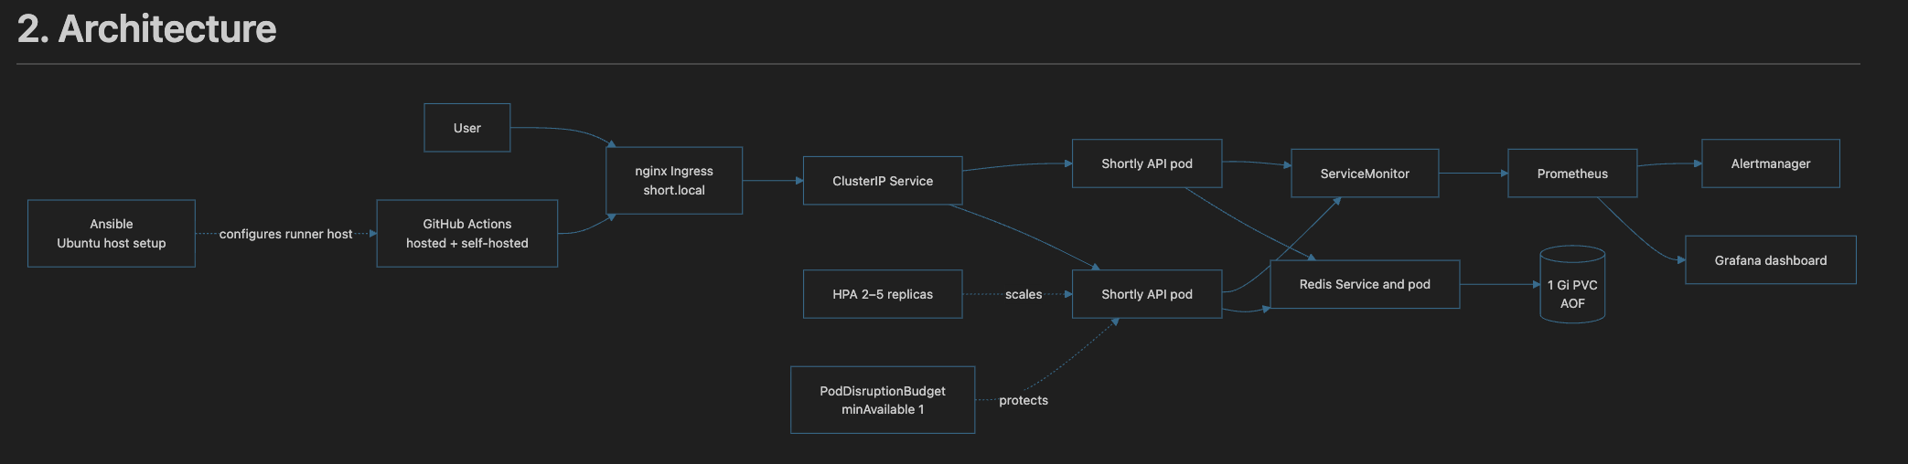
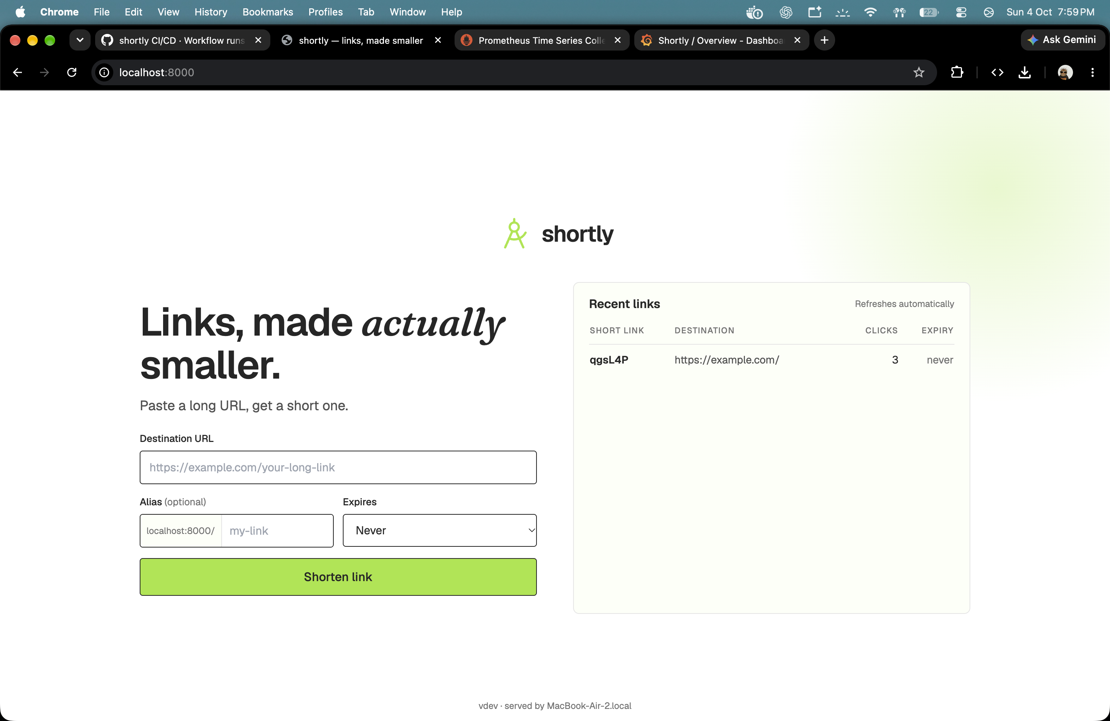
Shortly turns long URLs into shared, trackable links
Architecture and project team
Captured project architecture diagram
PROJECT GROUP
Harsh Ledwani
Roll no. 23070122100
Shivam Kapure
Roll no. 23070122113
Kashyup Gaud
Roll no. 23070122114
Kisna Kanti
Roll no. 23070122116
The app creates and lists short links
SHORTLY / DEVOPS CA-2 01
Notes:
Shortly is a FastAPI URL shortener. The browser reaches the API through nginx Ingress and a Kubernetes Service. Two or more stateless API pods share link state through Redis. Redis writes to a persistent volume. Prometheus scrapes application metrics, while Grafana and Alertmanager show and evaluate them. GitHub Actions builds and checks each release, and a self-hosted runner deploys to the local Minikube cluster. The team members and roll numbers come from the project report notes.

Slide 2
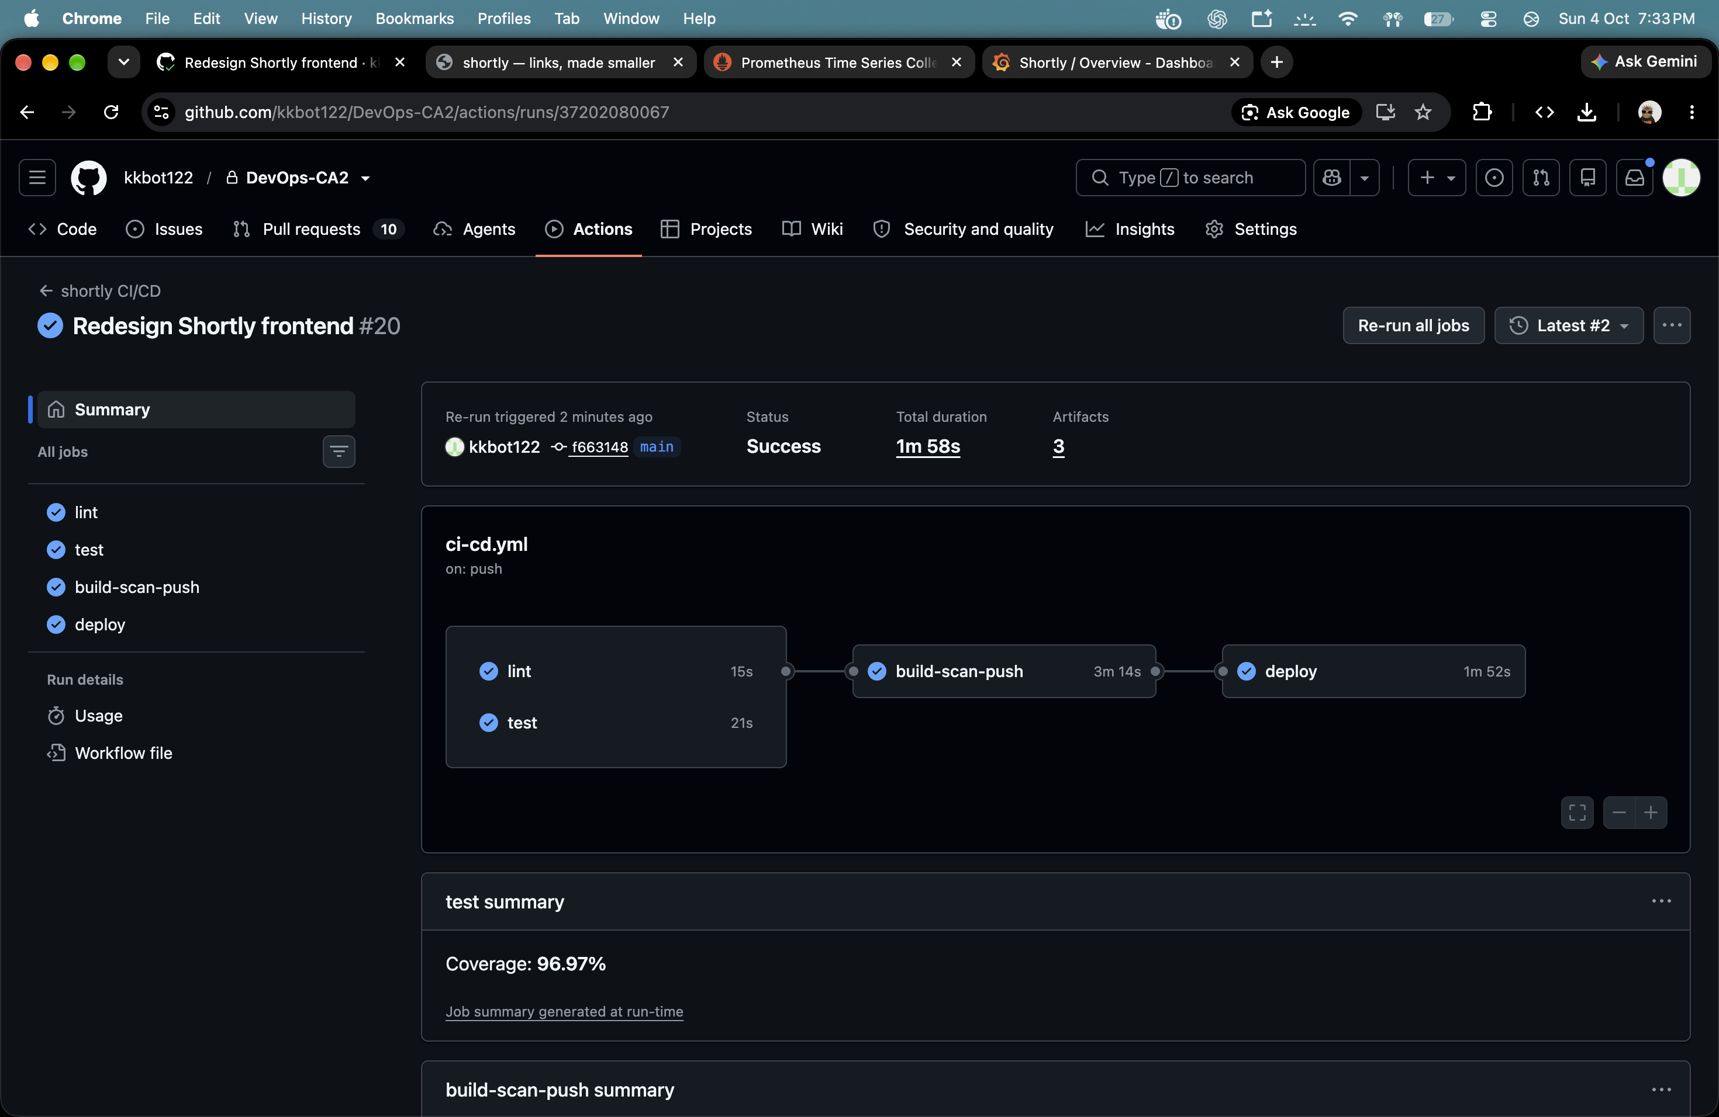
GitHub Actions checks the image before Minikube deploys it
Hosted build and scan jobs hand the verified image to a guarded local runner
GITHUB-HOSTED
SELF-HOSTED
Push to main
Lint and tests
Build, scan
and SBOM
Publish image
to GHCR
Verify digest
and deploy
Verify rollout, smoke
and version
Failure: undo rollout; job stays red
Pass: release succeeds
The deploy job verifies the same image digest that passed the hosted scan.
A verification failure triggers rollback and leaves the workflow visibly failed.
Captured successful workflow run: all jobs passed in 1m 58s
SHORTLY / DEVOPS CA-2 02
Notes:
The workflow runs lint and tests on GitHub hosted runners, builds a container, scans it with Trivy and creates an SBOM, then publishes it to GHCR. The self-hosted job checks its cluster context and verifies the published image digest before deploying. It then waits for rollout probes and checks smoke requests and the version. The screenshot shows a successful workflow run lasting 1 minute 58 seconds. The failure branch automatically rolls back, while the workflow remains red so the release failure is visible.

Slide 3
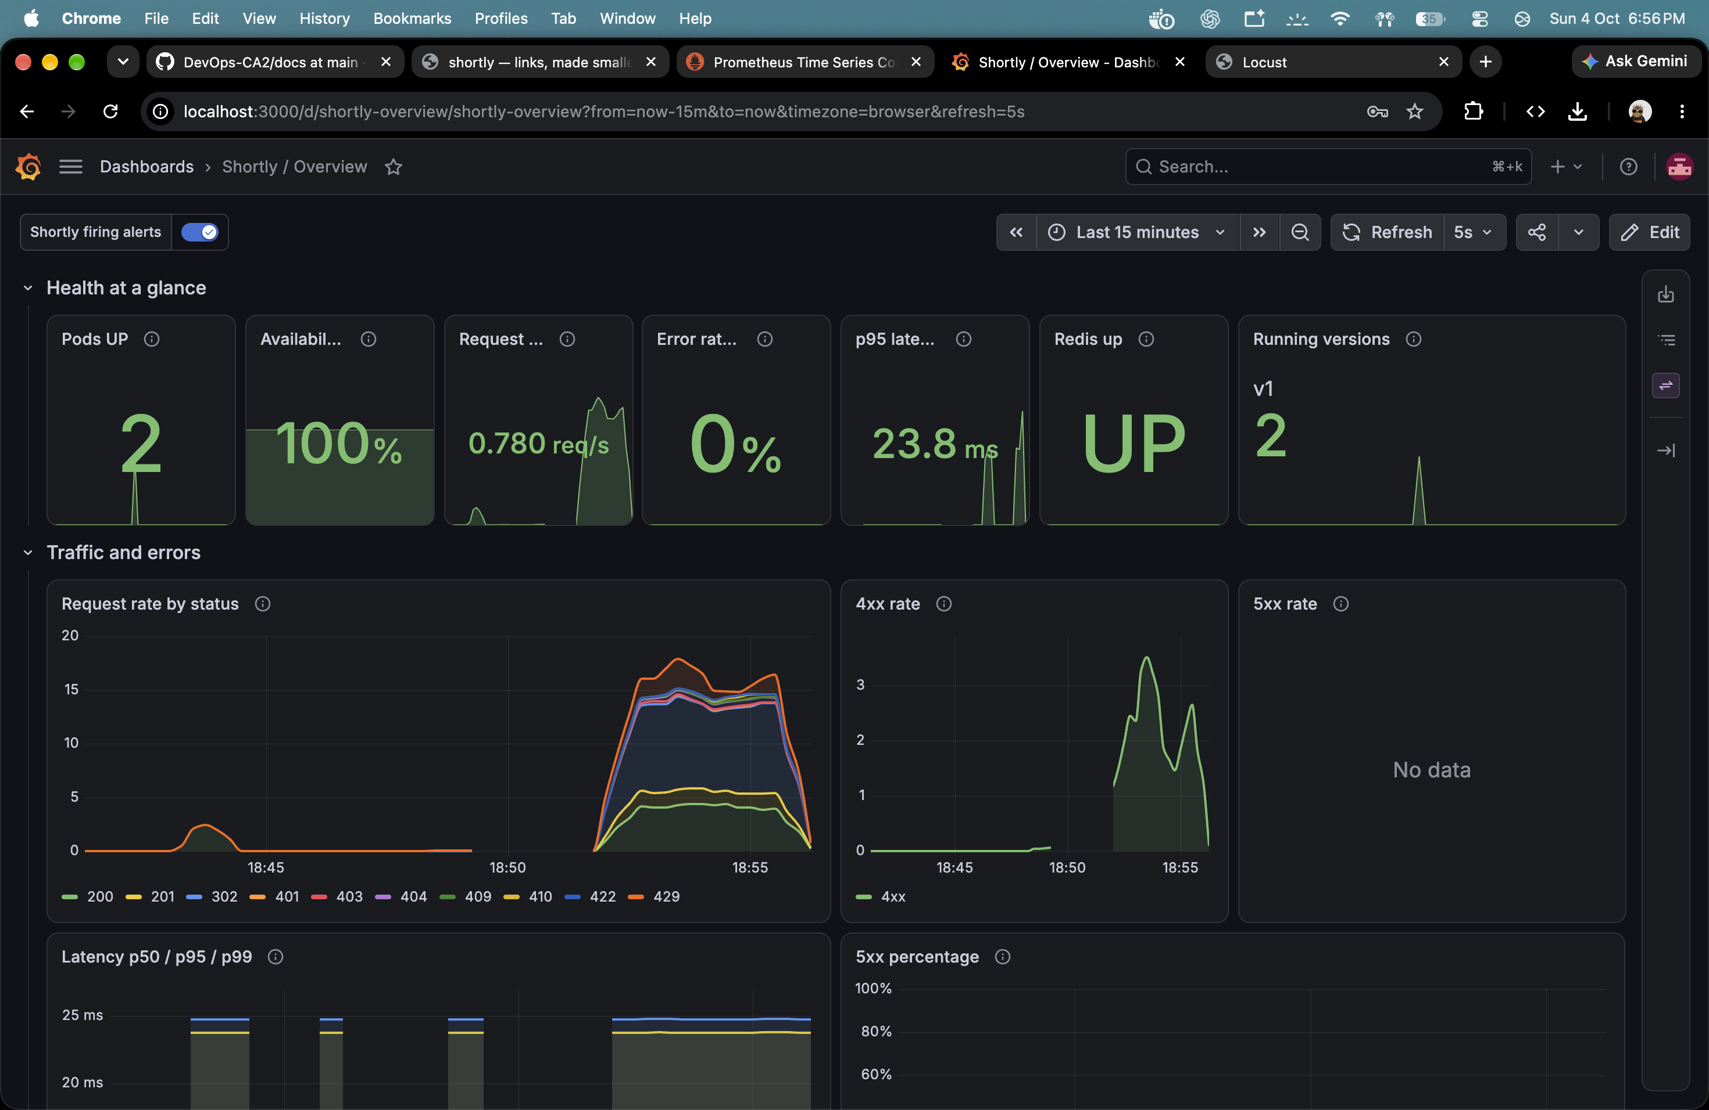
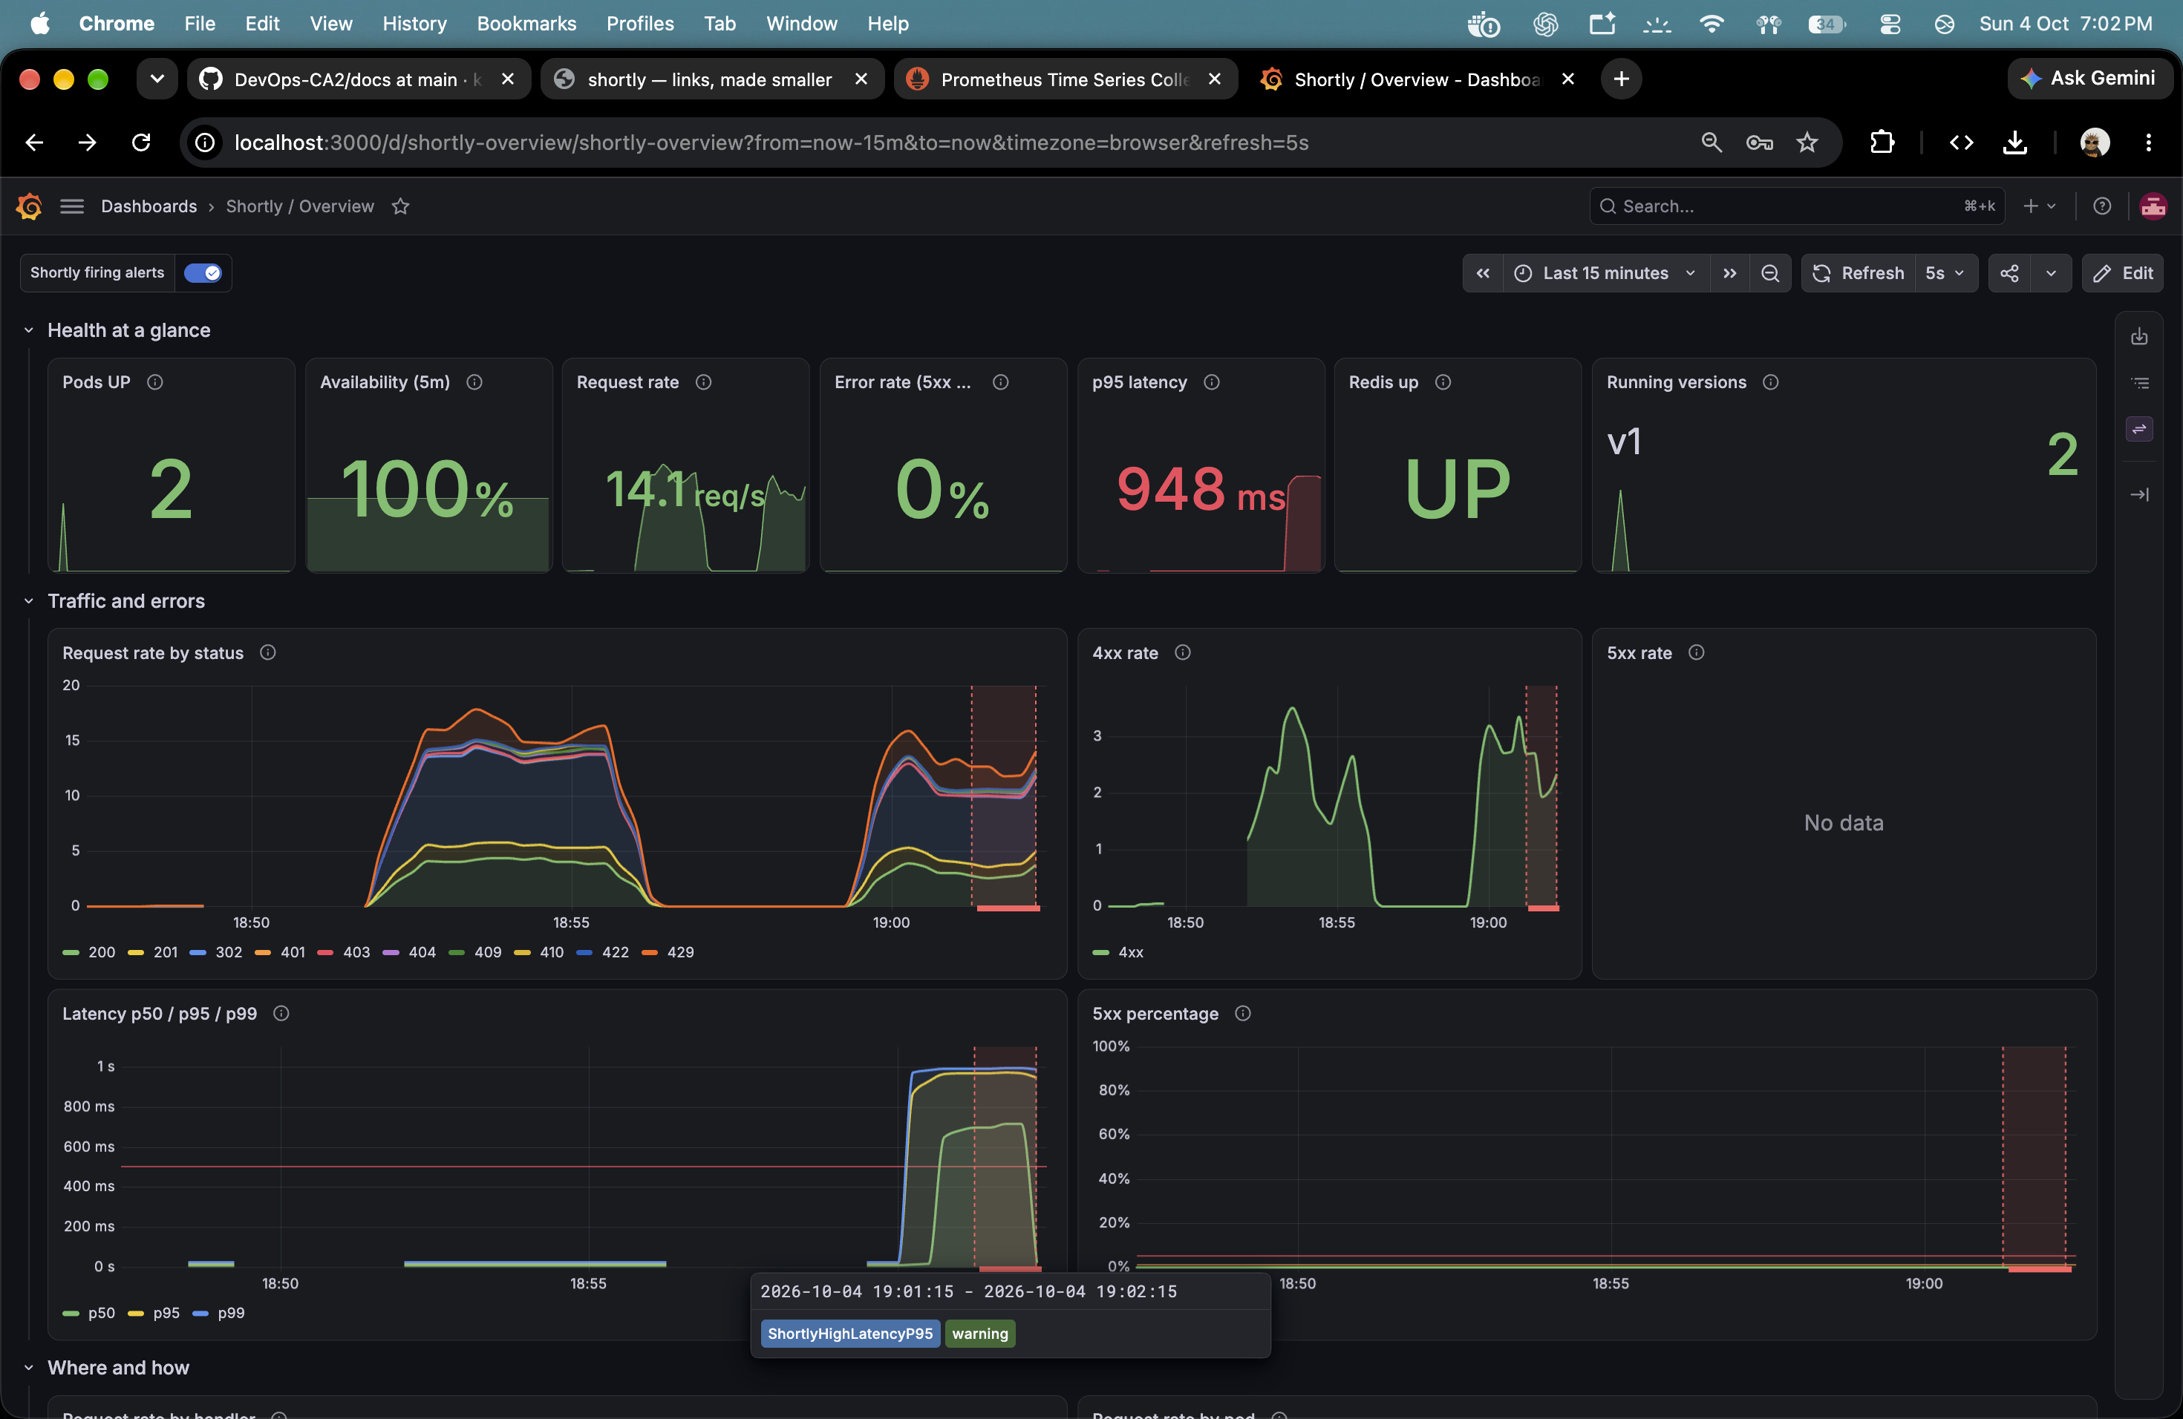
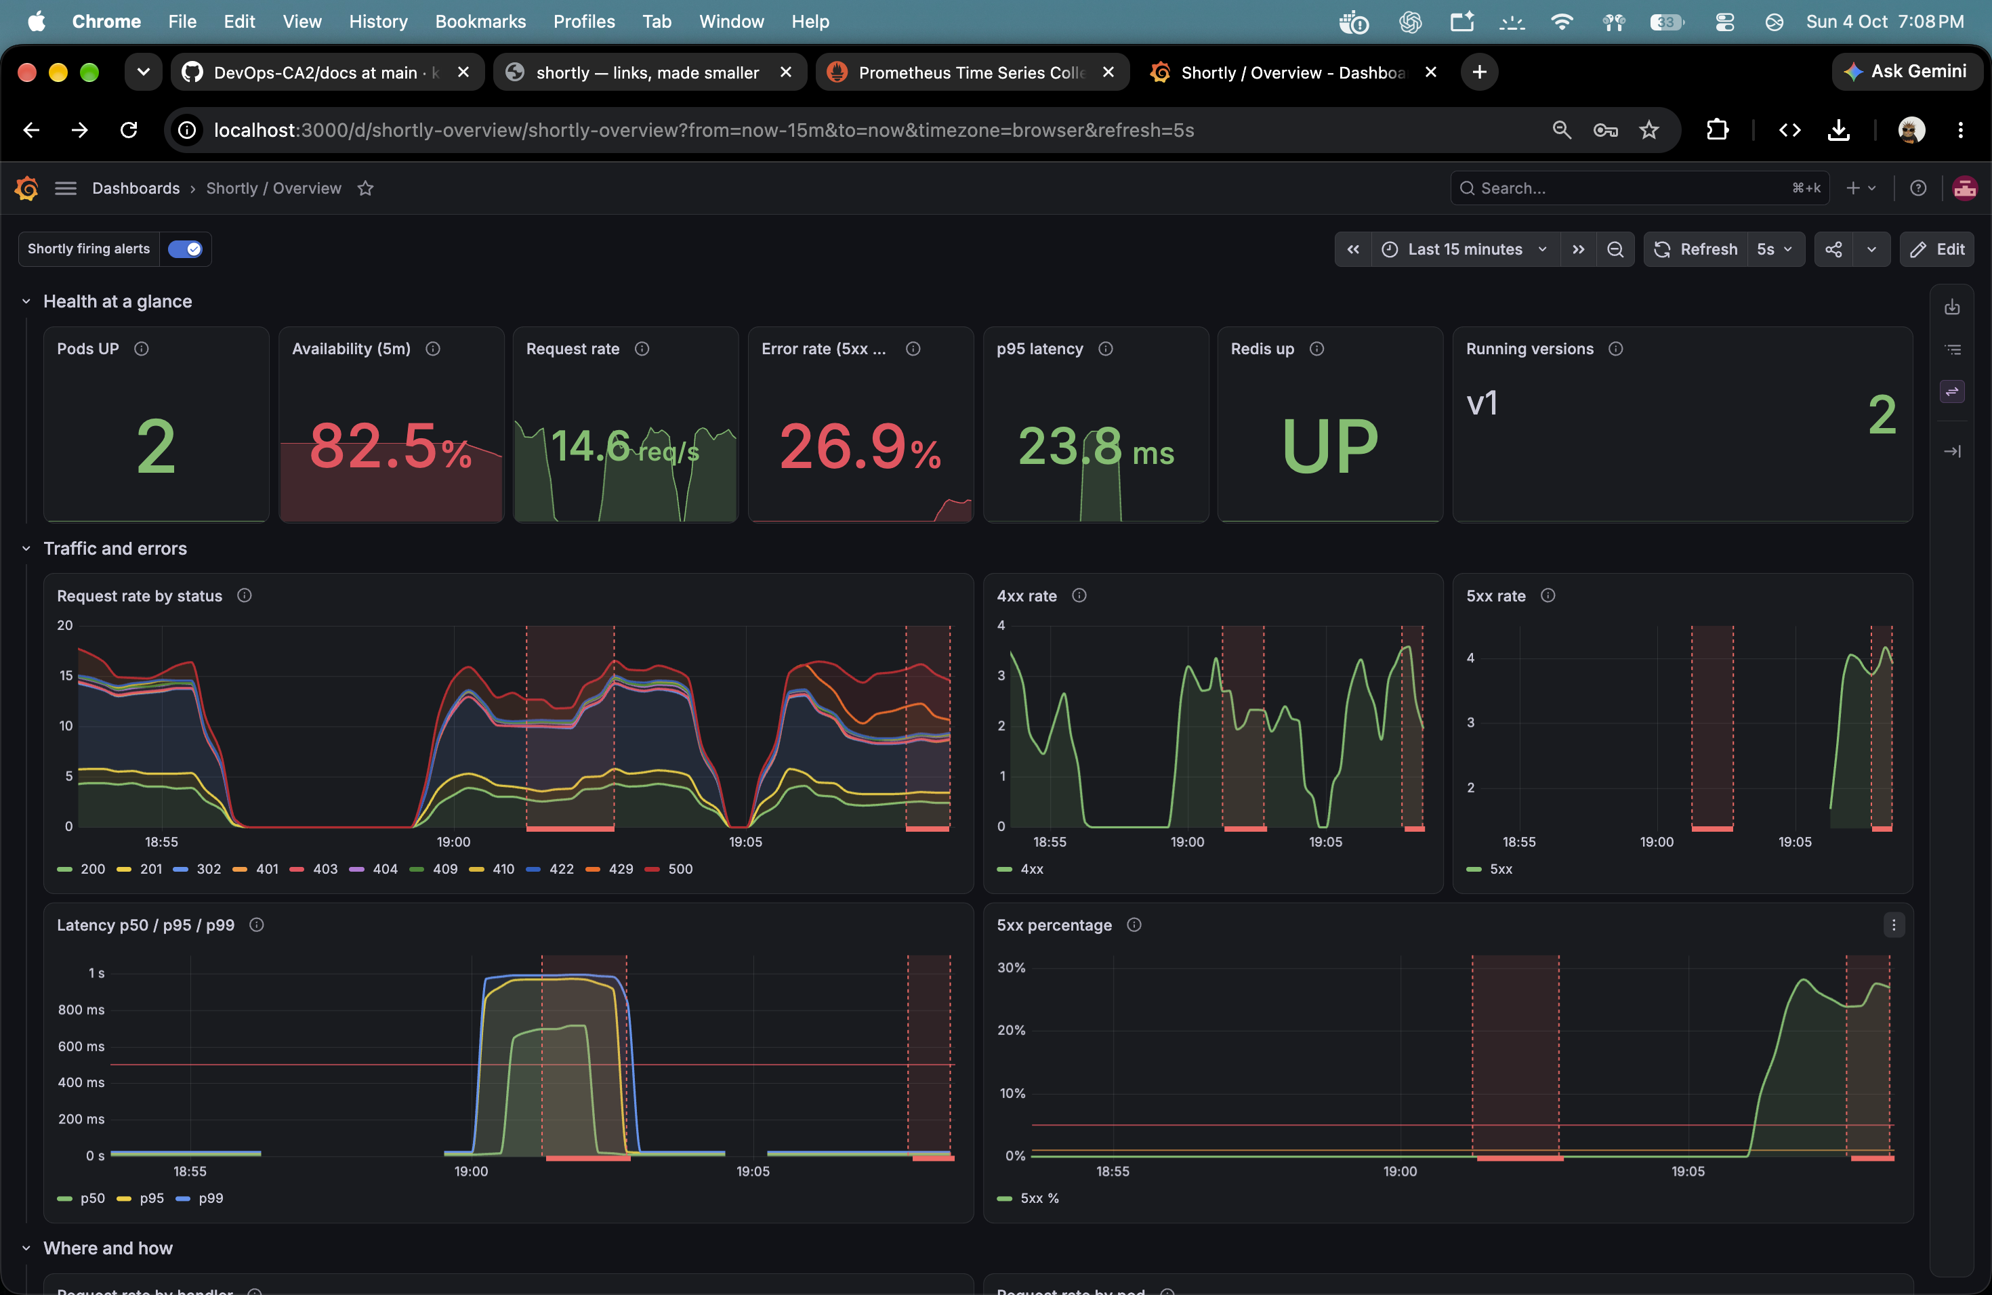
Grafana makes traffic, errors, and latency visible
Prometheus scrapes the app; the dashboard turns those metrics into signals
Latency scenario: p95 rises above the 500 ms threshold
Error scenario: 5xx rate rises during injected failures
Captured baseline dashboard: 100% availability and 0% 5xx
Saved baseline: 3,753 requests · 0 unexpected failures · client p95 8 ms
SHORTLY / DEVOPS CA-2 03
Notes:
The dashboard presents pod count, availability, request rate, 5xx rate, p95 latency and Redis health. The baseline run recorded 3,753 requests, zero unexpected failures and an 8 ms client p95. Separate captured Grafana views show the latency fault rising above the configured threshold and the 5xx rate increasing during the error scenario. The scenario summary records that both alerts fired and later recovered. These are saved screenshots and report values, not a live rerun during deck preparation.

Slide 4
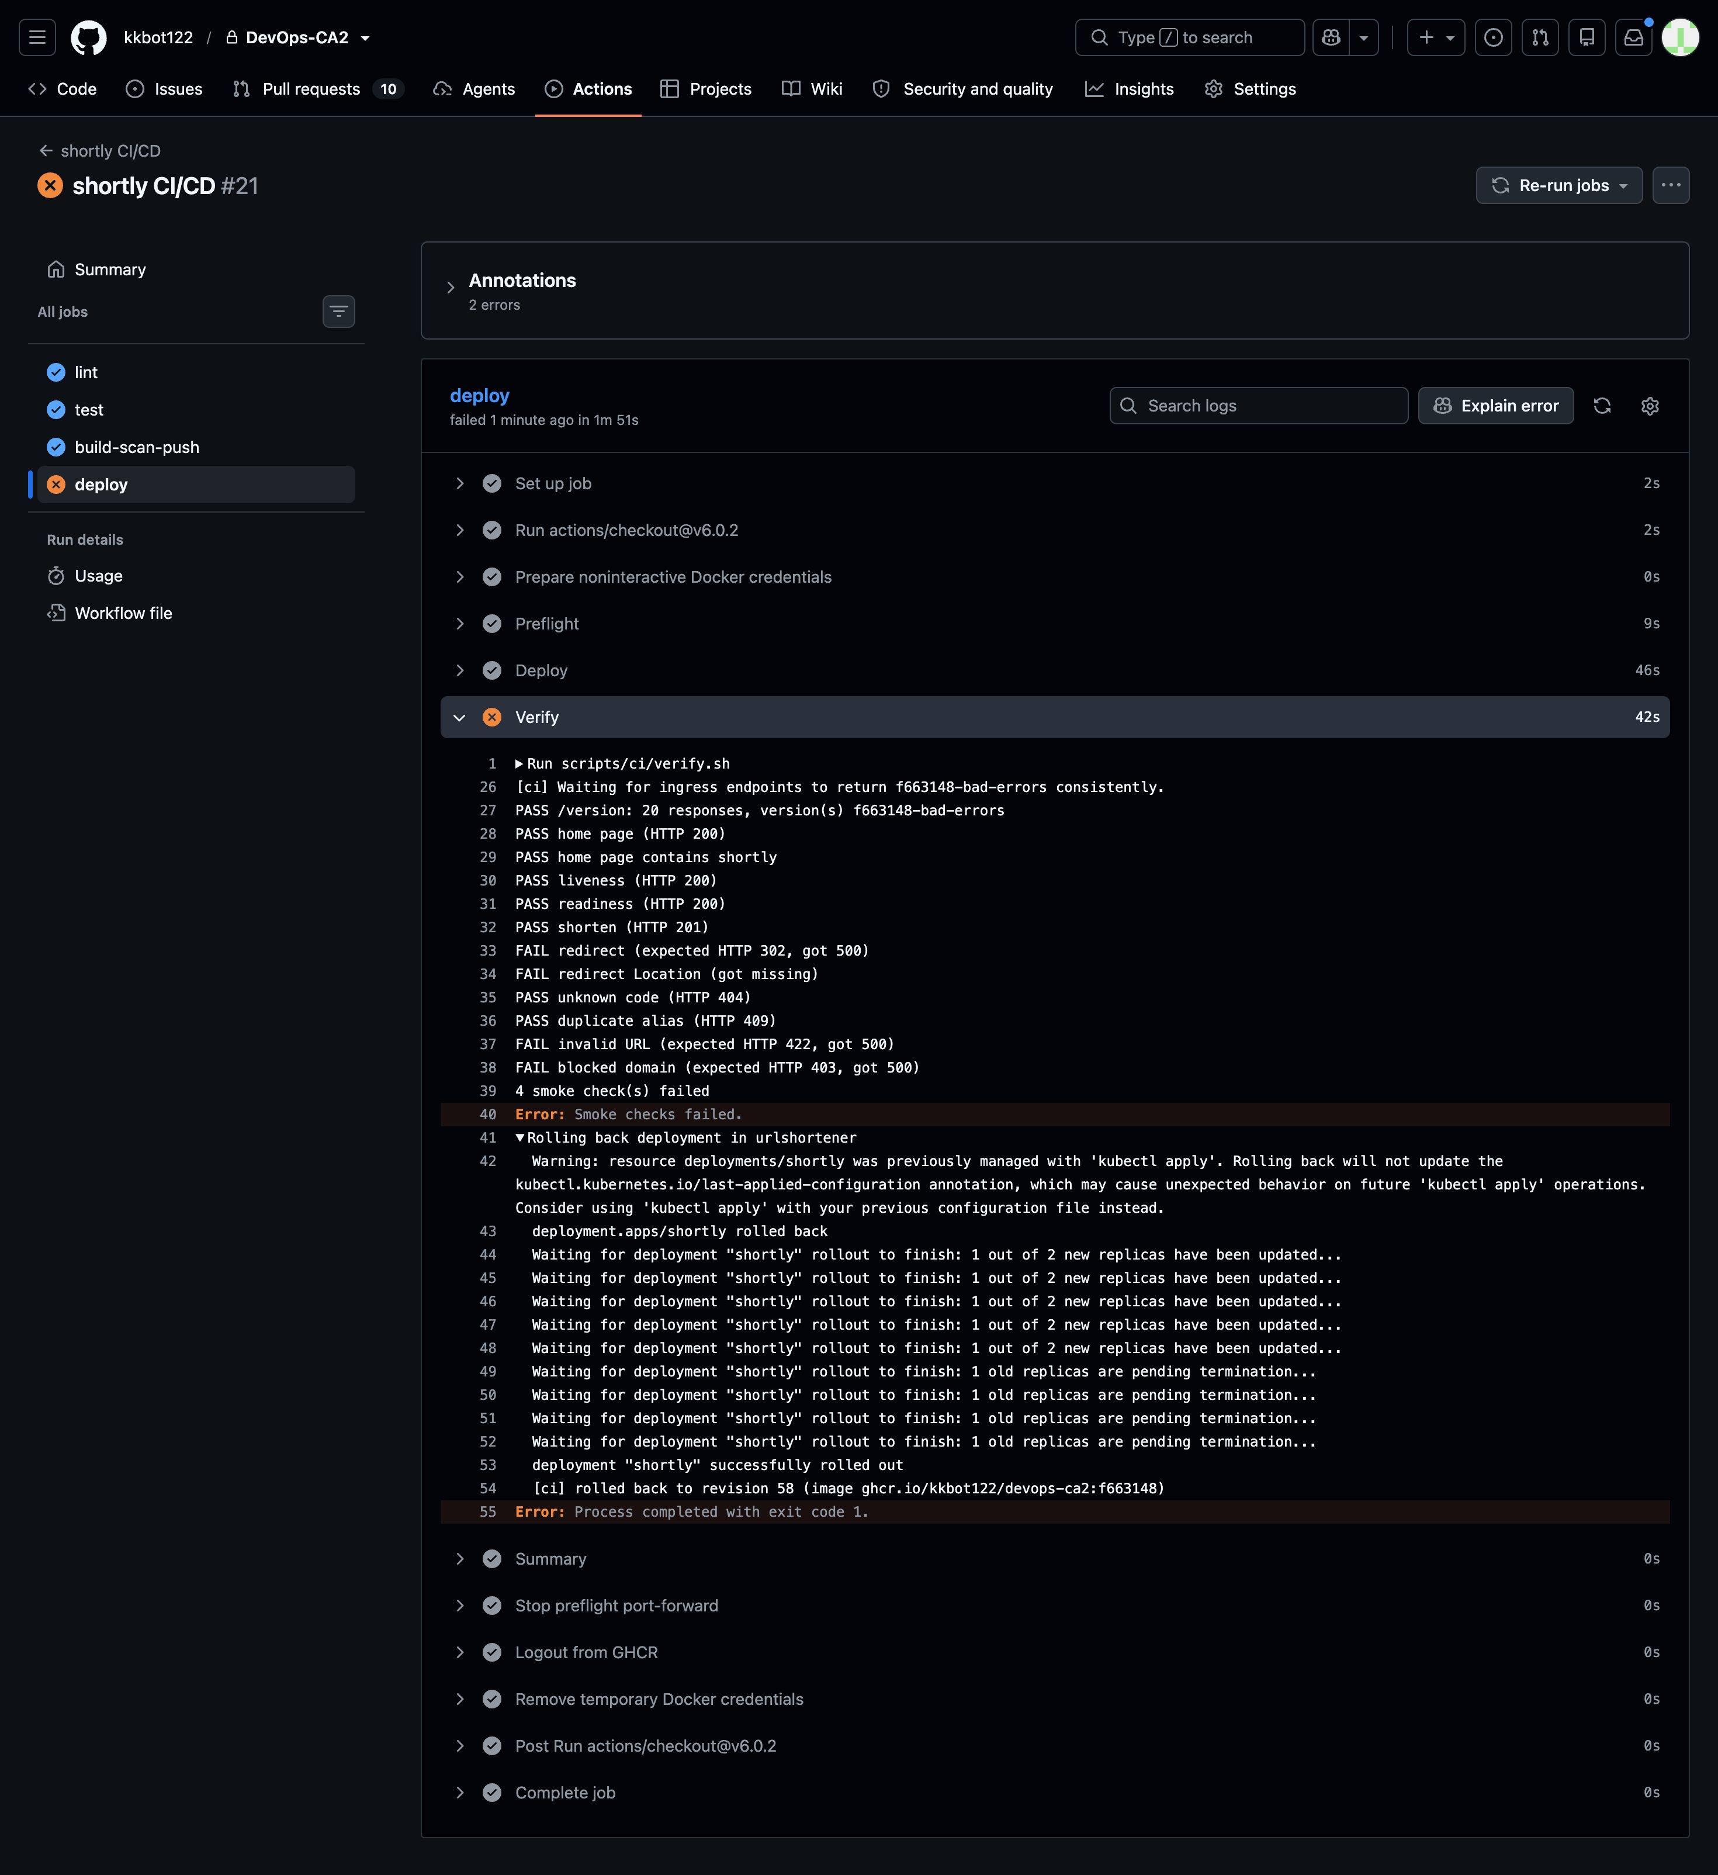
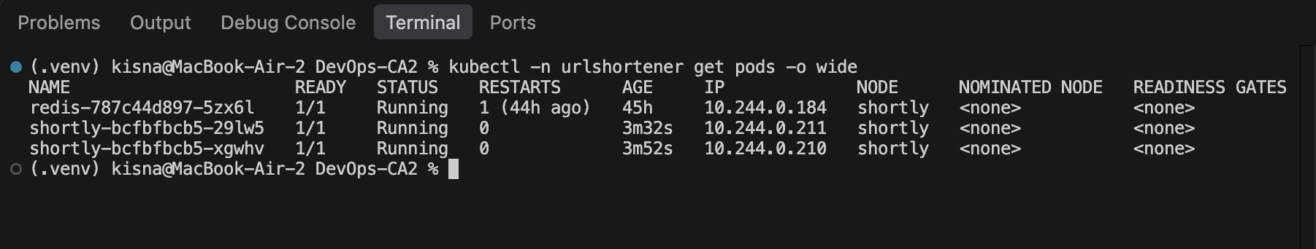
Readiness alone did not catch a broken release
The release stayed Ready while ordinary redirect requests failed
WHAT HAPPENED
The bad image passed Kubernetes readiness, but smoke checks found redirect, URL validation, and blocked-domain requests returning 500.
Ready API and Redis pods
HOW THE PIPELINE RESPONDED
It rolled the Deployment back to revision 58. The workflow stayed failed so the team could see that verification stopped the release.
LESSON
Health probes check process and dependency health. Smoke tests check user behavior.
Captured failed release with automatic rollback
Ansible runs on a supported Ubuntu 24.04 target. The first apply changed 31 items; the repeat apply changed 0.
SHORTLY / DEVOPS CA-2 04
Notes:
The bad-release-errors scenario demonstrated a gap between pod readiness and correct application behavior. Readiness remained green while normal redirects and other smoke requests failed. The workflow ran its rollback helper, restored revision 58 and returned a failed status. The pods screenshot shows the stable app and Redis state after recovery. Ansible's positive results come from the disposable Ubuntu 24.04 container: the first apply changed 31 items, and the second changed zero. The Mac host was rejected by the playbook before changes.

Slide 5
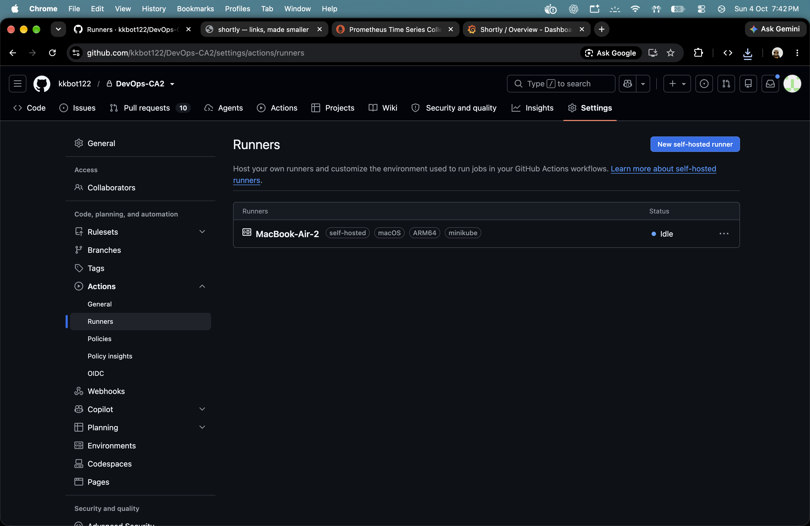
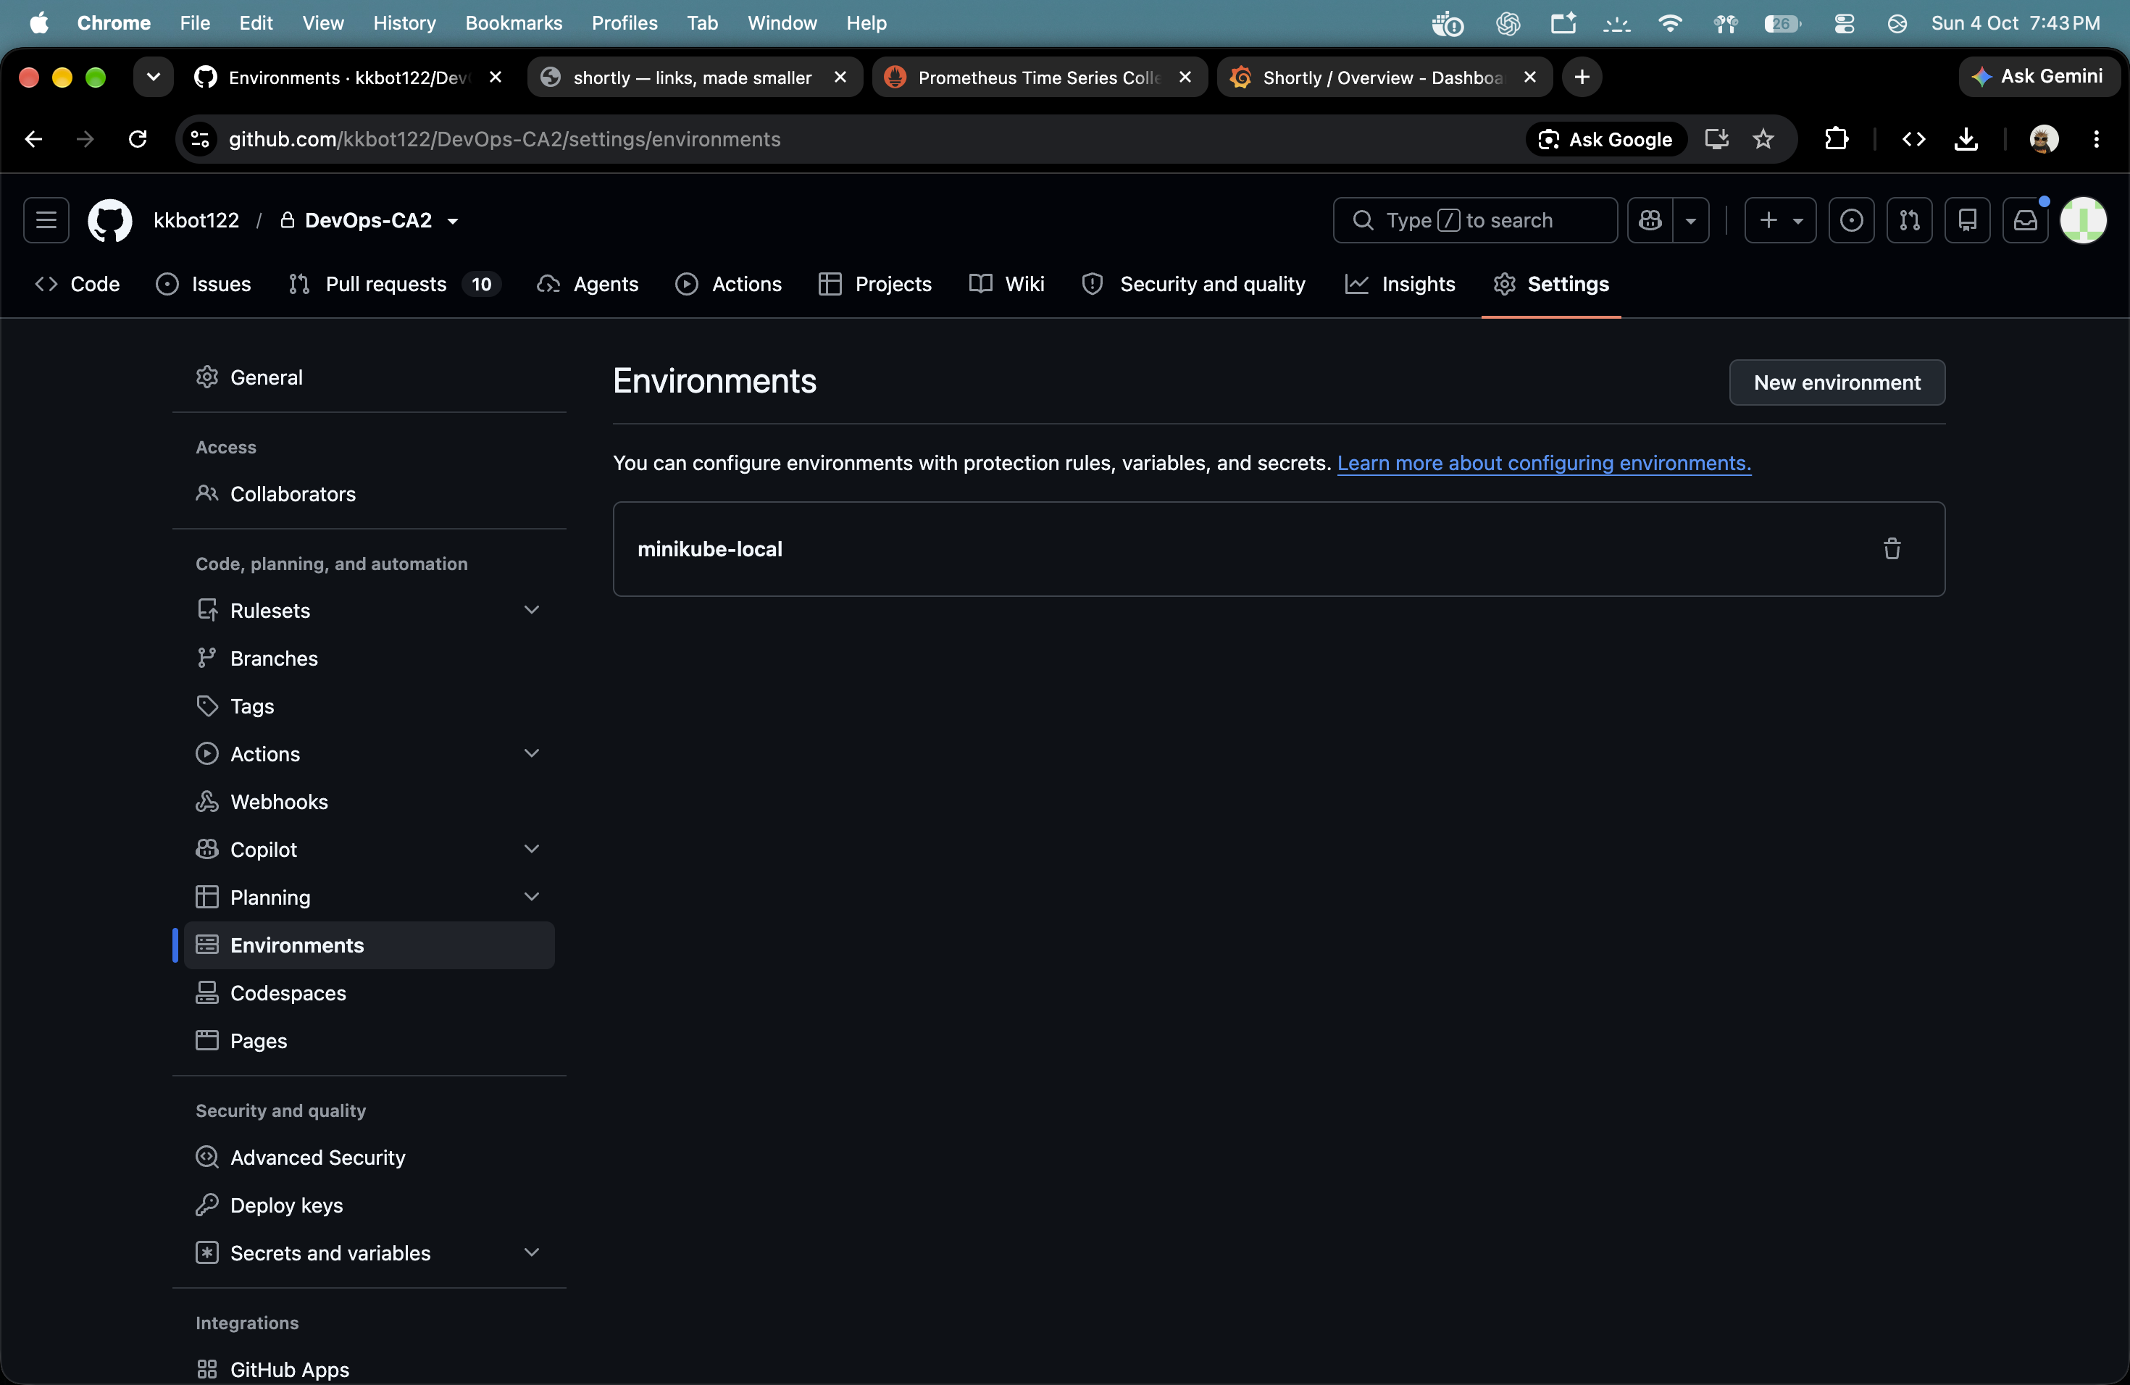
The build taught us to verify releases from the user's side
Results, limits, and the next improvements
01
Keep readiness and user-facing checks separate.
8 of 9 scenarios passed in the saved full run
02
Deploy the exact scanned image, then verify requests and version.
The focused abuse rerun later passed. The full suite was not rerun, so the original 8/9 result remains the reported full-run outcome.
03
Use observed resource needs and keep alerts tied to real traffic.
04
Run configuration management on a supported, repeatable host.
Self-hosted deployment runner
GitHub environment configured for local Minikube
Next: repeat on a multi-node cluster, add a real alert receiver, and isolate the deployment runner.
SHORTLY / DEVOPS CA-2 05
Notes:
The main learning is that a healthy process does not guarantee a healthy user request. The pipeline now verifies the exact image after deploy and automatically undoes a release when checks fail. Observed load results and alert behavior informed resource and monitoring choices. The saved full scenario run passed eight of nine tests; a focused abuse rerun passed afterward, but the full suite was not rerun. The project uses a single-node local Minikube cluster, one Redis replica, a null Alertmanager receiver, and a local self-hosted runner. Future work is to repeat this on a multi-node cluster, route alerts to a real receiver and isolate the runner.

