Slide 1
Predicting Pathogenicity using Aberrant Splicing Predictions of Single Nucleotide Variants in Autism Spectrum Disorder
Is it possible to use the likelihood that an SNV causes aberrant splicing to predict that SNV’s pathogenicity in the context of Autism Spectrum Disorder?

Slide 2
Hypothesis | Using a Bayesian inference model, the likelihood that a SNV causes aberrant splicing (like cassette exon skipping) can be used to predict the presence of the disease phenotype when that SNV targets a gene co-expression network hub
Assumptions | Genes with many co-expression partners are central to biological pathways Co-expression partners can be identified using metrics like the Pearson Correlation Coefficient Alternative splicing of these genes can cause these biological pathways to be disrupted due to alternative gene products Disruption of these biological pathways can lead to expression of the pathogenic phenotype (ASD) Splicing scores and pathogenicity predictions can be reliably predicted by on-the-market computational tools
SNV predicted to be pathogenic
Non-pathogenic SNV
Cassette exon skipping
No splicing change
Disease Phenotype (ASD)
Healthy Phenotype

Slide 3
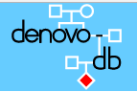
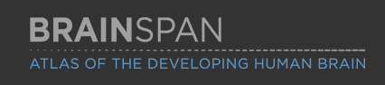
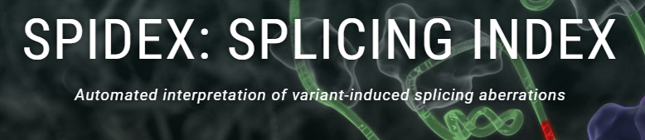
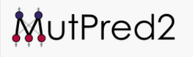
Denovo-DB: Database of nucleotide variants for various phenotypes, including autism and controls
BrainSpan: Gene co-expression data
Spidex: Aberrant splicing scoring tool
MutPred2: Pathogenicity scoring tool

