Slide 1
BENG 183 Final Project
Application of Network Based Co-Expression Expression Patterns to Differential Expression of Genes in Tumorigenic Prostate Epithelial Cells

Slide 2
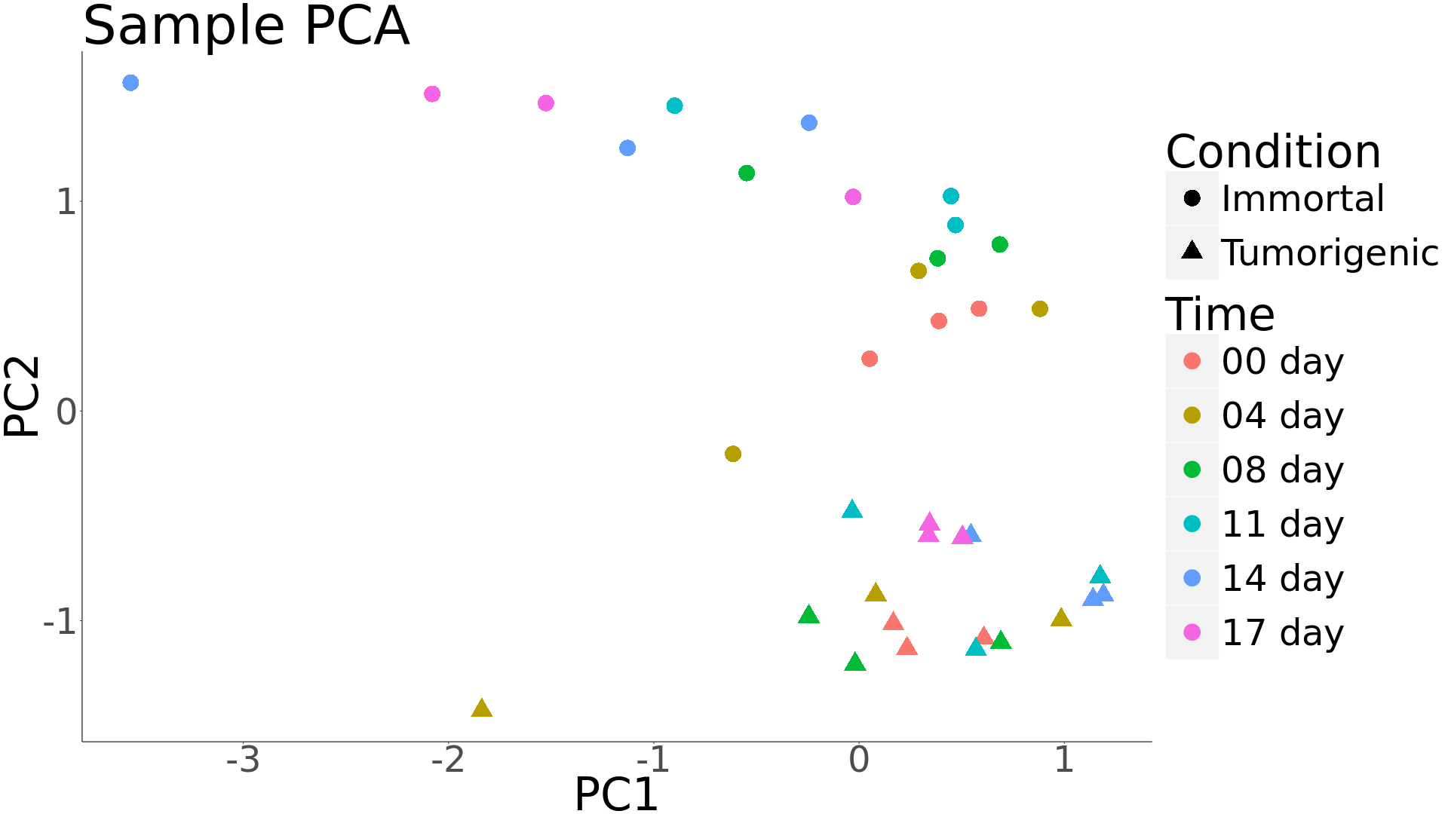
Principal Components Analysis of Samples
VST (DESeq2) first applied to overall count matrix
PCA computed with scale=TRUE and center=TRUE; rotated

Slide 3
Principal Components Analysis of Samples
Notes:
Claim can be made for time-course covariance of samples

