Slide 1
BENG 183 Final Project
Application of Network Based Co-Expression Expression Patterns to Differential Expression of Genes in Tumorigenic Prostate Epithelial Cells

Slide 2
Overview of Original Analysis
Differential expression analysis with limma

Slide 3
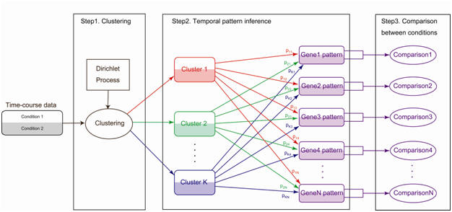
Network Based Co-Expression Patterns (NACEP)
Huang et al., Bioinformatics (2010)

Slide 4
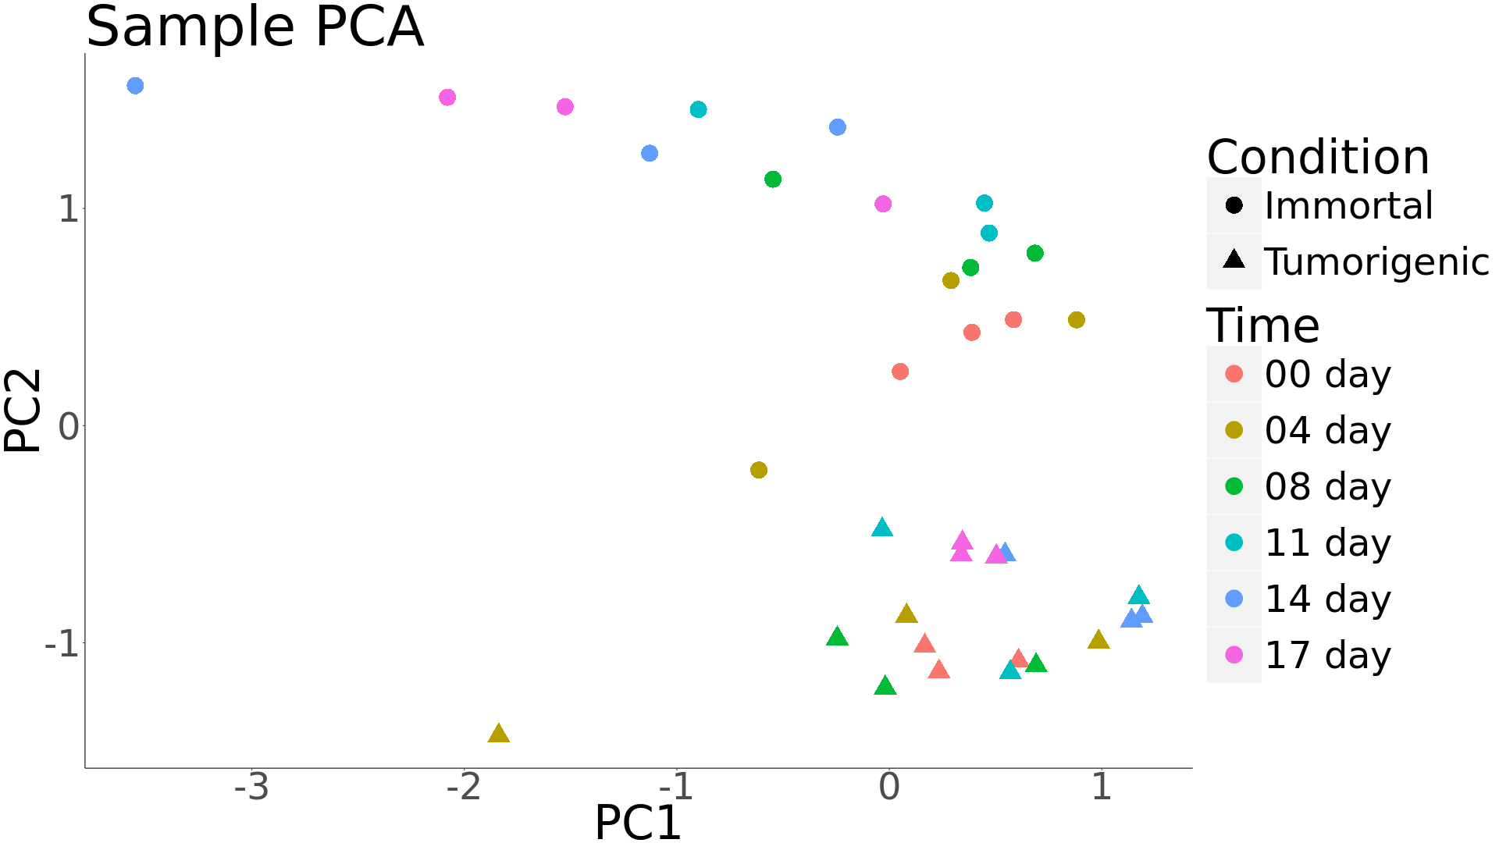
Sample Principal Components Analysis

Slide 5
References

