Slide 1
BENG 183 Final Project
Application of Network Based Co-Expression Expression Patterns to Differential Expression of Genes in Tumorigenic Prostate Epithelial Cells

Slide 2
Network Based Co-Expression Patterns
A tool for integrating time-course expression data into differential expression analysis

Slide 3
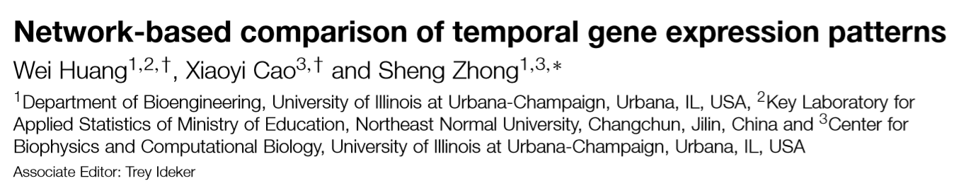
Motivation:
Incorporate time-course expression data in differential expression analysis
Prior work was limited to an independent gene-by-gene approach
NACEP uses expression pattern clustering to solve these issues

Slide 4
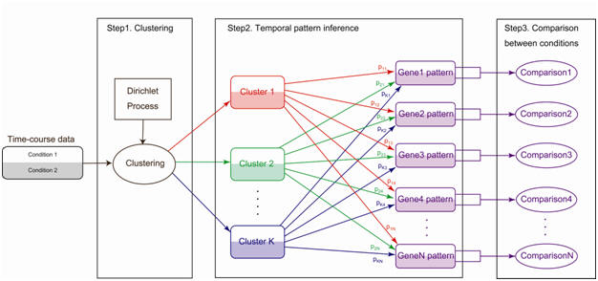
Network Based Co-Expression Patterns (NACEP)
Huang et al., Bioinformatics (2010)

Slide 5
Network Based Co-Expression Patterns (NACEP)
Infinite-mixture model for clustering time-course data
Number of clusters is determined by Dirichlet Process
Cluster memberships are missing data, generated by Chinese Restaurant Process

Slide 6
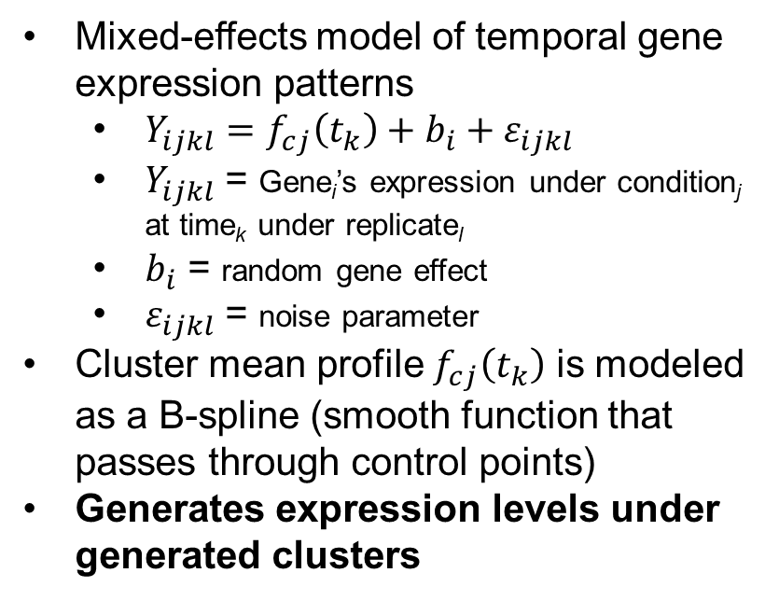
Network Based Co-Expression Patterns (NACEP)
Mixed-effects model of temporal gene expression patterns
$Y_{ijkl}=f_{cj}\left(t_{k}\right)+b_{i}+ε_{ijkl}$
$Y_{ijkl}$ = Gene_{i}’s expression under condition_{j} at time_{k} under replicate_{l}
$b_{i}$ = random gene effect
$ε_{ijkl}$ = noise parameter
Cluster mean profile $f_{cj}\left(t_{k}\right)$ is modeled as a B-spline (smooth function that passes through control points)
Generates expression levels under generated clusters

Slide 7
Network Based Co-Expression Patterns (NACEP)
Cluster assignment probabilities calculated from Bayesian model
NACEP model is rewritten in Bayesian form with Dirichlet Process prior
Bayesian posterior probabilities = probability for any gene belonging to any cluster for all genes and all clusters
Gibbs sampling algorithm makes model inferences

Slide 8
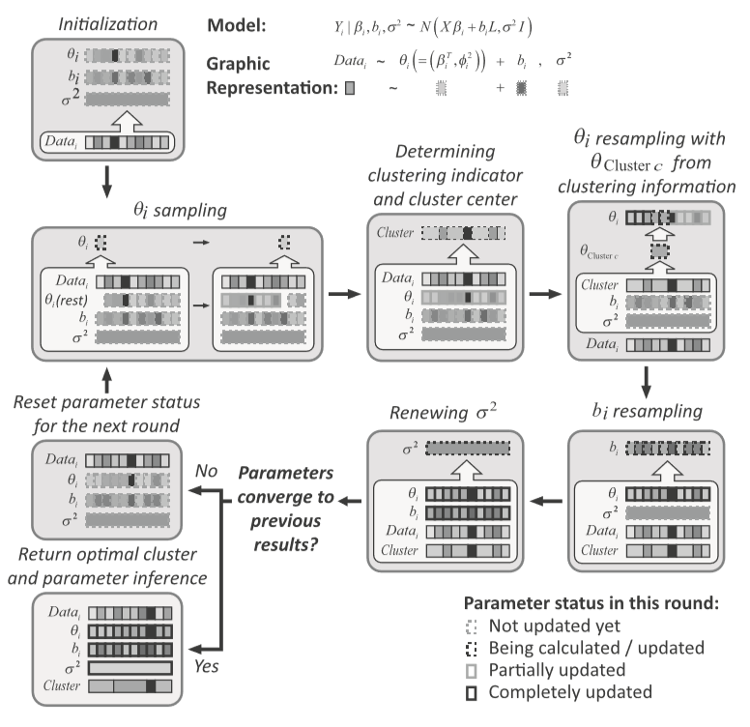
Network Based Co-Expression Patterns (NACEP)
Gibbs Sampling Algorithm
Θ_{i} = collection of all parameters
Estimates parameters for Bayesian form of NACEP model
Runs until parameters converge OR specified number of iterations
Huang et al., Bioinformatics (2010)

Slide 9
Network Based Co-Expression Patterns (NACEP)
Differences between experimental conditions are calculated as distances
Distance is calculated as weighted average of differences between temporal patterns per cluster
Weights = posterior probability of gene-cluster membership
Differentially expressed genes are ranked by statistical significance (FDR-corrected for multiple hypothesis testing)

Slide 10
Validation of NACEP Methodology
Authors used NACEP on gene expression data for Embryonic Stem Cells (ES) (Data obtained from Ivanova et. al)
Tested Retinoic Acid (RA) induced differentiation vs. spontaneous differentiation
Tested with data collected over time period of 0 to 7 days
Results were compared to Ivanova et. al (2007)
Notes:
Mention that RA is hypothesized to cause neurogenic differentiation, enrich neurogenic precursor cells
Hypothesis of paper is that RA induction -> mediated by neurogenic regulatory genes

Slide 11
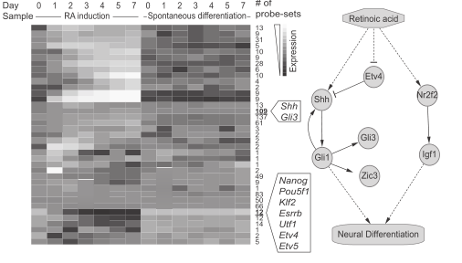
RA induced vs. Spontaneous
NACEP ranked Gli3, Zic3, and Shh highly in the RA sample
Gli and Shh were clustered together – consistent with hypothesis
Consistent with results from Ivanova et. al
Notes:
Gli – key TFs in Shh pathway
Zic3 – downstream target of Gli TFs
Shh pathway associated with neurogenic differentiation and brain tumors

Slide 12
Analysis of Tumorigenic Prostate Epithelial Cells
Incorporating time-course data in differential expression analysis with NACEP

Slide 13
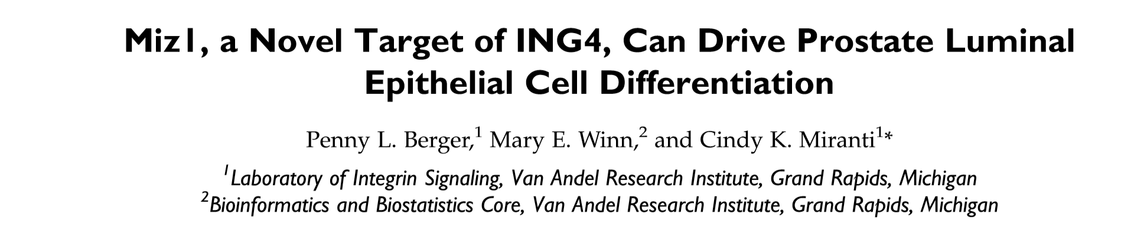

Data Gathering
Initial Data Analysis
Data Cleaning
NACEP
DEX Analysis and Annotations
Principal Components Analysis
Filter data by expression and variance
Run NACEP on filtered dataset
ID diff. expr. genes

Slide 14
Control samples: Immortalized Prostate Epithelial Stem Cells
iPrEC
Generated from primary clinical prostectomies
Express only basal epithelial cell markers
Disease samples: Tumorigenic Prostate Epithelial Stem Cells
EMP
Overexpression of Erg, Myc, shPten
25,702 initial genes with 6 time periods, 3 replicates per time period
Datasets downloaded from NCBI Gene Expression Omnibus as read count matrices and converted to TPM

Slide 15
Sample Principal Components Analysis
Convert possibly correlated values into linearly uncorrelated principal components
Resulting vectors are mutually orthogonal
Summarizes data points by data variance
Procedure:
Perform variance stabilizing transformation on counts matrix
Calculate scaled and centered principal components
Rotate and plot

Slide 16
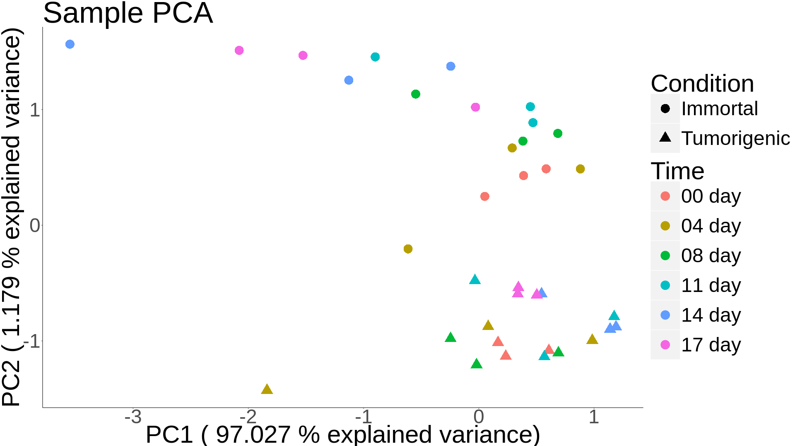
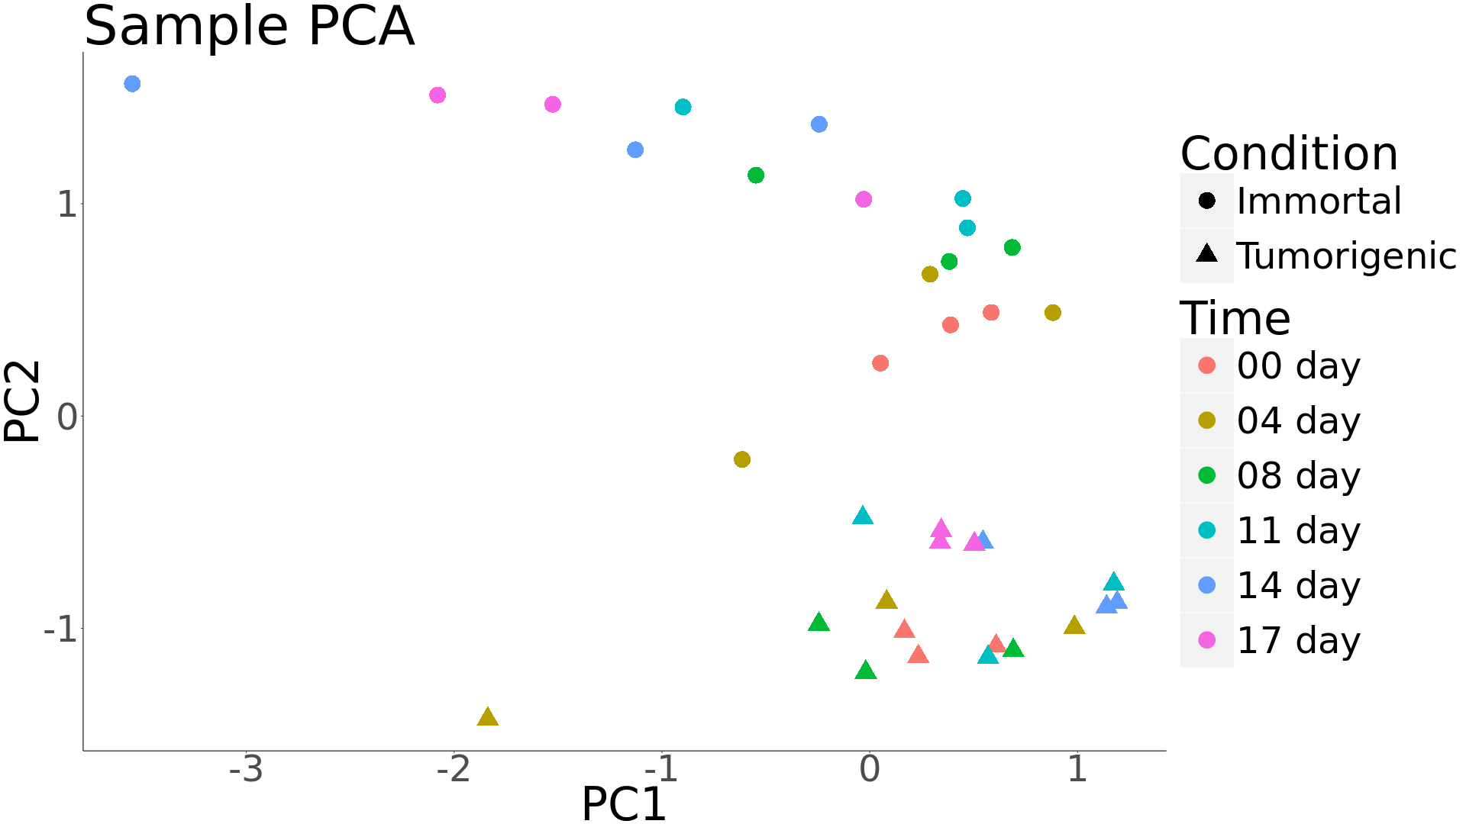
Sample Principal Components Analysis

Slide 17
Filtering by Expression and Variance
NACEP is very computationally expensive
Need to drastically reduce dataset size
Gene Retention Criteria
17% of samples have TPM >= 39 (average TPM)
log₁₀(gene variance) >= 2.4
Result: 4022 genes retained out of 25702 genes

Slide 18
NACEP Function Call and Parameters
source("NACEP.r");
NACEP(filename="dataFilter.txt", # input file
spcNum=2, # conditions
Timelength=18, # time points
Knot=15, # knots for spline
loop=300, # iterations (default=500)
compStart=200, # begin comparisons
compInterval=100, # interval betw. results
alpha=50 # cluster strength
);

Slide 19
High Scoring Genes
Entrez ID | Gene Symbol | Description | Previous cancer studies?
3861 | KRT14 | Epithelial cell cytoskeleton | Yes
4536 | MT-ND2 | Mitochondrially encoded NADH dehydrogenase 2 | Yes
6319 | SCD | Fatty acid biosynthesis | Yes
667 | DST | Adhesion junction plaque | No
7812 | CSDE1 | RNA-binding | No
5317 | PKP1 | Cytoskeleton | Yes
3868 | KRT16 | Epithelial cell cytoskeleton | No
9168 | TMSB10 | Actin binding | Yes
6273 | S100A2 | Cell cycle regulation | Yes
Notes:
Take this result with a grain of salt; a lot of filtering had to be performed. Also, iteration count had to be cut; other analyses using NACEP ran with 10000 iterations.

Slide 20
References
Huang, W., Cao, X., & Zhong, S. (2010). Network-based comparison of temporal gene expression patterns. Bioinformatics, 26(23), 2944–2951. http://doi.org/10.1093/bioinformatics/btq561
Berger, P. L., Winn, M. E., Miranti, C. K. (2016). Miz1, a Novel Target of ING4, Can Drive Prostate Luminal Epithelial Cell Differentiation. The Prostate. 77(1), 49-59. http://doi.org/10.1002/pros.23249

